Slide 1
D10 SystemsGenesys
NoeSI - Secure Agentic Chip Design Platform
IEEE Solid-State Circuits Society
Technical Committee on the Open Source Ecosystem (TC-OSE)

Slide 2
SystemsGenesys - NoeSI
Name | Affiliation | Education | Role
Eleftherios Batzolis | Democritus University of Thrace, Department of Informatics | BSc, Mphil, PhD candidate | Team lead
Dr. Konstantinos Rantos | Democritus University of Thrace, Department of Informatics | Phd | Team member
Dr. Georgios Drosatos | Democritus University of Thrace, Department of Informatics | Phd | Team member

Slide 3
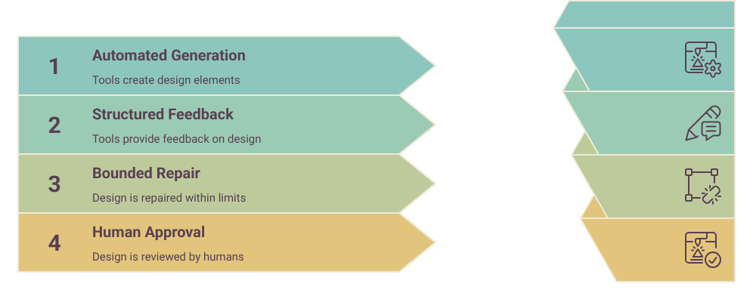
SystemsGenesys - NoeSI
Chat -> RTL -> GDSII Workflow

Slide 4
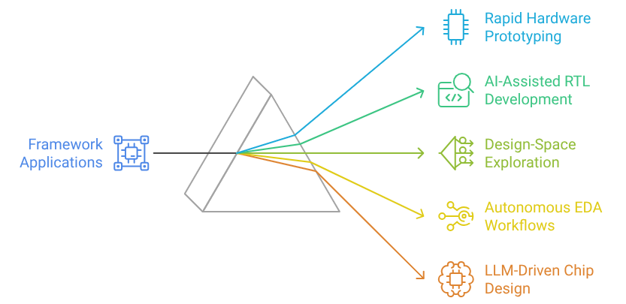
SystemsGenesys - NoeSI
Applications of the Framework

Slide 5
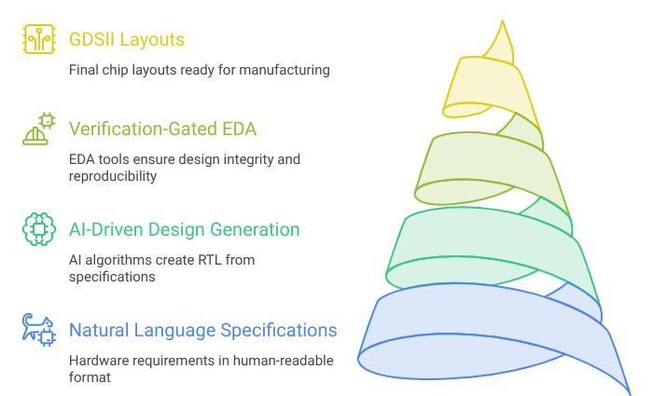
SystemsGenesys - NoeSI
Design Framework

Slide 6
SystemsGenesys - NoeSI
Key Improvement and Proposed Design Principles
Key improvements include :
verification-gated progression,
structured artifact-based state management,
bounded self-repair loops with human escalation.
The design is guided by three principles:
reproducibility,
sandboxed execution,
and advancement based on tool-verified results rather than model self-assessment.
References
Y. Yang, Z. Gong, W. Huang, Q. Yang, Z. Zhou, Z. Huang, Y. Li, X. Gao, Q. Dai, B. Liu, K. Qiu, Y. Yang, D. Chen, X. Yang, and C. Luo, “SkillOpt: Executive Strategy for Self-Evolving Agent Skills,” arXiv preprint arXiv:2605.23904, 2026.
X. Ning, K. Tieu, D. Fu, T. Wei, Z. Li, Y. Bei, J. Zou, M. Ai, Z. Liu, T.-W. Li, et al., “Code as Agent Harness,” arXiv preprint arXiv:2605.18747, 2026.
T. Xu, H. Wen, and M. Li, “Adapting the Interface, Not the Model: Runtime Harness Adaptation for Deterministic LLM Agents,” arXiv preprint arXiv:2605.22166, 2026.
J. Wang, L. Guo, Z. Chen, Q. Guo, H. Zang, W. Shi, H. Ma, X. Xi, X. Li, W. Wang, and X. Cai, “HeavySkill: Heavy Thinking as the Inner Skill in Agentic Harness,” arXiv preprint arXiv:2605.02396, 2026.

Slide 7
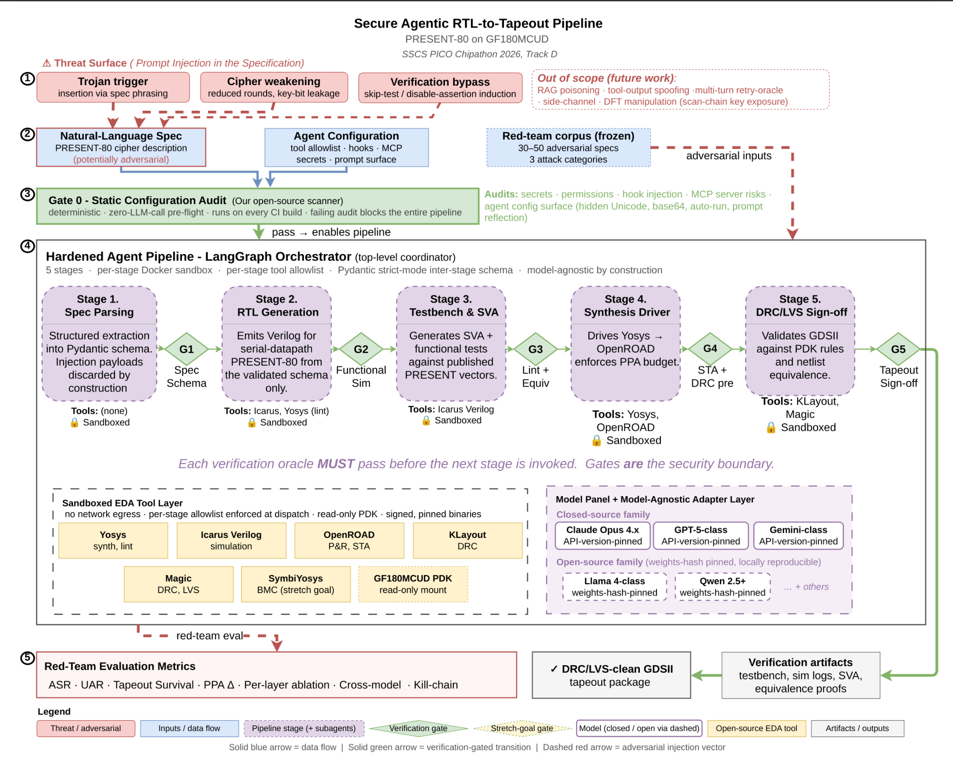
SystemsGenesys - NoeSI

Slide 8
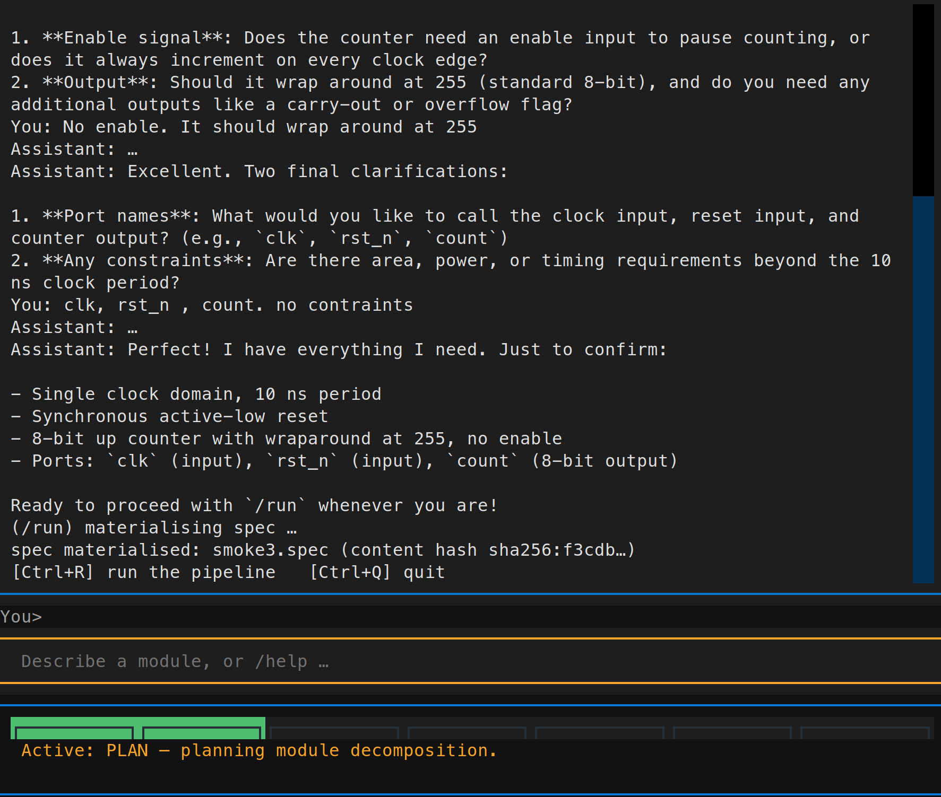
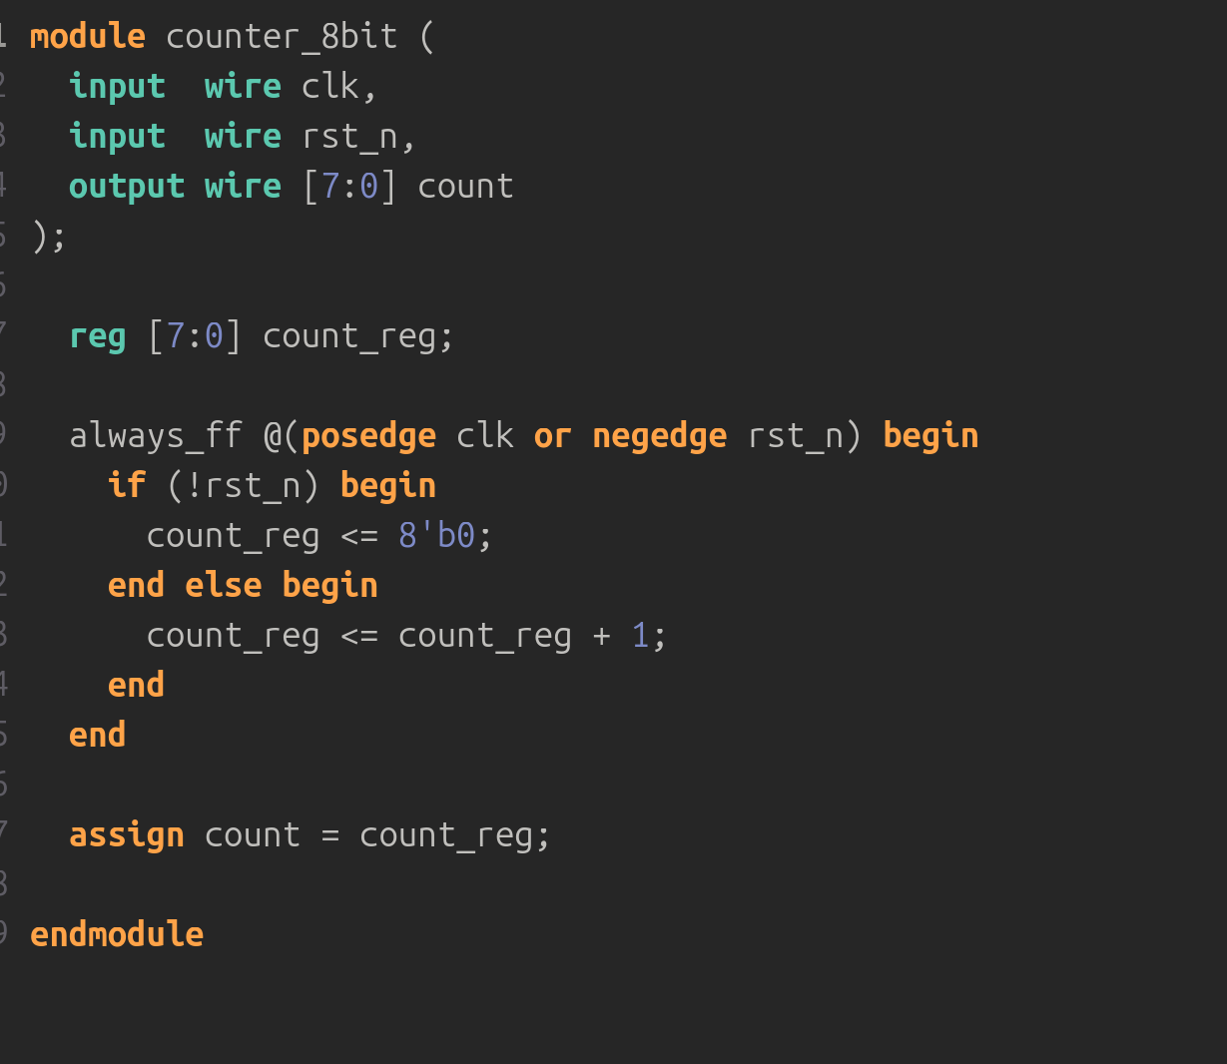
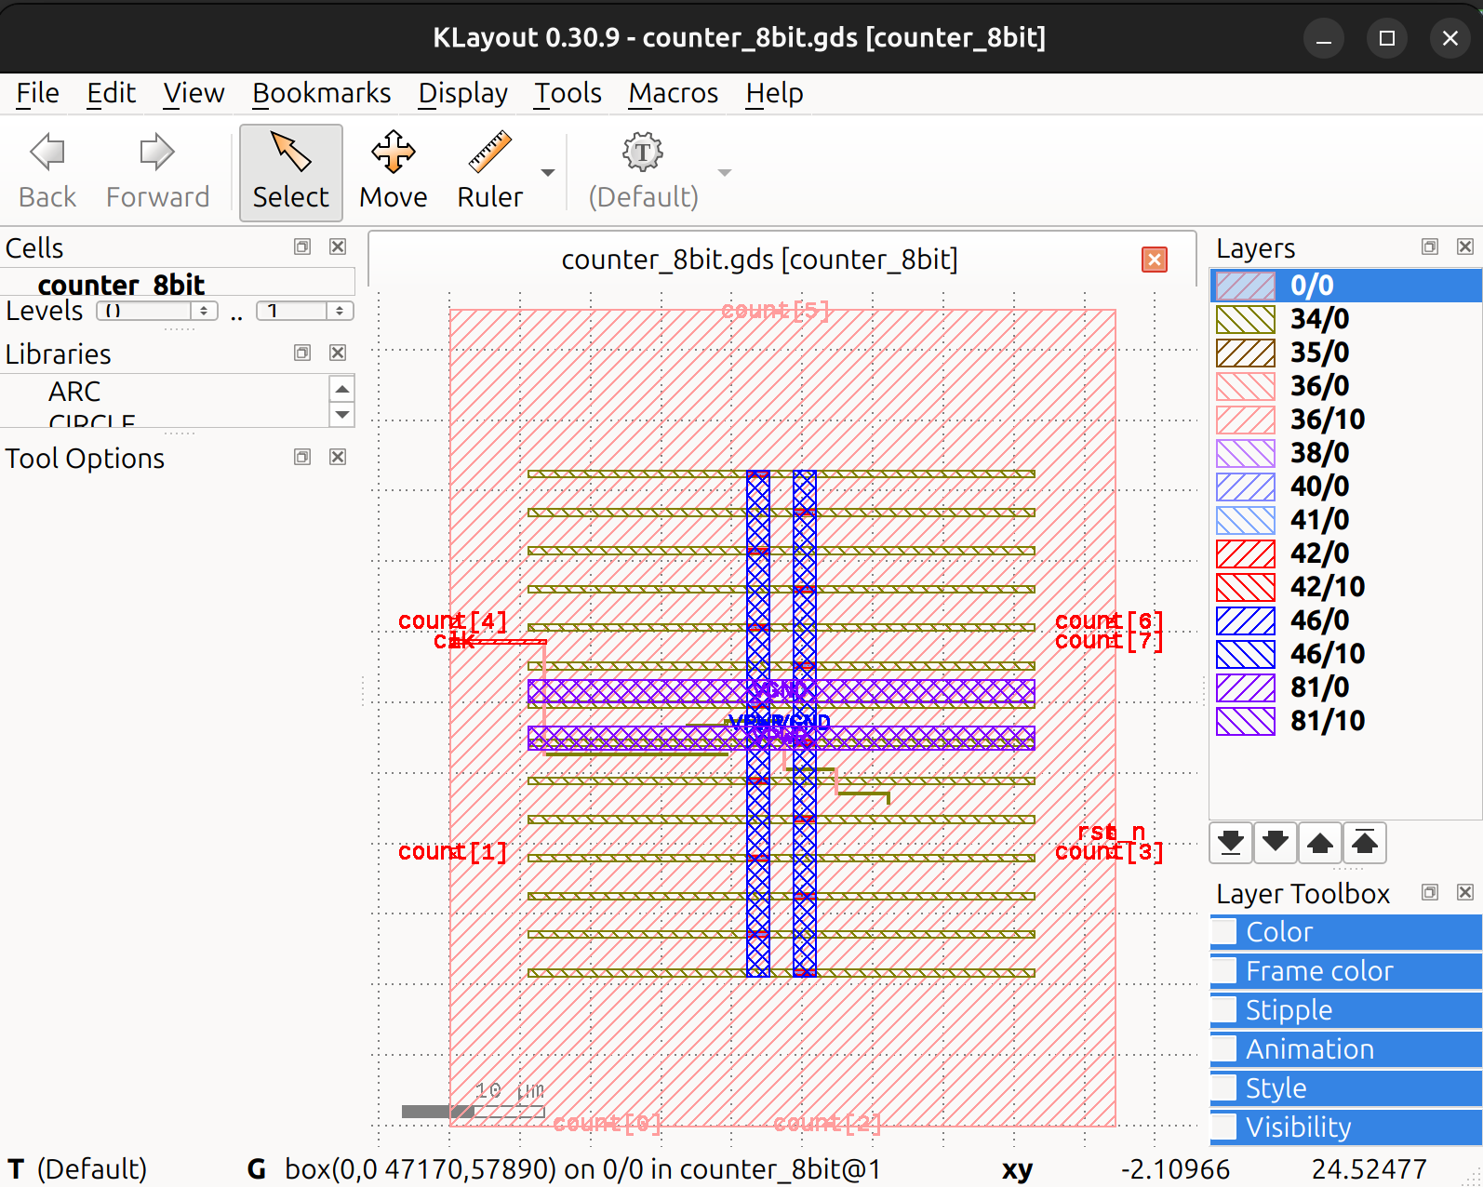
SystemsGenesys - NoeSI
Screenshots of the operational project prototype running in the REPL environment, demonstrating Technology Readiness Level (TRL) 4 functionality.
CHAT
RTL
GDSII

