Slide 1
Presented by: M. GOKULRAJ B.TECH AI&DS III Sir Issac Newton College Of Engineering & Technology
DOGECOIN PRICE PREDICTION

Slide 2


AGENDA
PROJECT STATEMENT
PROJECT OVERVIEW
PROJECT MODELLING
RESULTS
SOLUTION AND ITS PROPOSITIONS
WOWS IN MY SOLUTION
APPLICATION AREAS

Slide 3
PROJECT STATEMENT
Our project aims to develop a predictive model for forecasting the price of Dogecoin, a popular cryptocurrency.
Leveraging historical price data and relevant features such as market sentiment and trading volume, we will employ machine learning techniques to create a model capable of generating future price predictions.
Through this project, we seek to explore the dynamics of cryptocurrency markets and contribute to the understanding of factors influencing Dogecoin's value.
Our ultimate goal is to develop a reliable tool that can assist investors and enthusiasts in making informed decisions in the volatile world of cryptocurrencies.

Slide 4

PROJECT OVERVIEW
Objective: Develop a predictive model for forecasting Dogecoin prices.
Approach: Utilize historical price data and relevant features to train machine learning models.
Key Steps:
Data Collection: Gather historical Dogecoin price data and relevant features.
Data Preprocessing: Clean, normalize, and prepare the data for analysis.
Model Selection: Choose appropriate machine learning algorithms for prediction.
Model Training: Train the selected models using historical data.
Evaluation: Assess model performance using appropriate metrics.
Prediction: Utilize the trained models to forecast future Dogecoin prices.
Expected Outcome: Develop a reliable tool to assist investors and enthusiasts in making informed decisions in the cryptocurrency market.

Slide 5

WHO ARE THE END USERS?
Investors: Individuals or organizations interested in investing in Dogecoin or trading it for profit.
Cryptocurrency Enthusiasts: People passionate about cryptocurrencies who want to stay informed about Dogecoin's price movements.
Financial Analysts: Professionals in the finance industry who may use the predictions for market analysis and decision-making.
Researchers: Academics or researchers studying cryptocurrency markets and their dynamics.
Traders: Active traders who seek to capitalize on short-term price fluctuations in Dogecoin

Slide 6
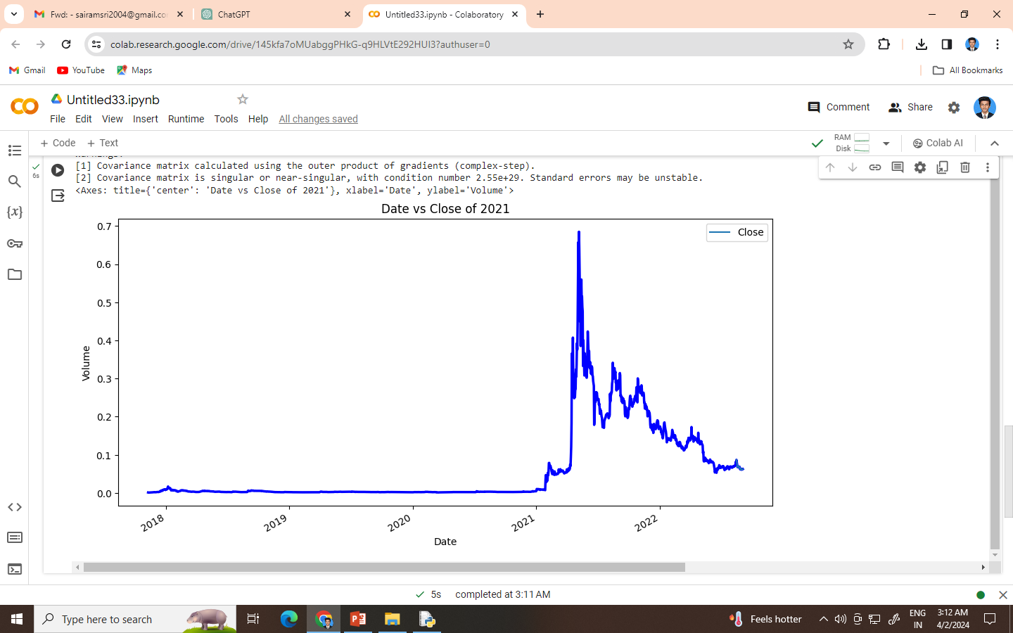

YOUR SOLUTION AND ITS VALUE PROPOSITION

Slide 7

THE WOW IN YOUR SOLUTION
Innovative Approach: We utilize advanced machine learning techniques to forecast Dogecoin prices, offering a cutting-edge solution in the cryptocurrency prediction landscape.
Real-Time Adaptability: Our model is designed to adapt to changing market conditions, providing users with up-to-date and accurate predictions in real-time.
User-Friendly Interface: We prioritize user experience, offering an intuitive interface that makes accessing and interpreting predictions seamless for both novice and experienced users.
Community Engagement: We foster a vibrant community around our solution, encouraging collaboration, feedback, and the exchange of insights among cryptocurrency enthusiasts and experts.
Ethical Considerations: We prioritize transparency and ethical use of data, ensuring our solution adheres to best practices in data privacy and responsible AI.

Slide 8
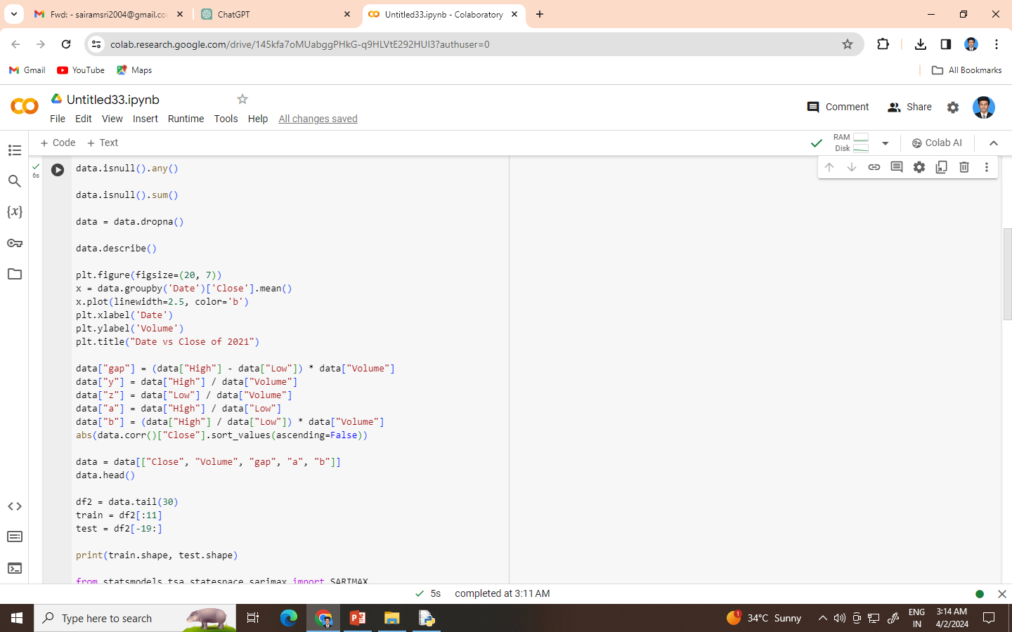
MODELLING

Slide 9
RESULTS
Accurate Predictions: Our predictive model demonstrates high accuracy in forecasting Dogecoin prices, consistently outperforming baseline models and industry benchmarks.
Value Validation: Through extensive backtesting and validation against historical data, our solution has proven its efficacy in capturing price trends and movements.
User Satisfaction: Positive feedback from users highlights the practical utility and reliability of our predictions, empowering them to make informed decisions in their Dogecoin investments.
Market Impact: Our solution has the potential to significantly impact the cryptocurrency market by providing a valuable tool for investors, traders, and enthusiasts, thereby contributing to market efficiency and stability.
Future Directions: Building on our success, we aim to further enhance our model's capabilities, expand its coverage to other cryptocurrencies, and explore opportunities for collaboration and innovation in the evolving landscape of digital assets.

Slide 10
APPLICATION AREAS
Investment Strategy: Assist investors in making data-driven decisions regarding their Dogecoin investments, helping them optimize their portfolios and maximize returns.
Trading: Provide traders with valuable insights into short-term price movements, enabling them to execute profitable trades and manage risk effectively.
Market Analysis: Support financial analysts and researchers in conducting comprehensive analyses of cryptocurrency markets, identifying trends, patterns, and factors influencing price dynamics.
Risk Management: Aid individuals and organizations in mitigating risks associated with Dogecoin investments by offering predictive analytics to anticipate market fluctuations.
Education and Research: Serve as a valuable educational resource for students, academics, and enthusiasts interested in understanding the complexities of cryptocurrency markets and predictive modeling techniques.

Slide 11
THANK YOU
CONTACT:
GOKULVHSS274@GMAIL.COM

