Slide 1
Migrating Legacy SCM and Defects to GitHub
Modernizing development workflows with advanced tools
Notes:
AI-generated content may be incorrect. ---

Slide 2

Why This Migration Matters
Legacy Limitations
Old SCM platforms limit development with centralized check-ins and costly branching, hindering collaboration and integration.
Value of Institutional Memory
Preserving source history and defect data protects engineering insights vital for accountability and regulatory compliance.
Benefits of Modern Migration
Migrating to GitHub enables distributed workflows, automation, and better developer experience if critical data is maintained.
Balanced Migration Approach
Successful migration balances modernization with preserving engineering continuity to ensure stakeholder alignment and trust.
Notes:
Legacy SCM platforms impose structural and workflow limitations that hinder modern development. Centralized check-in models slow collaboration, branching is expensive, and integration with modern CI/CD pipelines is often limited or brittle. At the same time, organizations cannot afford to discard years of engineering insight embedded in these systems. Source history documents how systems evolved, defects explain why changes were made, and release data provides regulatory and operational evidence. A poorly executed migration risks erasing this institutional memory, leading to loss of accountability, reduced confidence in the new platform, and resistance from experienced engineers. This slide emphasizes that successful migration must balance modernization with preservation. GitHub adoption unlocks distributed workflows, automation through GitHub Actions, and improved developer experience, but only if teams can still answer critical questions such as who changed what, when, and why. Framing migration as a business and engineering continuity problem helps stakeholders align around the need for high-fidelity outcomes rather than quick wins.

Slide 3

Migration Scope: Beyond Source Code
Comprehensive Data Migration
Migration includes source code files, versions, branches, and releases mapped to Git entities like commits and tags.
Defect Data Integration
Defect data with identifiers, statuses, priorities, and comments must be migrated to preserve defect lifecycle context.
Traceability Links
Linking defects to changesets and releases maintains traceability essential for audits and impact analysis.
Collaboration History
Preserving timestamps and authorship data supports forensic analysis and audit requirements post-migration.
Notes:
A comprehensive CMVC to GitHub migration must account for multiple categories of data. Source code includes files, versions, branches, and releases that must be translated into Git commits, branches, and tags. Defect data encompasses identifiers, descriptions, status transitions, priorities, owners, and comments that collectively represent the defect lifecycle. Traceability connects these domains, linking defects to specific changesets and releases. Additionally, collaboration history such as timestamps and authorship is essential for audits and forensic analysis. This slide clarifies that a source-only migration is insufficient for enterprise teams, as it strips away context that engineers rely on daily. By explicitly defining migration scope early, teams can select appropriate tooling, design data mappings, and set realistic expectations with stakeholders. This clarity reduces rework and ensures the resulting GitHub repositories feel complete and trustworthy from day one.

Slide 4
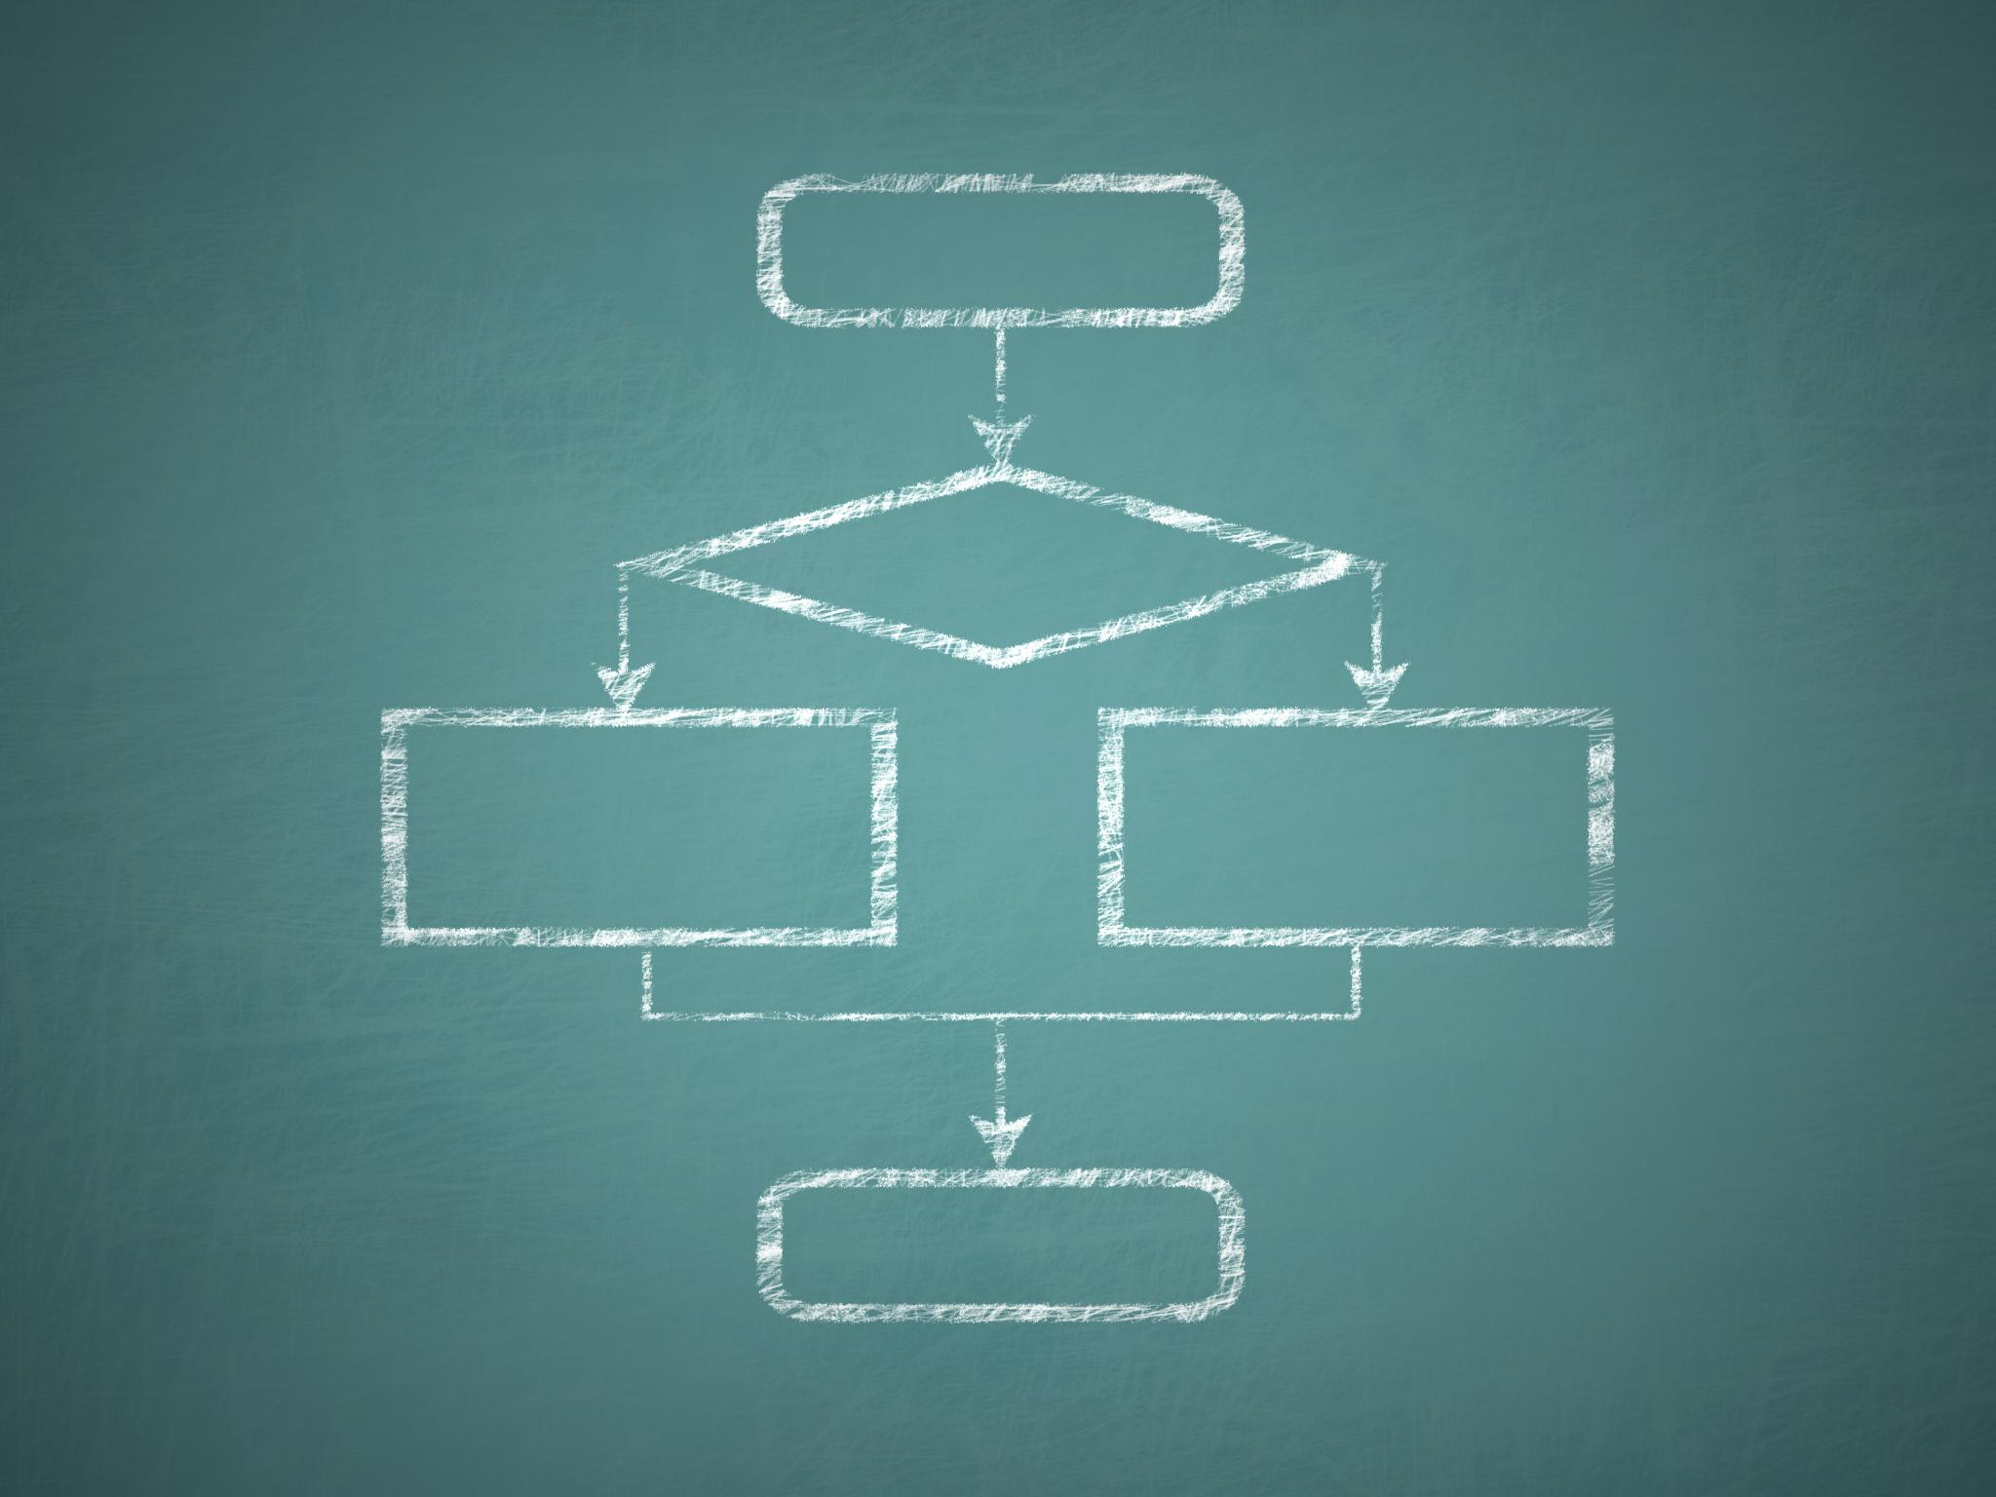
Target Migration Architecture
Extraction Phase
Data is extracted from CMVC, including versions, history, defects, and relationships for migration.
Transformation Phase
Extracted data is normalized and mapped to structures compatible with GitHub.
Load Phase
Transformed data is converted into Git commits and defects become GitHub issues via APIs.
Validation Phase
Validation ensures data integrity by comparing counts, sampling metadata, and verifying traceability.
Notes:
The migration architecture presented follows an Extract, Transform, Load, and Validate (ETLV) model tailored for SCM and defect systems. In the extraction phase, data is pulled from CMVC, including file versions, change history, defects, comments, and relationships. Transformation normalizes this data by mapping users, timestamps, branches, releases, and defect states into structures compatible with Git and GitHub. The load phase converts transformed source history into Git commits and pushes repositories to GitHub, while defects are created as GitHub issues using APIs. Validation closes the loop by comparing artifact counts, sampling metadata, and verifying traceability. This structured approach ensures repeatability, supports dry runs, and provides audit evidence. It also allows incremental improvement of tooling without risking data corruption, making it suitable for large-scale enterprise migrations.

Slide 5

Preserving Source History as Git Commits
Accurate Authorship and Timing
Each CMVC change is converted into a Git commit preserving original authorship and timestamp for accountability.
Preserving Branching and Tags
Branch structures and release levels are recreated as Git branches and tags for historical reference.
Embedding Defect References
Commit messages embed original defect IDs linking code changes directly to issues.
Notes:
Preserving source history is central to migration credibility. Each CMVC change is transformed into a meaningful Git commit that reflects original authorship and timing. User identities are mapped so that Git commit authors correspond to original engineers, maintaining accountability. Original timestamps are preserved where possible to keep chronological accuracy. CMVC releases or levels are represented as Git tags, enabling teams to reference historical baselines. Branching structures are recreated using Git branches that align with modern naming conventions. Commit messages often embed original defect IDs, providing a direct link between code and issues. Together, these practices ensure that Git history remains navigable and informative, rather than a flattened snapshot. Engineers can continue to use familiar investigative techniques such as git blame and log with confidence in the results.

Slide 6

Migrating Defects to GitHub Issues
Defect Context Preservation
Migration preserves the lifecycle and context of defects beyond simple record import.
Historical Comments Migration
Historical defect discussions and comments are migrated to preserve decision rationale.
Linking Defects to Code
Relationships between defects and code changes are maintained via commit references.
Notes:
Defect migration focuses on preserving lifecycle and context rather than merely importing records. Each CMVC defect is migrated to a GitHub issue with its original identifier retained in the title or metadata. Status values are mapped to issue states and labels, while ownership becomes assignees. Severity and priority are represented using labels or structured fields. Historical comments are migrated as issue comments, maintaining discussion threads and decision rationale. Relationships between defects and code changes are preserved through references to commit hashes or pull requests. By using GitHub’s REST APIs, the migration tooling can accurately recreate these artifacts at scale. The result is a defect backlog that feels native to GitHub while retaining the richness of legacy data.

Slide 7

Automation Strategy for Migration
Configuration-Driven Migration
Migration scripts use configuration files to define repository, user mappings, and status translations for automation.
Dry-Run Testing
Dry-run mode generates migration reports without changes, allowing early detection of potential issues and gaps.
Execution and Error Handling
Batch migrations are executed with logging, retries, and error handling to ensure reliability and scalability.
Notes:
Automation is critical for reliability and scalability. Migration scripts are driven by configuration files that define repository mappings, user mappings, and status translations. Dry-run modes allow teams to generate reports without modifying GitHub, enabling early detection of gaps. Execution phases perform batch migrations with logging, retries, and error handling. Reporting summarizes successes, failures, and exceptions, providing transparency to stakeholders. This automated approach avoids error-prone manual processes and supports repeatable migrations across multiple repositories. It also enables iterative refinement, where mappings can be adjusted and migrations rerun until validation criteria are met.

Slide 8

Validation Checklist and Quality Assurance
Verification of Repository Data
Teams verify repository data, default branches, and commit totals to ensure migration accuracy.
Defect Validation Process
Validation confirms issue counts, states, labels, assignees, and comments match source system data.
Traceability and Exception Reporting
Traceability tested via links from defects to commits; exception reports highlight unmapped users.
Notes:
Validation provides confidence that the migration meets fidelity requirements. Teams verify repository counts, default branches, and commit totals. Spot checks confirm authors, timestamps, branches, and tags. Defect validation ensures issue counts, states, labels, assignees, and comments match the source system. Traceability is tested by following links from defects to commits and releases. Exception reports highlight unmapped users or unsupported artifacts. Finally, stakeholders review sampled high-value components to provide sign-off. This disciplined validation process transforms migration from a leap of faith into an evidence-based transition.

Slide 9
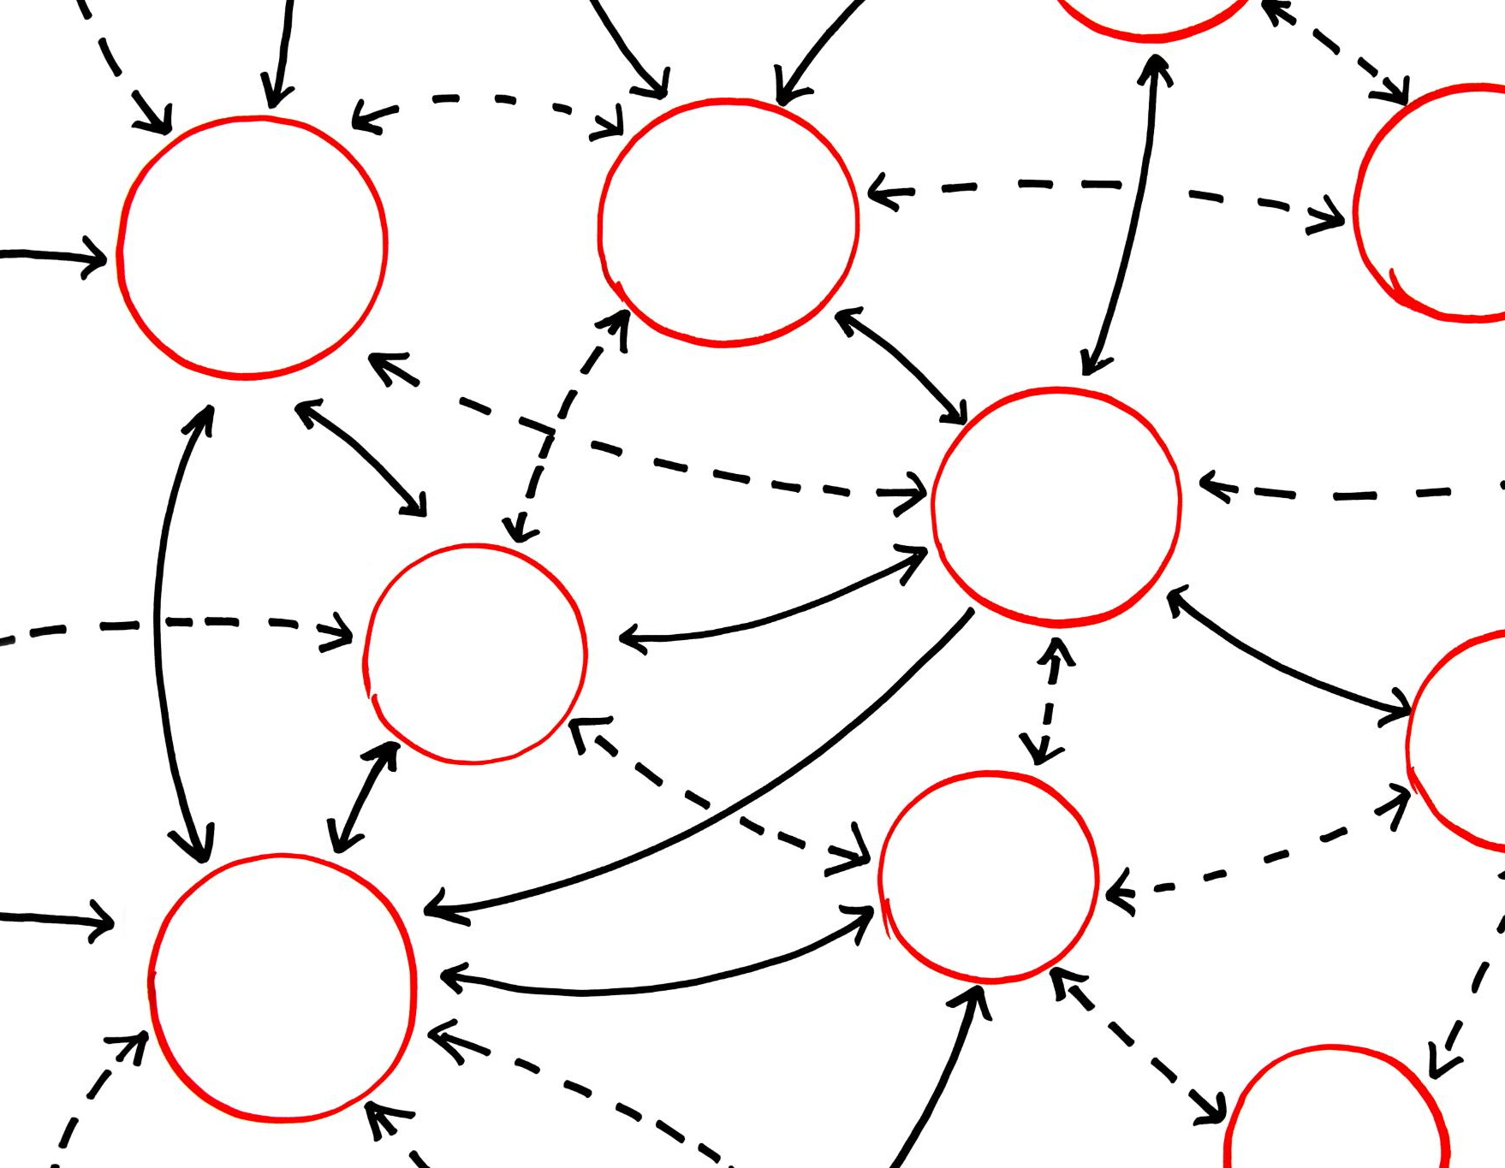
Live Demonstration Flow
Migration Pipeline Overview
The demonstration shows the entire migration pipeline from CMVC exports to Git repositories and GitHub issues creation.
Automated Repository Processes
Commits, branches, tags, and comments are generated automatically, showcasing automation in repository management.
Validation and Transparency
Validation reports ensure accuracy while defining expected outputs before execution builds trust in the process.
Practical Application Benefits
The walkthrough helps attendees visualize applying similar tooling in their own environments effectively.
Notes:
The live demonstration illustrates the complete migration pipeline in action. Starting with CMVC source and defect exports, the tooling extracts and transforms data before generating Git repositories and GitHub issues. Attendees observe how commits, branches, tags, issues, labels, and comments are created automatically. Validation reports are reviewed to confirm accuracy. By defining expected outputs before execution, the demo reinforces transparency and builds trust in the process. This practical walkthrough helps attendees visualize how similar tooling could be applied in their own environments.

Slide 10

Key Takeaways for Attendees
Migration Planning and Execution
Attendees learn to plan and execute SCM to GitHub migration including source code and defects effectively.
Preserving Code Integrity
Techniques cover preserving authorship, timestamps, releases, branches, and traceability during migration.
Automation and Validation
Automation enables repeatability and validation ensures accuracy in the migration process.
Transition to Git Collaboration
Insight into moving from centralized SCM to modern Git collaboration models enhancing developer experience.
Notes:
Attendees leave with a clear understanding of how to plan and execute a legacy SCM to GitHub migration that includes both source code and defects. They learn techniques for preserving authorship, timestamps, releases, branches, and traceability. The session demonstrates how defects can be migrated with full lifecycle context, how automation enables repeatability, and how validation ensures accuracy. Finally, attendees gain insight into transitioning from centralized SCM workflows to modern Git-based collaboration models that improve developer experience without sacrificing historical integrity.

Slide 11

Conclusion
Modernizing Workflows
Organizations can update development workflows while retaining crucial engineering knowledge and history.
Disciplined Migration
Treat migration as a strategic transformation that integrates collaboration and automation effectively.
Notes:
The session concludes by reinforcing the core message: organizations can modernize their development workflows without losing their engineering memory. By treating migration as a disciplined transformation effort, teams can adopt GitHub’s powerful collaboration and automation features while preserving the historical context that underpins quality and accountability. The closing discussion invites questions, encourages sharing of migration challenges, and highlights that successful transitions are as much about people and trust as they are about tooling.

Slide 12
THANK YOU

