Slide 1
CPT Qwen3-4B
LoRA vs QLoRA
Continual Pre-Training on Vietnamese Legal Corpus
VLSP2025 Legal SLM
Hoang Dinh Quy Vu | May 2026

Slide 2
Experiment Setup
Comparing LoRA (full-precision) vs QLoRA (4-bit quantized) for continual pre-training
Parameter | LoRA (bf16) | QLoRA (4-bit NF4)
Base Model | unsloth/Qwen3-4B | unsloth/Qwen3-4B-bnb-4bit
Quantization | None (bf16) | 4-bit NF4 + double quant
LoRA rank (r) | 64 | 64
LoRA alpha | 64 (scale=1.0) | 128 (scale=2.0)
Learning Rate | 1e-4 | 1e-4
Batch Size | 4 x 4 = 16 effective | 8 x 2 = 16 effective
Epochs | 1 | 1
Total Steps | 451 | 448
Scheduler | cosine | cosine
Data | Vietnamese Legal Corpus (parquet, packed)
Key difference: QLoRA uses alpha=128 (scale=2.0) to compensate for 4-bit quantization noise

Slide 3
Mathematical Formulation
1. Cross-Entropy Loss (CLM)
2. Perplexity
T
LCE = − ¹/ᴛ ∑ log P( xt | x<t )
t=1
PPL = exp( LCE )
PPL = 1.0 : perfect prediction
PPL < 2.0 : strong language model
Lower is better
Causal Language Modeling: predict next token given all previous tokens in the sequence
3. LoRA (Low-Rank Adaptation)
4. QLoRA (Quantized LoRA)
h = W0 x + (α/r) · B A x
h = QNF4(W0) x + (α/r) · B A x
W0 : frozen pre-trained weights
B ∈ ℝd×r , A ∈ ℝr×d (low-rank matrices)
α/r : scaling factor
Only B, A are trained (~2-5% of total params)
QNF4 : 4-bit NormalFloat quantization
W0 stored in 4-bit, computed in bf16
Double quantization: quantize the quantization constants
α=128, r=64 → scale=2.0 (vs LoRA scale=1.0)
Higher scale compensates quantization noise

Slide 4
Training Loss Curves
Train loss over global steps (logged every 20 steps, 1 epoch)

Slide 5
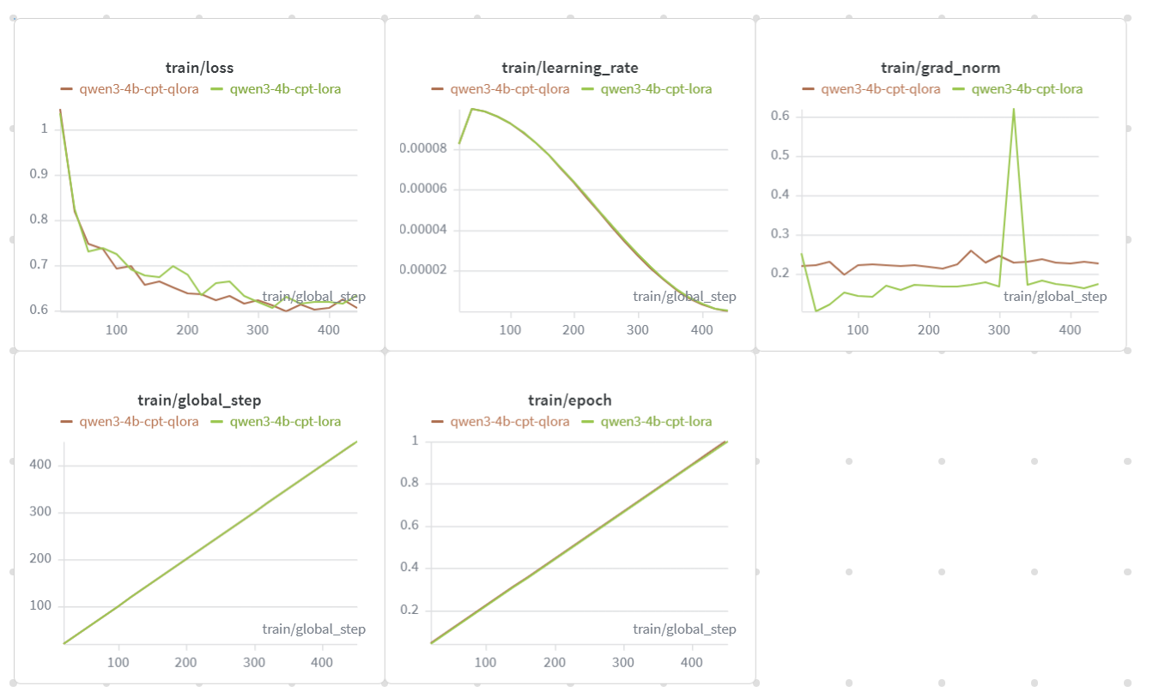

Slide 6
Evaluation Results
Perplexity evaluation on held-out Vietnamese legal test set
LoRA (bf16)
QLoRA (4-bit)
1.86
1.83
perplexity | eval_loss = 0.6197
perplexity | eval_loss = 0.6034
LOWER PERPLEXITY = BETTER

Slide 7
Analysis
Key Findings
Trade-offs
QLoRA outperforms LoRA
Perplexity 1.83 vs 1.86 despite 4-bit quantization
Higher alpha compensates quantization
alpha=128 (scale=2.0) vs alpha=64 (scale=1.0) helps QLoRA learn stronger updates
Similar convergence speed
Both converge within ~200 steps, 1 epoch sufficient
 | LoRA | QLoRA
VRAM | ~14-16 GB | ~6-8 GB
Speed | ~2421s | ~2392s
Quality | PPL 1.86 | PPL 1.83
Download | ~8 GB | ~2.5 GB
Insight: QLoRA delivers better quality with ~50% less VRAM. The higher alpha (scale=2.0) effectively compensates for quantization noise, making 4-bit training viable for domain-specific CPT.

Slide 8
Conclusions & Next Steps
Conclusion
QLoRA is the recommended approach for CPT on Qwen3-4B.
It achieves lower perplexity (1.83 vs 1.86), uses ~50% less VRAM (~6-8 GB vs ~14-16 GB), and trains at comparable speed. The 4-bit quantization with alpha scaling (2.0) is effective for Vietnamese legal domain adaptation.
Next Steps
1
Use QLoRA CPT adapter as base for SFT
Apply the best CPT adapter before supervised fine-tuning on downstream legal tasks
2
Evaluate on downstream tasks
MC, NLI, Syllogism benchmarks (ViLawQA) to measure task-specific improvement
3
Scale to larger models
Test CPT QLoRA on Qwen3-8B or larger if VRAM-efficient approach confirmed
4
Expand training data
Add more Vietnamese legal documents for longer CPT (2-3 epochs)

Slide 9
Glossary
CPT
Continual Pre-Training. Further training a pre-trained LLM on domain-specific text to adapt its knowledge.
bf16
Brain Float 16. 16-bit floating point with 8-bit exponent. Same range as fp32 but half the memory.
LoRA
Low-Rank Adaptation. Injects trainable low-rank matrices (B, A) into frozen model weights. Only ~2-5% params trained.
Cosine LR
Cosine annealing learning rate scheduler. Decays LR following a cosine curve from initial value to near zero.
QLoRA
Quantized LoRA. Combines 4-bit NF4 quantization of base weights with LoRA adapters trained in bf16.
Packing
Concatenating multiple short sequences into one max-length sequence to maximize GPU utilization during training.
NF4
NormalFloat 4-bit. Quantization format optimized for normally-distributed neural network weights. 16 discrete levels.
Grad Ckpt
Gradient Checkpointing. Trades compute for memory by recomputing activations during backward pass instead of storing them.
PPL
Perplexity = exp(loss). Measures how well the model predicts the next token. Lower = better. PPL=1.0 is perfect.
VRAM
Video RAM. GPU memory used for model weights, activations, gradients, and optimizer states during training.
Adapter
Small trainable module added to a frozen model. LoRA adapters are the B and A matrices for each target layer.
PEFT
Parameter-Efficient Fine-Tuning. Family of methods (LoRA, Prefix Tuning, etc.) that train only a small subset of parameters.

