Slide 1
Model System Rules and Business Legal Technical for Personal Data & Individual Identity
Design Methodology &
Integrated Architectural Approach
January 17, 2013
Daniel “Dazza” Greenwood, JD
Lecturer, MIT Media Lab, Human Dynamics Group

Slide 2
Design Axioms
Flexible, Scalable & Extensible
Mutliparty and Distributed
Standard and Interoperable
Modular and Customizable

Slide 3
Business/Legal/Technical
Integrated Appraoch
Mutliparty and Distributed
Standard and Interoperable
Extensible and Customizable
Flexible and Adaptive

Slide 4
Methodology
Identity the Stakeholders and Goals
Establish Steering Groups of Principals
Establish Domain Working Groups
Provide Initial Draft for Groups to Iterate
Harmonize Iterations Across Groups
Steering Group Approves Final Rules

Slide 5
Designing for Core Value Moments
The vision of networked ecosystems of high value, volume and velocity data and transactions will require rethinking how certain key moments occur.
The Personal Data Ecosystem and broader economic and social aims for globally scaled trusted networks are possible with existing technology, if it solves for these moments.

Slide 6
Core Legal Event Verified Evidence Registration
By designing CLEVER moments into the fabric of activity, Rules, Architecture & Implementation make Registration almost invisible to participants, though automated:
Business Operations and Practices
Legal Compliance and Procedures
Technical Implementations and Processes

Slide 7
Core Legal Event examples include:
Register Third Party
Enable User Grant of Authority
Enable Aggregate or De-Identified Reports
Minimal Metering or Direct Reporting
Harmonize Access With Customer IdM

Slide 8
OAuth2 Has CLEVER User Control Points
The Grants of Authorization are recorded and drive access rights as well as dynamic real time user administration panels for management of connected applications.

Slide 9
Layers &/or Interfaces
Layers:
Network
System
Platform
Service
Transaction
Record
Interfaces:
RESTful End Points
Documented Standards and Profiles
Service/App Registration (Manual or Dynamic)

Slide 10
Terms of Authorization
The terms and conditions of agreement to give authorization for authentication or access

Slide 11
User Control Dash
With User Contract
User Terms of Service and Privacy Policy paradigms severely fail at intended goals
Vision to combine commercial code, legal code and technical code for rules-driven user-control difficult with usual approaches
Human Dynamics & IDcubed goals require integrated legal/tech user-control solution

Slide 12
Converge Terms of Service and Apps Pages
By combining the Terms of Service and App preferences pages, a Resource Server can provide a user controlled and easily administered part of the user contract. This approach can be expanded to provide a more complete and integrated interface point for users to control contractual and business terms.

Slide 13


Terms of Use

Slide 14
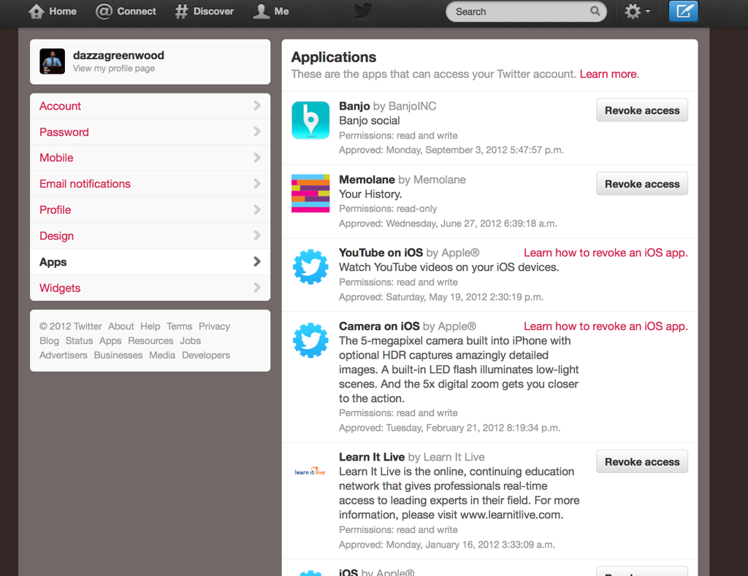
Terms of Use

Slide 15
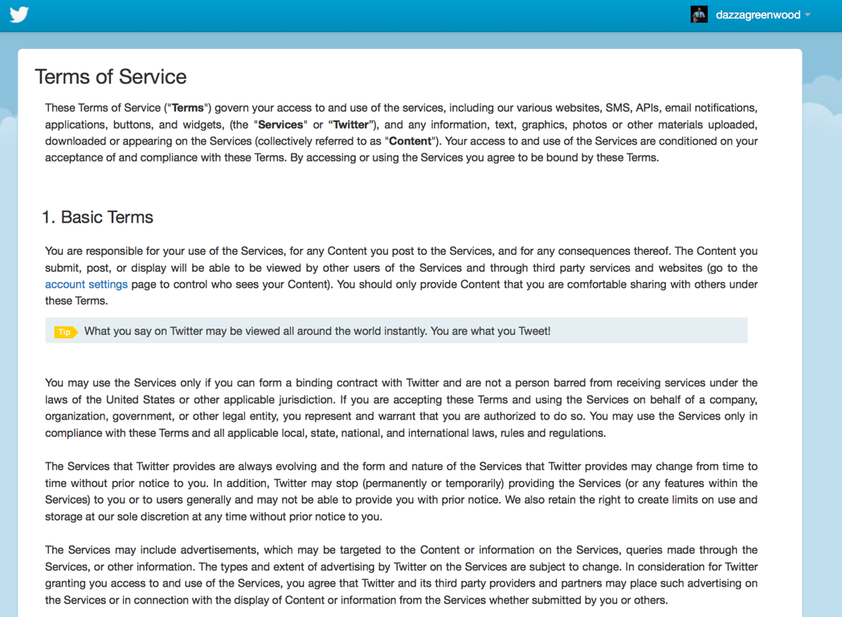

Slide 16
Terms of Use

Slide 17
Terms of Use

Slide 18

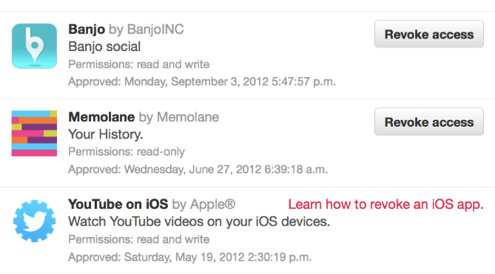
Terms of Use

Slide 19
Next Steps on User Dash:
IAP Hack-a-Thon development of User Dash and Contract “Terms of Authorization” approach, and to experiment with making the approach available for OpenPDS.
Refine Model Rules, including updating the substance and reformatting the content so that the authoritative version exists in a “Registry” with RESTful features.

Slide 20
Future Development: Templates and Wizards
Model Network & System Rules
Model Architecture and Use Cases
Model Member Account and Contract
Model Core Legal Events and Processes
Model Registries and Automated Updates

Slide 21
More Information
http://eCitizen.MIT.edu
dazza@media.mit.edu
617-500-3644

