Slide 1
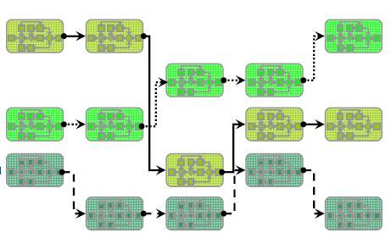
Business Process Management (BPM)

Slide 2
Information
Instructor:
  Assist. Prof. Maria-Iuliana Dascalu, PhD, FILS-UPB
Contact address:
  maria.dascalu@upb.ro
The course material will be available on:
  www.mariaiulianadascalu.com/teaching
Schedule:
  Friday, 9th of May, 18-21, room 2103
  Saturday, 16th of May, 9-18 , room 2017
  Sunday, 17th of May, 9-18 , room 2017
Grading:
  10%: written exam (18 multiple-choice qs and an open qs), 24th of May, 9-9.50 , room 2017
  20%: research presentation on a given subject (in teams) in-class on Sunday, 17th of May
  70%: project presentation (in teams), 24th of May, 10-12

Slide 3


Slide 4
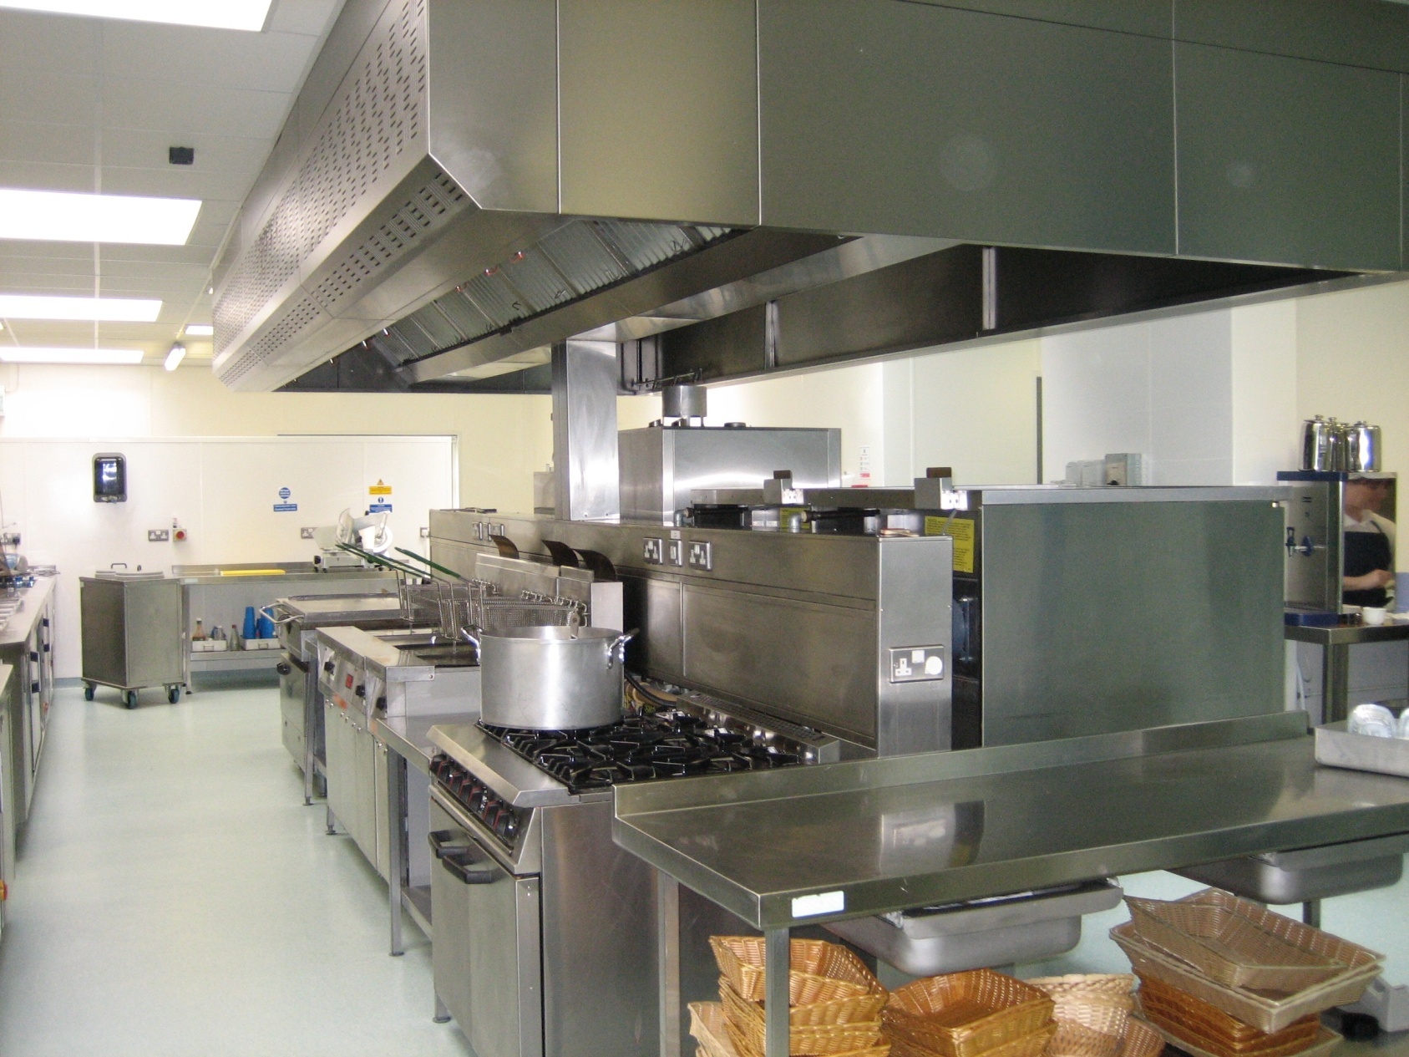

Slide 5


Slide 6
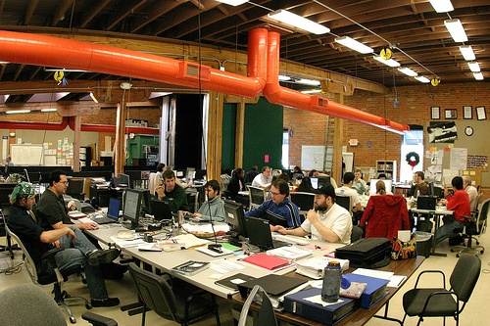

Slide 7
The bottom line is…
Clean kitchen does not necessarily produce tasty food, but
  we’d rather eat a so-so tasty food from a clean kitchen.
Good processes does not necessarily develop quality software, but
  we’d rather fly in Airbus with a software from a well-known company than a small software development house.
So, there is a need for quality processes, since they decrease the risk of companies producing low quality products.
Process management ensure qualitative processes.

Slide 8
Outline
Definitions
Core concepts and their descriptions
Components
Lifecycle
Examples
Advanced concepts

Slide 9
Definitions (1)
Business = person/ corporation engaged in commerce, manufacturing, or a service; profit-seeking enterprise (people/teams are involved for a specific outcome; refers to individuals, interacting together, to perform a set of activities to deliver value to customers and a return on investment to the stakeholders)
Process= a systematic series of actions directed to some end; a continuous set of actions, operations or series of changes taking place in a definite manner
Management = the act or manner of managing; handling, direction or control; executive ability; the person or persons controlling and directing the affairs of a business or institution (it requires handling exceptions, providing directions, controlling variables to achieve desirable outcomes; it requires skills and involves people and executives)
Notes:
process is a defined set of activities or behaviours performed by humans or machines to achieve one or more goal
triggered by specific events and have one or more outcome that may result in the termination of the process or a handoff to another process
composed of a collection of interrelated tasks or activities which solve a particular issue

Slide 10
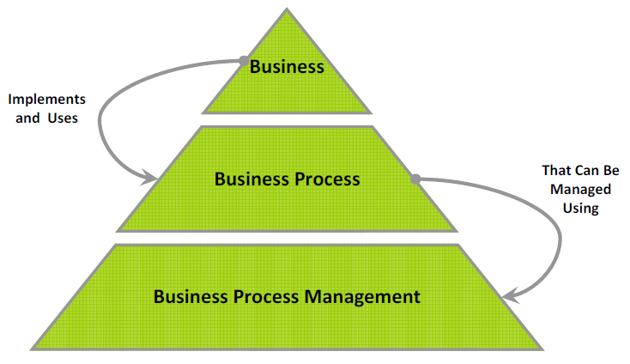
Definitions (2)

Slide 11
Definitions (3)
Business Process Management:
  Disciplined approach to identify, design, execute, document,measure, monitor and control both automated and nonautomated business processes to achieve consistent, targeted results aligned with an organisation’s strategic goals
  Involves the deliberate, collaborative and increasingly technology aided definition, improvement, innovation and management of end-to-end business processes that drive business results, create value and enable an organisation to meet its business objectives with more agility
  Enables an enterprise to align its business processes to its business strategy, leading to effective overall company performance through improvements of specific work activities either within a specific department, across the enterprise or between organisations
(Association of Business Process Management Professionals-ABPMP)

Slide 12
Outline
Definitions
Core concepts and their descriptions
Components
Lifecycle
Examples
Advanced concepts

Slide 13
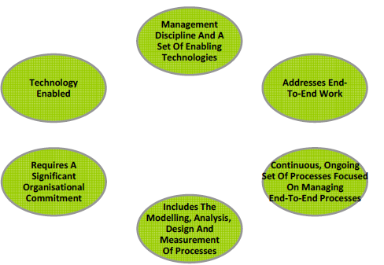
Core Concepts
The defining characteristic of process vs. project is repeatability vs. uniqueness.
Process is a repetitive collection of interrelated tasks aimed at achieving a certain goal.
Project is a unique endeavour with a beginning and an end undertaken to achieve a goal.
Notes:
• BPM addresses end-to-end work and distinguishes between sets of subprocesses, tasks, activities and functions
• BPM requires a significant organisational commitment, often introducing new roles, responsibilities and structures to traditional functionally oriented organisations
• BPM is technology enabled with tools for visual modelling, simulation, automation, integration, control and monitoring of business processes and the information systems which support these processes

Slide 14
Management Discipline and Enabling Technologies
Enabling technology is meaningless without the management disciplines and processes for exploiting the technology
Vendors have created application suites which help enable organisations to better manage their business processes
  Tools to visually design and model business processes
  Simulate and test business processes, automate, control and measure business processes
  Provide feedback and reporting on process performance
  Some vendors have combined these into integrated business process management suites
Notes:
Most large organisations have a significant investment into a number of legacy systems:
Designed to support specific functions
A BPMS must be able to integrate with legacy systems in order to control work, get information or measure performance
Common framework for how these technologies are deployed is most often referred to as a Service Oriented Architecture (SOA)

Slide 15
Addresses End-To-End Work
Business functions are typically defined by a group of activities related by a particular skill or goal such (i.e. sales, finance, manufacturing)
Business processes focus on the end-to-end work, i.e., tasks and activities, across functional boundaries to deliver customer value
Business processes have defined inputs and outputs and functions have not

Slide 16
Ongoing Management of Processes
BPM involves a permanent ongoing organisational commitment to managing the organisations processes
Includes:
  Modelling
  Analysis
  Process design
  Performance measurement

Slide 17
Modelling, Analysis, Design and Measurement of Processes
Practice of BPM requires the measurement and supervision of process performance
  Setting process performance goals
  Measuring actual performance, the efficiency of the business processes (“doing the thing right“)
  Reviewing the effectiveness of business processes (“doing the right thing“)
  Providing information, insight and feedback to other primary activities such as process analysis, design and transformation
Gather information at key points in the process to support decisions regarding cost or timing

Slide 18
Organisational Commitment
Management of end-to-end business process crosses organisational boundaries
New roles and responsibilities are introduced, such as process owners, designers and architects
Individuals responsible for end-to-end process design must interact with traditional functionally based managers
New governance structures need to be introduced which may change the way organisations make decisions and allocate resources
Practice of BPM requires a significant organisational commitment: without organisational commitment, the practice and benefits of BPM is unlikely to mature within an organisation
• Without supporting leadership, values, beliefs and culture, BPM is unlikely to successfully take hold within an organisation

Slide 19
BPM Technology
BPM is a technology enabled and supported management discipline
Wide range of technologies available to support the planning, design, analysis, operation and monitoring of business processes
Application suites available which help enable organisations to better manage their business processes
BPM systems must be able to integrate with legacy systems in order to control work and get information or measure performance
Common framework for how these technologies are deployed is most often referred to as a Service Oriented Architecture (SOA)

Slide 20
Outline
Definitions
Core concepts and their descriptions
Components
Lifecycle
Examples
Advanced concepts

Slide 21
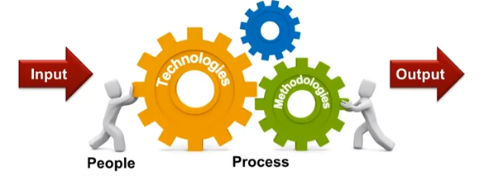
Components
A management approach to continuously improve processes and archive organizational objectives through a set of methodologies and technologies
People and processes are a key part

Slide 22
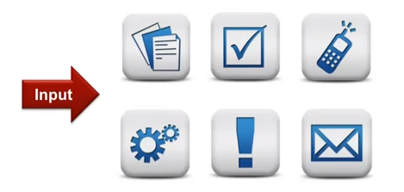
Input
An input can be a form, a document, an image, an approval from a person (employee/customer/ manager can trigger an event), data, alert, mail from a person or a system.

Slide 23
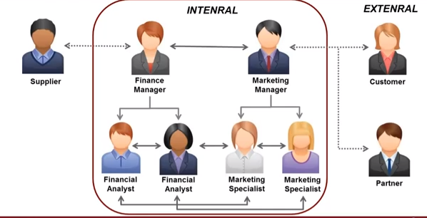
Process Participants
From the same team project, but also cross-functional

Slide 24
Process Activities
Types:
  Value Added - contribute to the process output in a positive way
  Handoff - pass control of the process to another department or organisation
  Control - assure that the processes behave within desired tolerances or specify a validity checkpoint
Examples:
  Planning & strategy
  Analysis
  Design & modeling
  Implementation
  Monitoring & controlling
  Refinement

Slide 25
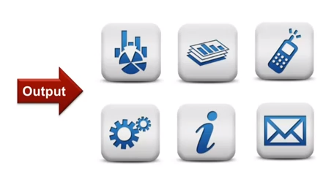
Output
Management dashboard, reports, phones, e-mail alerts from key participants and reviewers
Good outcomes for participants and organization + bring the process to an end

Slide 26
Outline
Definitions
Core concepts and their descriptions
Components
Lifecycle
Examples
Advanced concepts

Slide 27
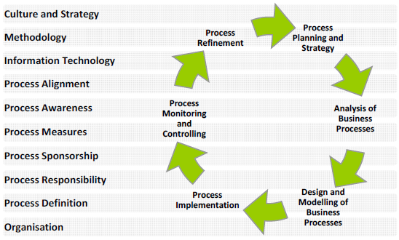
BPM Lifecycle (1)
The BPM activities are affected by several factors: leadership, values, culture and beliefs factors

Slide 28
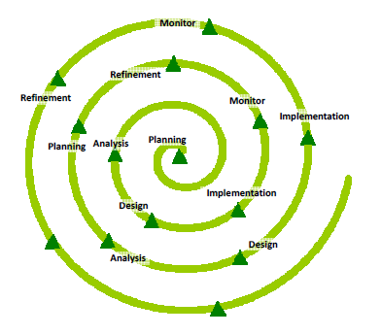
BPM Lifecycle (2)
Iterative, phased set of activities

Slide 29
Process Planning and Strategy
Sets the strategy and direction for the BPM process
Plan starts with an understanding of organisational strategies and goals
Provides a foundation for a holistic BPM approach to ensure the alignment with organisational strategy and the integration of strategy, people, processes and systems across functional boundaries
Identifies appropriate BPM organisational roles and responsibilities, executive sponsorship, goals and expected performances measures and methodologies

Slide 30
Analysis of Business Processes
Takes information from strategic plans, process models, performance measurements, changes in the environment and other factors in order to fully understand the business processes in the context of the overall organisation

Slide 31
Design and Modelling of Business Processes
Document the sequence of activities, including the design of what work is performed, at what time, in what location, by what process actors using what methodology
Defines what the organisation wants the process to be and answers the what, when, where, who and how questions of how end-to-end work is executed
Ensures that the proper management controls and metrics are in place for compliance and performance measurement

Slide 32
Process Monitoring and Controlling
Continuous measuring and monitoring of business processes provides the information necessary to adjust resources in order to meet process objectives
Measuring and monitoring also provides critical process performance information through key measurements related to goals and value to the organisation
Analysis of process performance information can result in improvement, redesign or reengineering activates

Slide 33
Process Refinement
Implements the output of the iterative analysis and design cycle
Addresses organisational change management challenges
Aimed at continuous improvement and process optimisation

Slide 34
Outline
Definitions
Core concepts and their descriptions
Components
Lifecycle
Examples
Advanced concepts

Slide 35
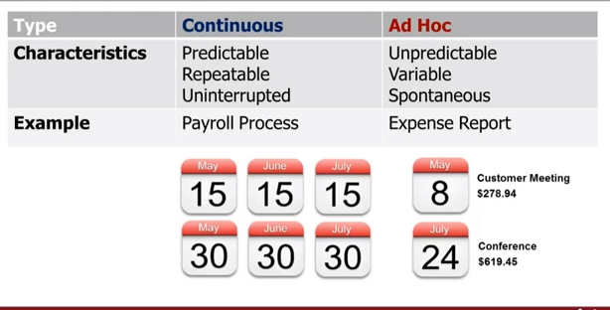
Continuous vs. Ad Hoc

Slide 36
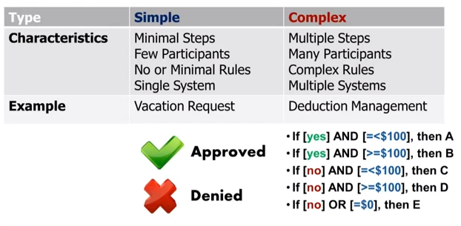
Simple vs. Complex: number of steps, number of participants, number of people/systems involved, number of exceptions

Slide 37
Other examples…
Management processes:
  used to measure, monitor and control business activities
  ensure that a primary or supporting process meets operational, financial, regulatory and legal goals
Primary (core) processes:
  end-to-end, cross-functional processes which directly deliver value
  represent the essential activities an organisation performs to fulfill its mission
Support processes:
  support primary processes, often by managing resources and/or infrastructure required by primary processes
  not directly deliver value (does not mean that they are unimportant to an organisation); e.g. information technology management and human resource management

Slide 38
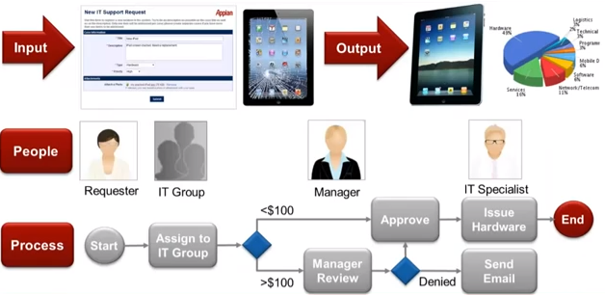
Example: Request to IT Department

Slide 39
Outline
Definitions
Core concepts and their descriptions
Components
Lifecycle
Examples
Advanced concepts

Slide 40
Advanced Concepts
1. Process Ownership
2. Process Modelling
3. Process Analysis
4. Process Design
5. Process Performance Measurement
6. Process Transformation
7. Process Implementation
8. Process Quality
9. Process Management Organisation
10. Enterprise Process Management
11. Process Management Technology

Slide 41
1. Process Ownership

Slide 42
Process Ownership
Successful BPM implementations recognise that the role of a process owner is critical
Process owner is responsible for the entire end-to-end process across functional departments
Success of this role depends on the authority the individual has to control the budget and make decisions that effect the development, maintenance and improvement of the business process

Slide 43
2. Process Modelling

Slide 44
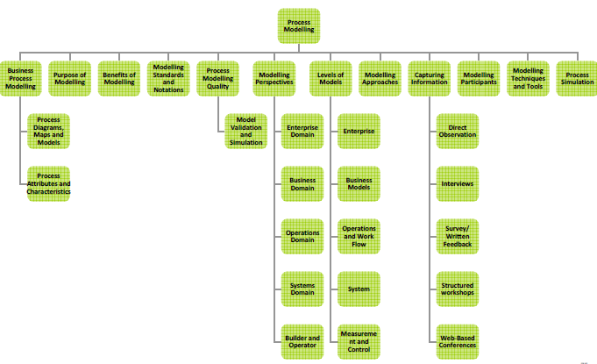
Process Modelling
Notes:
Set of activities involved in creating representations of an existing (as-is) or proposed (to-be) business process
• Provides an end-to-end perspective of an organisations primary, supporting and management processes
• Modelling is a means to an end and not an end in itself
− You model to get results and reach conclusions

Slide 45
Process Diagrams, Maps and Models
Diagrams:
  Process diagram often depicts simple notation of the basic workflow of a process
  Depicts the major elements of a process flow, but omits the minor details which are not necessary for understanding the overall flow of work
Maps:
  More precision than a diagram
  More detail about process and important relationships to other elements such as performers (actors), events, results
  Provide a comprehensive view of all of the major components of the process
Models:
  Represents the performance of what is being modelled
  Needs greater precision, data about the process and about the factors that affect its performance
  Often done using tools that provide simulation and reporting capability to analyse and understand the process

Slide 46
Process Attributes and Characteristics
describe the properties, behaviour, purpose and other elements of the process
are captured in a tool in order to organise, analyse and manage an organisation’s portfolio of processes
examples:
  Inputs/Outputs, Events/Results, Value Add, Roles/Organisations, Data/Information, Probabilities, Queuing, Transmission Time, Wait Time, Arrival Patterns/Distributions, Costs (indirect and direct), Entry Rules, Exit Rules, Branching Rules, Join Rules, Work/Handling Time, Batching, Servers (number of people available to perform tasks)

Slide 47
Purpose of Process Modelling (1)
A model is rarely a complete and full representation of the actual process
Objective is to create a representation of the process that describes it accurately and sufficiently for the task at hand
Models are simplified representations that facilitate understanding of that which is being studied and making decisions about it

Slide 48
Purpose of Process Modelling (2)
Focus on representing those attributes of the process that support continued analysis from one or more perspectives
Understanding the business process through the creation of the model
Creating a visible representation and establishing a commonly shared rerspective
Process models are the primary means for
  Measuring performance against standards
  Determining opportunities for change
  Expressing the desired end state preceding a change effort
Benefits of Modelling:
  Models are relatively fast, easy and inexpensive to complete
  Models are easy to understand (when compared to other forms of documentation)
  Models provide a baseline for measurement
  Models facilitate process simulation and impact analysis

Slide 49
Modelling Standards and Notations
Range of number of modelling and notational standards and Techniques
Models provide a language for describing and communicating as-is and to-be process information
  Like all new languages must be learned
Examples:
  Business Process Modelling Notation (BPMN)
  Flow Charting
  Event Process Chain (EPC)
  Value Chain
  Unified Modelling Language (UML)
  IDEF-0 (Integration Definition for Function Modelling)
  LOVEM-E (Line of Visibility Engineering Method - Enhanced)
  SIPOC (Supplier, Input, Process, Output and Customer)
  Systems Dynamics
  Value Stream Mapping
Notes:
Flow charting: simple type of diagram that represents a process, showing the steps as boxes of various kinds and their order by connecting these with arrows
Swim lanes: an addition to the boxes and arrows process flow view of flow-charting that show how the work flows across organisational units or is handed-off from one role to another
Overall process is divided into lanes, with one lane for each person, group or subprocess.
Processes and decisions are grouped by placing them in lanes.
Event process chain (EPC): an ordered graph of events and functions
An EPC provides various connectors that allow alternative and parallel execution of processes
EPC method was developed within the framework of ARIS (BPM toolset)
Value chain:is used to demonstrate a single continuous flow from left to right of the sub-processes that directly contribute to producing value for the organisation’s customers
Chain of activities gives the products more added value than the sum of added values of all activities
Unified Modelling Language (UML) activity diagrams
IDEF-0: developed by the US Air Force for documenting manufacturing processes; part of the IDEF family of modelling languages in software engineering:
IDEF0 produces a function model that is structured representation of the functions, activities or processes
IDEF1 produces an information model that represents structure and semantics of information
IDEF2 produces a dynamics model that represents time-varying behavioural characteristics
LOVEM-E was developed as part of IBM’s Business Process Reengineering Methodology
SIPOC - style of process documentation used in Six Sigma
Systems Dynamics - approach to understanding the behaviour of complex systems over time; Deals with internal feedback loops and time delays that affect the behaviour of the entire system
Systems Dynamics models are “activity on arrow” diagrams rather than “activity on node” diagrams

Slide 50
Business Process Modelling Notation (BPMN)
Widely used and supported standard for business process modelling
Provides a graphical notation for specifying business processes in a Business Process Diagram (BPD)
Uses a flowcharting technique similar to activity diagrams from Unified Modelling Language (UML)
Can output BPMN to Business Process Execution Language (BPEL)
  Standard executable language for specifying interactions with Web Services
Emerging standard

Slide 51
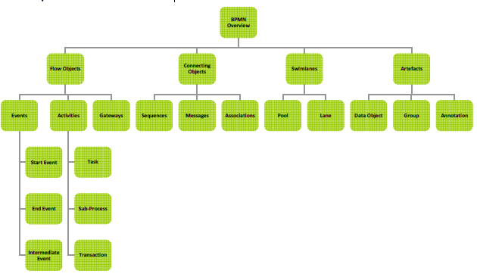
BPMN - Structure

Slide 52
BPMN – Events: denote something that happens
  Classifications: Catching – triggered by external event or Throwing – generating an output
  Types: Start Event - acts as a trigger for the process, End Event - represents the result of a process, Intermediate Event - represents something that happen between the start and end events
BPMN – Activities: describe the kind of work that must be done
  Types: Task - represents a single unit of work that is not or cannot be broken down to a further level of business process detail, Sub-Process - used to hide or reveal additional levels of business process detail, Transaction - a form of sub-process in which all contained activities must be treated as a whole
BPMN – Gateway: determines forking and merging of paths depending on the conditions expressed
BPMN – Flow objects are connected to each other using connecting objects.
  Types: Sequence Flow - shows in which order the activities will be performed, Message Flow - shows what messages flow across organisational boundaries, Association - associate an Artefact to a Flow Object and can indicate directionality
BPMN - Swim Lanes: visual mechanism of organising and categorising activities, based on cross functional flowcharting
  Types: Pool - represents major participants in a process and contains one or more lanes, Lane - used to organise and categorise activities within a pool according to function or role
BPMN – Artefacts: used to bring some more information into the model/diagram
  Types: Data Objects - show the data is required or produced in an activity, Group - used to group different activities but does not affect the flow in the diagram, Annotation - used to provide the model/diagram with understandable details

Slide 53
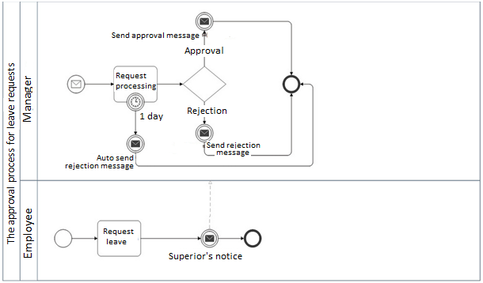
Notes:
Pentru a ilustra modul în care se aplică BPMN în cadrul unui scenariu de business complet, se va analiza următoarea situaţie: se face o cerere de concediu de către un angajat către superiorul său ierarhic, care aprobă sau nu cererea. Actorii implicaţi în proces sunt angajatul, superiorul ierarhic şi sistemul.
Setul de activităţi este definit de: (a) angajatul solicită concediu şi îşi notifică superiorul; (b) superiorul ierarhic procesează cererea, decide dacă o aprobă sau nu şi îl notifică pe angajat; (c) sistemul respinge automat cererea, în cazul în care superiorul nu răspunde în timp de o zi. BPD-ul este creat prin intermediul unui pool cu două lane-uri, unul pentru angajat şi celălalt pentru superiorul ierarhic. Următorul pas este plasarea elementelor BPMN pe BPD: evenimentele de start, atât pentru angajat cât şi pentru superiorul ierarhic, activităţile, evenimentele de stop.

Slide 54
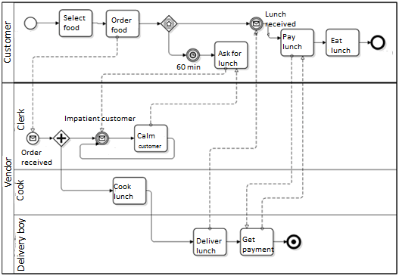
Notes:
Modelarea achiziţionării unui produs
Un alt proces este modelat în figura de mai jos. Situaţia este una clasică: clientul doreşte să comande prânzul. Sunt modelate interacţiunile dintre client şi casier, casier şi bucătar, bucătar şi curier. Actorii implicaţi sunt: clientul, casierul, bucătarul şi curierul. Setul de activităţi este definit de: (a) clientul alege prânzul şi comandă, plăteşte şi mănâncă comanda primită; în cazul în care nu primeşte ce a comandat după 60 minute, clientul ii va cere explicaţii casierului; (b) casierul primeşte comanda şi are rolul de a oferi explicaţii clientului dacă acesta le cere; (c) bucătarul pregăteste comanda; (d) curierul livrează prânzul şi primeşte plata. BPD-ul este creat prin intermediul unui lane separat pentru client şi al unui pool cu trei lane-uri pentru casier, bucătar, respectiv curier.

Slide 55
References
Association of Business Process Management Professionals (ABPMP) Business Process Management Common Body of Knowledge (CBOK)
Alan McSweeney, “Introduction to Business Process Management”, 2010
M. Staron, W. Meding, “Ensuring Reliability of Information Provided by Measurement Systems”, Ericsson
M. Staron, “Software Leadership and Quality Assurance”, Gothenburg University, 2010

