Slide 1
CIMPLE
A new kind of provider environment
Mike Brasher, Karl Schopmeyer
Inova Development
January 16, 2006
Version 1.0

Slide 2
Introduction

Slide 3
What is CIMPLE?
CIMPLE is a miniature CIM provider engine.
  Embeddable.
  Light-weight.

Slide 4
CIMPLE Architecture
Dispatcher API (CIM Operations)
Provider Manager
P1
P2
P3
Repository

Slide 5
CIMPLE Applications
Pegasus
“CMPI-CIMOM”
CIMLITE
Integration Glue
Integration Glue
Integration Glue
CIMPLE
CIMPLE
CIMPLE
P1
P2
P3
R
P1
P2
P3
R
P1
P2
P3
R
SMASH
WS-Management
WSDM
Integration Glue
Integration Glue
Integration Glue
CIMPLE
CIMPLE
CIMPLE
P1
P2
P3
R
P1
P2
P3
R
P1
P2
P3
R

Slide 6
Advantages
CIMPLE is used to develop providers with four key advantages.
  Easy to build
  Small
  Fast
  More reliable

Slide 7
Conventional Provider
CIMOM
Provider Interface
Provider “glue”
Managed Resource
The provider is mostly “glue” that maps a managed resource to a provider interface. CIMPLE eliminates the need to develop much of the provider.

Slide 8
Key simplifications
Eliminates the need to implement several of the provider operations.
Generates real classes in the target language from MOF classes.
Generates the provider skeleton and CIM interface automatically.

Slide 9
Provider Operations
Get-instance
Get-instance-names*
Enum-instance
Enum-instance-names*
Get-property*
Set-property*
Create-instance
Modify-instance
Delete-instance
Associators*
Associator-names*
References*
Reference-names*
Method-stubs*
Deliver indication
*CIMPLE provides these operations

Slide 10
Class generation
CIMPLE generates classes in the target language from MOF classes.
class Fan
{
[key] string DeviceID;
uint64 Speed;
uint64 DesiredSpeed;
uint64 SetSpeed(
[in] uint64 speed);
};
class Fan
{
Value<string> DeviceID;
Value<uint64> Speed;
Value<uint64> DesiredSpeed;
CIMPLE_CLASS(Fan);
};

Slide 11
Provider skeleton generation
Generates skeletons for instance operations.
Generates method signatures and method dispatchers.
Get_Instance_Status Fan_Provider::get_instance(
const Fan* model,
Fan* instance)
{
return GET_INSTANCE_UNSUPPORTED;
}
Invoke_Method_Status Fan_Provider::SetSpeed(
const Fan* inst,
const Value<uint64>& DesiredSpeed,
Value<uint32>& return_value)
{
return INVOKE_METHOD_UNSUPPORTED;
}

Slide 12
CIMPLE Module Architecture
CIMPLE Provider Module
CIMPLE
Provider-1
CIMPLE
Provider-2
CIMPLE
Provider-N
…

Slide 13
Motivation

Slide 14
The Problem
Conventional providers are:
  hard to develop and maintain.
  error prone – errors caught at run-time rather than compile-time.
  too large for some environments (embedded).
  too slow for some hardware (embedded).
Management of the provider infrastructure dominates the provider development effort.

Slide 15
Dynamic interfaces
Uint32 GetSpeed(CIMInstance& fan) throw(Exception)
{
Uint32 pos = fan.findProperty(“speed”);
if (pos == PEG_NOT_FOUND)
throw Exception(“not found”);
try
{
Uint32 speed;
fan.getProperty(pos).getValue().get(x);
return speed;
}
catch(…)
{
throw Exception(“type mismatch”);
}
}

Slide 16
What if Fan were a real class?
inline Uint32 GetSpeed(const Fan& fan)
{
return fan.Speed.value;
}
// Or just ‘fan.Speed.value’

Slide 17
Pegasus/CIMPLE
void Pegasus_example()
{
try
{
CIMInstance inst("TheClass");
inst.addProperty(CIMProperty("u", "hello"));
inst.addProperty(CIMProperty("v", Uint32(99)));
inst.addProperty(CIMProperty("w", Boolean(true)));
inst.addProperty(CIMProperty("x", Real32(1.5)));
Array<Uint32> y;
y.append(1);
y.append(2);
y.append(3);
inst.addProperty(CIMProperty("y", y));
Uint32 pos = inst.findProperty("v");
if (pos != PEG_NOT_FOUND)
{
Uint32 v;
CIMProperty prop = inst.getProperty(pos);
prop.getValue().get(v);
}
}
catch(...)
{
}
}
void CIMPLE_example()
{
TheClass* inst = TheClass::create();
inst->u.value = "hello";
inst->v.value = 99;
inst->w.value = true;
inst->x.value = 1.5;
inst->y.value.append(1);
inst->y.value.append(2);
inst->y.value.append(3);
uint32 v = inst->v.value;
destroy(inst);
}

Slide 18
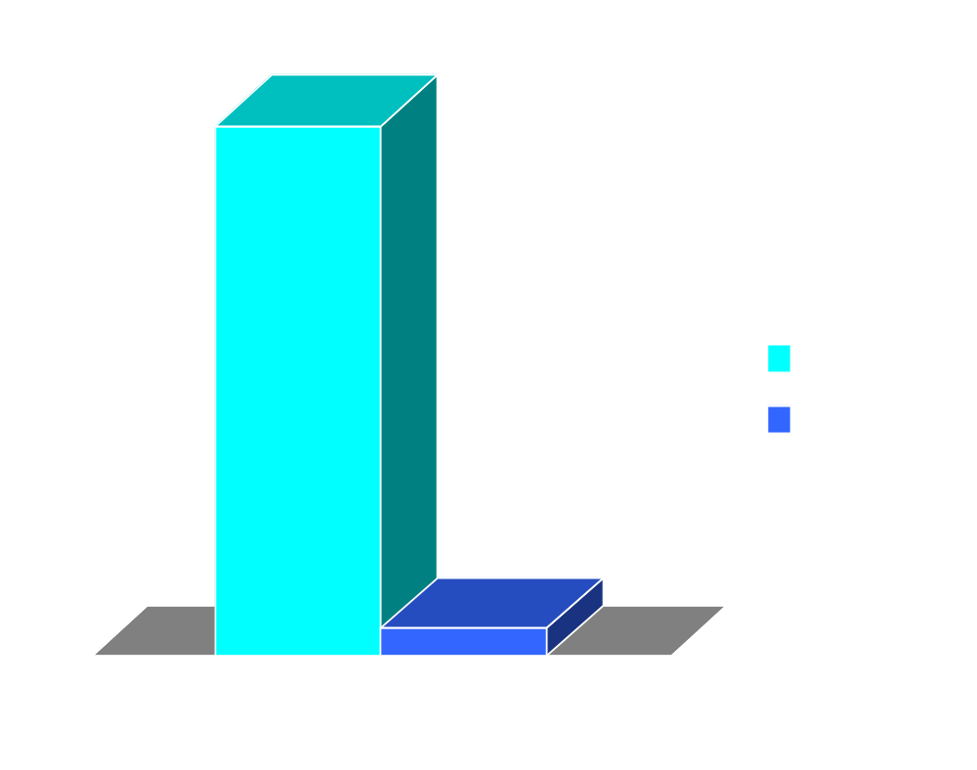
Speed Comparison
(seconds*)
* One million iterations (18X)

Slide 19
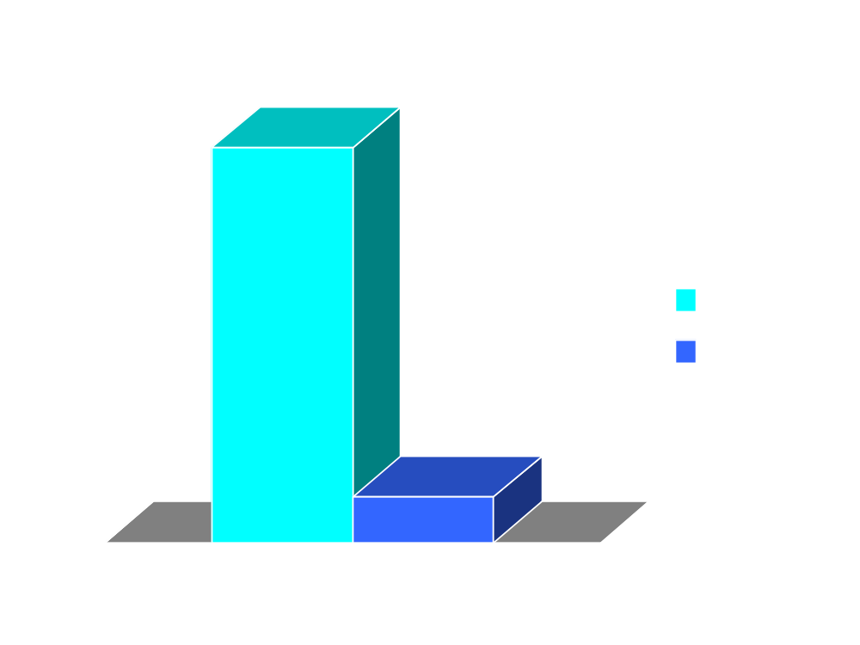
Size Comparison
(bytes)
* (9X)

Slide 20
Advantages

Slide 21
CIMPLE advantages
Easier – eliminates busy work, allowing one to concentrate on the core problem.
Smaller – reduces object size and memory usage.
Faster – improves performance.
Reliable – catches at compile time rather than run-time.
Interoperable – could potentially run under any CIMOM.

Slide 22
Easier
Development easier with first class objects.
Fewer instance provider operations to implement.
No need to implement association operations.
Method signatures automatically generated.
Tools automate complex activities:
  genclass – generates C++ classes from MOF.
  genprov – generates provider skeletons.
  regmod – registers provider with Pegasus.
  testmod – pre-loads and tests providers.

Slide 23
Smaller
CIMPLE providers have smaller object size.
CIMPLE providers use heap size.

Slide 24
CIMOM vs. provider size
The object size of the CIMOM is a fixed cost.
The cost of the provider is a variable cost (it increases as you add or enhance providers).

Slide 25
Faster
Use of first-class objects reduces overhead by one order of magnitude (no longer necessary to search property lists).

Slide 26
Reliable
Due to first class objects:
  more errors can be detected at compile time.
  complexity is substantially reduced.

Slide 27
Interoperable
CIMPLE was designed to work with any CIMOM (or environment).
CIMPLE provider can be loaded by Pegasus today.

Slide 28
Developing the provider

Slide 29
CIMPLE provider development
Define MOF class.
Generate class (genclass).
Generate provider skeleton (genprov).
Implement operations.
Pre-test provider (testprov).
Register provider with Pegasus.
Fan.h
MOF Class
Fan
genclass
Fan.cpp
Fan_Provider.h
MOF Class
Fan
genprov
Fan_Provider.cpp
testprov
test report
libFan.so
regmod
Pegasus
Repository
libFan.so

Slide 30
Define the MOF class
// repository.mof
class Fan
{
[key] string DeviceID;
uint64 Speed;
uint64 DesiredSpeed;
uint32 SetSpeed([in] uint64 DesiredSpeed);
};

Slide 31
Generate the class
Fan.h
MOF Class
Fan
genclass
Fan.cpp
% genclass Fan
Created Fan.h
Created Fan.cpp
% _

Slide 32
Generate provider skeleton
Fan_Provider.h
MOF Class
Fan
genprov
Fan_Provider.cpp
% genprov Fan
Created Fan_Provider.h
Created Fan_Provider.cpp
% _

Slide 33
get_instance method
// Fan_Provider.cpp:
Get_Instance_Status Fan_Provider::get_instance(
const Fan* model,
Fan*& instance)
{
instance = model->clone();
// Only one fan in this system.
if (inst->DeviceID.value == “FAN01”)
{
inst->Speed.value = _get_fan_speed(1);
inst->DesiredSpeed.value = 0;
return GET_INSTANCE_OK;
}
return GET_INSTANCE_NOT_FOUND;
}

Slide 34
SetSpeed method
// Fan_Provider.cpp:
Invoke_Method_Status Fan_Provider::SetSpeed(
const Fan* inst,
const Value<uint64>& DesiredSpeed,
Value<uint32>& return_value)
{
// Only one fan in this system.
if (inst->DeviceID == “FAN01”)
{
_set_desired_speed(1, DesiredSpeed);
return_value.value = _get_fan_speed(1);
return INVOKE_METHOD_OK;
}
return INVOKE_METHOD_FAILED;
}
// Note: Pegasus version of SetSpeed() is 87 lines of code.

Slide 35
Pre-test the provider
testprov
test report
libFan.so
% testprov libcmplfan.so
% _

Slide 36
Register module with Pegasus
regmod
Pegasus
Repository
libFan.so
% regmod libcmplfan.so
% _

Slide 37
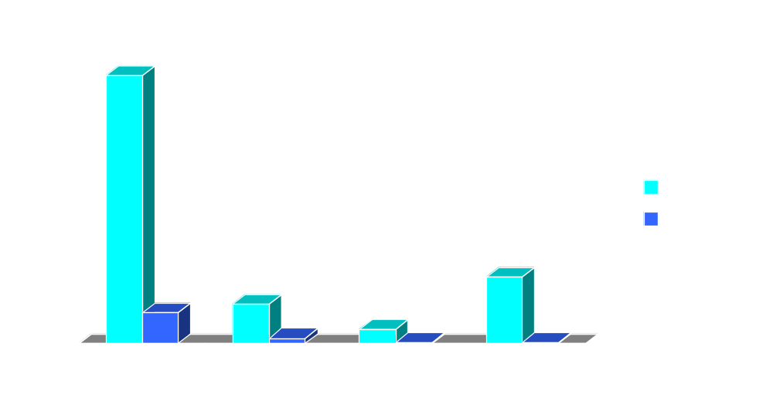
Provider size comparison
(kilobytes)
Note: savings increases with the complexity of the provider

Slide 38
Conclusion

Slide 39
Status
Complete:
  Instance providers
  Method providers
  Association providers
  Indication providers
  CMPI adapter*
Work in progress:
  Query providers
  Access control

Slide 40
Obtaining CIMPLE
CIMPLE can be downloaded from http://www.cimple.org.

Slide 41
Contact us
Karl Schopmeyer – k.schopmeyer@inovadevelopment.com
Mike Brasher – m.brasher@inovadevelopment.com

