Slide 1
Digital Channel Sounding and Noise Filtering
Team Members
McRee Brian
He Xiang
Okodaso Mamie

Slide 2
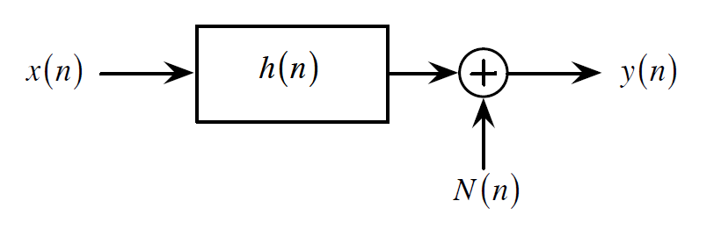
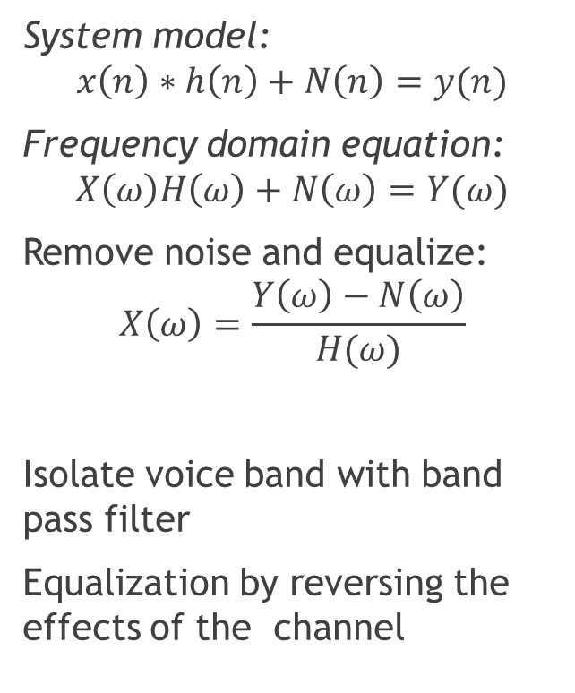
Theory
System Model
System model:
$$x\left(n\right)∗h\left(n\right)+N\left(n\right)=y(n)$$
Frequency domain equation:
$$X\left(ω\right)H\left(ω\right)+N\left(ω\right)=Y(ω)$$
Remove noise and equalize:
$$X\left(ω\right)=\frac{Y\left(ω\right)−N\left(ω\right)}{H(ω)}$$
Isolate voice band with band pass filter
Equalization by reversing the effects of the channel

Slide 3
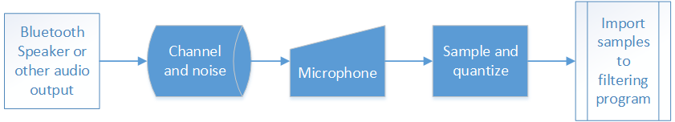
System Flowchart

Slide 4
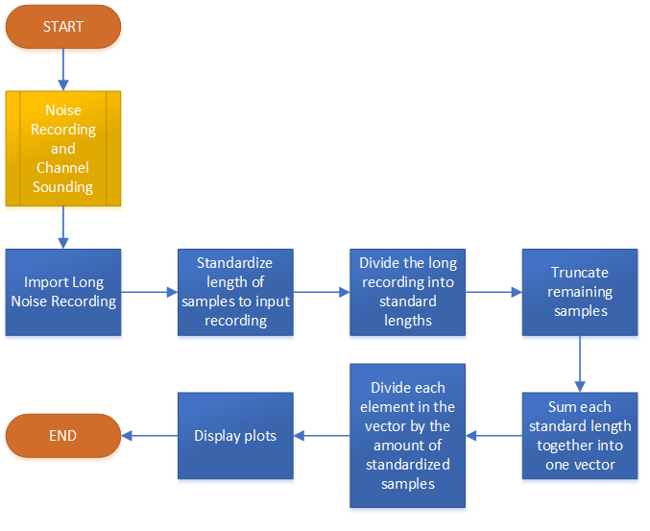
Noise and Channel Estimation

Slide 5
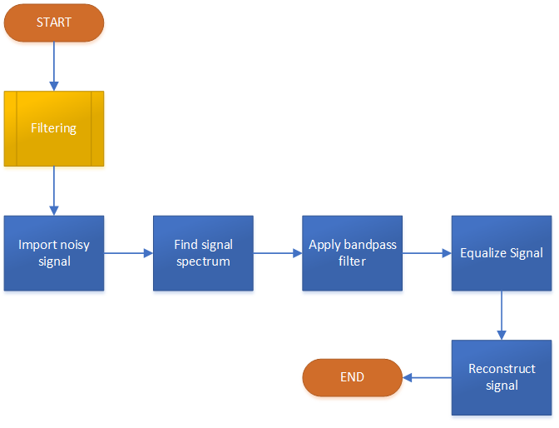
Filtering

Slide 6
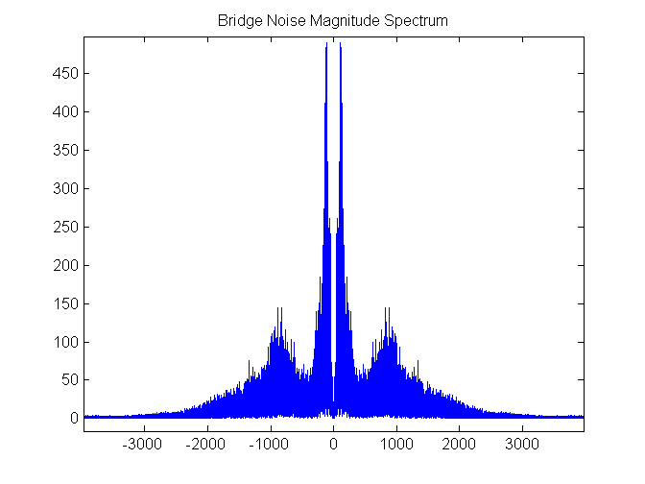
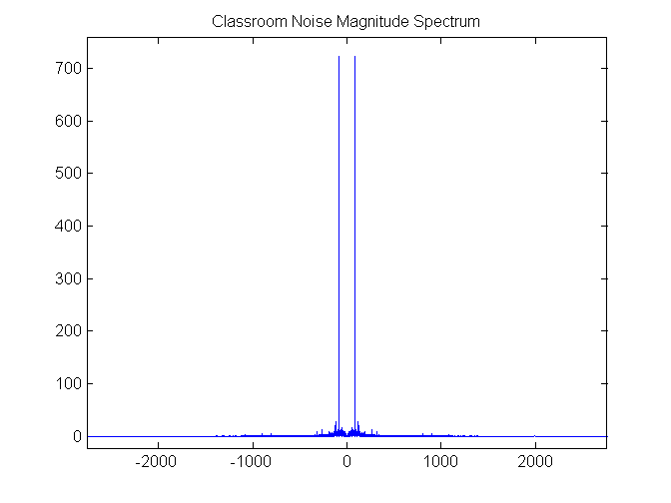
Average Noise Spectrums

Slide 7
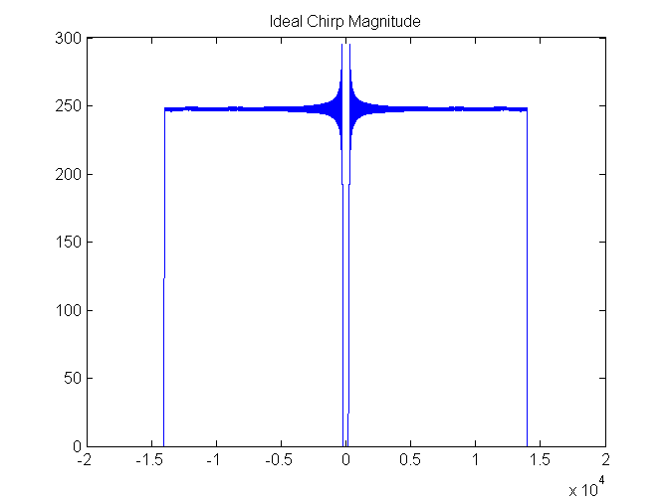
Ideal Chirp
Chirp generated at 0 – 18kHz
Truncated to 200 – 14kHz

Slide 8
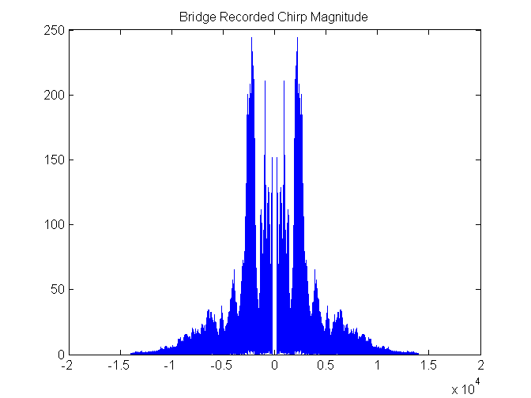
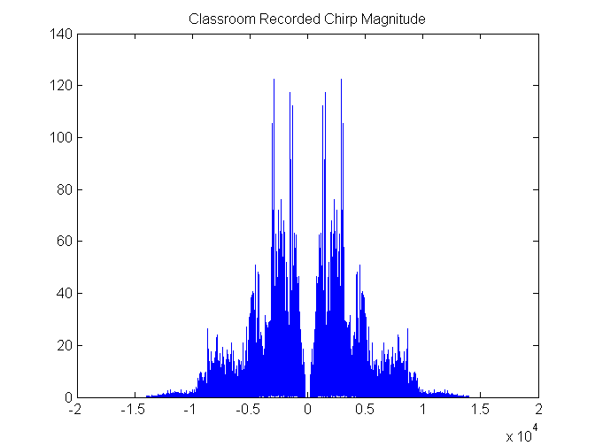
Average Recorded Chirp

Slide 9
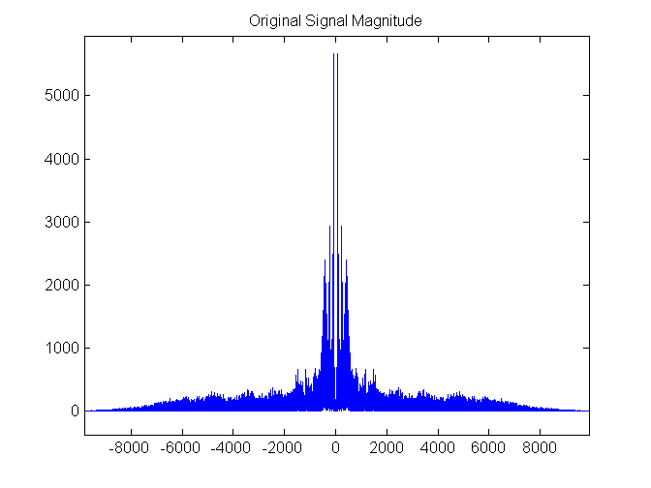
Spectrum of Original Signal

Slide 10
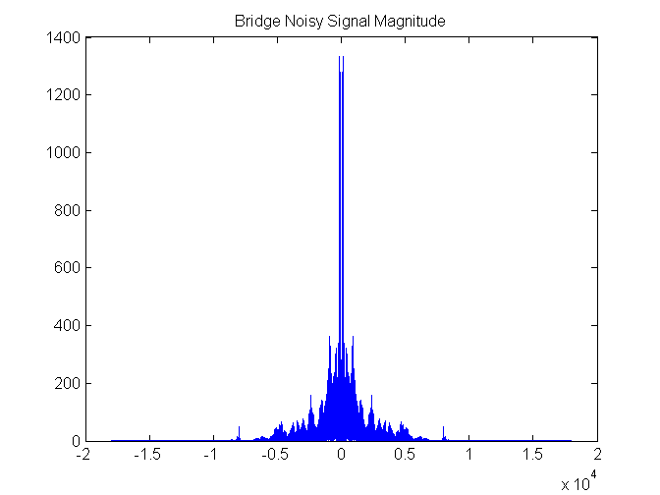
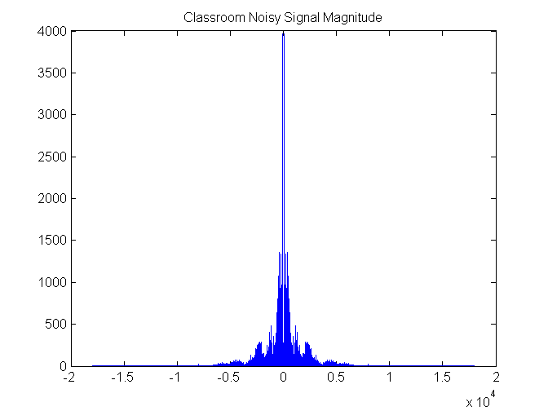
Noisy Signals

Slide 11
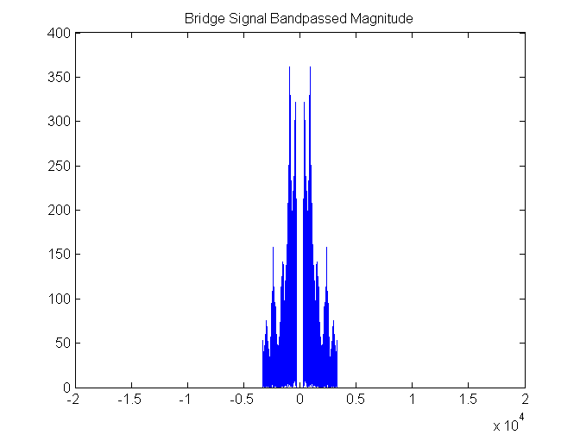
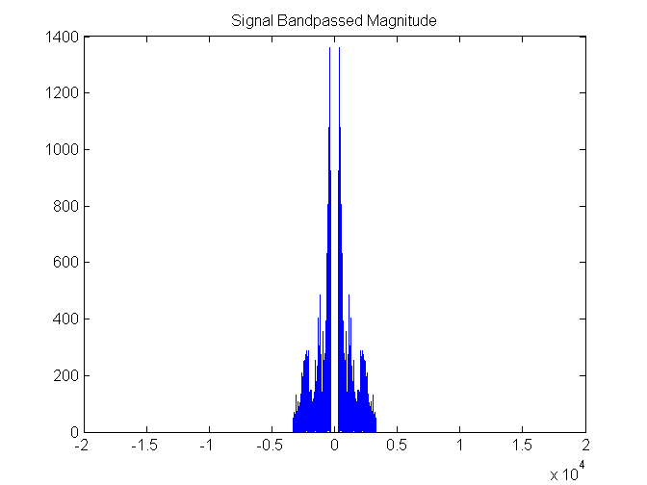
Bandpassed Signals

Slide 12
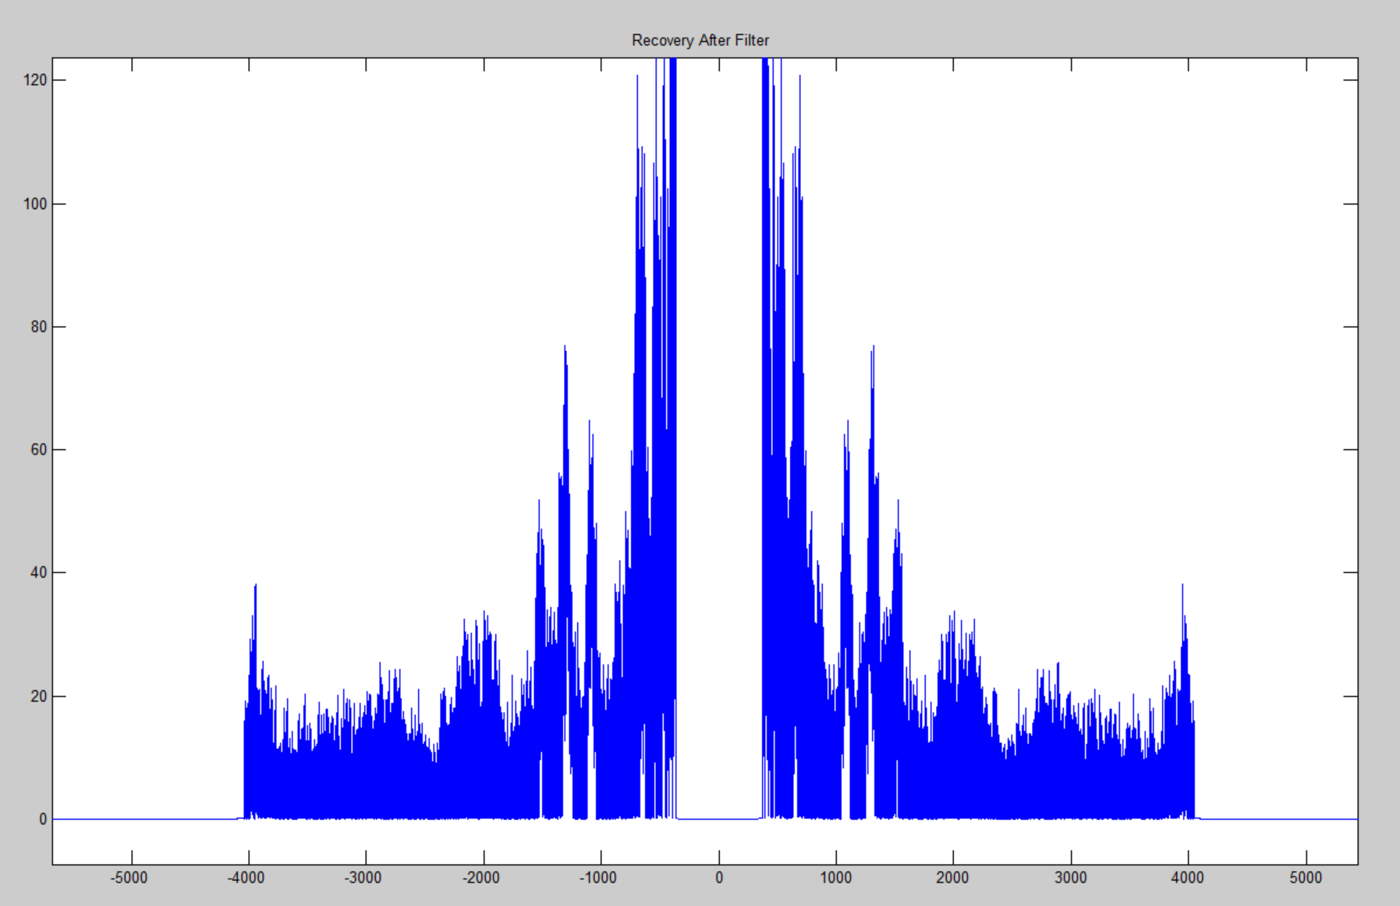
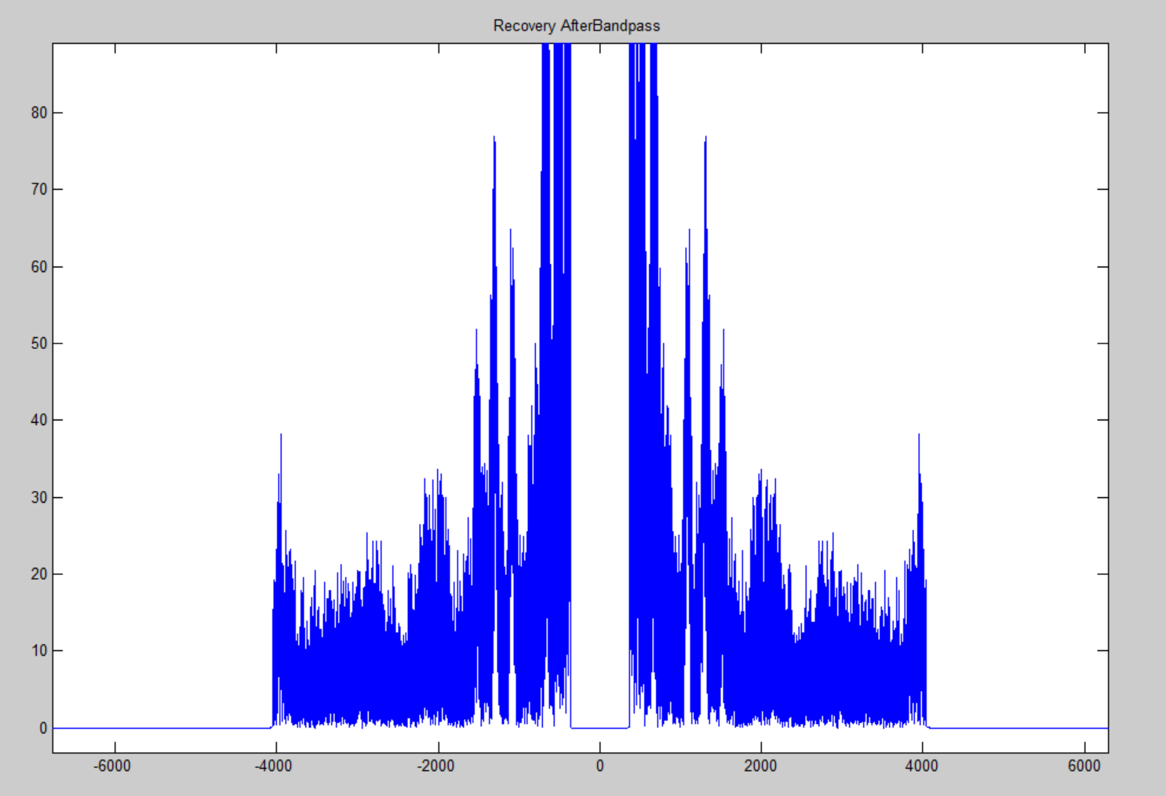
Threshold limiting
Bandpass Filtered
Threshold limited

Slide 13
Conclusions
Brick wall bandpass filters effectively remove undesirable frequencies that corrupt signals in software.
A limitation to ideal filtering is that such filters cannot be realized.
Appling a filter to the voice band does not remove all noise
Other methods are required to reduce noise levels, such as examining the power density spectrum, or periodogram, for noise estimation. http://home.mit.bme.hu/~bako/zaozeng/chapter4.htm
Equalization can become complex due to inverting small value of the channel transfer function that result in extreme signal gains.
Finally, it can be concluded that simple mathematical models do not always work when applying them to more complex real world systems.

