Slide 1
Digital Channel Sounding and Noise Filtering
Team Members
McRee Brian
He Xiang
Okodaso Mamie

Slide 2
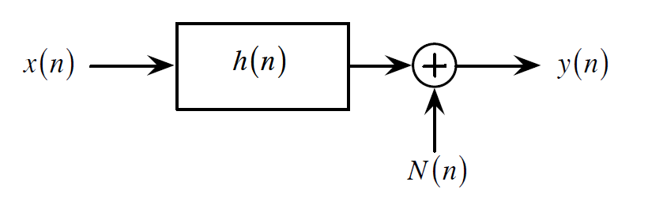
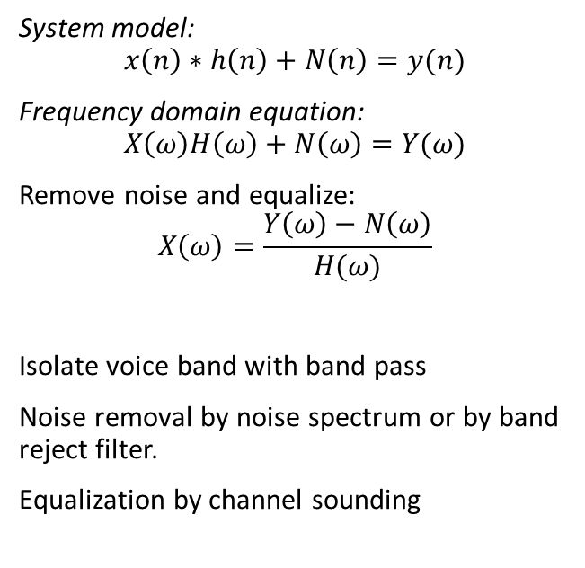
Theory
System Model
System model:
$$x\left(n\right)∗h\left(n\right)+N\left(n\right)=y(n)$$
Frequency domain equation:
$$X\left(ω\right)H\left(ω\right)+N\left(ω\right)=Y(ω)$$
Remove noise and equalize:
$$X\left(ω\right)=\frac{Y\left(ω\right)−N\left(ω\right)}{H(ω)}$$
Isolate voice band with band pass
Noise removal by noise spectrum or by band reject filter.
Equalization by channel sounding

Slide 3
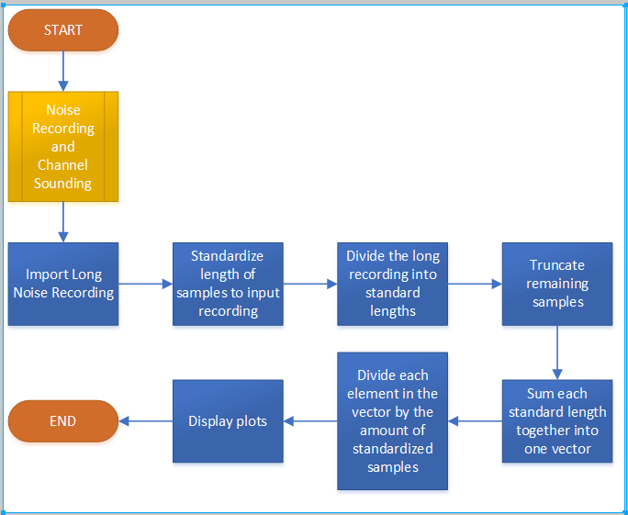
Software Flowchart

Slide 4
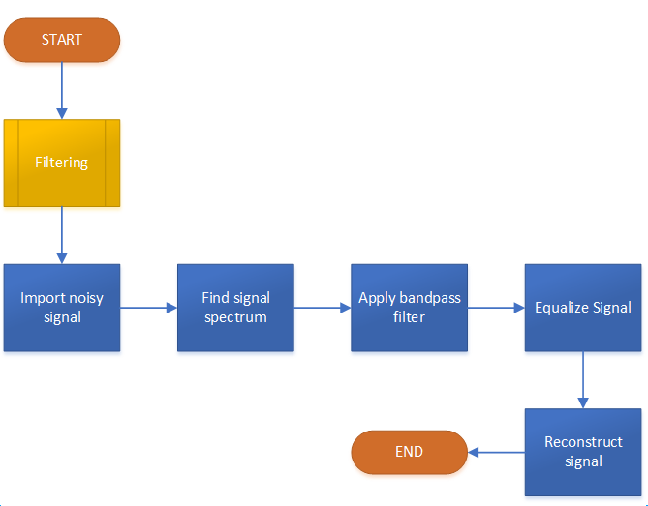

Slide 5
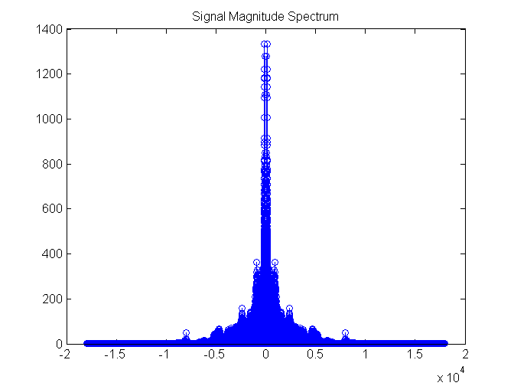
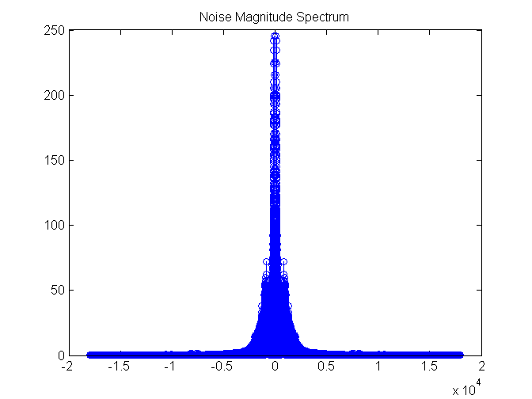
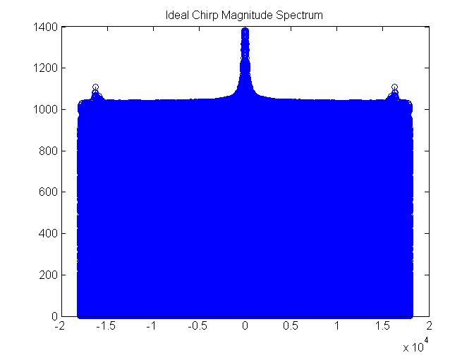
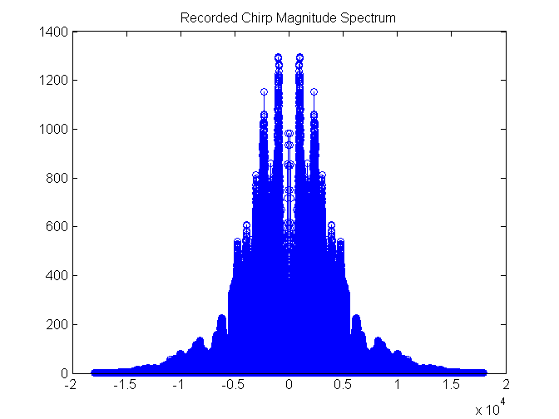

Slide 6

Outputs
Original Signal
Signal with noise
Filtered Signal

