Slide 1
―•―• •―― ――― ――― ―•― Continuous Wave On Off Keying
Aka: Morse Code

Slide 2
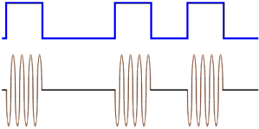
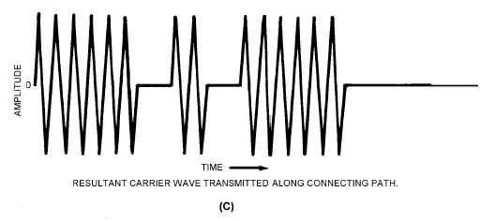
OOK: Protocol
The dahs, the dits, and the spaces in between sections of Morse code correspond to the presence of a carrier wave that falls into a very narrow bandwidth in terms of frequency.
Ideally constant frequency
Carrier wave is interrupted for switching
Picture credit: http://forum.allaboutcircuits.com/showthread.php?t=56421
Picture credit: http://electriciantraining.tpub.com/14184/css/14184_40.htm

Slide 3
System flowchart

Slide 4
Expansions and applications
The program could be further developed to filter…
Phase-shift keying
Frequency-shift keying
Amplitude-shift keying
Other non-CW radio filtering applications
Frequency modulated radio (FM)
Amplitude modulated radio (AM)
Picture credit: http://en.wikipedia.org/wiki/File:Amfm3-en-de.gif

