Slide 1
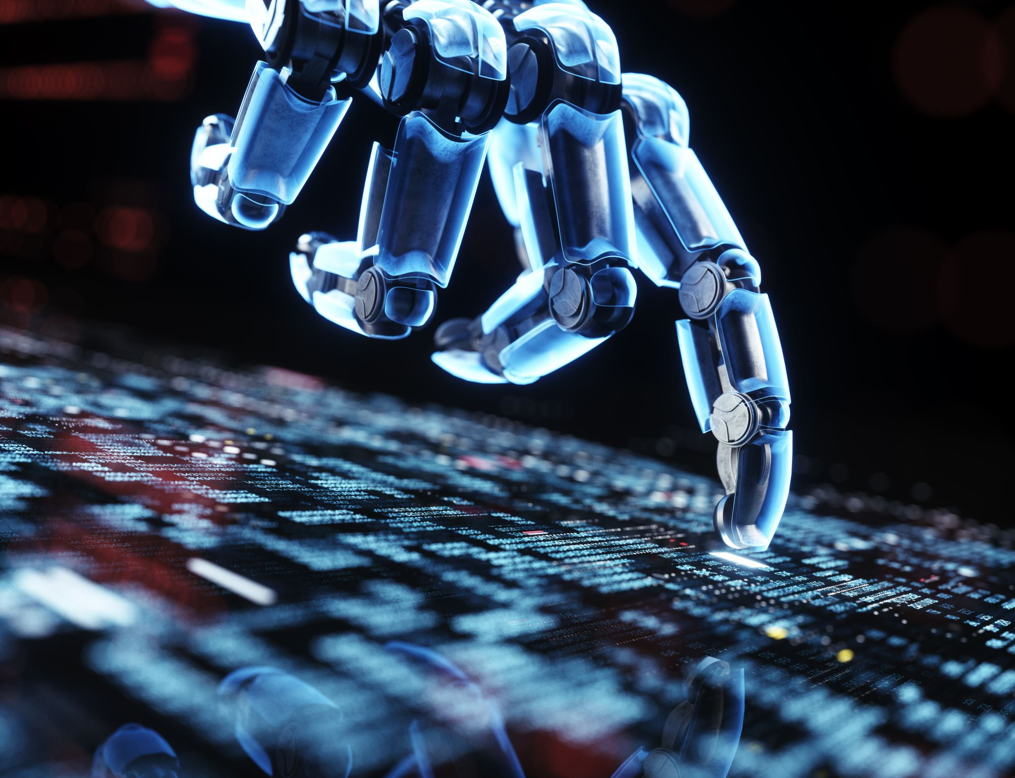
Tech Giants Face-Off: AI Companies vs. S&P 500 and Dow Jones
Presentation by: Nate S., Andrea M. Dante P., Sabrina L., Melissa G., and Krissy K.
Do AI stocks have higher daily or cumulative returns with lower risks?
Notes:
https://www.forbes.com/advisor/investing/best-ai-stocks/

Slide 2
Objective
This presentation provides a comparative analysis of daily and cumulative returns, as well as volatility (risks), of the top 10 AI companies' stocks with the S&P 500 and Dow Jones indices for the last 5 years.
Notes:
Presenter:

Slide 3
Hypothesis: Question, Null, & Alt
Question
Does the growth of AI stocks in the last 5 years suggest that investing in these companies is significantly more profitable than investing in most other companies based on the market indices?
If-Then
If I invest in the top AI companies, then I will see better profit compared to the market indices, because there is a significant difference in the growth of these stocks and the market indices.
Null Hypothesis
There is no significant difference between the growth of AI stocks and the market indices, as determined by average daily return year over year from 2019-2024, as compared to the S&P 500 or DOW.
Alt Hypothesis
There is a significant difference between the growth of AI stocks and the market indices as determined by average daily return year over year from 2019-2024, as compared to S&P 500 or DOW.
Notes:
Presenter:
Final measure ave daily return year over year

Slide 4
Data Description
Data Obtained
List what data sets are used and where we got them from
Top 10 AI companies kaggle dataset 1990 through present as selected by Forbes
S&P 500 and Dow Jones index ETF funds gathered through alphavantage.co API
Data Details
Datasets contained columns: Symbol, date, open, high, low, close, volume, adjusted
Derived Variables
Cleaning done on columns to align datasets, data types correction, and filtered for last 5 years
Daily returns and cumulative returns generated as decimal
Volatility calculated as standard deviation of returns
Data grouped by stock symbol and year
Notes:
The US stock market opens at 9:30 a.m. ET and closes at 4:00 p.m. ET (6:30 AM -1:00 PM), Monday through Friday
align datasets, match column names for later processing, match date formats, remove adjusted as it is only in some data. Dtype correction, some numbers were object type not numerics

Slide 5
Stock Performance Analysis
Daily Return=Closing Price YesterdayClosing Price Today−Closing Price Yesterday​
Analyzing stock performance involves multiple factors. In this project, we used a simplified approach based on parameters such as average stock prices, daily and cumulative returns, and volatility.
Basics:
Daily and Cumulative Returns: Indicators of a stock's performance over specific periods.
Volatility (Standard Deviation): Measures stock risk. Higher deviation indicates higher risk.
Risk Levels Based on Standard Deviation (STD):
Low risk: < 10% STD
Medium risk: 10% ≤ STD < 20%
High risk: ≥ 20% STD
Now, let's move on to the graphs that illustrate these concepts in the context of our analysis.
Notes:
Presenter:

Slide 6
Daily Return=Closing Price YesterdayClosing Price Today−Closing Price Yesterday​
This bar graph on the next slide shows an average cumulative return of each stock during 2019-2024.
It indicate that some AI companies outperformed S&P 500 and Dow Jones, while others under performed.

Slide 7
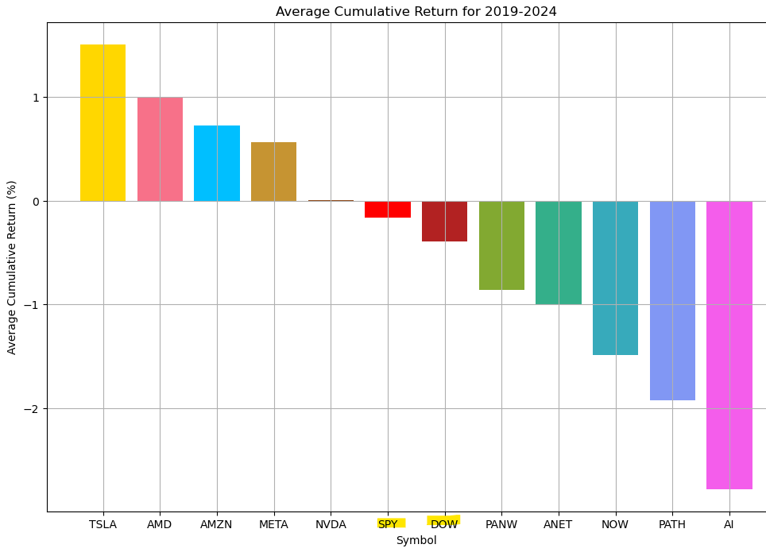
Daily Return=Closing Price YesterdayClosing Price Today−Closing Price Yesterday​

Slide 8
Daily Return=Closing Price YesterdayClosing Price Today−Closing Price Yesterday​
The graph on the next slide compares cumulative returns of S&P 500 and Dow Jones to the average of the analyzed AI companies.
It shows that on average, the stocks of AI companies did not overperformed S&P 500 and Dow Jones.
We will examine statistical testing in more details in the later slides.

Slide 9
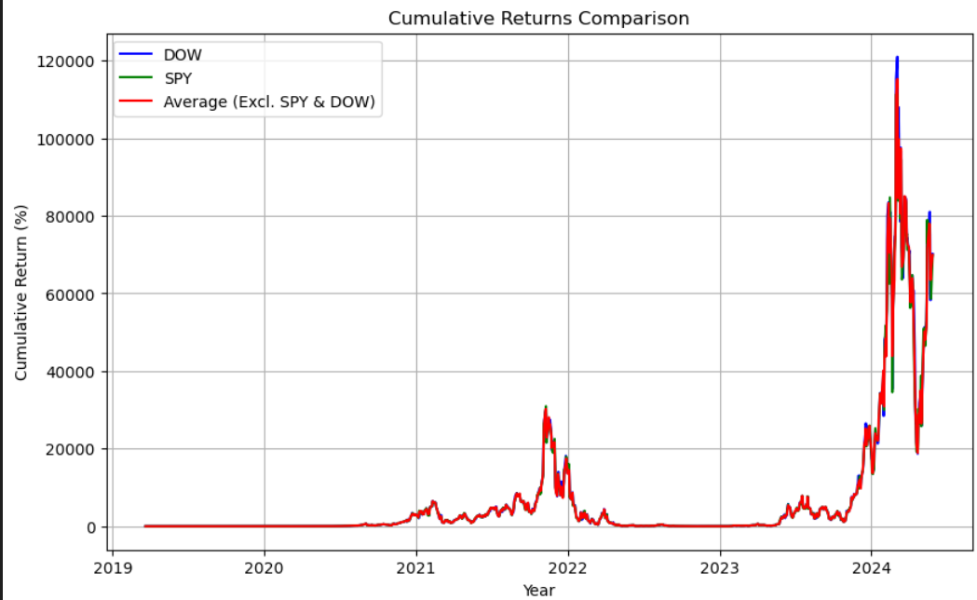
Daily Return=Closing Price YesterdayClosing Price Today−Closing Price Yesterday​

Slide 10
Daily Return=Closing Price YesterdayClosing Price Today−Closing Price Yesterday​
Next slide shows average daily returns for each company and indexes for each year.
They also show that AI stocks (with exception of a few companies) did not significantly outperformed S&P 500 and Dow Jones.
Notes:
AI stock in 2020 is an artefact of the IPO - initial public offering (going public)
https://www.forbes.com/sites/seanhanlon-1/2024/03/28/ai-is-coming-no-its-already-here/

Slide 11
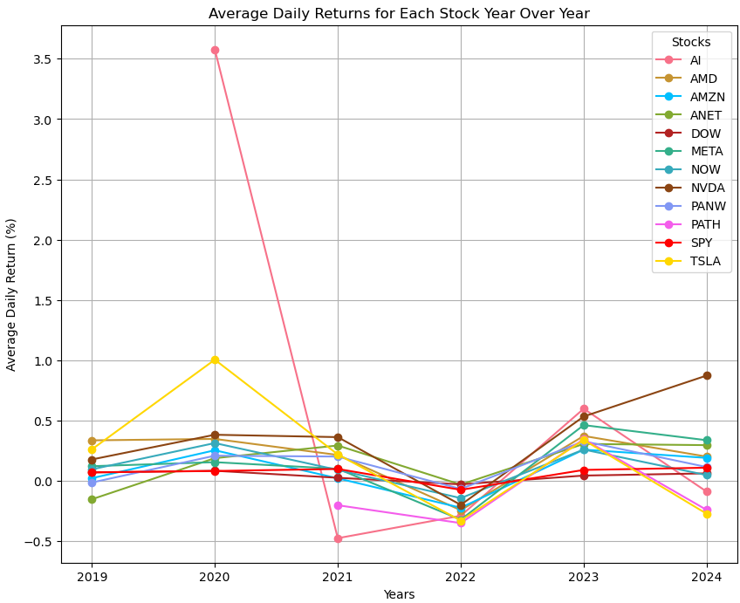
Daily Return=Closing Price YesterdayClosing Price Today−Closing Price Yesterday​
Notes:
AI stock in 2020 is an artefact of the IPO - initial public offering (going public)
https://www.forbes.com/sites/seanhanlon-1/2024/03/28/ai-is-coming-no-its-already-here/

Slide 12
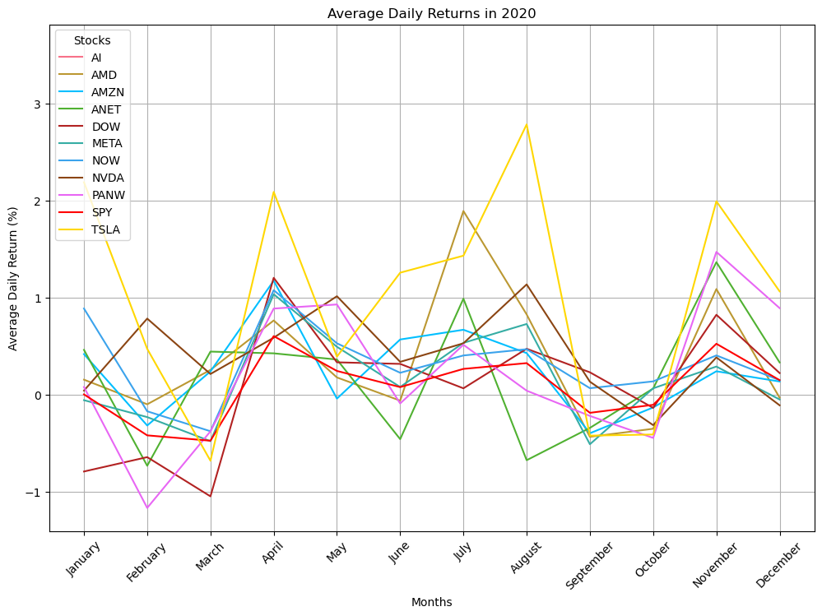
Daily Return=Closing Price YesterdayClosing Price Today−Closing Price Yesterday​
Covid Snapshot

Slide 13
Daily Return=Closing Price YesterdayClosing Price Today−Closing Price Yesterday​
This graph on the next slide shows average daily returns with different colors indicating volatility (standard deviation) in % (the highest volatile and 2 lowest volatile companies, compared to S&P 500 and Dow Jo9nes).
This finding suggests no statistically significant difference in overall risk between the AI companies and the S&P 500 and Dow Jones indices.
Our analysis revealed that AI and Tesla exhibited the highest volatility among the examined stocks. However, the remaining AI companies displayed relatively low risk with standard deviation measures falling below 10%.
Our dataset does not provide insights into the reasons behind the increased volatility observed in Tesla and AI stock prices. For a deeper analysis, we recommend examining the publicly available financial records during the relevant period. This should include changes in key financial metrics such as sales numbers or revenue. Additionally, a sentiment analysis of media coverage, focusing on the frequency and tone of negative articles, may offer further insights.

Slide 14
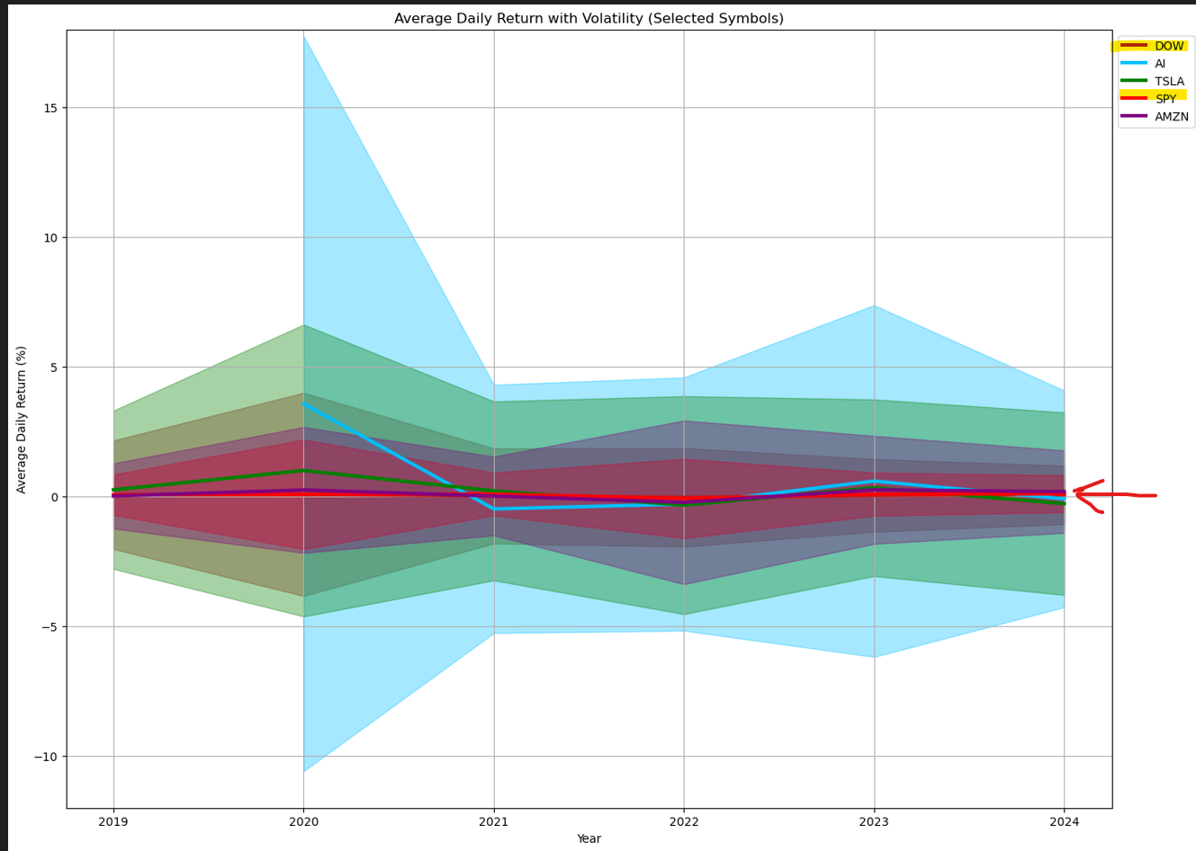
Daily Return=Closing Price YesterdayClosing Price Today−Closing Price Yesterday​

Slide 15
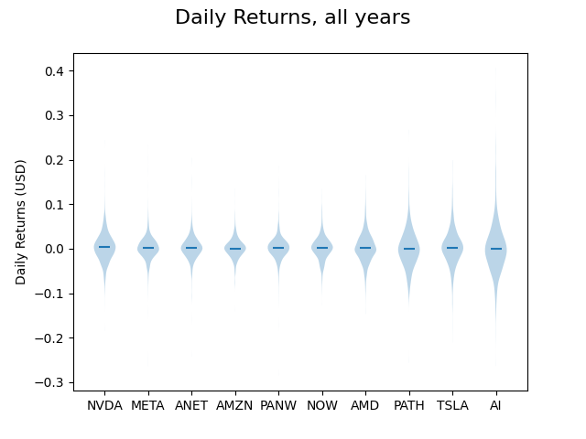
Daily Return=Closing Price YesterdayClosing Price Today−Closing Price Yesterday​
Statistical testing and visualization
At first glance, distributions looks similar
Statistical testing necessary to prove that
Extrema go to 0.42 in some cases

Slide 16
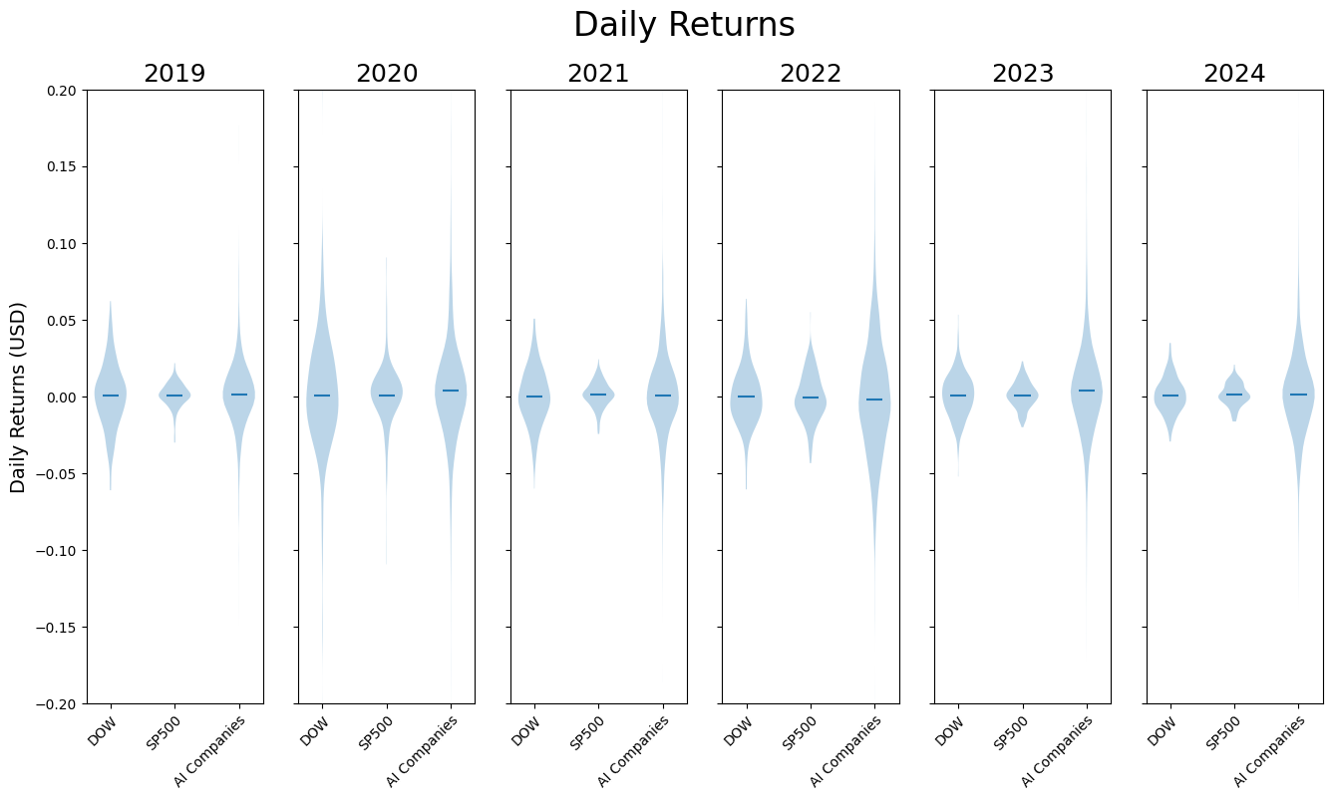
Daily Return=Closing Price YesterdayClosing Price Today−Closing Price Yesterday​

Slide 17
Statistical Test #1: Repeated Measures Anova
Daily Return=Closing Price YesterdayClosing Price Today−Closing Price Yesterday​
Repeated measures ANOVA is used to test the difference between means over time for multiple groups. We want to know whether there is a statistical difference in the average daily mean return between the top 10 AI companies and the indices from 2019 to 2024.
General Hypothesis H0: all means are equal ; Ha: at least one mean is different
1: Fail to reject the null hypothesis. There is not enough evidence to suggest al difference between AI aggregate performance and indices ETFs
2: Reject the null hypothesis. There is a significant difference in average daily returns per year across the top AI companies.
Hypotheses: | F-Statistic | Numerator DF | Denominator DF | P-Value
1. AI companies and indices | 2.6513 | 5 | 15 | 0.0655
2. AI companies only | 8.6322 | 5 | 35 | 0.0000
Notes:
1 critical val: 2.9 2. critical val: 2.5

Slide 18
Statistical Test #2: Post-hoc Pairwise T-Tests
Daily Return=Closing Price YesterdayClosing Price Today−Closing Price Yesterday​
Pairwise Post-hoc Tests | T-Test statistic | P-Value
AMZN & NVDA | -2.8266 | 0.0368
META & NVDA | -2.9126 | 0.0332
Post-hoc pairwise t-tests are performed after a significant ANOVA test to see which mean pairs are driving the differences found among the groups.
A Bonferroni adjustment is used to test for multiple comparisons, a necessary p-value adjustment when performing multiple tests.
The t-test pairs showing a significant mean between 2019-2024 are between NVDA and AMZN and then NVDA and META.
Notes:
Presenter:
eliminated AI and PATH as the datasets were not blanced. they did not go the whole 5 years.

Slide 19
Daily Return=Closing Price YesterdayClosing Price Today−Closing Price Yesterday​
This line graph on the next slide shows that the stock prices of most AI companies are below those of the S&P 500 (SPY symbol) and above those of the Dow Jones Industrial Average (DOW symbol).
The prices of AI companies appear to fluctuate more compared to the S&P 500 and the Dow Jones. This indicates that for conservative investors, AI companies may not be the safest investment option.
Notes:
Presenter:

Slide 20
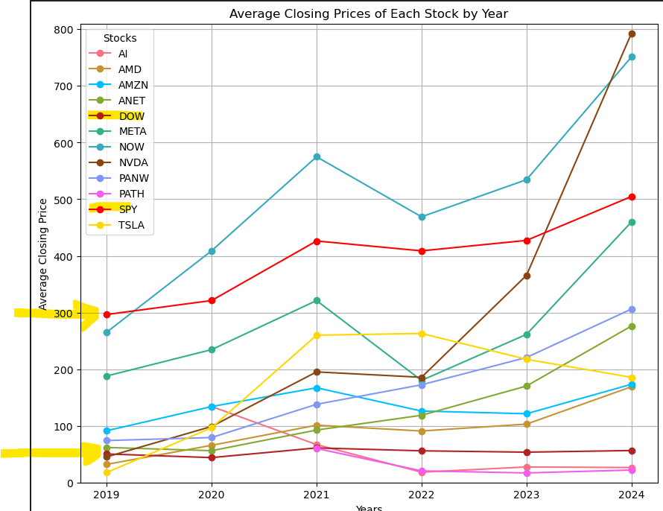
Daily Return=Closing Price YesterdayClosing Price Today−Closing Price Yesterday​
Notes:
Presenter:

Slide 21
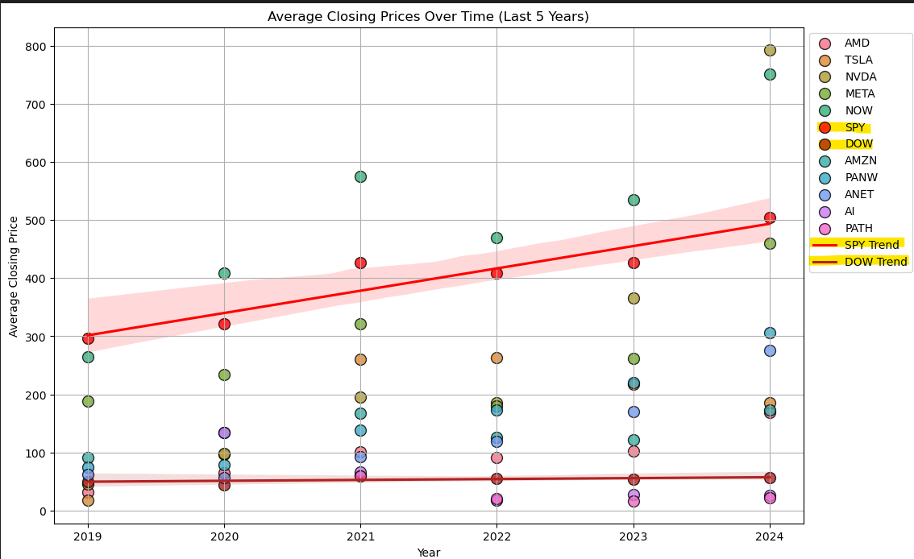
Daily Return=Closing Price YesterdayClosing Price Today−Closing Price Yesterday​
The previous slide showed a line graph; this slide presents a scatter plot of the same information:
Average closing price of each stock/index during 2019 - 2024
Notes:
Presenter:

Slide 22
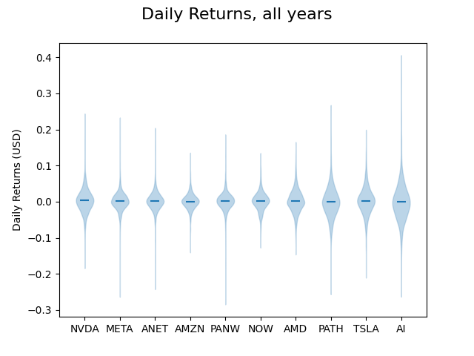
Daily Return=Closing Price YesterdayClosing Price Today−Closing Price Yesterday​
Outlined tails to display extrema clearly.
Violin plots do not highlight extreme values like box plots do

Slide 23
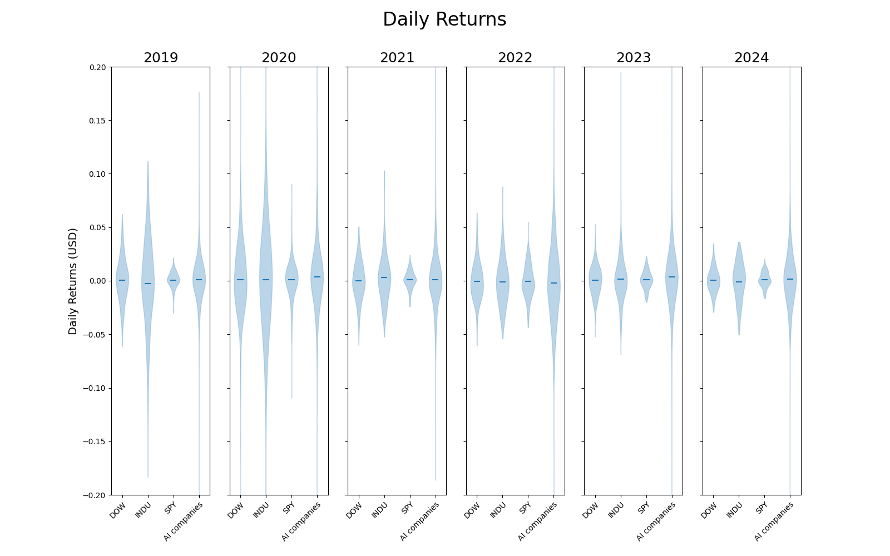
Daily Return=Closing Price YesterdayClosing Price Today−Closing Price Yesterday​
Outlined tailed

Slide 24
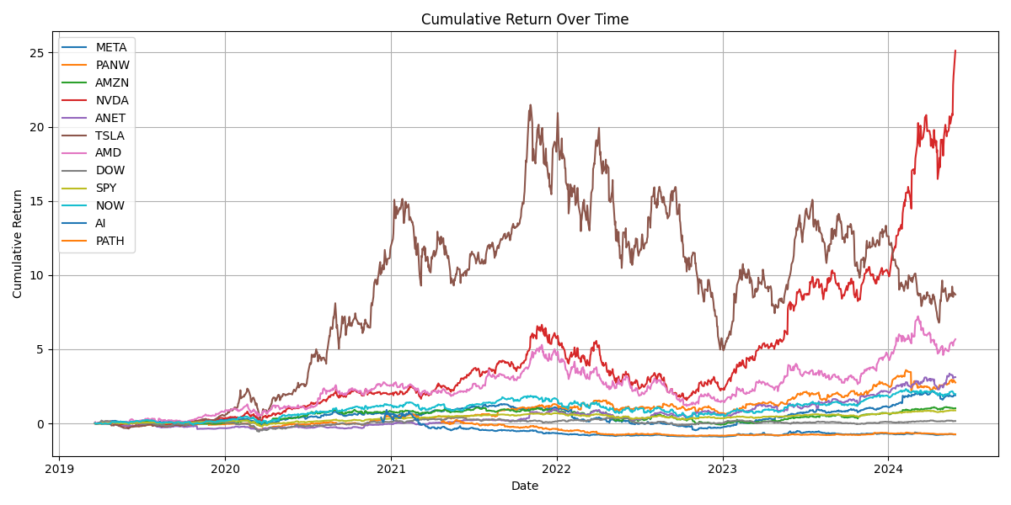
Daily Return=Closing Price YesterdayClosing Price Today−Closing Price Yesterday​
The graph suggests higher cumulative returns for AI companies.
We will examine statistical testing in more details in the later on.

Slide 25
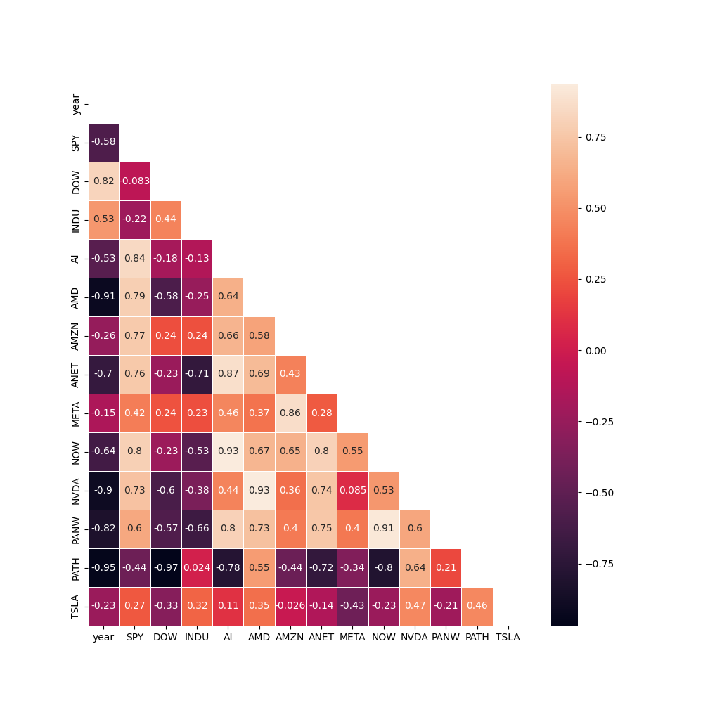
Daily Return=Closing Price YesterdayClosing Price Today−Closing Price Yesterday​
Correlation heatmap
Avg daily returns
by year
Indicates which stocks might be used as indicators for others
May indicate if stocks in the same industry have a major impact on others
Or if they are all equally subject to the same market pressures
Meta returns are largely independent of other stocks (except Amazon)
Nvidia, AMD, are greatly correlated, as expectly being largely GPU makers

Slide 26
Conclusion
Compare with Benchmark: Evaluate how each AI company's performance compares with the S&P 500.
Our analysis shows that while AI companies have strong returns and generally low volatility; they do not outperform or display lower risk than the S&P 500 and Dow Jones indices consistently.
Since any difference is largely statistically insignificant, we fail to reject our null hypothesis, indicating AI companies in general are not different from the indices. Specific companies like Nvidia may not adhere to this generalization.
Notes:
Presenter:

Slide 27
Data Limitations
The S&P 500 includes 8 of the 10 AI companies we are comparing.
Notably, some of the top 10 companies are not exclusively focused on AI products.
The dataset available for free is quite limited.
Our sample of 10 AI companies does not necessarily represent general AI market trends, but rather the stock performance of specific companies. Additionally, we aligned the timepoints between the Polygon API and the Kaggle dataset for consistent analysis.

Slide 28
Q&A
Compare with Benchmark: Evaluate how each AI company's performance compares with the S&P 500.

Slide 29
Thank you, all for listening and a special thank you to our team, for the great collaboration!
Andrea M.
Dante P.
Krissy Nalani K.
Melissa G.
Nate S.
Olga Sabrina L
T

Slide 30

The end.
Thank you for your interest!

