Slide 1
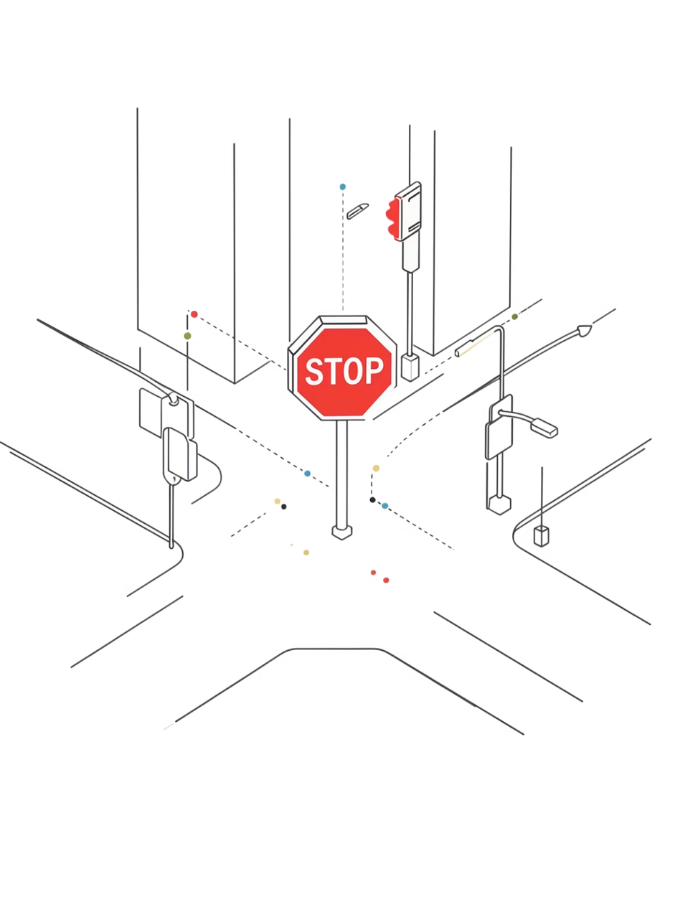

Stop Sign Detection Using HOG Features and a Linear SVM Classifier
Course: CSE445, Section 6 | Group: 08
Md Tanveer Hossain Nihal
2211935042
Chandrima Saha
2212561042
Wafa Alam
2211707042
Lamia Amin Tisha
2231198642

Slide 2
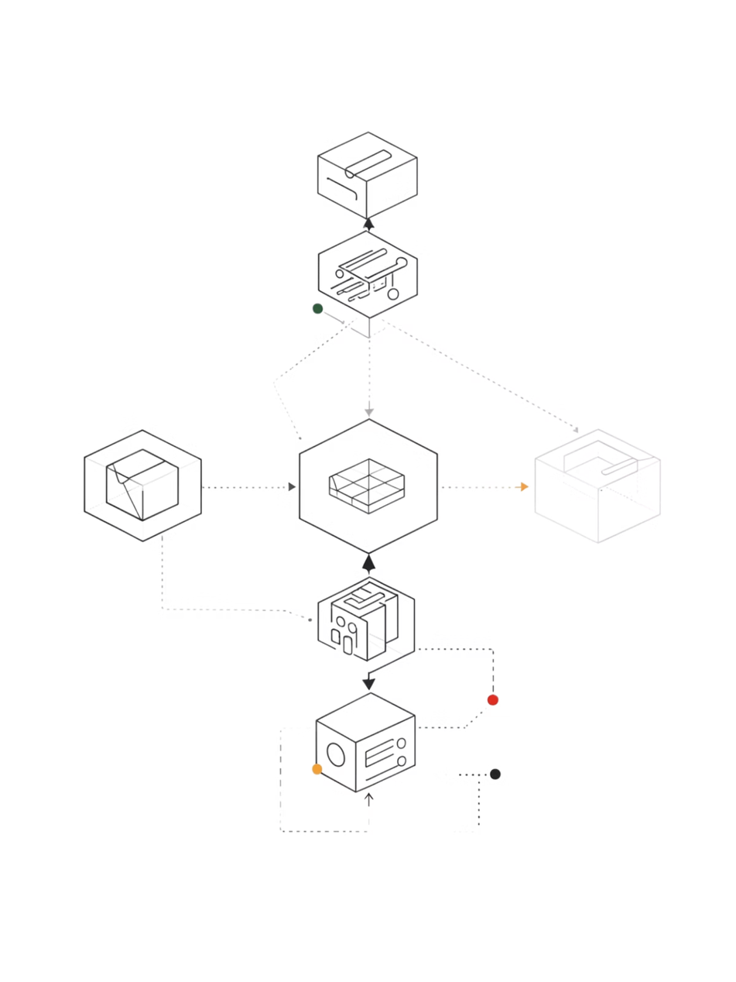


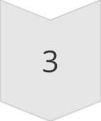
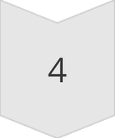
About the Project
A complete, end-to-end classical computer vision pipeline for detecting stop signs in still images. Built on four tightly coupled stages:
1. Data Preparation
Annotated positive sample extraction + random negative mining from a 50-image dataset
2. HOG Features
HOG feature extraction from fixed-size 64×64 patches
3. Linear SVM
Training a Linear SVM on 1764-dimensional feature vectors
4. Inference
Multi-scale inference via image pyramid + sliding window, followed by NMS
Implemented in Python using scikit-image and scikit-learn — no GPU required.

Slide 3

Motivation
Traffic sign recognition (TSR) is safety-critical in intelligent transportation and autonomous driving. A missed stop sign can cause accidents or life-threatening collisions.
Two broad approaches exist:
Classical (HOG + SVM)
Deep CNNs
Interpretable
Data-efficient
Deployable on embedded hardware
State-of-the-art accuracy
Require large datasets, GPUs, and complex pipelines
For small datasets and limited hardware, classical pipelines remain highly relevant and form the conceptual foundation for understanding modern deep detectors.

Slide 4
Project Goals
Accurate Classification
Multi-Scale Detection
CPU-Only Execution
Accurately classify stop-sign patches with minimal false positives/negatives
Detect stop signs at arbitrary scales (multi-scale detection)
Run entirely on CPU — no GPU required
Transparent Pipeline
Small Dataset
Maintain a transparent, interpretable pipeline with mathematical grounding
Train on a small dataset of only 50 images

Slide 5
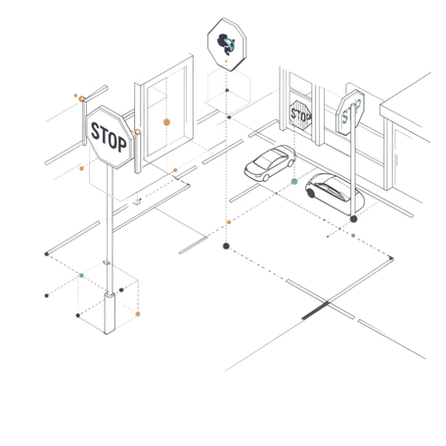
Dataset & Annotation
Data Collection
50 RGB street-view images with stop signs under varied conditions (lighting, viewpoints, occlusion, distances)
Annotated using CVAT (Computer Vision Annotation Tool) — bounding boxes exported as XML
Positive patches (y=1): Each annotated box cropped and resized to 64×64
Negative patches (y=0): Up to 15 random non-overlapping background windows per image → ~750 negatives
Class imbalance ~15:1 (negatives:positives) — intentional to mirror real sliding-window conditions
Parameter
Value
Total images
50
Patch size
64×64 px
Positive patches
~57
Negative patches
~750
Train / Test split
80% / 20% (stratified)

Slide 6

HOG Feature Extraction
HOG represents local shape by the distribution of gradient orientations in localized image regions.
Gradient
9‑Bin Histogram
L2‑Hys Normalize
Square‑Root
The four steps above transform raw pixel patches into a compact, illumination-robust descriptor optimized for object detection.
Parameter
Value
Input patch size
64×64 px (grayscale)
Orientations
9
Pixels per cell
8×8
Cells per block
2×2
Block normalization
L2-Hys
Feature vector length
1764 dimensions

Slide 7
SVM Classifier
A LinearSVC finds the maximum-margin hyperplane separating stop signs from backgrounds.
Why Linear Kernel?
Training Details
HOG features are approximately linearly separable (confirmed by Dalal & Triggs)
Faster training — linear vs. quadratic/cubic for kernel SVMs
Weight vector w is spatially interpretable (visualizable HOG template)
C = 1.0 (default regularization)
max_iter = 10000
Stratified 80/20 train/test split (random_state=42)
Training set: 645 samples | Test set: 162 samples
Model saved via joblib → stop_sign_svm.pkl

Slide 8
Detection Pipeline
Image Pyramid + Sliding Window + NMS
Image Pyramid
Sliding Window
Non-Maximum Suppression
Test image repeatedly downscaled by factor 1.25 until smaller than 64×64. Detections scaled back to original coordinates.
64×64 window sweeps the image with step size = 16 pixels. HOG extracted at every position → SVM score computed.
Greedy algorithm sorts candidates by score, suppresses overlapping boxes with IoU > 0.3, retains one final bounding box per detection.
Parameter
Value
Window size
64×64 px
Step size
16 px
Scale factor
1.25
Confidence threshold
0.0
NMS IoU threshold
0.3

Slide 9

Experimental Results
Classification Report (20% Test Split)
Class
Precision
Recall
F1
Support
Background (0)
0.99
1.00
0.99
151
Stop Sign (1)
1.00
0.82
0.90
11
Overall Accuracy
98.77%
—
—
—
Inference Time (CPU)
Resolution
Windows
Pyramid Levels
Time
320×240
~1,200
4
~2s
640×480
~4,800
5
~8s
1280×720
~14,000
6
~25s
Qualitative result: 1 stop sign correctly detected and localized in unseen test image after NMS.

Slide 10
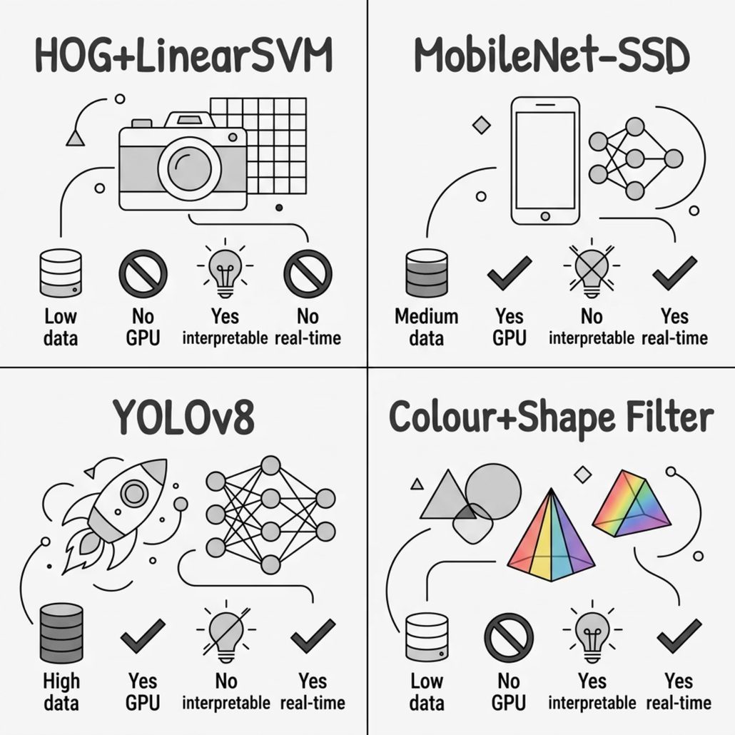

Comparison with Alternative Approaches
Our approach is the only option requiring no GPU, no large dataset, while remaining fully interpretable — ideal for embedded/resource-constrained environments.

Slide 11
Implementation Challenges
Annotation parsing: CVAT stores coordinates as float strings → must use int(float(value)) not int(value)
Negative mining: Rejection loop capped at 100 attempts per image to avoid infinite loops when stop sign fills the frame
HOG parameter consistency: Training and inference MUST use identical HOG parameters — solved by a single shared compute_hog() function
Pyramid boundary conditions: Scaled image may become smaller than 64×64 — both height AND width must be checked independently
Score display: SVM decision_function returns raw margin distances, not calibrated probabilities — displayed as score/100 for readability only
Memory management: ~800 patches × 1764 dims ≈ 11 MB (feasible); but 1000+ images would require incremental learning with SGDClassifier.partial_fit()

Slide 12
Strengths & Limitations
Strengths:
Trains on only 50 images — extreme data efficiency
Fully interpretable — SVM weight vector visualizable as HOG image
Runs on standard CPU — no GPU needed
Deterministic — consistent results across runs
Limitations:
Slow inference — ~8s for 640×480 on CPU (not real-time)
No colour information — discards the distinctive red hue of stop signs
Scale sensitivity — fixed scale factor may miss signs between pyramid levels
Occlusion sensitivity — heavy occlusion significantly degrades HOG descriptors

Slide 13
Future Work
Hard negative mining — iteratively add false positives from unannotated images to the training set
Colour pre-filtering — HSV red-channel thresholding to reduce sliding window search space by ~90%
Integral HOG — precompute cumulative histograms for O(1) window evaluation → enables real-time inference
Data augmentation — random rotations (±15°), flips, brightness jitter, Gaussian noise
Transfer learning — CNN backbone (e.g., ResNet-50) features + linear SVM for deeper representations

Slide 14
Conclusion
Delivered a complete, end-to-end classical CV pipeline for stop sign detection
HOG + LinearSVM achieved 98.77% accuracy on only 50 training images
Successfully localised stop signs in unseen test images using image pyramid + NMS
Documented 6 real implementation challenges with concrete solutions
Pipeline is modular, reproducible, CPU-only, and fully interpretable
Serves as a strong baseline and pedagogical reference against deep learning detectors

Slide 15
Thank You!

