Slide 1
GEOMETRY & TRIGONOMETRY
Notes:
Follow “Targeted Group Practice Instructions” guidance here.

Slide 2
FOCUS SKILL #4
CIRCLES
Notes:
Follow “Targeted Group Practice Instructions” guidance here.

Slide 3
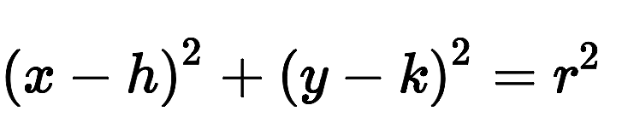
TIPS FOR THIS TYPE OF QUESTION
π radians = 180°
The equation of a circle is:
x = x-coordinate
y = y-coordinate
r = radius
Notes:
Follow “Targeted Group Practice Instructions” guidance here.

Slide 4
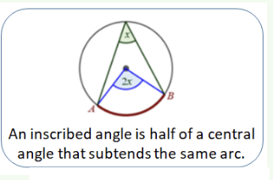
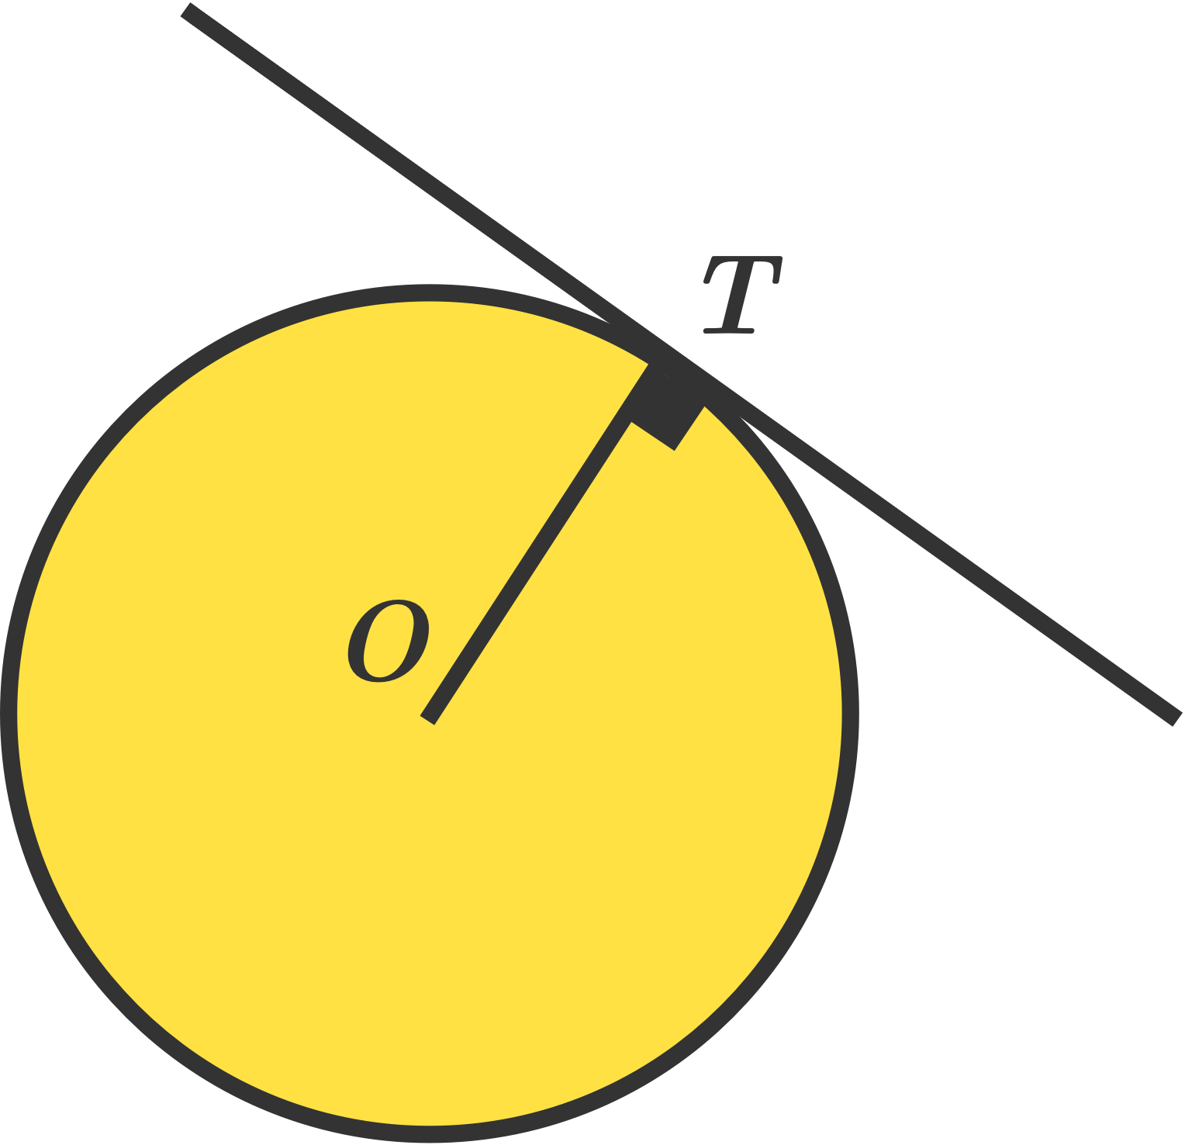
Tangent lines are perpendicular.
TIPS FOR THIS TYPE OF QUESTION
Notes:
Follow “Targeted Group Practice Instructions” guidance here.

