Slide 1
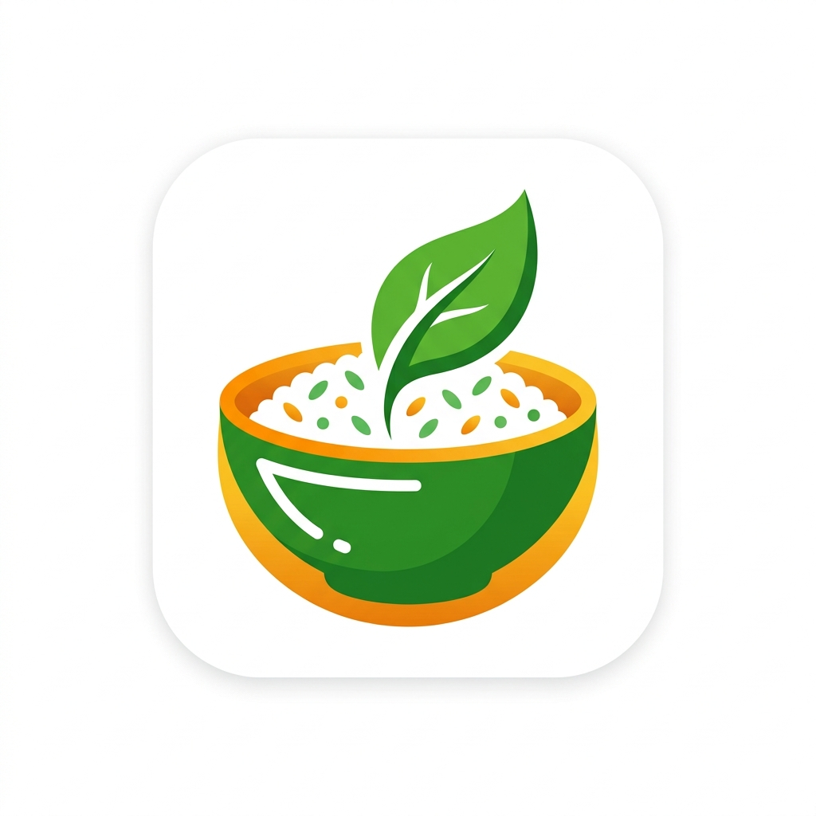
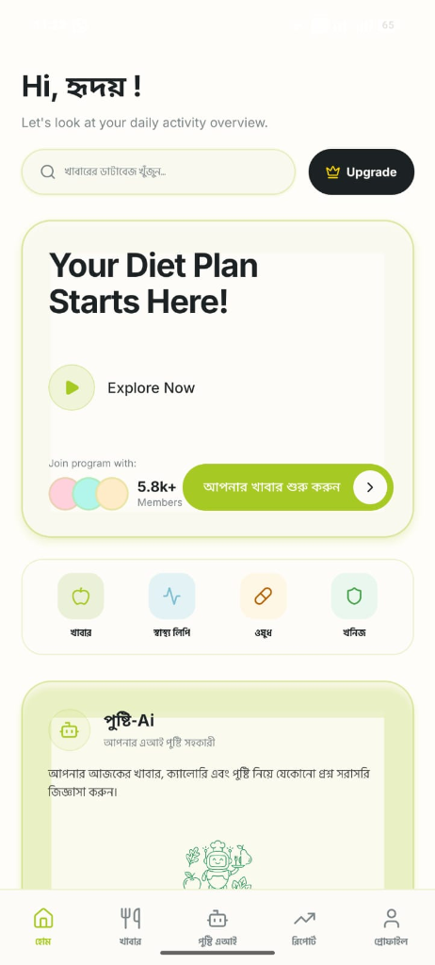

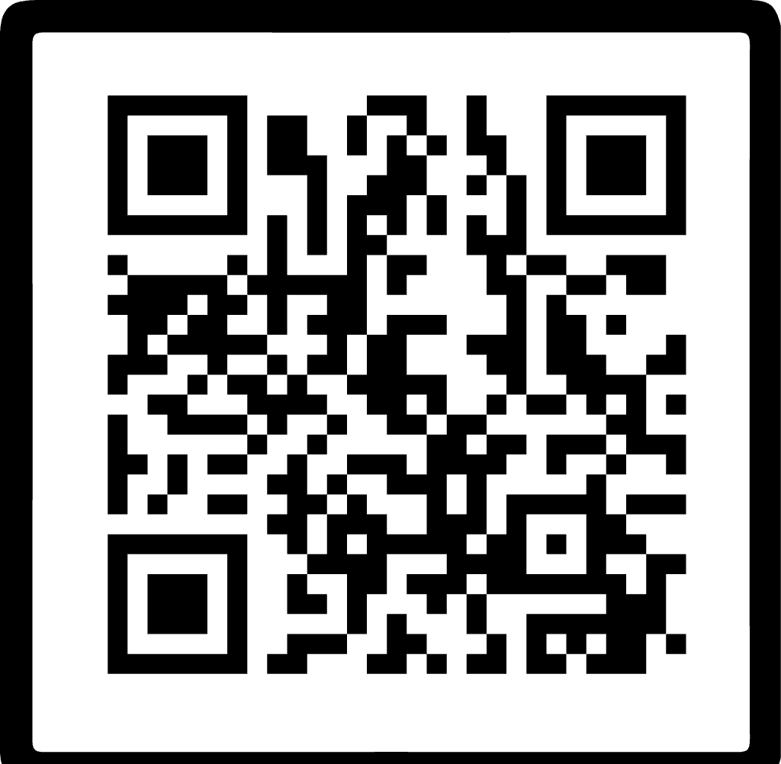
Desi-Diet AI
AI NUTRITION FOR BANGLADESH
Let’s Make a Healthy Bangladesh
Personalized meal plans and nutrition guidance built around Bangladeshi food and your health profile.
START FREE
WEBSITE
Scan and begin
Full dashboard and AI chat
MOBILE
Your plan works across the website, mobile and WhatsApp.
Meal plan and daily tracking
WHATSAPP
SCAN ME
Ask questions from your chat
desi-diet.vercel.app
Personalized nutrition, wherever you are
Notes:
Website supplied by the user: https://desi-diet.vercel.app/. All interface images, logo artwork, Pusti AI illustration, and QR code were supplied by the user.

Slide 2
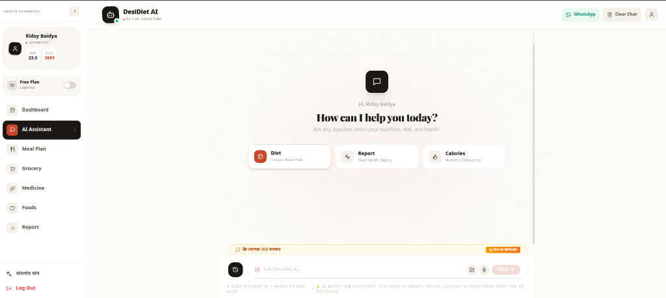
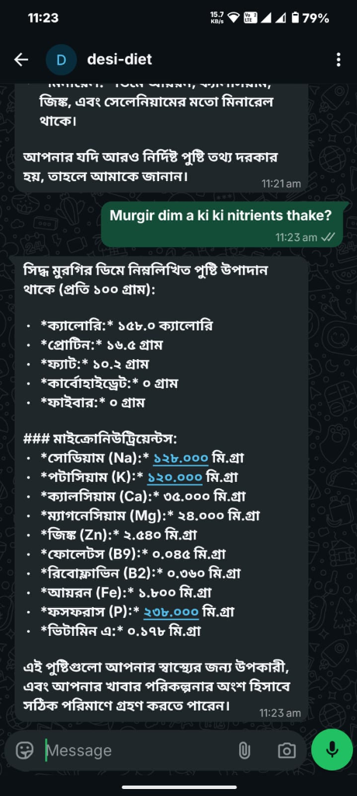
Why Desi-Diet
feels different
Nutrition guidance shaped for Bangladeshi meals, language and health needs.
Web assistant
WhatsApp access
600+
LOCAL FOODS
Plans use familiar Bangladeshi meals and portions instead of generic foreign menus.
70+
HEALTH CONDITIONS
Recommendations adapt to your profile, goals and selected health needs.
NDG 2025, FCT, WHO
TRUSTED REFERENCES
Guidance draws on Bangladeshi food composition data, plus WHO and ICMR references.
3 WAYS
EASY ACCESS
Use one nutrition companion on the website, from mobile, or through WhatsApp.
READY TO START?
PHONE
EMAIL
desi-diet.vercel.app
01762489345
tanzimp6@gmail.com
General nutrition guidance only. For medical decisions, consult a qualified health professional.
Notes:
Product positioning and feature claims are based on the user-supplied Desi-Diet screenshots and the project README: https://github.com/LegendaryBeast/desi-diet-AI. The README describes personalized meal planning, bilingual access, mobile web access, WhatsApp integration, Bangladeshi food data, NDG 2025, and health tracking features.

