Slide 1

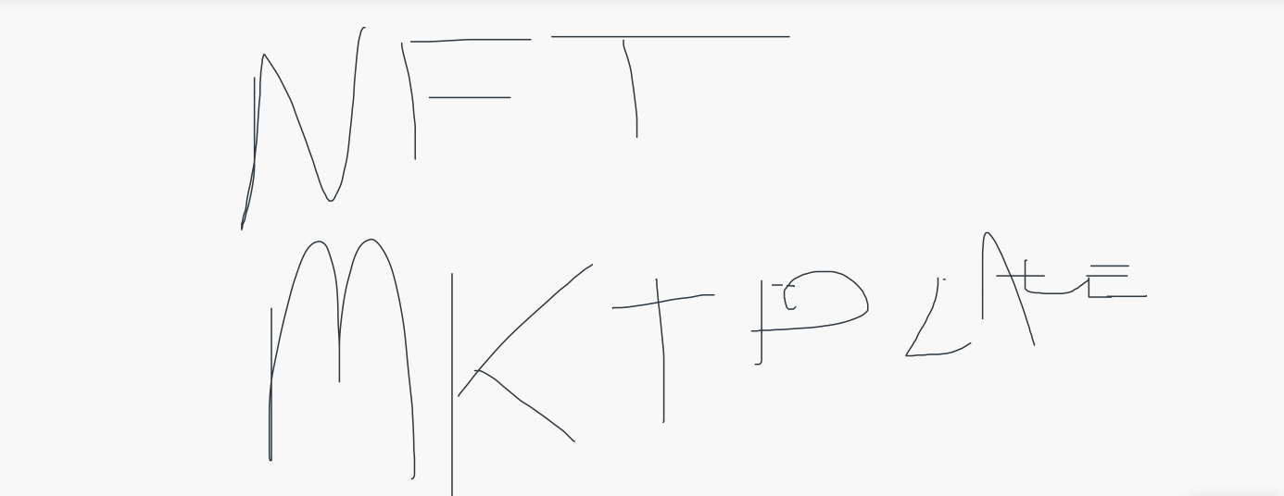
TEAM MEMBERS:
Kelvin le
Juan bohorquez
Ethan Rosenberg
Jaime villafuerte

Slide 2
Intro:
An examination of NFTs in the current Fintech world.
Technology used to develop our NFT Market token development.
An exploration of our NFT Market token.
Results and conclusions

Slide 3
NFTs in Fintech
It is no surprise that In the world of Financial Technology (Fintech) new tech is developed to improve and automate the delivery and use of financial services. With it comes new development of currency, cryptocurrency, designed to act as money a form of payment removing the need for third-party involvement.
The popularity of non-fungible tokens (NFTs) has skyrocketed since 2017 and evolved into one of the most favored concepts in the blockchain ecosystem.
In 2020 the NFT market achieved a sensational value worth of $2.5 billion.

Slide 4
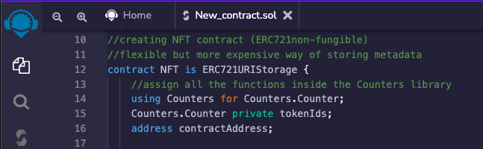
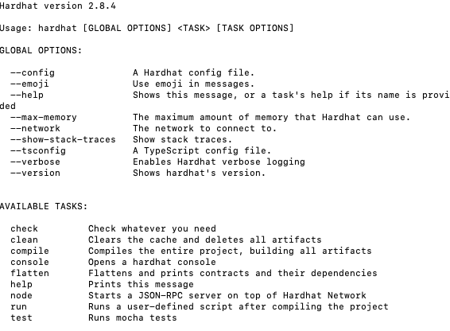
We used Remix IDE an open-source web. Mainly used for the development of contracts with Solidity while using Ethereum enabling smart contracts and applications built on its blockchain.
The snippet code shows the development of contract NFT using ERC721Storage while using Counters library to store further functions.
We also used the Hardhat environment to test, compile, deploy and debug our dApp based on the Ethereum blockchain.

