Slide 1
Car Price Prediction Project
The price of a car depends on a lot of factors like the goodwill of the brand of the car, features of the car, horsepower and the mileage it gives and many more. Car price prediction is one of the major research areas in machine learning.

Slide 2
Findings
Car age (derived from manufacturing year) negatively correlates with price.
Present price (ex-showroom price) has the highest positive impact on the selling price.
Manual transmissions and diesel engines tend to retain value better.
More driven kilometers decrease the car’s resale value.
Individual sellers generally price lower than dealers.

Slide 3
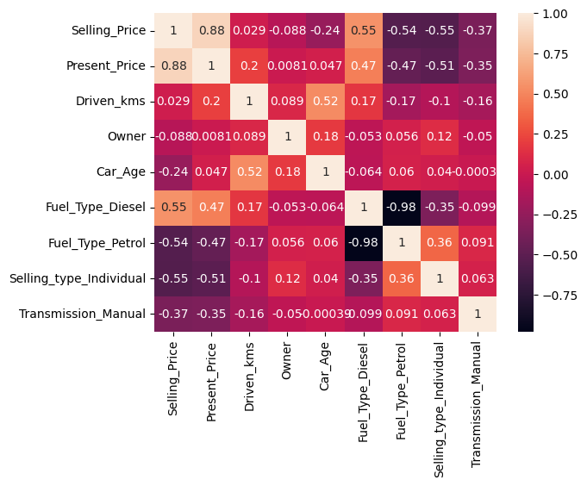
Correlation Map

Slide 4
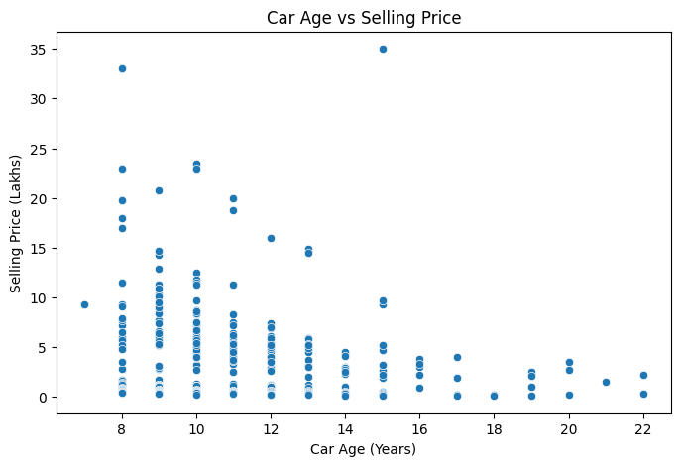
Car Age vs Selling Price

Slide 5
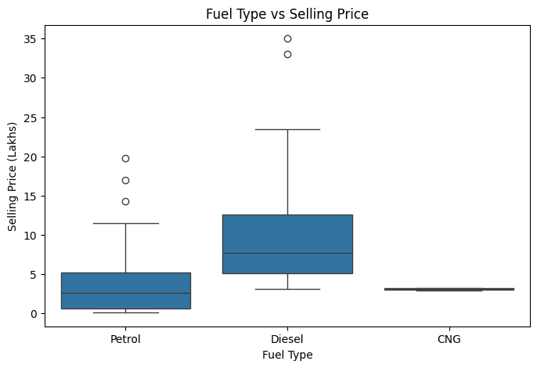
Fuel Type vs Selling Price

Slide 6
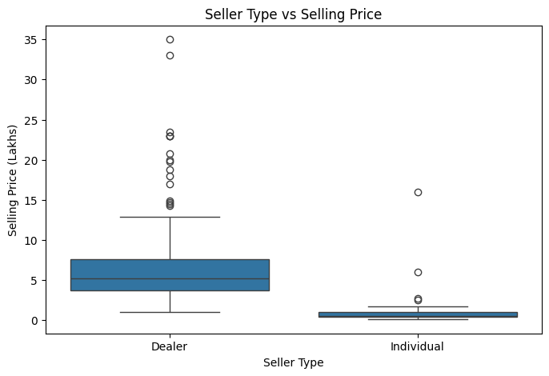
Seller Type vs Selling Price

Slide 7
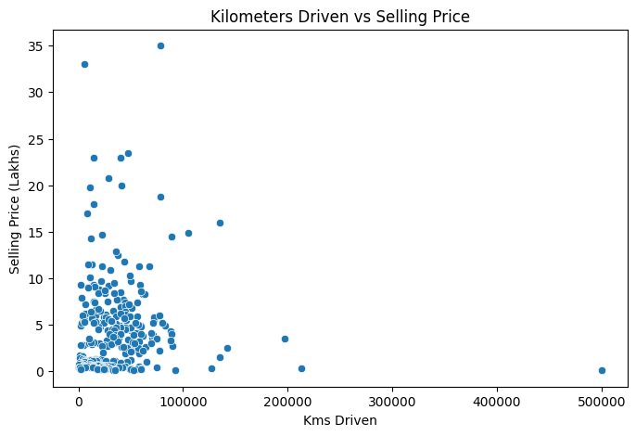
Kilometers Driven vs Selling Price

Slide 8
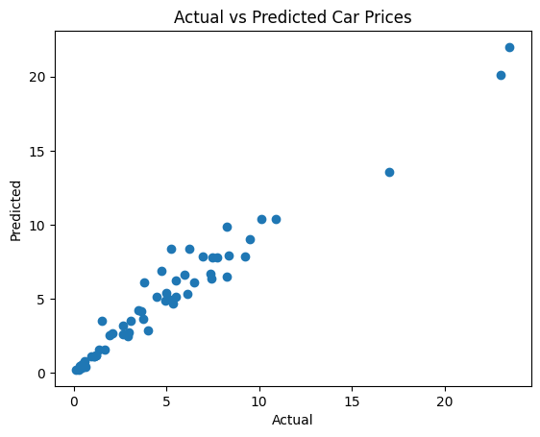
Actual vs Predicted Car Prices

Slide 9
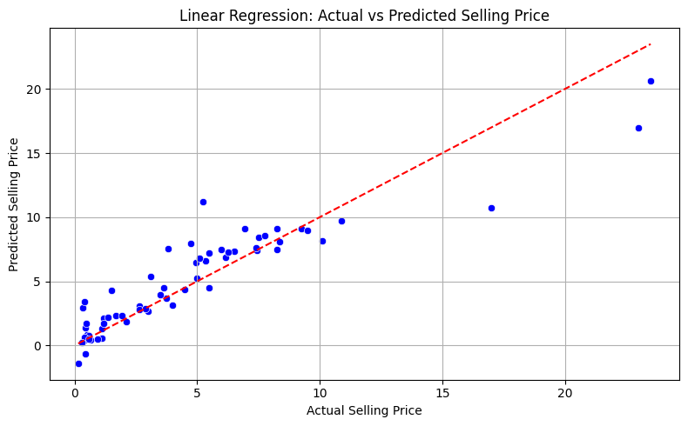
LR: Actual vs Predicted SP

Slide 10
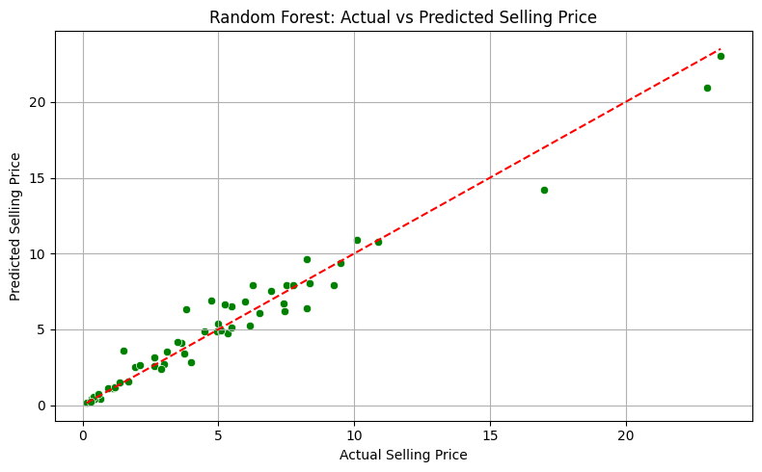
Random Forest: Actual vs Predicted SP

Slide 11
Model Performance
A Linear Regression model was used to predict car selling prices.
R² Score (Train): ~0.91
R² Score (Test): ~0.85
The model performs reasonably well, capturing key relationships among features.

Slide 12
Feature Importance
Present_Price - Strongest positive impact on selling price.
Car_Age - Older cars are priced lower.
Driven_kms - More usage lowers price.
Fuel_Type_Diesel - Diesel cars generally have higher resale value.
Transmission_Manual - Manual cars are slightly more common and lower priced.

Slide 13
Future Recommendations
Include features such as horsepower, mileage per liter, or accident history.
Collect and incorporate brand reputation scores from external sources.
Use ensemble or non-linear models for better accuracy.
Update the dataset periodically with new car models and pricing trends.
Consider deploying the model using a web interface for real-time predictions.

