Slide 1
Databases and Information Systems
Video Games releases &
Movie Adaption
Emma Fowler (mtf885)
Boris Pahota (mpb814)
Tobias Legenden (jkw333)

Slide 2
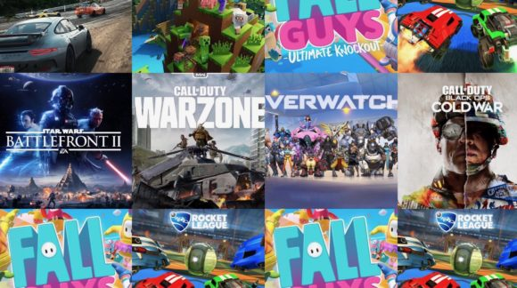
The project
Dataset for found on Kaggle.
Union of two seperate datasets
Video games release from 1983- 2023.
Video games movie adaption.
Interactive app to create SQL queries.

Slide 3
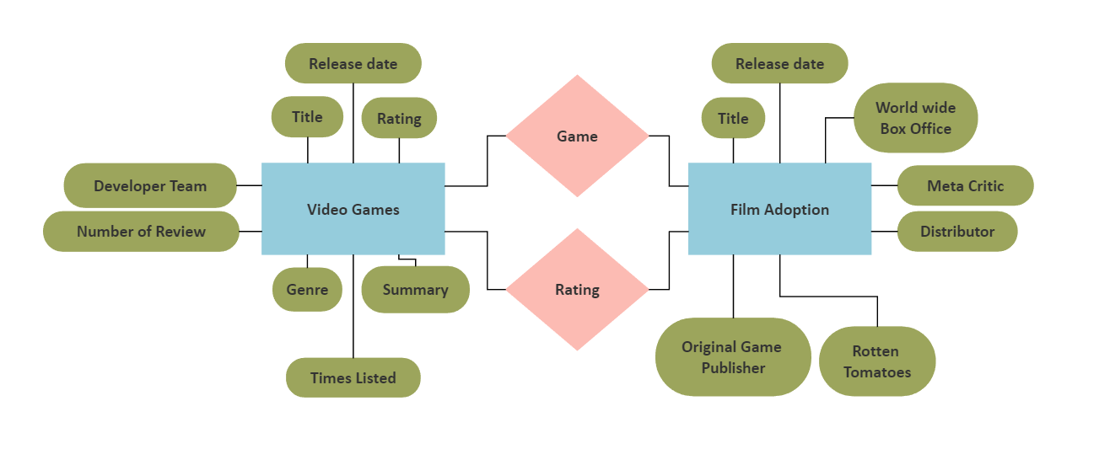
E/R diagram

Slide 4
Application dependencies
Flask: Flask_login
SQL package: psycopg2

