Slide 1

Grey Box associated State Space

Slide 2
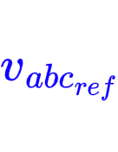







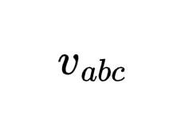
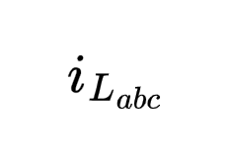
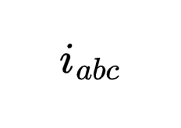
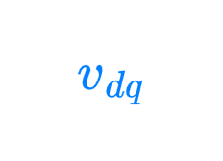
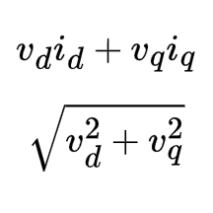



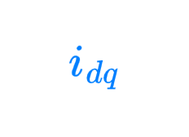

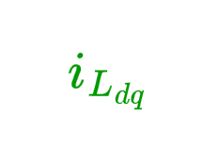

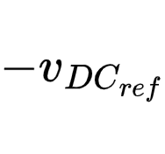

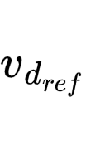
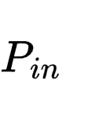





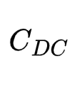
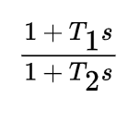









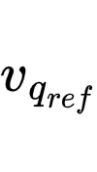
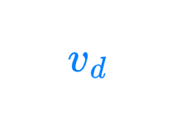

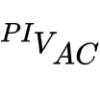


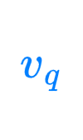




Original EMT model

Slide 3
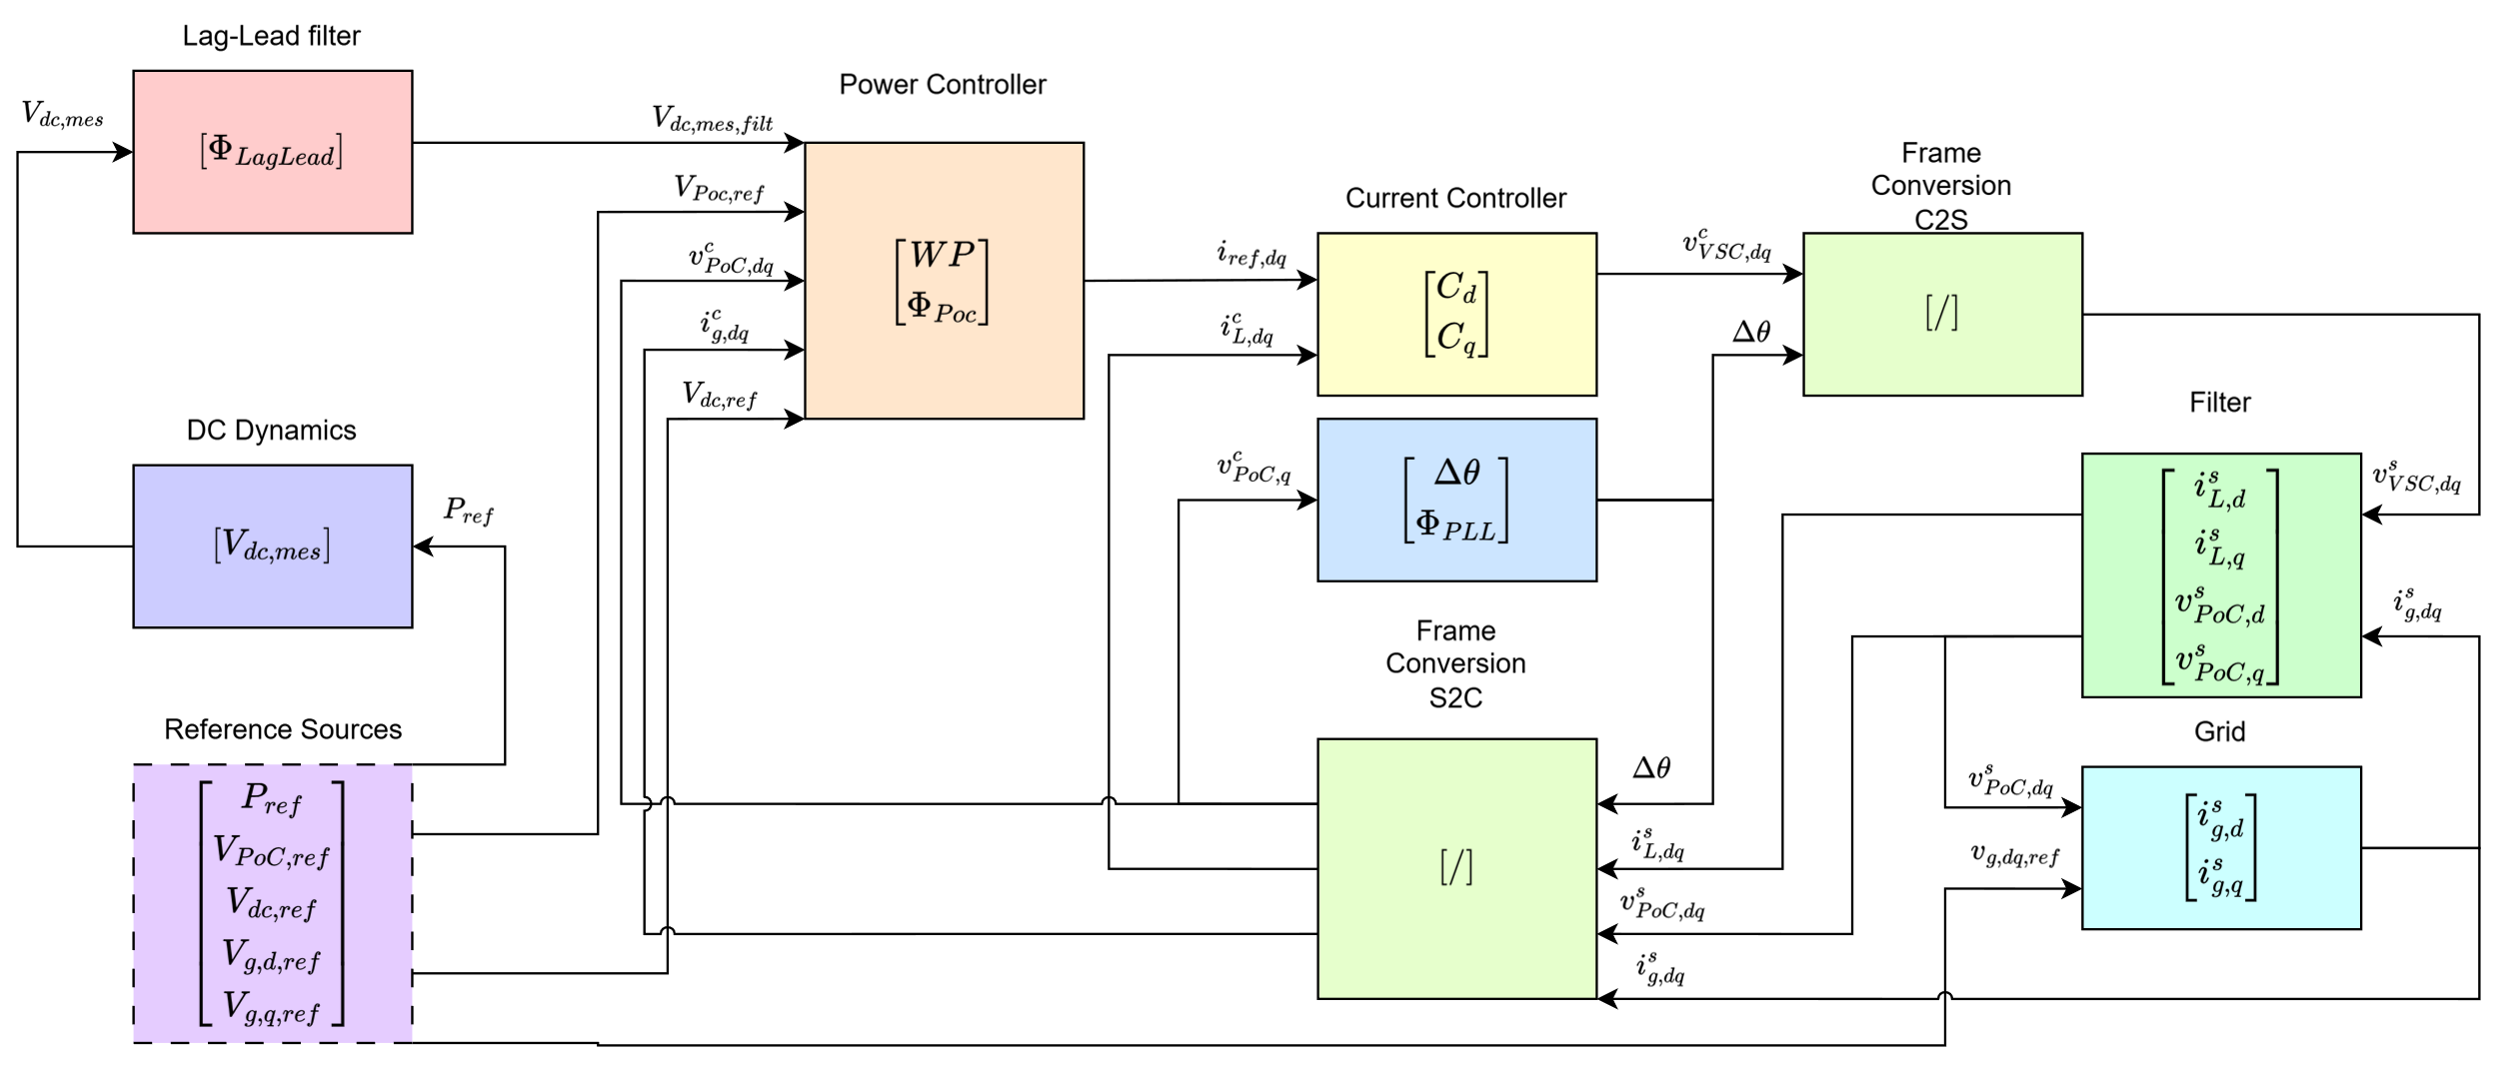
Composition

Slide 4






Validation Process
Select reference signals (e.g. Pref = 0.5 pu)
1
Run EMT and reach steady state condition
2
Extract: states and designated variables at steady state
3
Substitute initial condition in the Symbolic Linearized State Space Elements
4
Connect the state space elements
5
Compare the EMT small signal response with the State-Space one
6

Slide 5
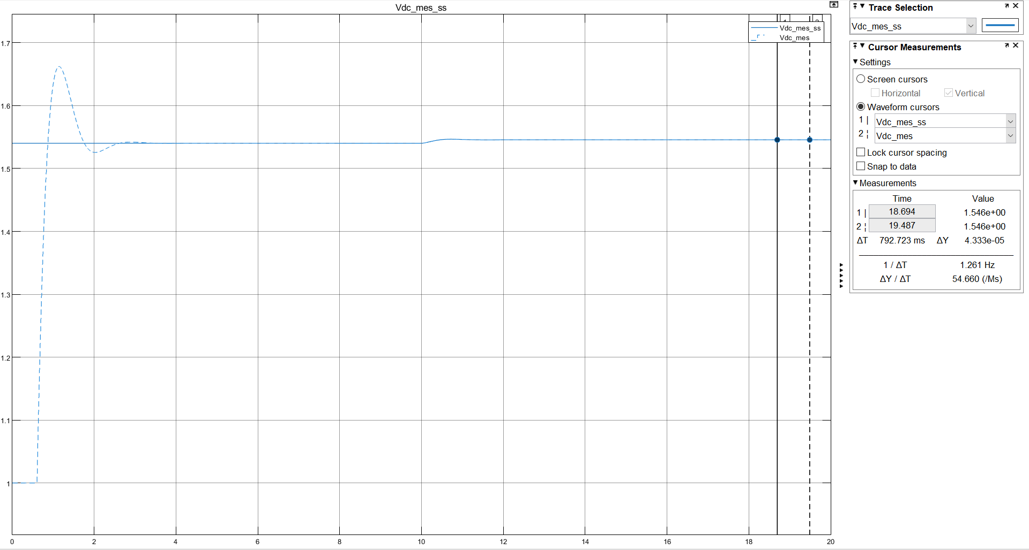
Transient description (for next slides)
Transient where the EMT model (dashed line) must reach the state-space’s (continuous line) initial condition
Application at t=10s of the same reference step on the EMT and SS. This is the principal transient area
Steady state area where it is measured the absolute error between the EMT and SS

Slide 6
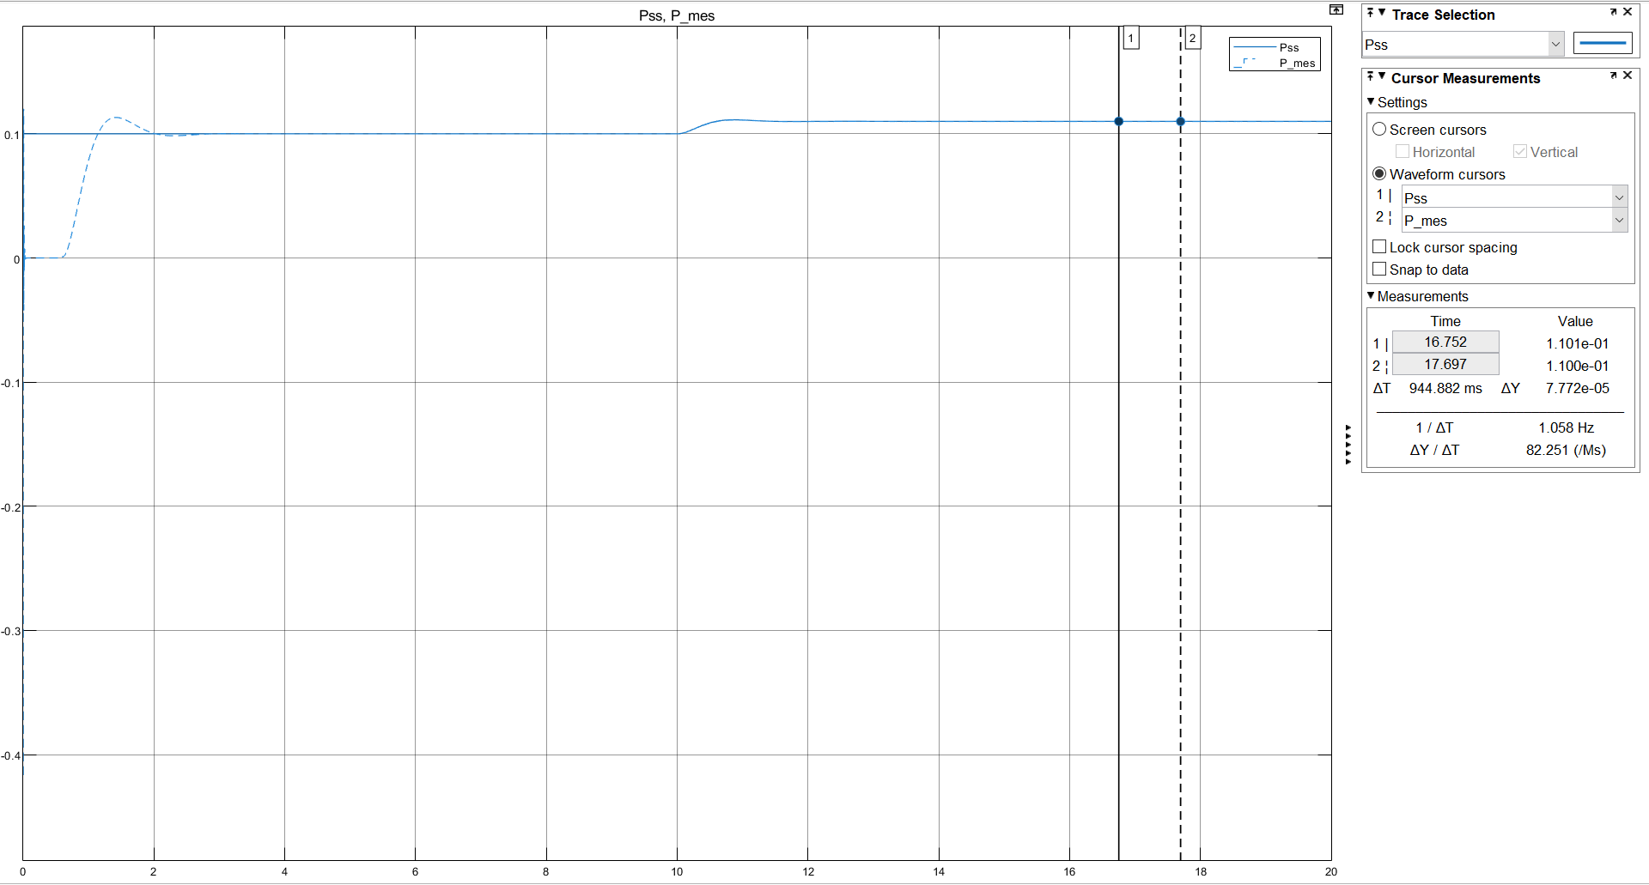
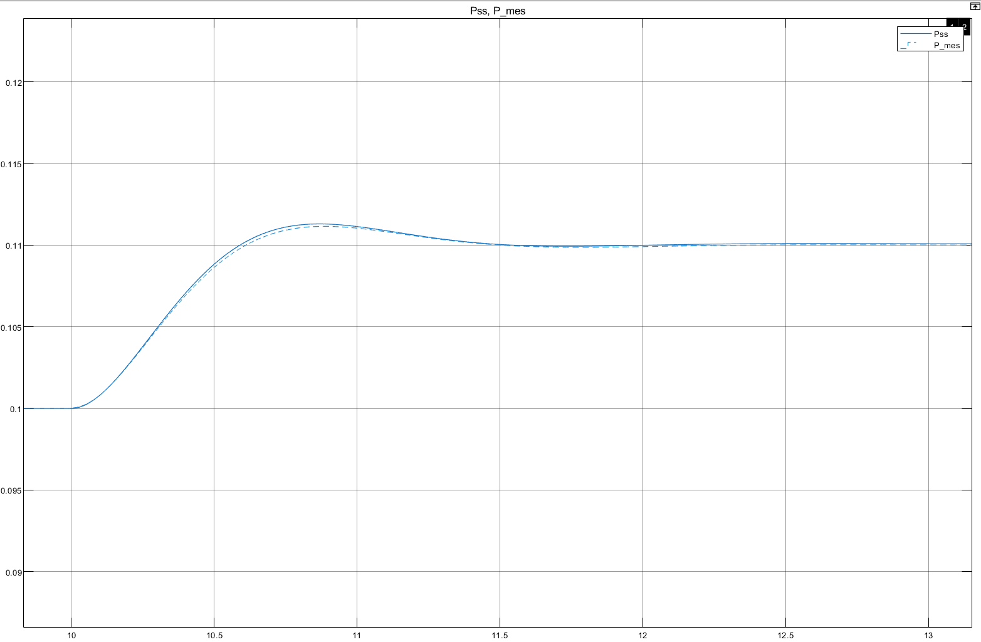


Results Active Power
$${E_{r}}_{\%}=0.07\%$$
$$P_{0}=0.1 pu \\ ΔP=0.01 pu \\ (Power step)$$

Slide 7
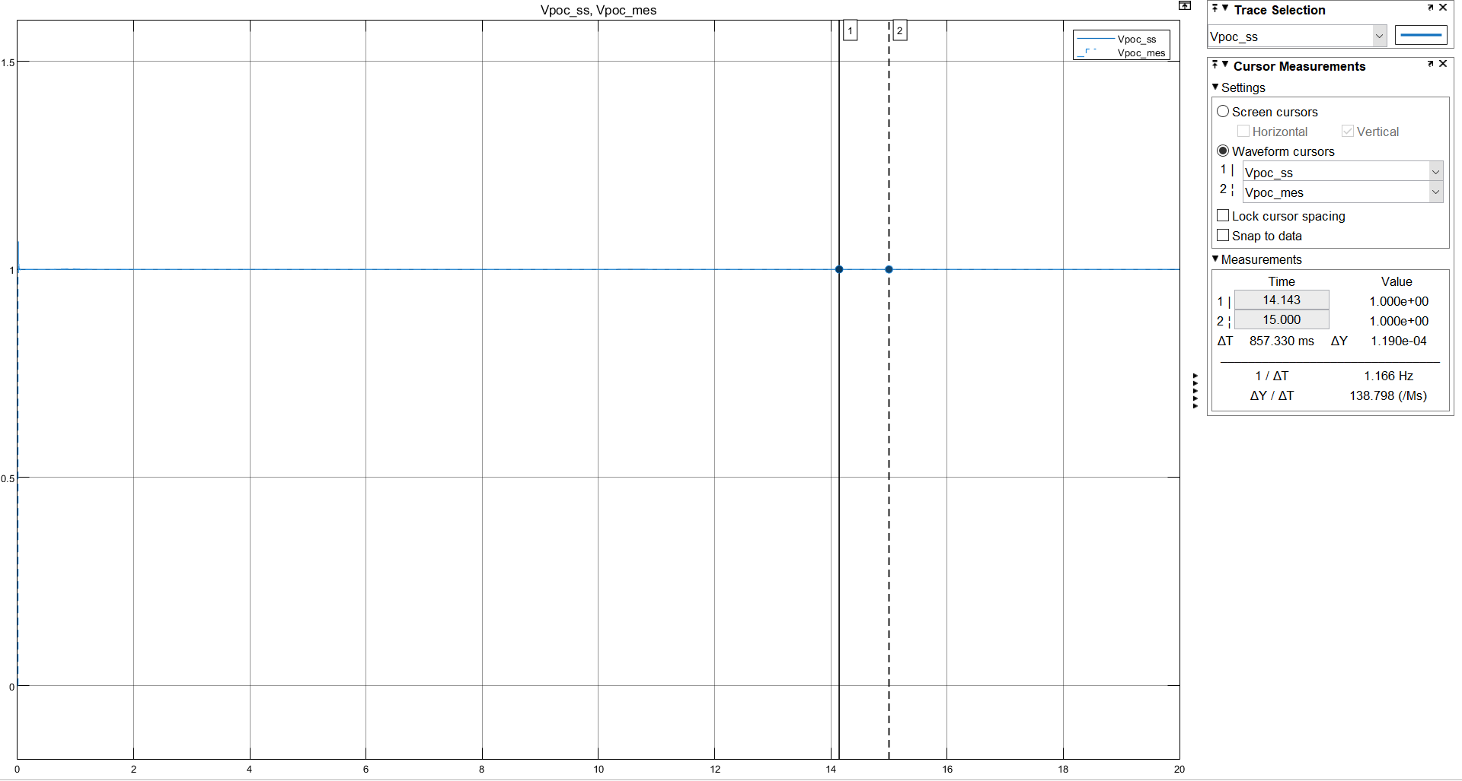

Results RMS Voltage Poc
$${E_{r}}_{\%}=0.01\%$$
$$P_{0}=0.1 pu \\ ΔP=0.01 pu \\ (Power step)$$

Slide 8
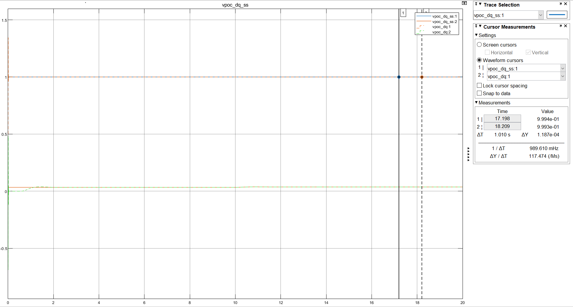
Results Voltages Poc
$${E_{r}}_{\%}=0.01\%$$
$$P_{0}=0.1 pu \\ ΔP=0.01 pu \\ (Power step)$$

Slide 9
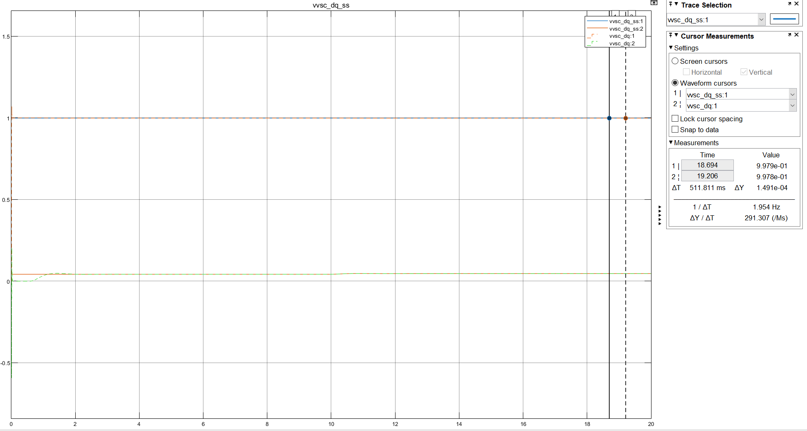

Results Voltages VSC
$${E_{r}}_{\%}=0.02\%$$
$$P_{0}=0.1 pu \\ ΔP=0.01 pu \\ (Power step)$$

Slide 10
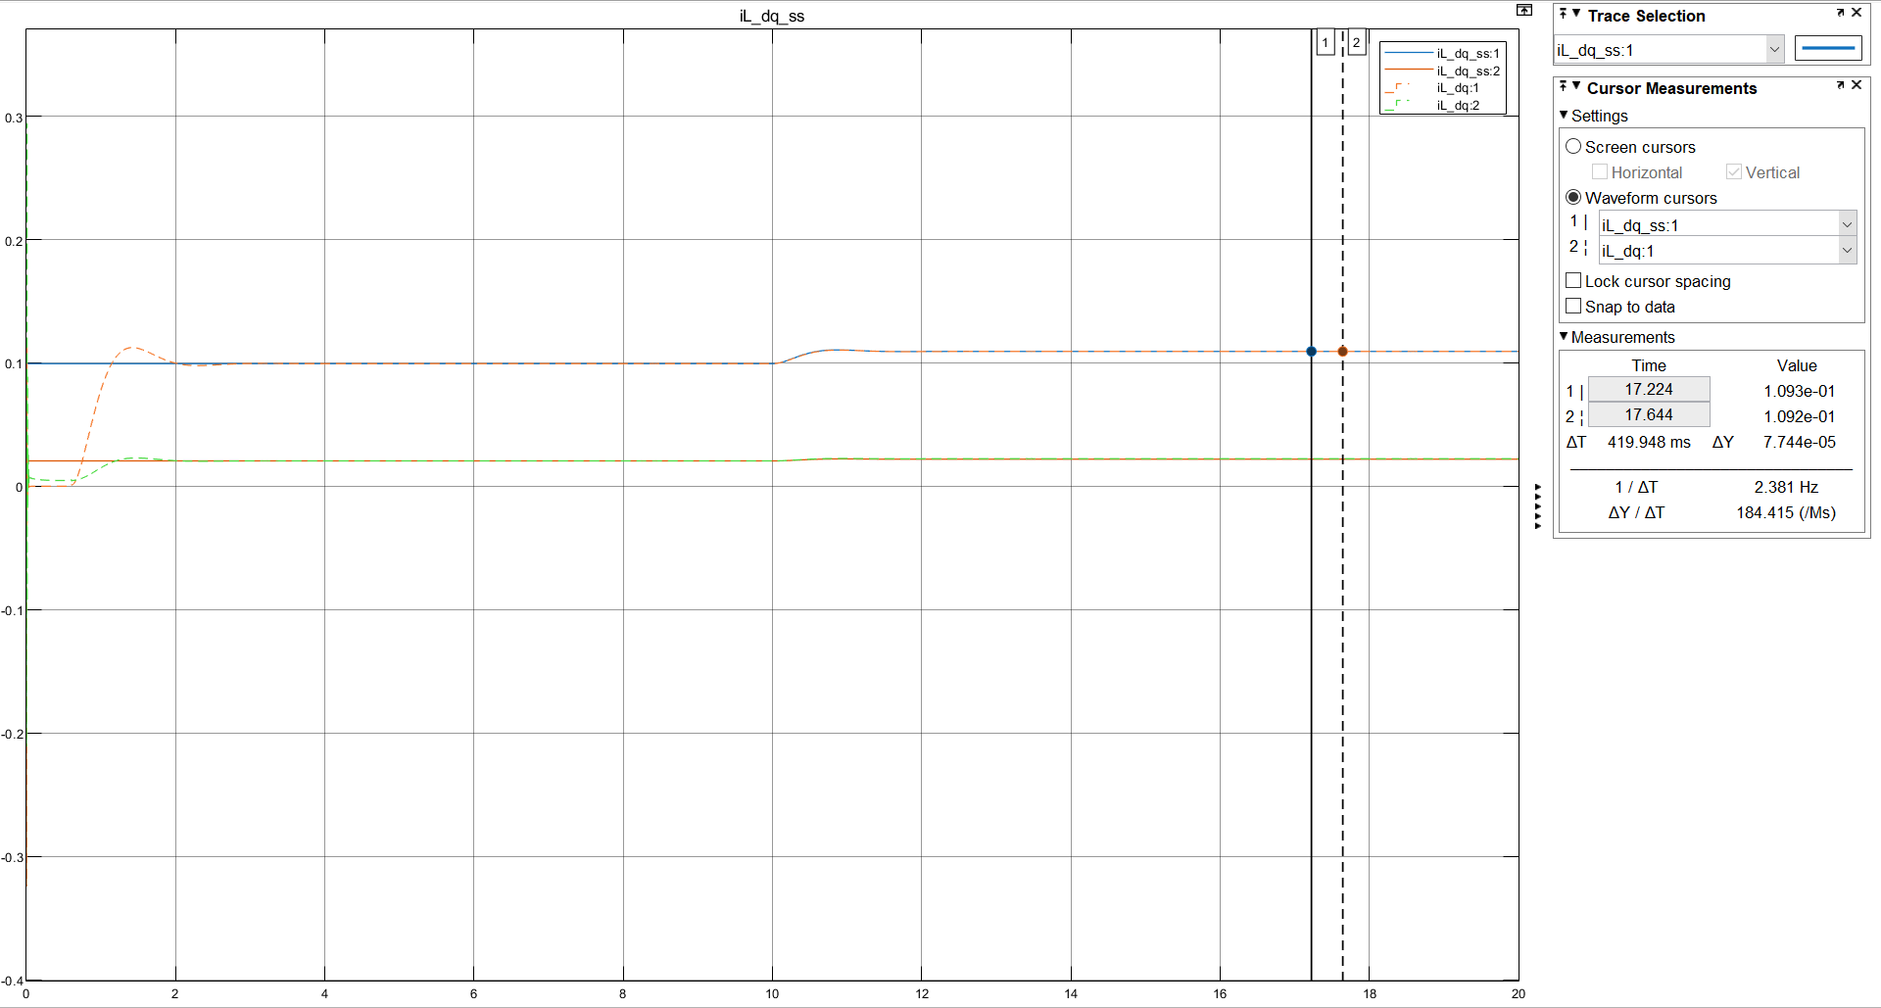
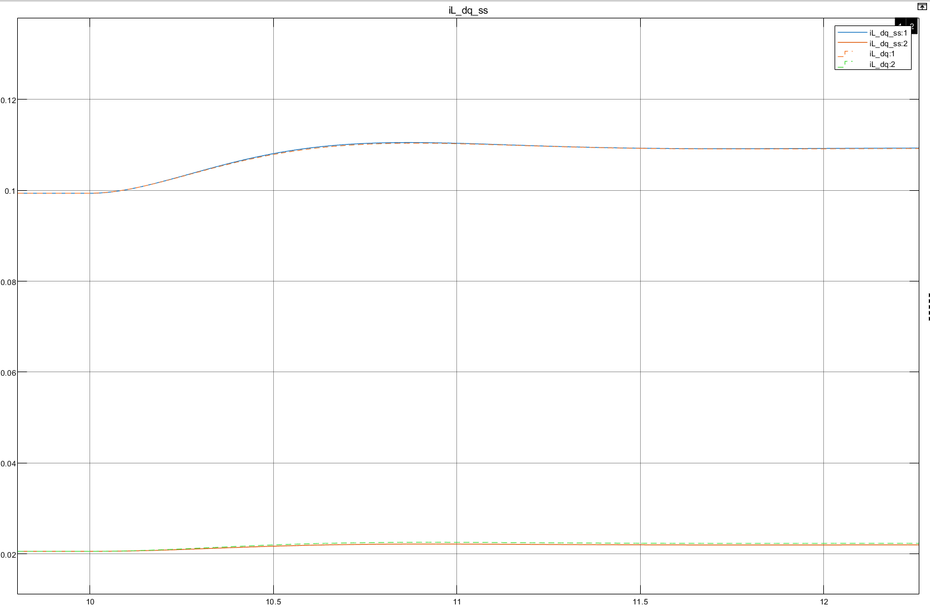

Results Currents VSC
$${E_{r}}_{\%}=0.07\%$$
$$P_{0}=0.1 pu \\ ΔP=0.01 pu \\ (Power step)$$

Slide 11
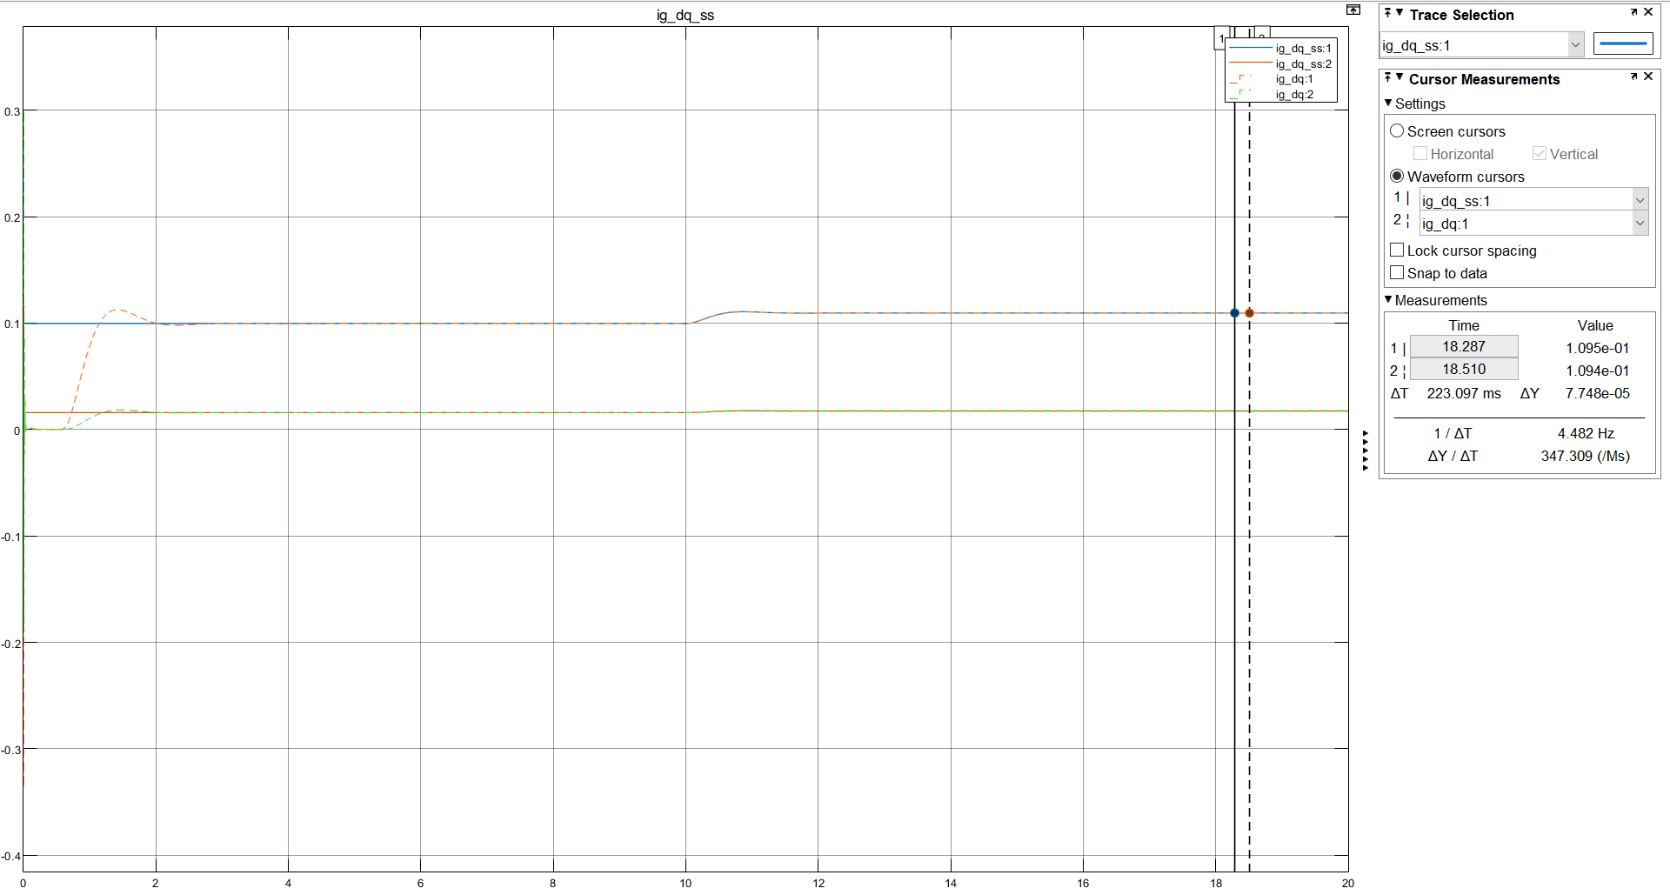
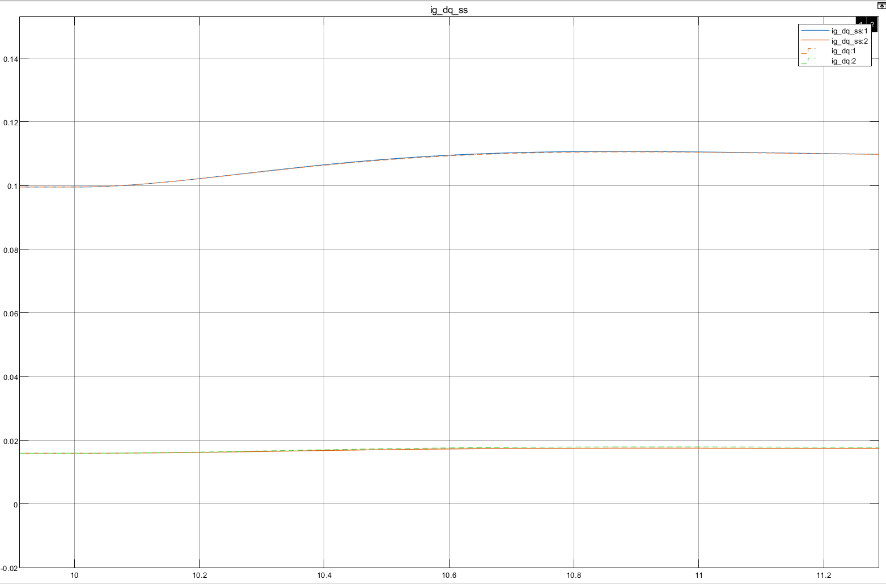
Results Currents Grid
$${E_{r}}_{\%}=0.07\%$$
$$P_{0}=0.1 pu \\ ΔP=0.01 pu \\ (Power step)$$

Slide 12
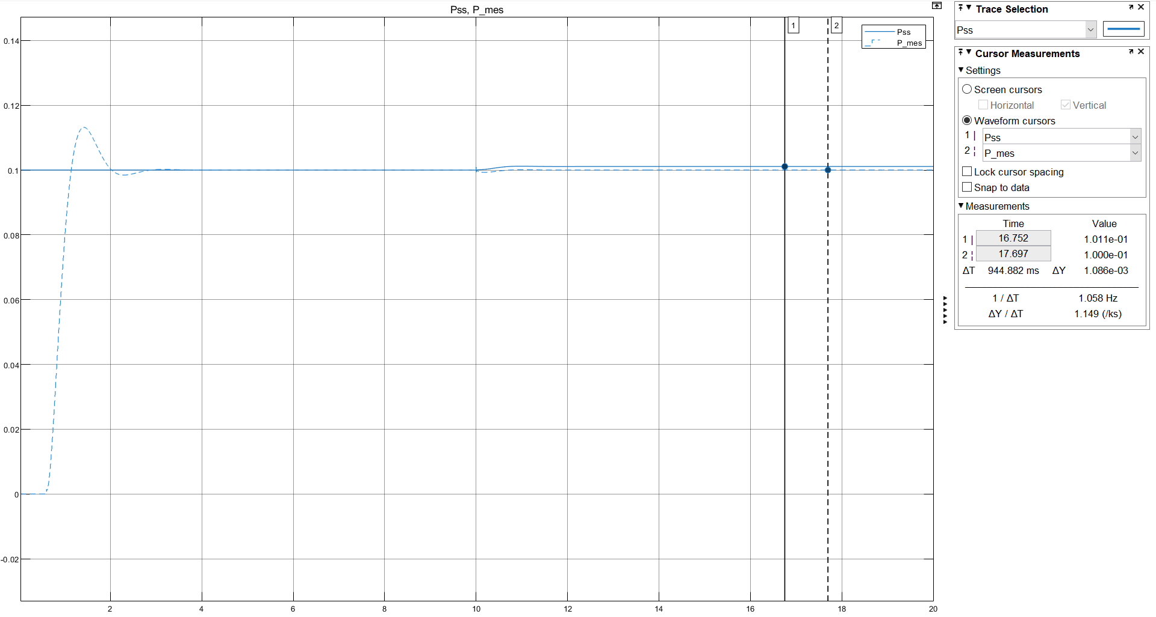
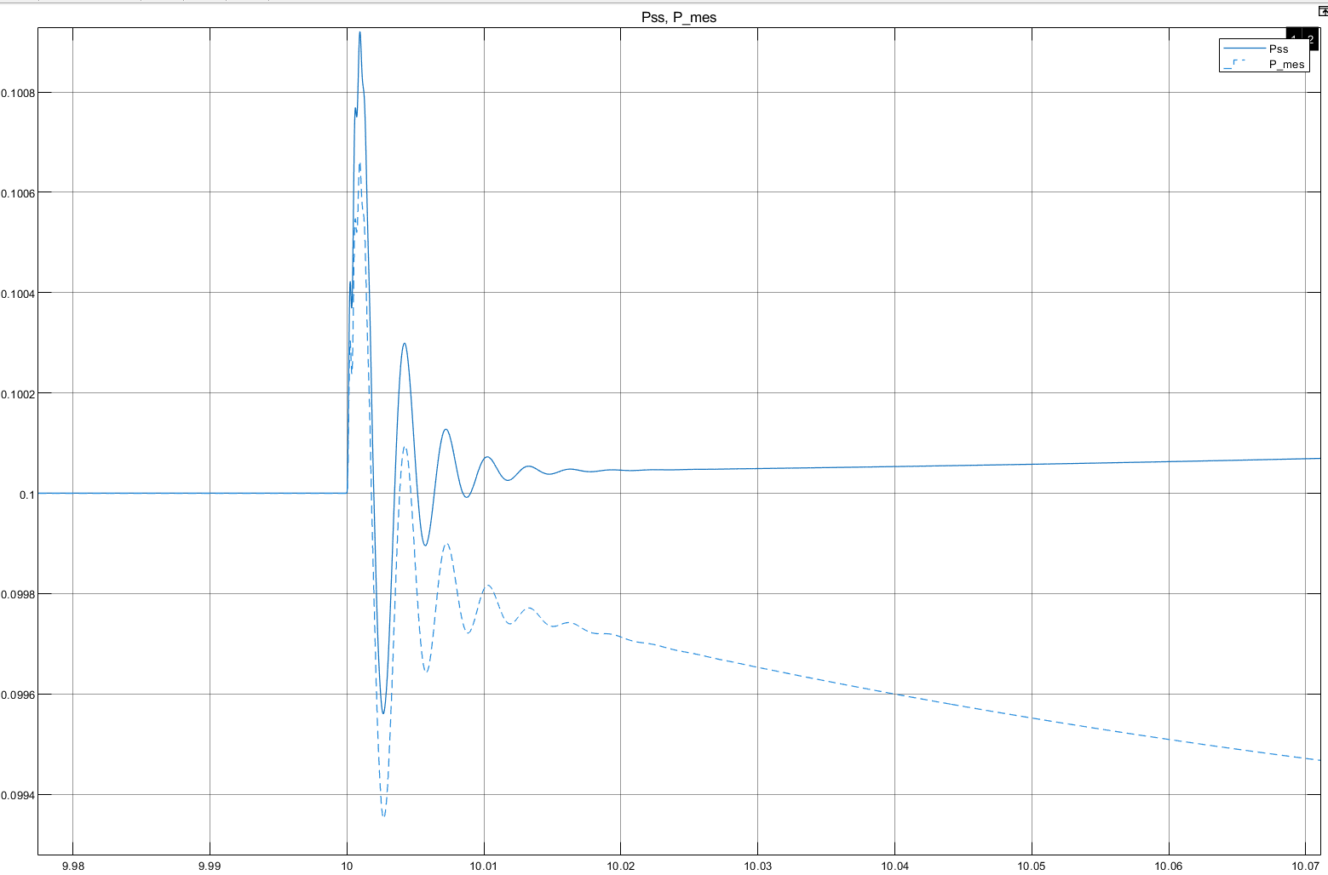
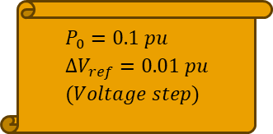

Results Active Power
$${E_{r}}_{\%}=1.09\%$$
$$P_{0}=0.1 pu \\ ΔV_{ref}=0.01 pu \\ (Voltage step)$$

Slide 13
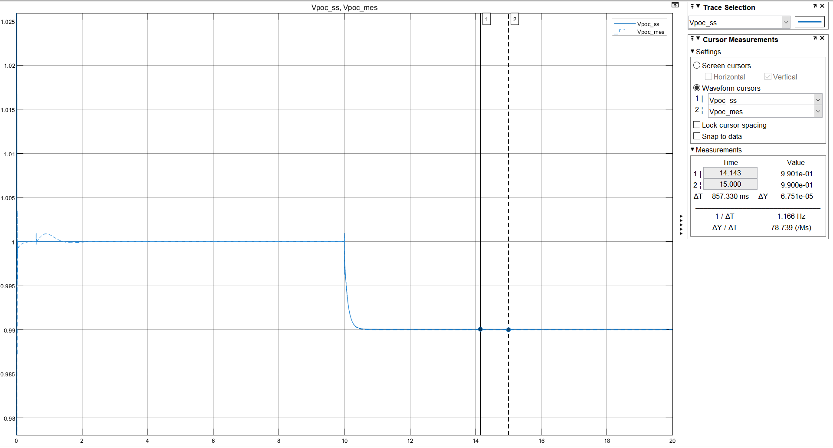
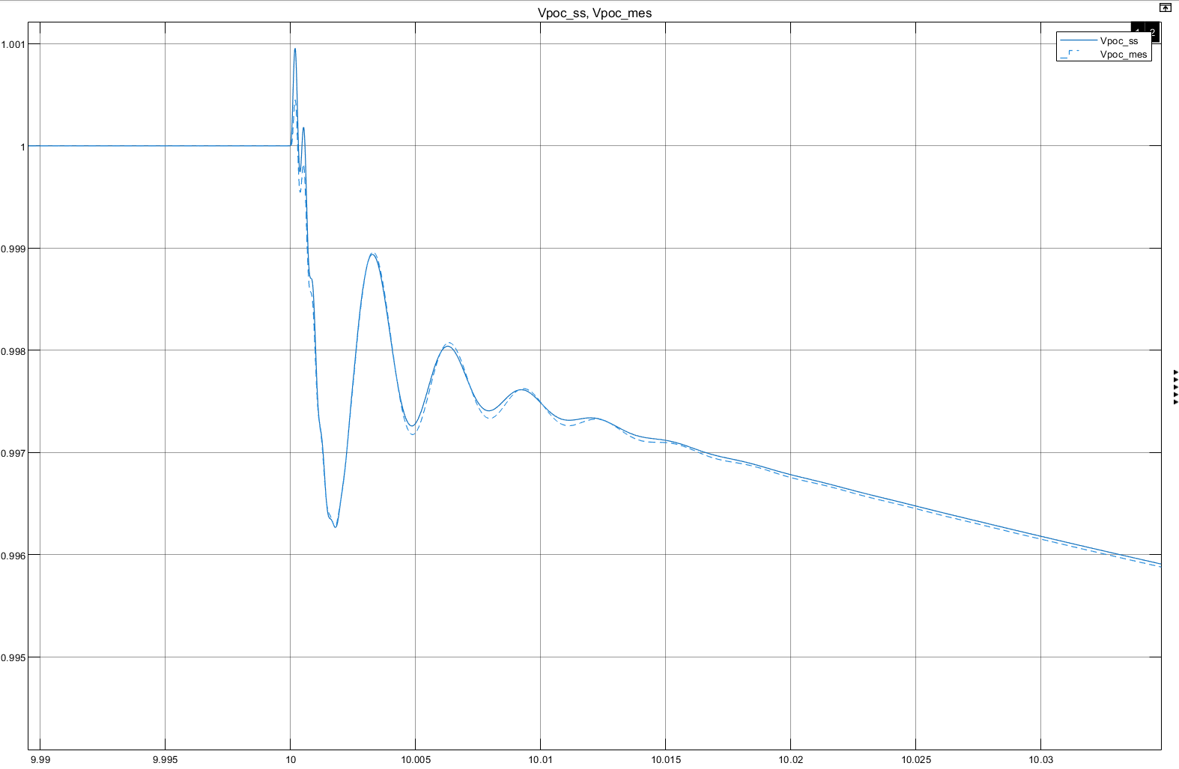

Results RMS Voltage Poc
$${E_{r}}_{\%}=0.01\%$$
$$P_{0}=0.1 pu \\ ΔV_{ref}=0.01 pu \\ (Voltage step)$$

Slide 14
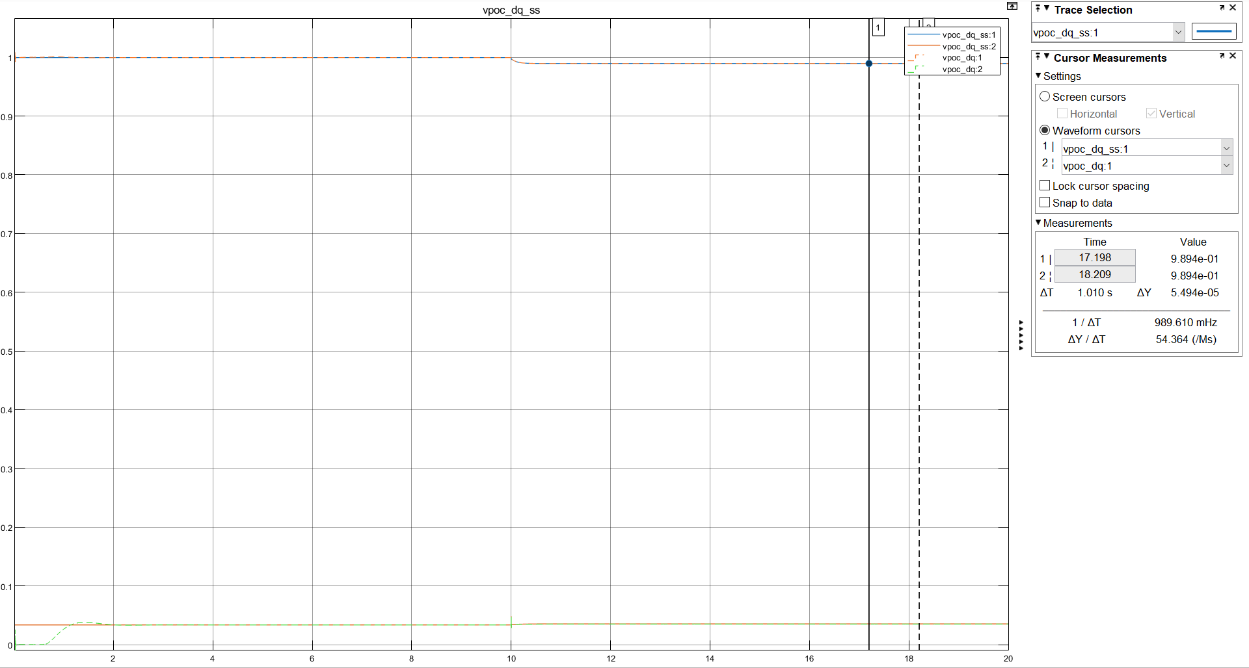
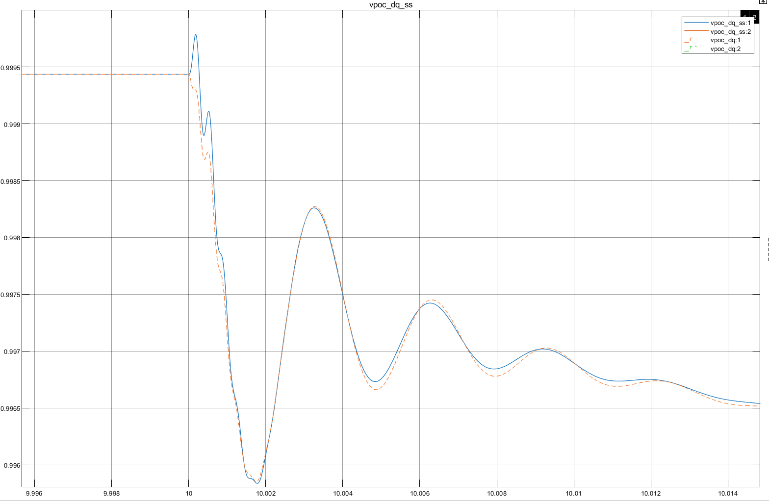
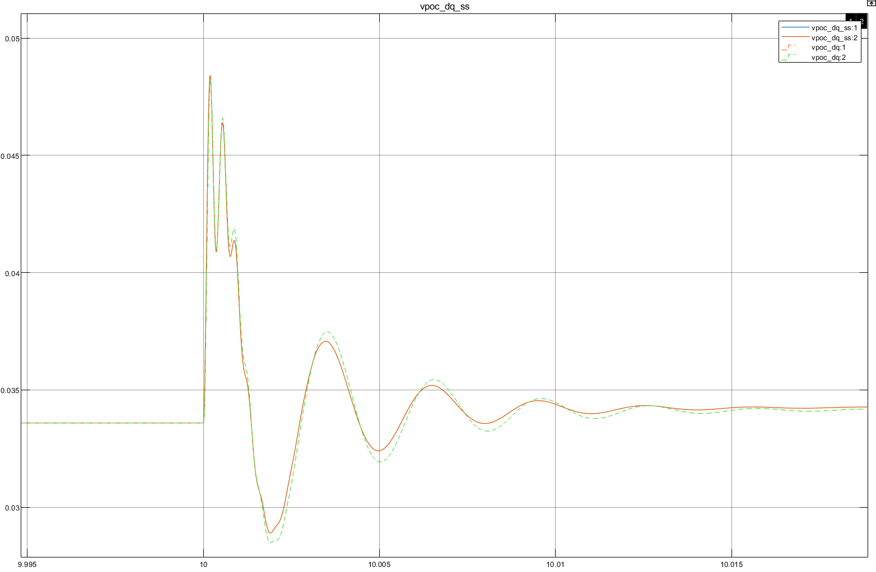
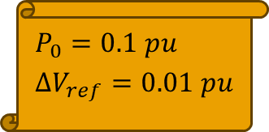

Results Voltages Poc
$${E_{r}}_{\%}=0.01\%$$
$$P_{0}=0.1 pu \\ ΔV_{ref}=0.01 pu$$

Slide 15
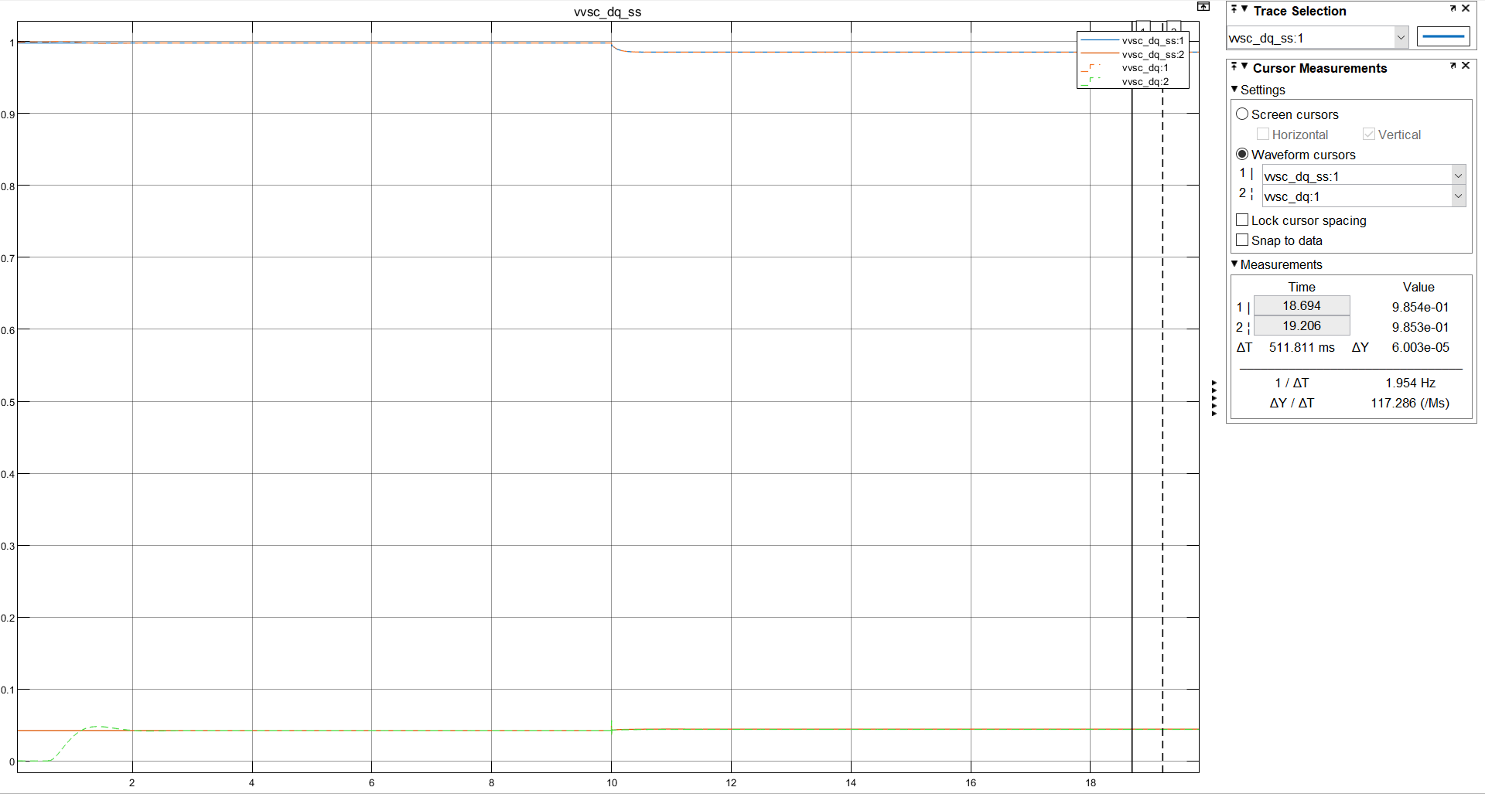
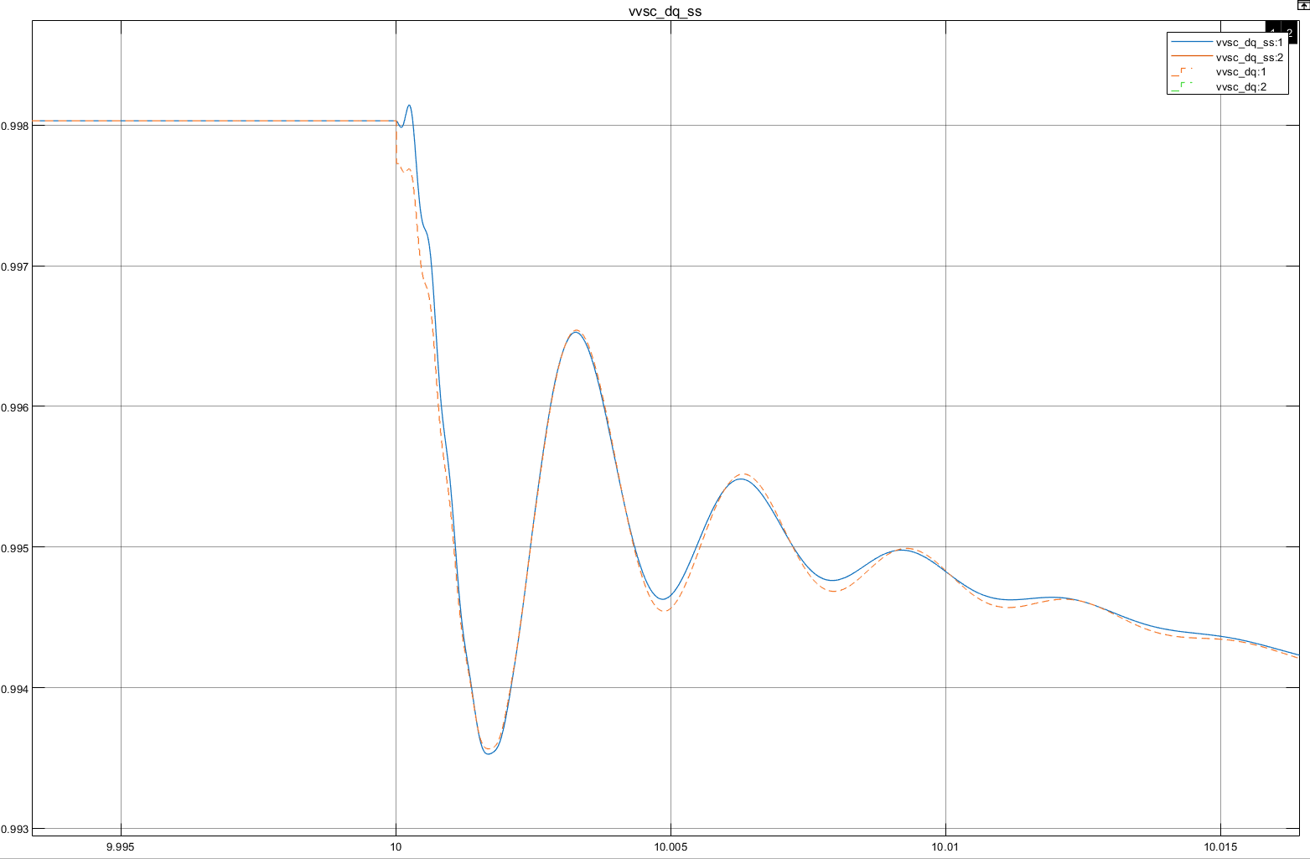
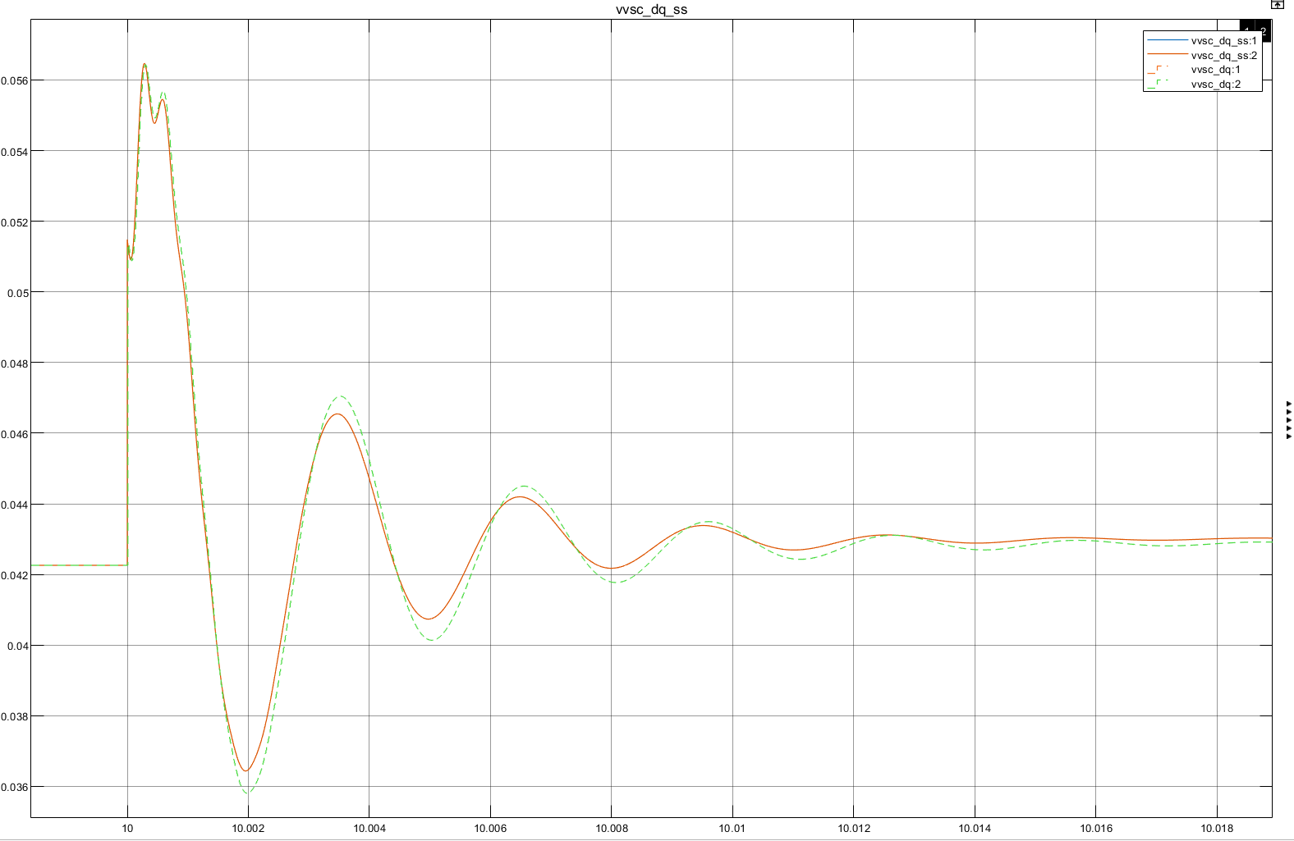
Results Voltages VSC
$${E_{r}}_{\%}=0.01\%$$
$$P_{0}=0.1 pu \\ ΔV_{ref}=0.01 pu \\ (Voltage step)$$

Slide 16
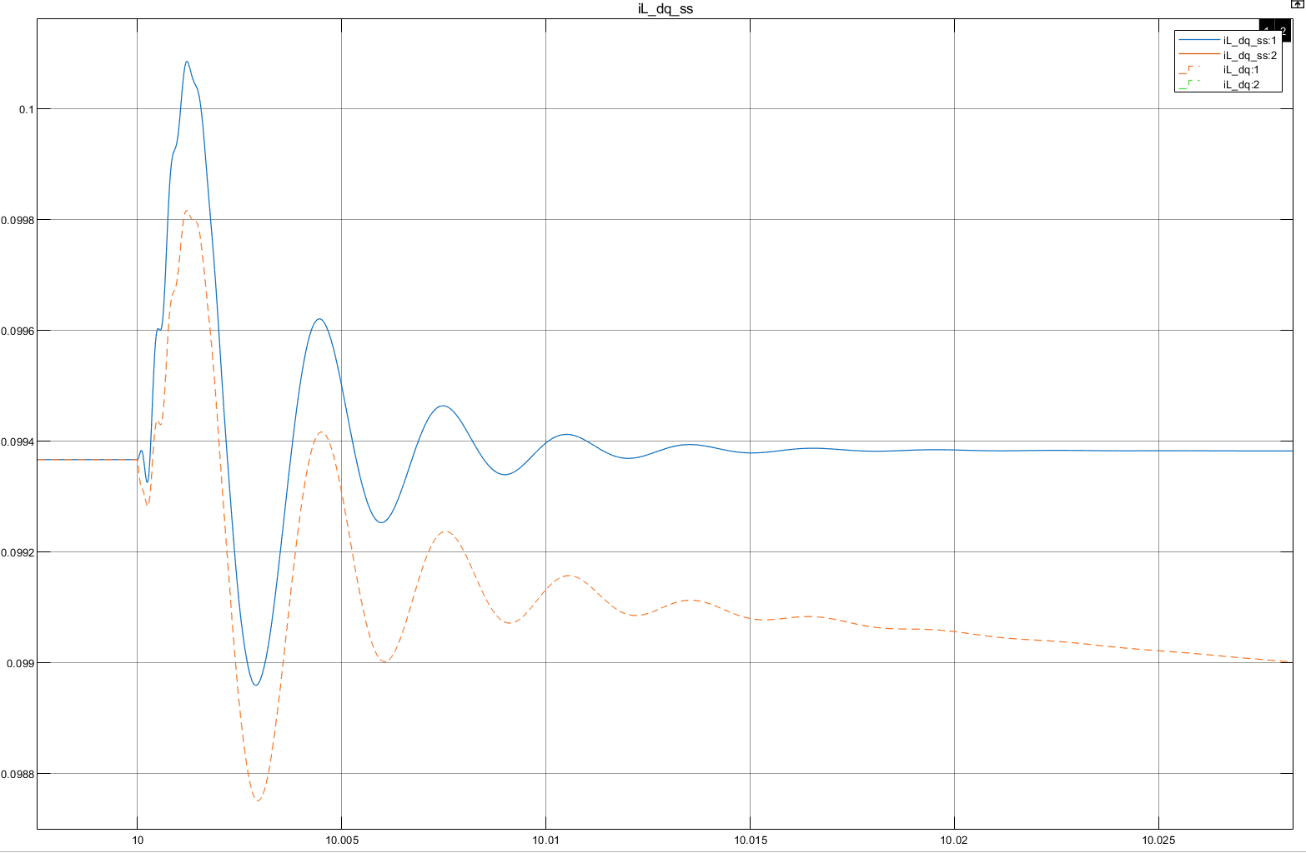
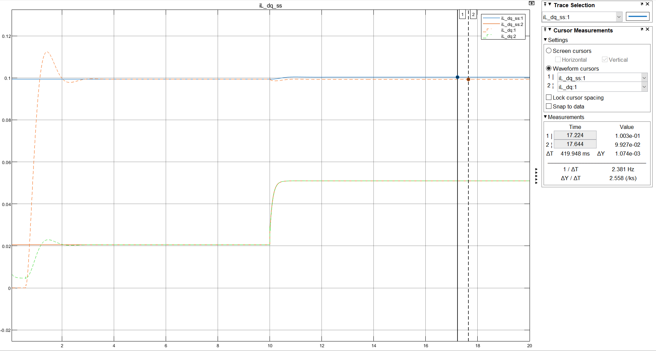
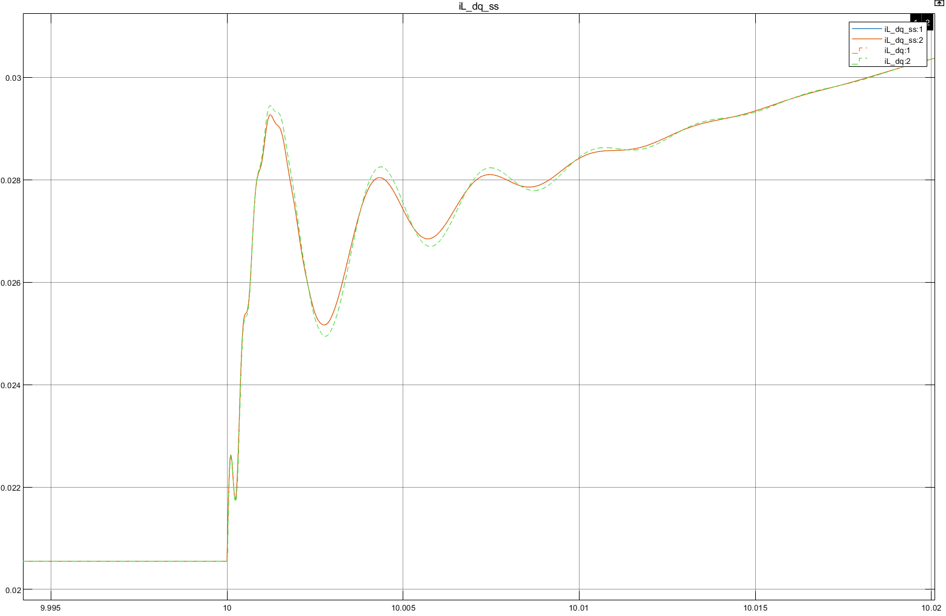

Results Currents VSC
$${E_{r}}_{\%}=1.09\%$$
$$P_{0}=0.1 pu \\ ΔV_{ref}=0.01 pu \\ (Voltage step)$$

Slide 17
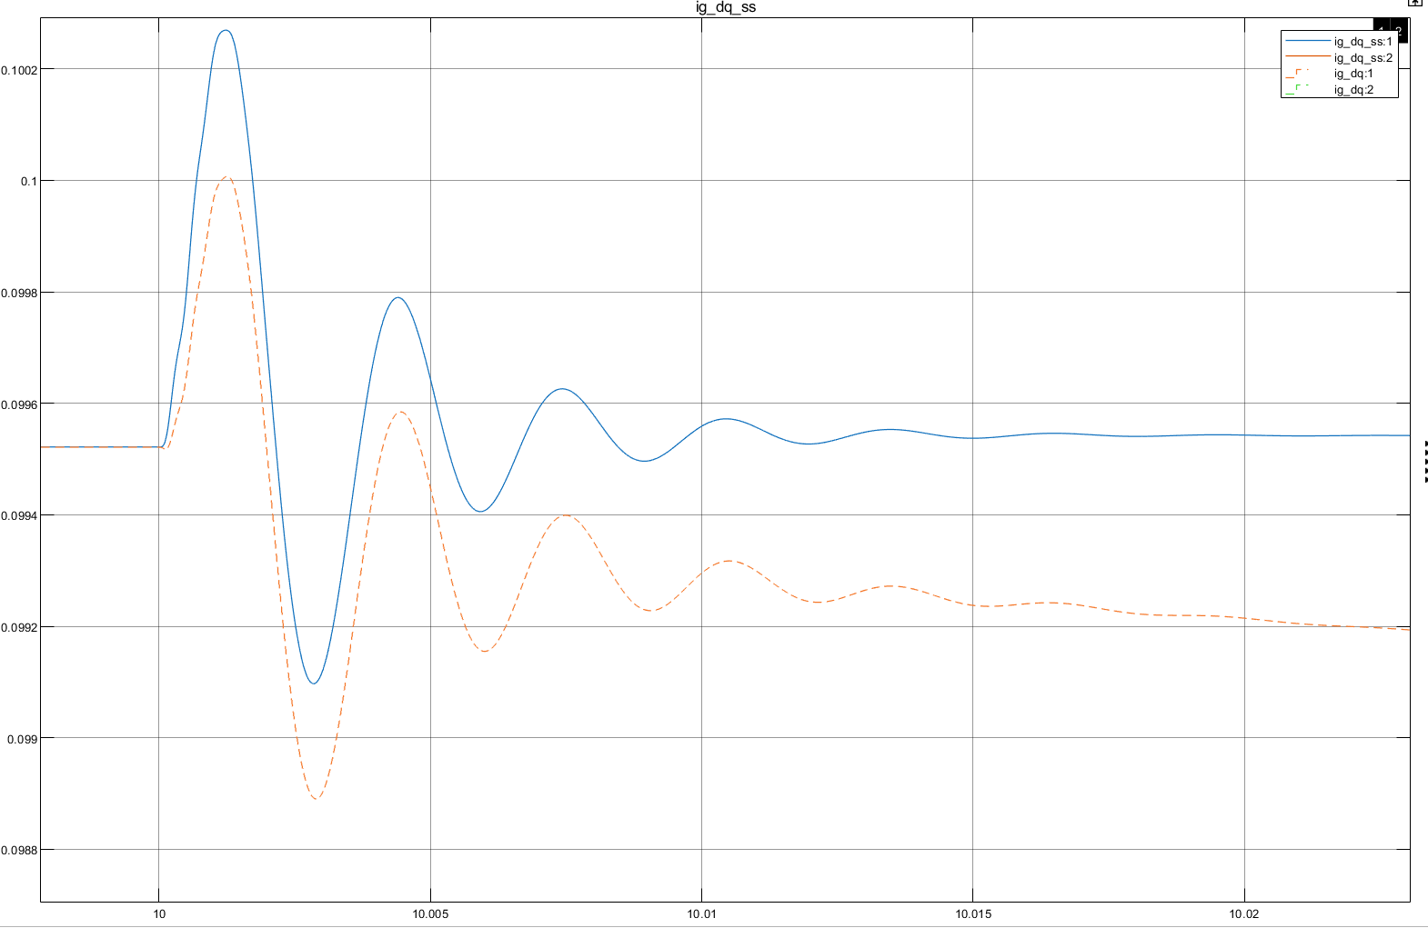
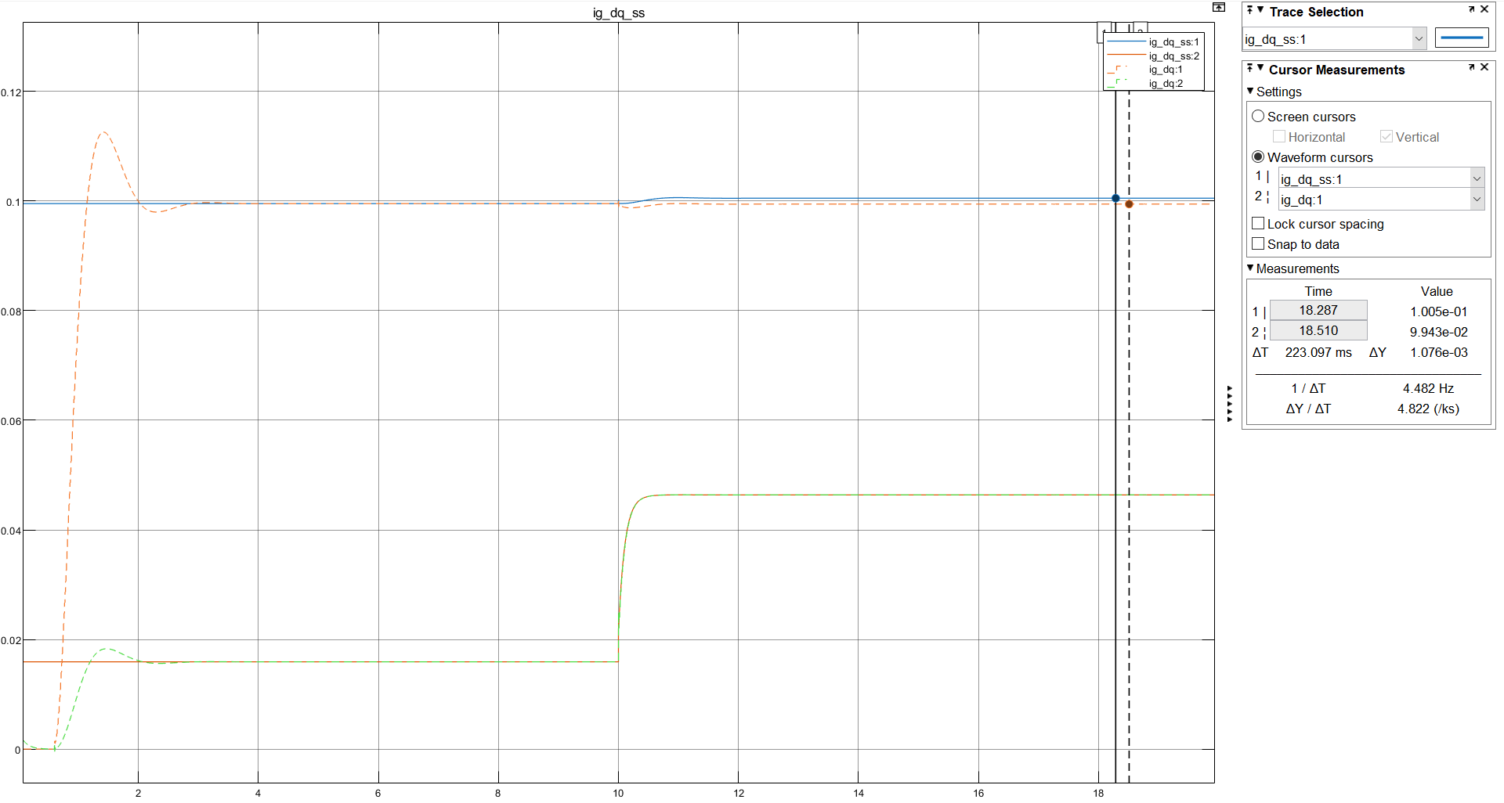
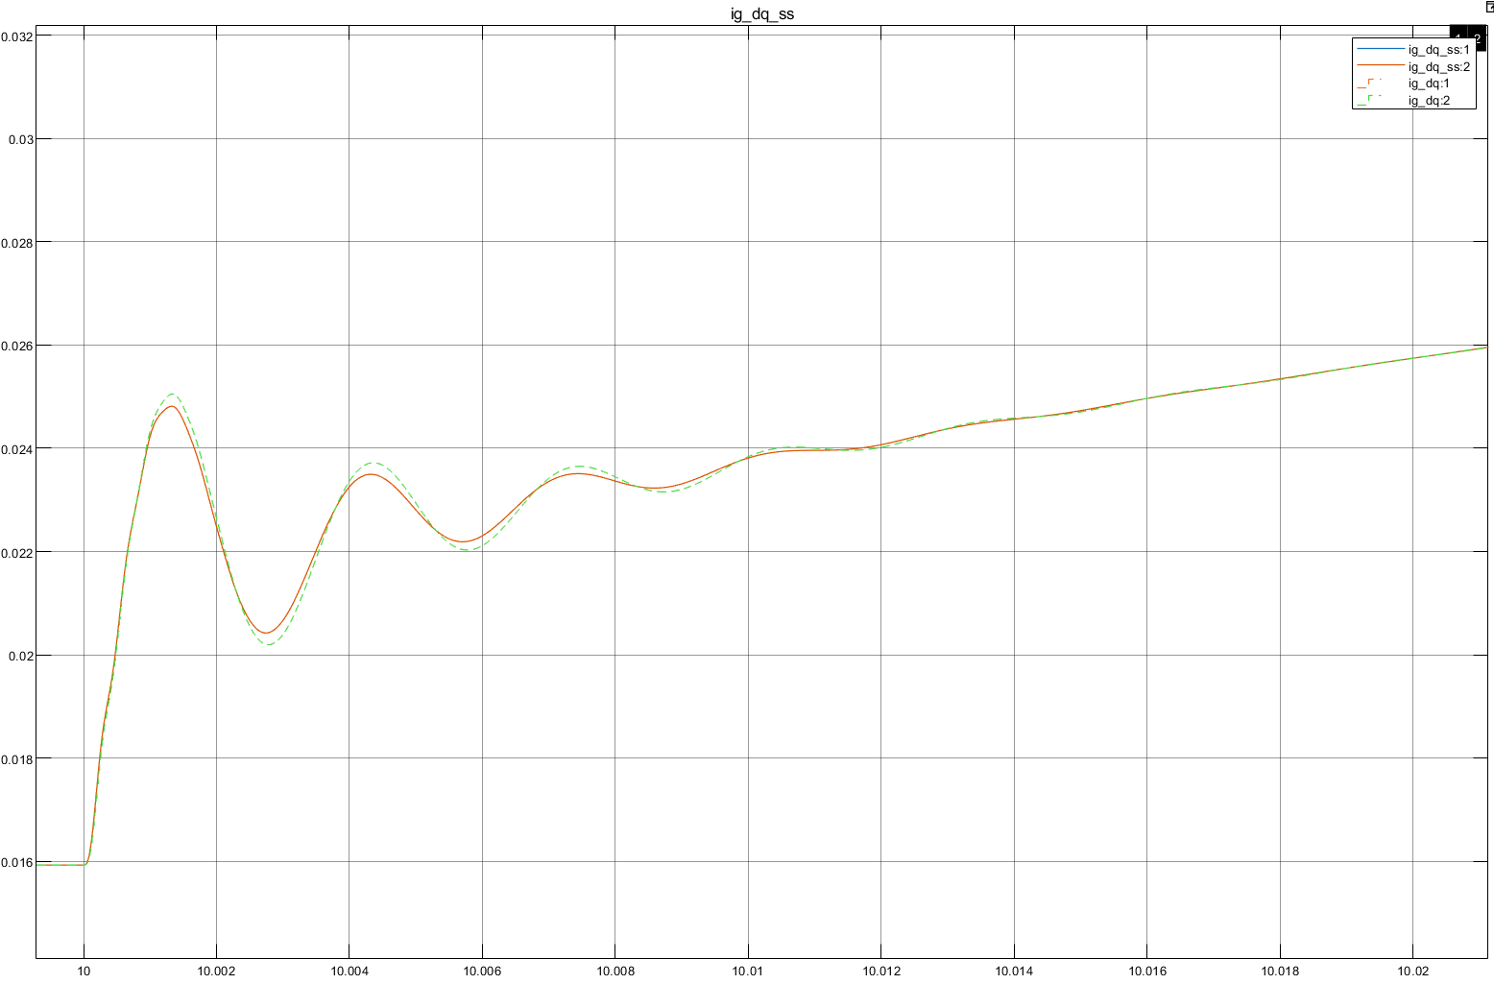
Results Currents Grid
$${E_{r}}_{\%}=1.09\%$$
$$P_{0}=0.1 pu \\ ΔV_{ref}=0.01 pu \\ (Voltage step)$$

Slide 18
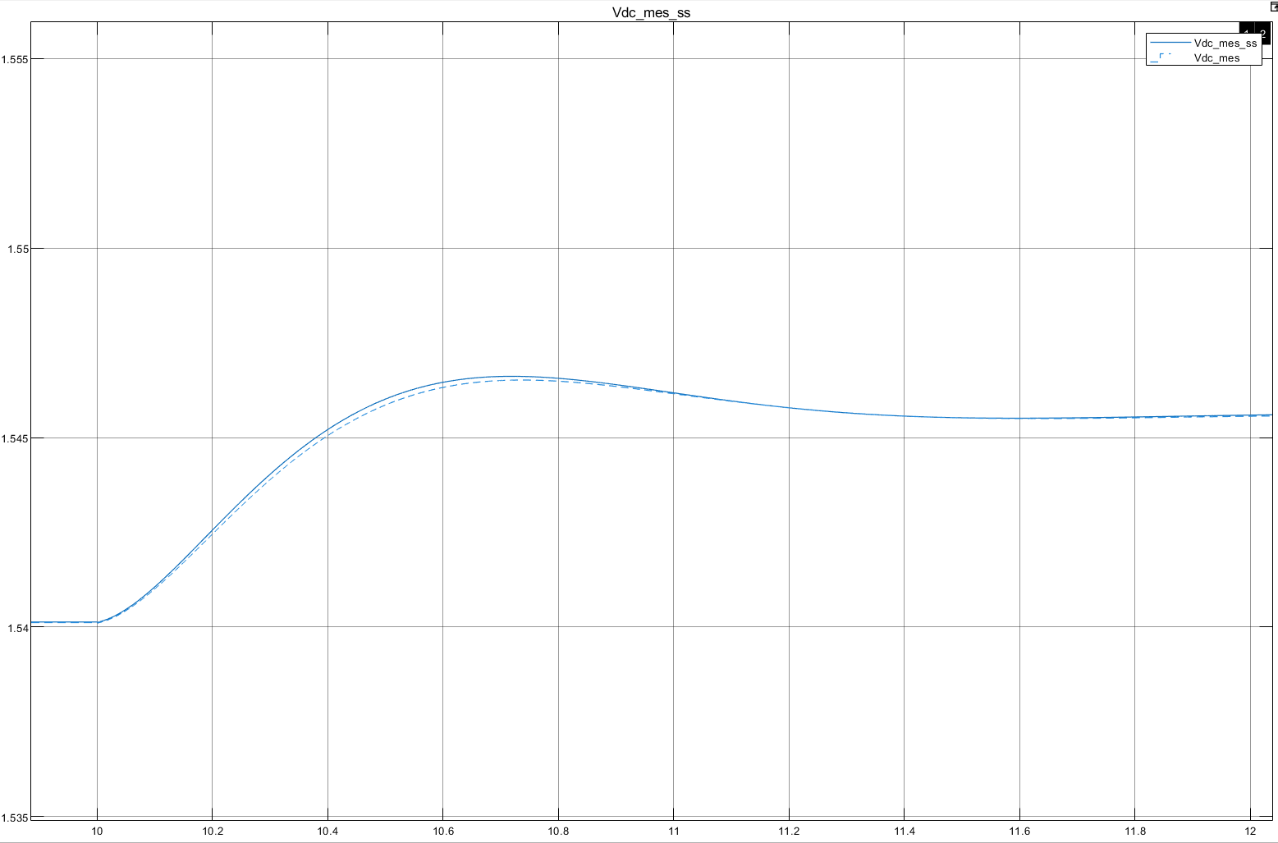

Results DC Voltage
$${E_{r}}_{\%}=0.01\%$$
$$P_{0}=0.1 pu \\ ΔV_{ref}=0.01 pu \\ (Voltage step)$$

Slide 19
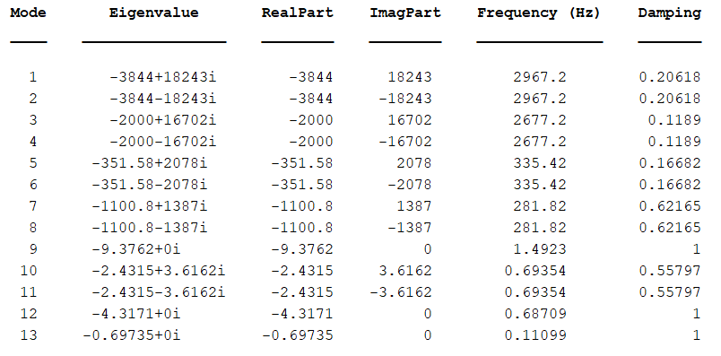
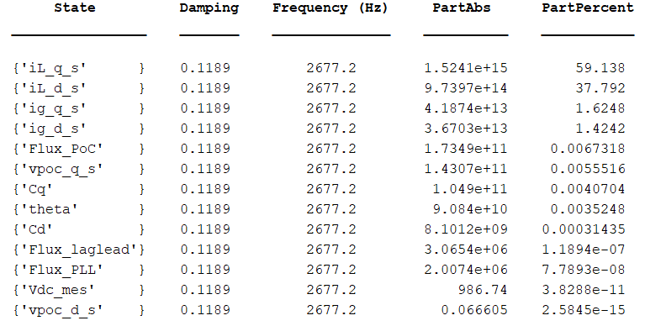
Stability Study

