Slide 1
VeggieScan
Rotten or Forgotten?
Zohaib Khawaja

Slide 2
Table of Contents
Introduction
Dataset introduction/samples
Model analysis/accuracy
Incorrect classification
Plans for future growth

Slide 3

Introduction
Classifying a photo of a vegetable/fruit as stale or fresh
Trained model with near 11 thousand images with 5 different fruit/vegetables

Slide 4
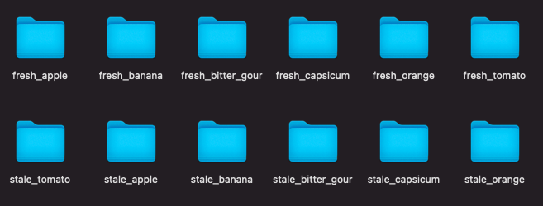
Dataset samples

Slide 5
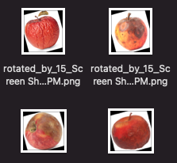
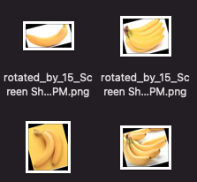
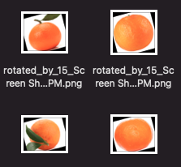
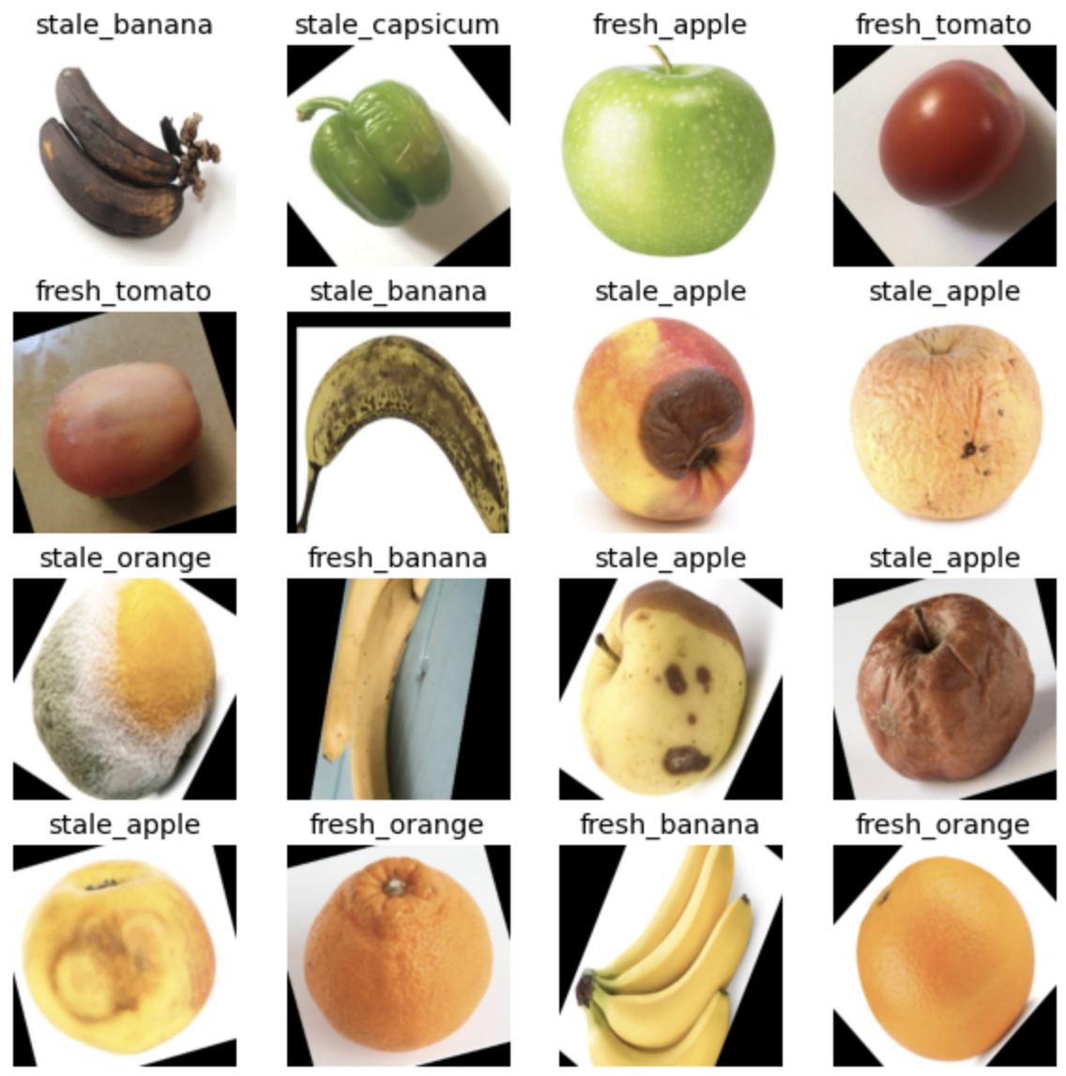
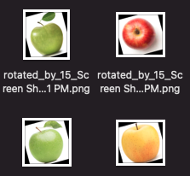
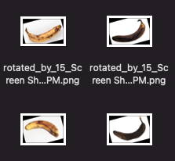
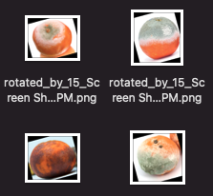
Dataset samples

Slide 6
Model Analysis/Accuracy
Settled on convolutional neural networks as a classifier
Accuracy of ~97.5% with Baseline accuracy of 16%
Baseline accuracy is lowest possible “guess”
Dataset of ~16000 images, trained with 11000, validated with 2000
Run time of approximately 11 minutes for training

Slide 7
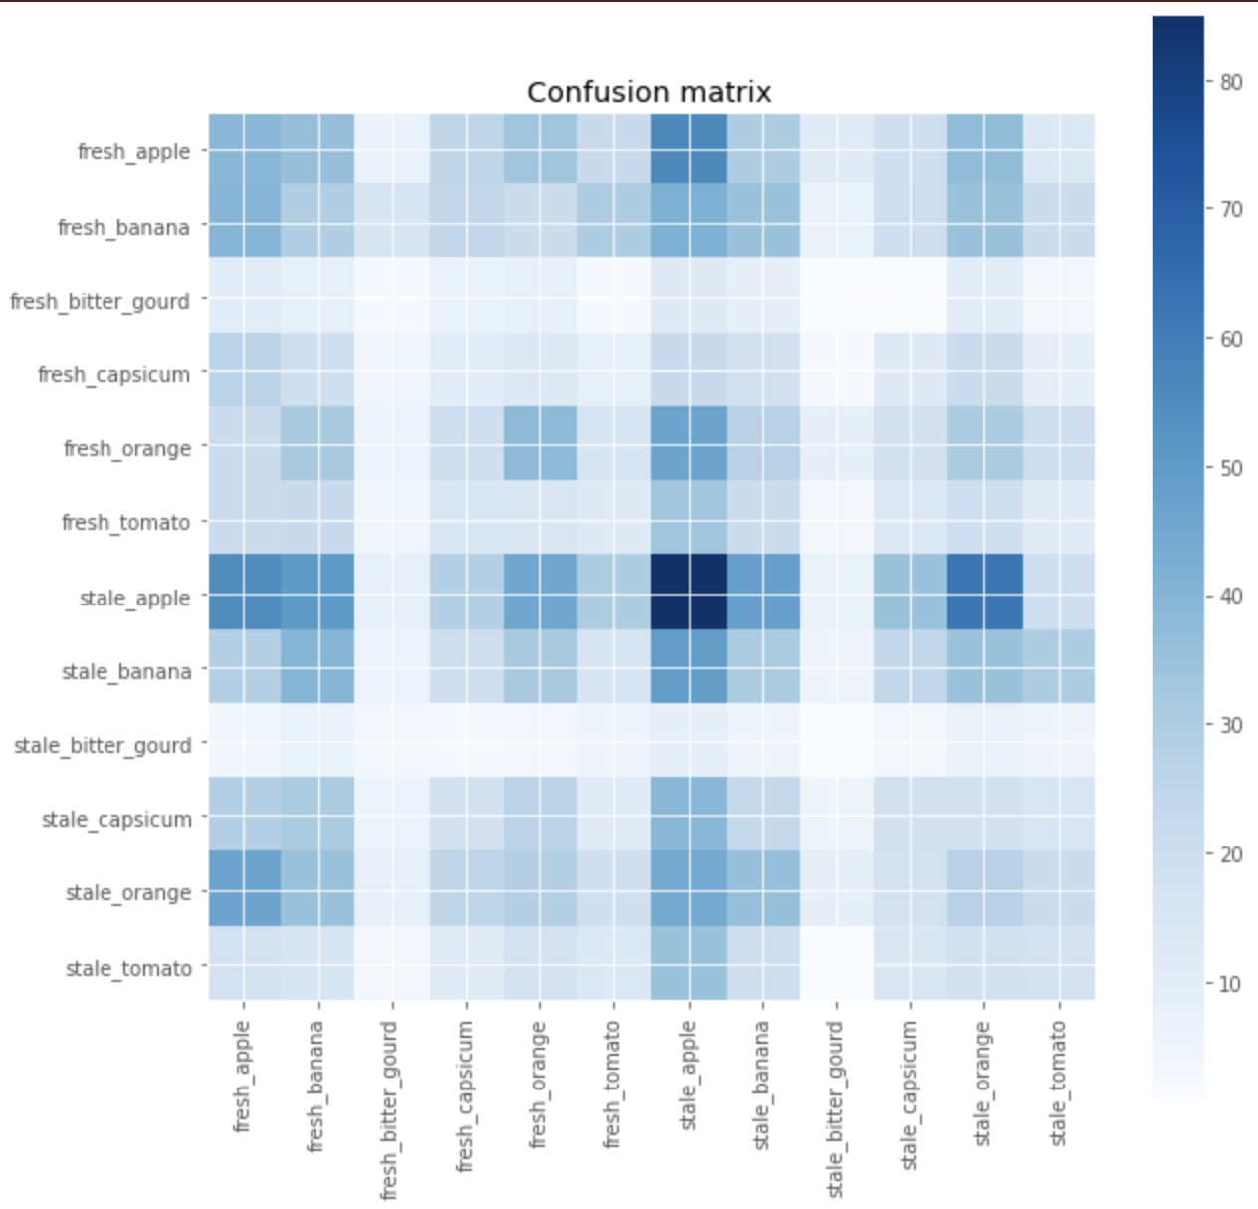

Slide 8
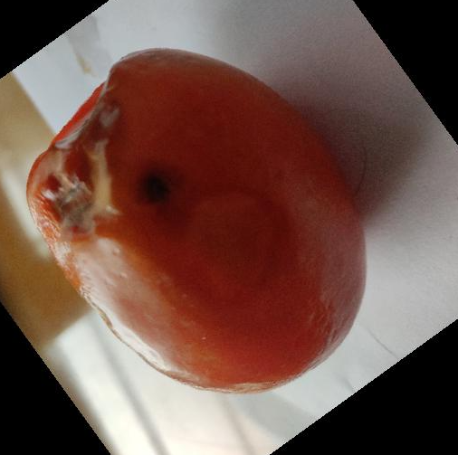
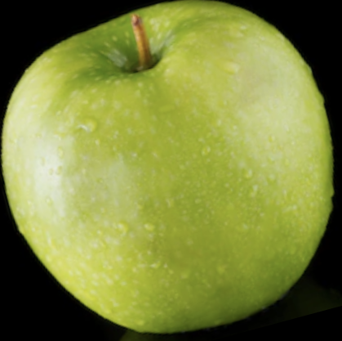
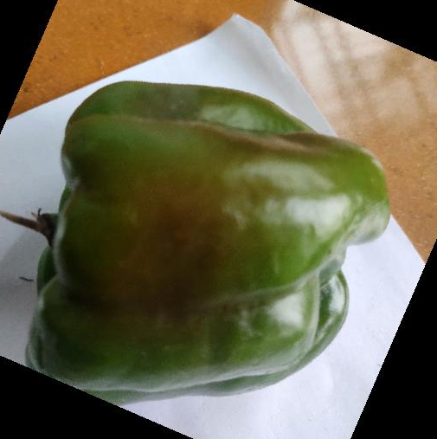
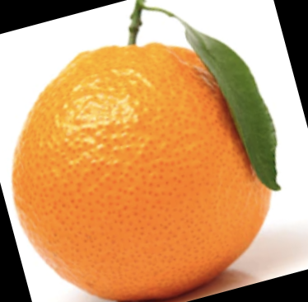
Model Analysis/Accuracy - What it gets right

Slide 9
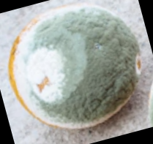
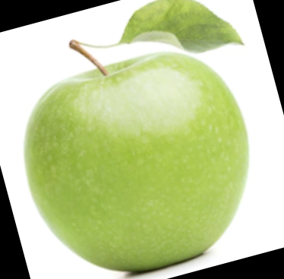
Incorrect Classifications
Vast majority of incorrect classifications were stale oranges that appeared green
Model often detected it as a fresh Granny Smith apple

Slide 10
Incorrect Classifications
Most other incorrect classifications were fruit that seemed round and discolored into a color that matched a fresh apple
Will use tens of thousands of more images to train model to higher accuracy
No incorrect classifications that had high confidence

Slide 11
Plans for future growth
Model that can run in real time via camera footage of a veggie/fruit stand
Real-time notification program that will notify fruit stand owner of stale fruit

Slide 12





Utilities Used

Slide 13
Additional Information
Dataset: https://www.kaggle.com/raghavrpotdar/fresh-and-stale-images-of-fruits-and-vegetables
Github: https://github.com/LeggoBoyo
Linkedin: https://www.linkedin.com/in/zohaib-khawaja-3675811b6/

