Slide 1
Neural Cognitive Diagnosis for Intelligent Education Systems
Fei Wang, Qi Liu, Enhong Chen, Zhenya Huang, Yuying Chen, Zai Huang, Shijin Wang
AAAI 2020
Anhui Province Key Lab. of Big Data Analysis and Application, University of S&T of China

Slide 2
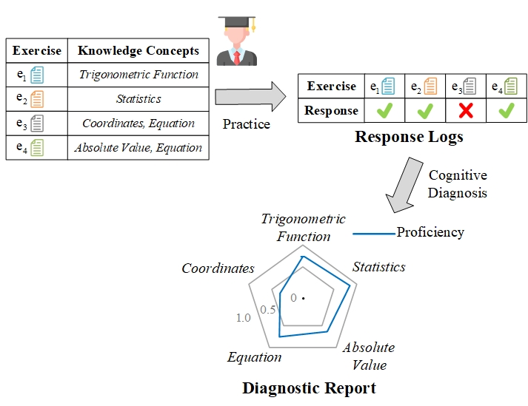
Background
Cognitive Diagnosis: A fundamental task in many scenarios, especially intelligent education
Notes:
Cognitive diagnosis is a fundamental task in many scenarios, especially in intelligent education. Here is a toy example. Generally, students usually first choose to practice some exercises and leave their response logs. Then, the goal of cognitive diagnosis is to infer their actual knowledge states on the corresponding concepts.

Slide 3



Traditional Works
IRT, MIRT: scalar or latent vectors for students and exercises; logistic-like interaction function
difficulty, discrimination, ability
DINA: binary vectors for students and exercises; conjunctive assumption in interaction function
Q-matrix
MF: latent vectors for students and exercises; inner productive interaction function
$$P\left(R_{uv}=1 | θ_{u},a_{v},b_{v} \right)=\frac{1}{1+exp⁡(−1.7a_{v}\left(θ_{u}−b_{v}\right))}$$
Skill proficiency
Discrimination
Difficulty
$$P\left(R_{ij}=1 | α_{i}\right)={(1−s_{j})}^{η_{ij}}{g_{j}}^{1−η_{ij}}$$
Skill proficiency vector
Slip
Guess
$$P\left(R_{uv}=1 | θ_{u},b_{v} \right)=θ_{u}∙b_{v}$$
Notes:
In the literature, massive efforts have been devoted for cognitive diagnosis. The most typical models are IRT and DINA from educational psychology. In IRT or multi-dimensional IRT, students and exercises are represented with scalars or latent vectors, and their interaction are modeled with logistic-like functions. In DINA, students and exercises are represented with binary vectors. The exercise vectors come from Q-matrix, which denotes the skills contained by each exercise. The interaction function between student and exercise vectors are designed based on conjunctive assumption, that is, the student needs to master all skills that required by the exercise to answer it correctly. Matrix factorization is a method from recommendation system, which represents students and exercises with latent vectors, and the interaction function is inner productive.
There are some problems in the interaction functions of these traditional models. First, these interaction functions are manually designed, which is labor intensive. Second, the designed functions are mostly linear, which might not be effective enough to model the complex relationship between students and exercises. Moreover, some simplistic assumptions behind the interaction function also restrict the scope of applications of the models.
Therefore, it is urgent to find an automatic way to learn the complex interactions for cognitive diagnosis.
Since neural network has developed for many years and has shown its strong ability of approximation in many areas, why not learn the interaction function with neural network from data?

Slide 4

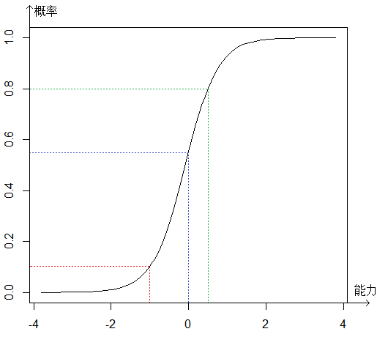
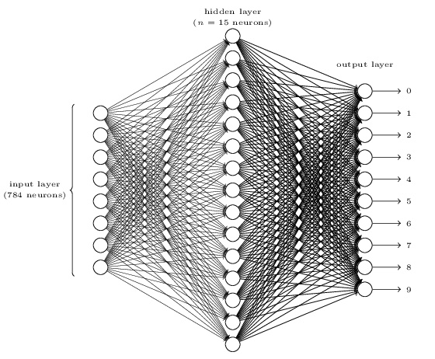
Problems in the interaction functions:
manually designed → labor intensive
mostly linear → limited approximation ability
simplistic assumptions → restricted scope of applications
It is urgent to find an automatic way to learn the complex interactions for cognitive diagnosis.
Learn the interaction function with neural network from data
$$P\left(R_{uv}=1 | θ_{u},a_{v},b_{v},c_{v}\right)=f\left(θ_{u},a_{v},b_{v},c_{v}\right)=\frac{1}{1+e^{−1.7a_{v}\left(θ_{u}−b_{v}\right)}}$$
Notes:
In the literature, massive efforts have been devoted for cognitive diagnosis. The most typical models are IRT and DINA from educational psychology. In IRT or multi-dimensional IRT, students and exercises are represented with scalarsor latent vectors, and their interaction are modeled with logistic-like functions. In DINA, students and exercises are represented with binary vectors. The exercise vectors come from Q-matrix, which denotes the skills contained by each exercise. The interaction function between student and exercise vectors are designed based on conjunctive assumption, that is, the student needs to master all skills that required by the exercise to answer it correctly. Matrix factorization is a method from recommendation system, which represents students and exercises with latent vectors, and the interaction function is inner productive.
There are some problems in the interaction functions of these traditional models. First, these interaction functions are manually designed, which is labor intensive. Second, the designed functions are mostly linear, which might not be effective enough to model the complex relationship between students and exercises. Moreover, some simplistic assumptions behind the interaction function also restrict the scope of applications of the models.
Therefore, it is urgent to find an automatic way to learn the complex interactions for cognitive diagnosis.
Since neural network has developed for many years and has shown its strong ability of approximation in many areas, why not learn the interaction function with neural network from data?

Slide 5


Challenges
Black-box nature of neural network
difficult to get explainable diagnosis results
Leverage rich exercise text information
difficult for traditional non-neural functions
worthy of exploring with the strong ability of neural network
?
Information
Notes:
However, it is nontrivial to adopt neural network for cognitive diagnosis. The black-box nature of neural network makes it difficult to get explainable diagnosis results, which is extremely import for cognitive diagnosis. Besides, there is rich information in exercise texts which may benefit the diagnosis. For traditional methods, it is difficult to leverage the exercise texts due to the limitation of their manually designed, non-neural functions. However, with the strong ability of neural network, it is worthy of finding ways to explore the rich information in exercise texts.

Slide 6
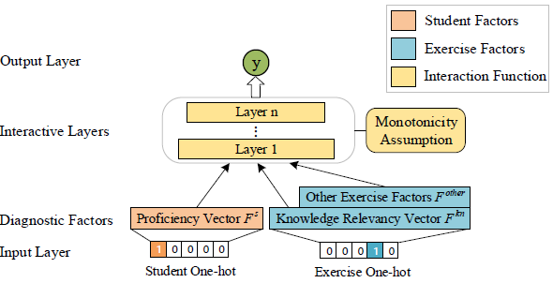
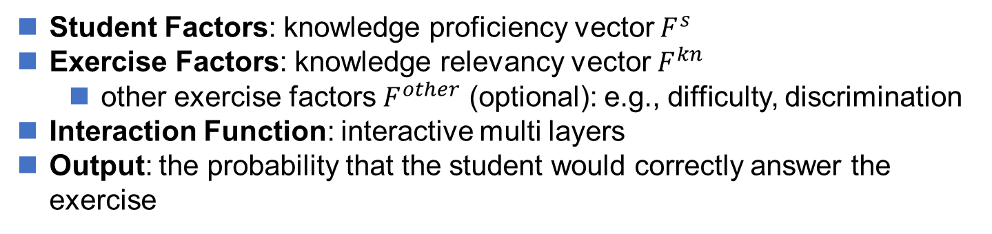
NeuralCD Framework
Student Factors: knowledge proficiency vector $F^{s}$
Exercise Factors: knowledge relevancy vector $F^{kn}$
other exercise factors $F^{other}$ (optional): e.g., difficulty, discrimination
Interaction Function: interactive multi layers
Output: the probability that the student would correctly answer the exercise
Notes:
To this end, we propose a general framework, NeuralCD to achieve our goal. We project students and exercises into different factors. For student, it is knowledge proficiency vector F^s. And for exercise, the main factor is knowledge relevancy vector, which we denote as F^{kn}. While some other optional exercises such as difficulty and discrimination can be integrated in. The interaction function is learned with multi-layers.

Slide 7


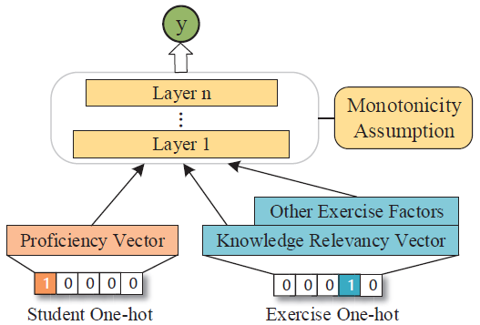

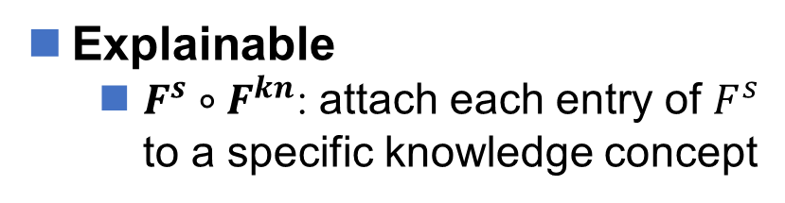
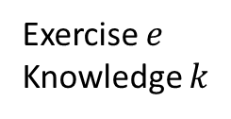


NeuralCD Framework
Explainable
$F^{s}∘F^{kn}$: attach each entry of $F^{s}$ to a specific knowledge concept
Proficiency $F^{s}$
Relevancy $F^{kn}$
Monotonicity Assumption: The probability of correct response to the exercise is monotonically increasing at any dimension of the student’s knowledge proficiency. (widely applicable)
Educational psychological assumption
Correct
Exercise $e$
Knowledge $k$
P(Correct)=0.3
Too low!
$F_{k}^{s}$ ↑
Optimization algorithm
Notes:
To get explainable results from the framework, we make two special designs. First, we force there exists the term $F^{s}∘F^{kn}$ in the input layer, in order to attach each entry of knowledge proficiency vector to a specific knowledge concept. Second, we apply monotonicity assumption on the interaction layers. The definition of the assumption is that: The probability of correct response to the exercise is monotonically increasing at any dimension of the student’s knowledge proficiency. For example, suppose exercise e contains knowledge k, and the student answered it correctly. When the model predicts him to answer it incorrect, in other words, output a low probability, then the optimization algorithm should increase his knowledge proficiency instead of decreasing. The monotonicity assumption is widely applicable in almost all circumstances, thus it has little influence on the generality of the framework.

Slide 8
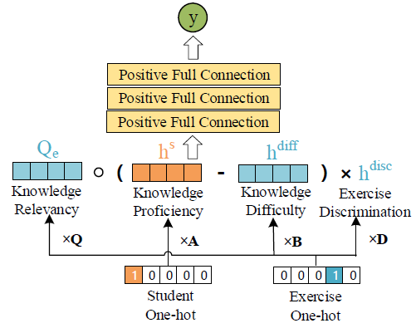


NeuralCDM
Feasible and effective – basic implementation with Q-matrix
input layer:
$$Q_{e}∘(h^{s}−h^{diff})×h^{disc}$$
$$F^{kn}∘F^{s}$$
Directly from Q-matrix
Notes:
Now I introduce two implementations based on NeuraCD framework. The first is a basic implementation with Q-matrix called NeuralCDM. The input layer is composed of knowledge relevancy vector, knowledge proficiency vector, knowledge difficulty vector and exercise discrimination. This part corresponds to the term that is mentioned before. The knowledge relevancy vector Q sub e comes directly from Q-matrix.

Slide 9
NeuralCDM
Feasible and effective – basic implementation with Q-matrix
interaction layer:
full connection
positive weights
Monotonicity Assumption
Notes:
The interaction layer is implemented with full connection layers. To achieve monotonicity assumption, we restrict all weights of layers to be positive.

Slide 10

NeuralCDM
Feasible and effective – basic implementation with Q-matrix
output layer:
Notes:
Finally, the output layer outputs the probability that the student would correctly answer the exercise. Then we use cross entropy loss for training.

Slide 11
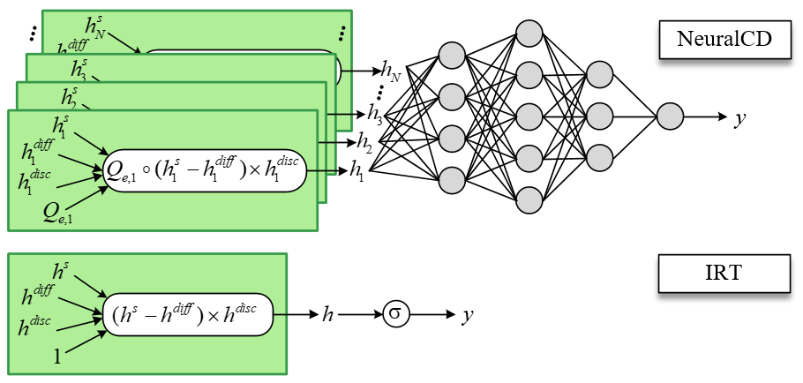
Generality of NeuralCD
NeuralCD framework is general and can cover some traditional models
e.g., IRT, MIRT, MF
Fix to 1
Multidimensional degraded to unidimensional
Multi-layer degraded to a single Sigmoid
Notes:
Finally, we also show that the framework is not only extendible, but also general. The NeuralCD framework can specialize to some traditional models, such as MF, IRT and MIRT.

Slide 12
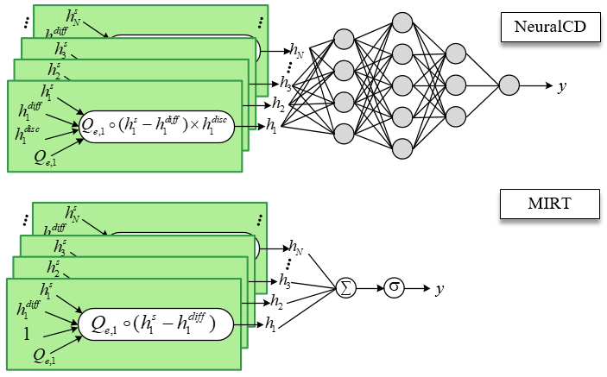
Generality of NeuralCD
NeuralCD framework is general and can cover some traditional models
e.g., IRT, MIRT, MF
NeuralCD
Multi-layer degraded to a summation and a single Sigmoid
MIRT
Fix to 1
Where Q is learned instead of labeled by experts. There is no explicit meaning of each dimension in Q.
Notes:
Finally, we also show that the framework is not only extendible, but also general. The NeuralCD framework can specialize to some traditional models, such as MF, IRT and MIRT.

Slide 13
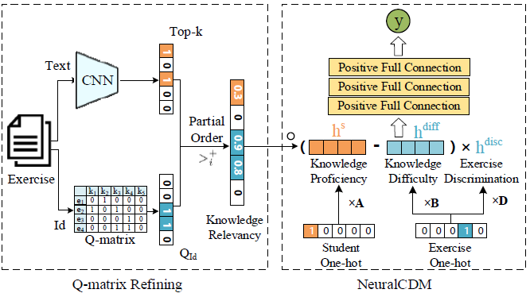
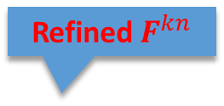

NeuralCDM+
Extendible – refine Q-matrix with exercise texts
pre-train a CNN to predict knowledge concepts of the input exercise
combine with Q-matrix through a partial order probabilistic scheme:
knowledge relevancy: Q-matrix >= predicted > other = 0
Predicted KCs
Refined$F^{kn}$
Original $F^{kn}$
Notes:
Another implementation extends NeuralCDM by refining Q-matrix with exercise texts. We first pre-train a CNN to predict knowledge concepts of the input exercise from the text. Then we combine the predicted concepts with Q-matrix through a partial order probabilistic scheme. That is, for each exercise, the relevancy of the knowledge concepts labeled by Q-matrix is higher than or equal to the predicted concepts. And all the rest knowledge concepts are irrelevant. Other parts are the same with NeuralCDM.

Slide 14
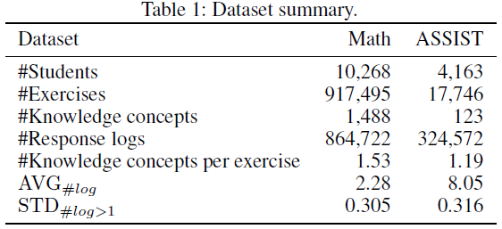
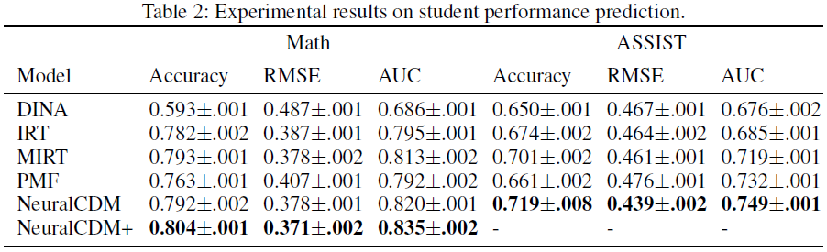
Experiments
Datasets
Math: Zhixue¹, mathematical exercises (with texts) and logs
ASSIST: Assistment², mathematical exercises (without texts) and logs
Student performance prediction
Best
¹Private dataset, provided by iFLYTEK Co., Ltd.
²https://sites.google.com/site/assistmentsdata/home/assistment-2009-2010-data/skill-builder-data-2009-2010
Notes:
We conducted experiments on two real-world datasets, Math and ASSIST. Math is a private dataset that collected from an online learning system Zhixue. ASSIST is public and collected from the online tutoring system ASSSITments. They both contains mathematical exercises and student logs. But ASSSIT does not provided the texts, so we didn’t test NeuralCDM+ on it.
AVG_{#log}: the average amount of logs that each student toke for each knowledge concept
STD_{#log>1}: the mean standard deviation of scores that each student got on each knowledge concept

Slide 15

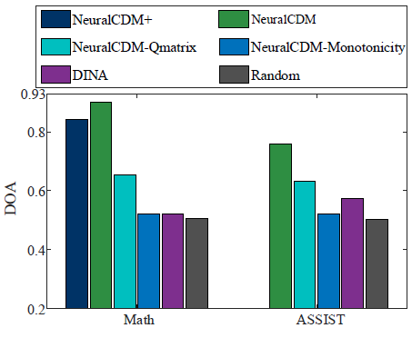
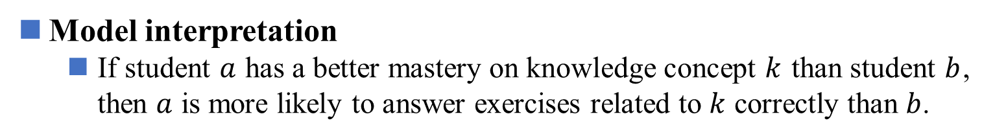
Experiments
Model interpretation
If student $a$ has a better mastery on knowledge concept $k$ than student $b$, then $a$ is more likely to answer exercises related to $k$ correctly than $b$.
Higher DOA: students who perform well on certain knowledge concept get higher diagnosed knowledge proficiency
Notes:
To measure the interpretation of the models, we computes DOA of the final student knowledge proficiency vectors. DOA is based on the intuition that if student $a$ has a better mastery on knowledge concept $k$ than student $b$, then $a$ is more likely to answer exercises related to $k$ correctly than $b$. This is the results. We can see that the DOAs of NeuralCDM and NeuralCDM+ is significantly higher than baselines. Besides, NeuralCDM-Qmatrix and NeuralCDM-Monotonicity denote removing Q-matrix and monotonicity assumption respectively. Their lower DOA indicates the importance of fined estimated knowledge relevancy vector and monotonicity assumption.

Slide 16
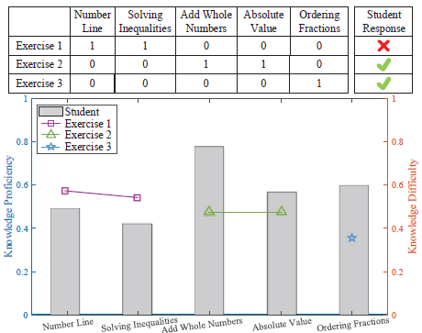
Experiments
Case study
a student’s performance on 3 exercise in ASSIST
and his/her diagnosed result
Q-matrix
Logs
The student is more likely to response correctly when his/her proficiency satisfies the requirement of the exercise.
Exercise Knowledge Difficulty (points)
Student Knowledge Proficiency (bars)
Notes:
Here we show a case study in ASSIST dataset. The upper part of the figure is the Q-matrix of 3 exercise and response logs of a student. For clarity, we only show 5 relevant knowledge concepts. In the lower part, the bars shows the student’s knowledge proficiencies on each concept, and the points shows the knowledge difficulties in corresponding exercises. From the figure we can observe that the student is more likely to response correctly when his proficiency satisfies the requirement of the exercise.

Slide 17
Conclusion
We propose a neural cognitive diagnostic framework: NeuralCD
student and exercise factors, neural network interaction layers
monotonicity assumption
Feasibility: NeuralCDM with Q-matrix
Extendibility: NeuralCDM+ with refined Q-matrix that leverages exercise texts
Generality: covers some traditional models
Effective and explainable: experiments on two real-world datasets
Code for NeuralCDM is available at https://github.com/bigdata-ustc/NeuralCD
Notes:
This is the conclusion of our work. we propose a neural cognitive diagnostic framework: NeuralCD, which project students and exercises to different factors and use neural network to learn interaction function between them. Monotonicity assumption is applied to guarantee the interpretation.
We show the feasibility and extendibility with two specific implementations of the framework, and the generality by proving that NeuralCD can cover some traditional models.
We further conducted experiments on two real-world datasets, and the results demonstrate that our models are both effective and explainable.

Slide 18
Thank you for listening
Q & A

