Slide 1
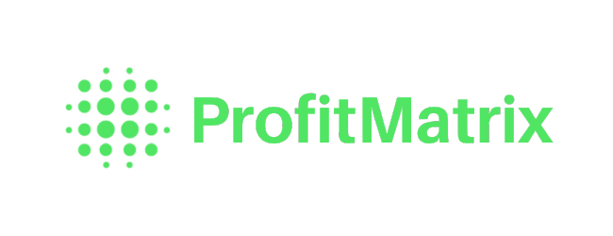
AI Pricing Manager Project
WEST CHESTER UNIVERSITY
Ali Abdulrazzak · Logan Yates · Dan Gannon· Ky-Khoa Nguyen · Karan Khademi · Alexander Sepella
Spring 2026

Slide 2



The Vision
2
$20B
One-person spreadsheets
Institutional knowledge walks out the door.
No early warning system
lost every year
No pricing team, no analysts, no alerts.
Small manufacturers bleed margin through hidden profit leaks — and nobody catches it.
Silent margin erosion
Revenue is gone before anyone notices.

Slide 3




About Our Client
3
MISSION
Maximize profit for manufacturers using simple, intuitive, and automated playbooks for pricing and margin analysis.
Giving small & mid-size manufacturers access to the same best-in-class pricing frameworks the largest companies use — to recover margin leakage at scale.
Kennett Square, PA
Founded 2024
Mid-size manufacturers
1K+ SKU complexity
Source: profit-matrix.com

Slide 4



The Solution
4
Three models. One dashboard.
Smart Clustering
Churn Detection
Margin Forecasting
Separates profit drivers from profit leaks using 80/20.
Flags at-risk customers via RFM before revenue disappears.
Predicts which products face margin squeeze next quarter.
All three feed one dashboard · alerts · drill-downs · audit trail

Slide 5




Agenda
5
What we'll walk through
01
02
03
04
05
Architecture
Cluster Model
Forecasting Model
Churn Model
Q&A
How the system is wired — from user prompt to model output.
Customer segmentation — Grow, Defend, Review, Optimize.
Predicting margin compression before it shows up in the P&L.
RFM-based scoring to flag at-risk customers early.
Status, next steps, and open discussion.
Start →
→ Wrap-up

Slide 6
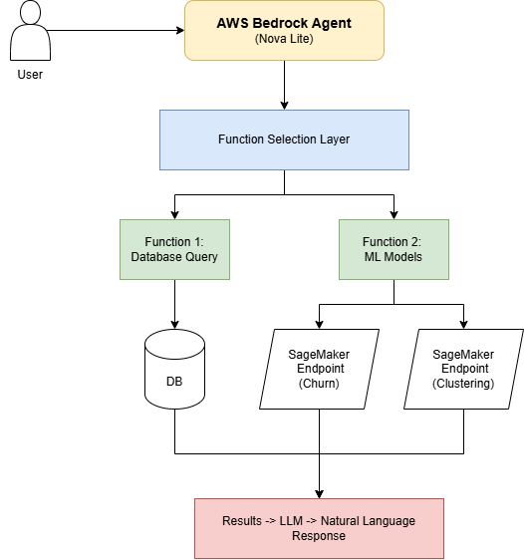
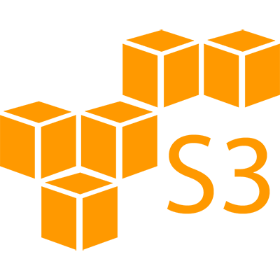
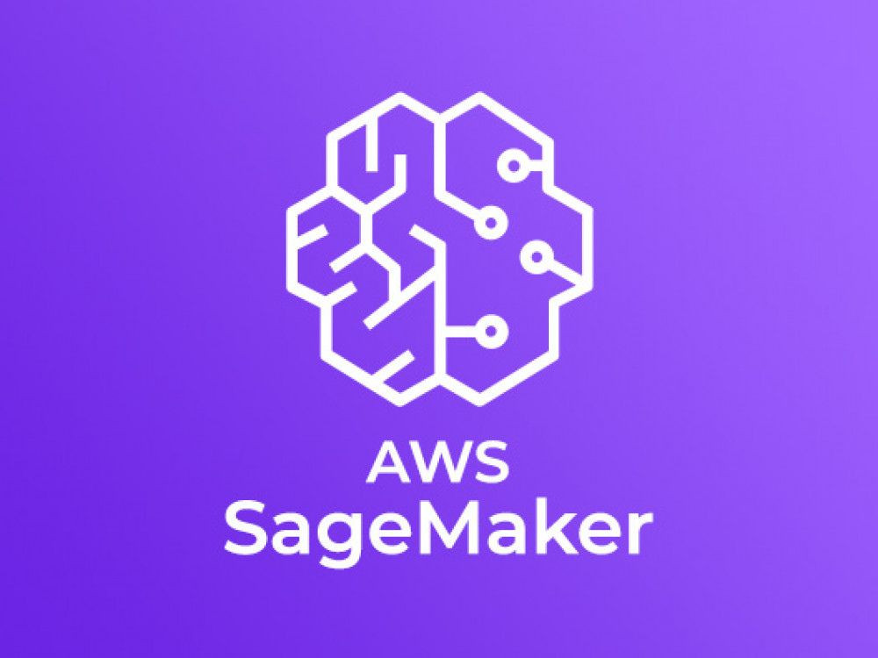
System Architecture
6

Slide 7
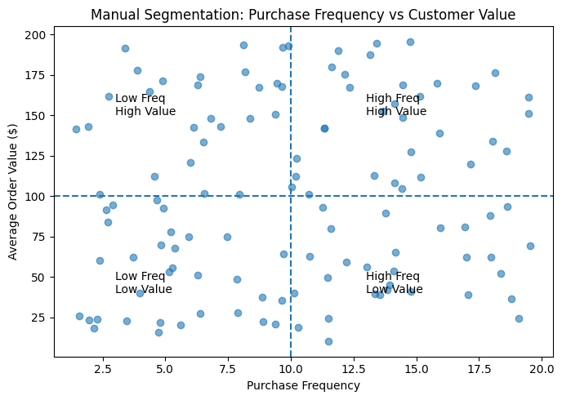
Manual Segmentation
7
Notes:
For the cluster model of our project, it takes advantage of two components. Manual segmentation is when you take the entirety of your data and split it into separate quadrants. In this example its easy to understand, anything above 50% is high, anything under is low, so in the botoom right corner it would represent high frequencey of purchase but a low value of product.

Slide 8
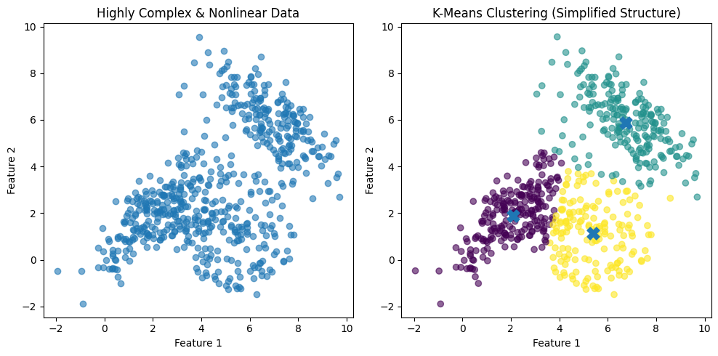
Clustering
8
Notes:
The second component is clustering where you group the data based on their similarity and proximity. When working with a bunch of data, its very hard to spot any patterns but with the model, it can detect and group the information based on the data that you have provided for it.

Slide 9
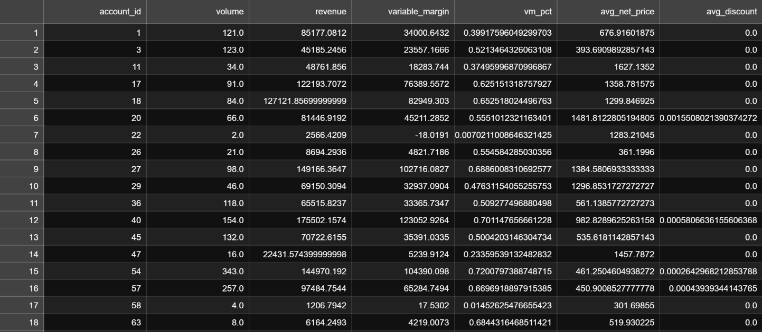
Raw Data
9
Notes:
So what you see right here is what I sale analst tend to work with. They would take your company raw data and transform it into a sales report that tells you actionable steps that you can take to improve your business. But the problem is that the small and medium size businesses that we catering to would not be able to afford a good 6 figure analyst. And at the same time, I don’t think anyone would want to go through hundreds of line of data to figure out what is wrong with their business. And so what our model would do is to take all of this data, and combine both the manual segmentation and clustering and transform it

Slide 10
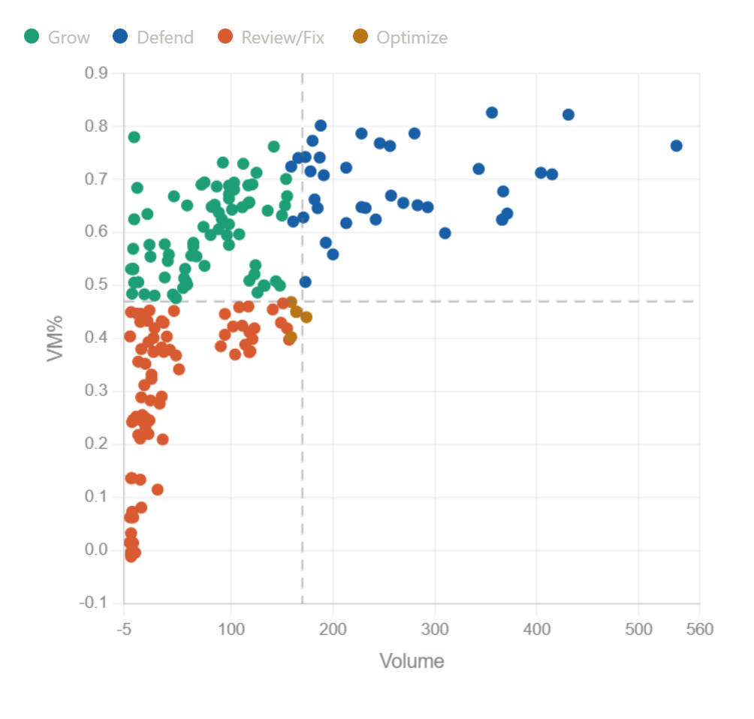
Clustering Segmention
10
Notes:
To get something called Clustering Segmentation, something more readable, understandable, and easier to digest. So now you can get a good representation of your company data that isnt just split into highs and lows category.

Slide 11
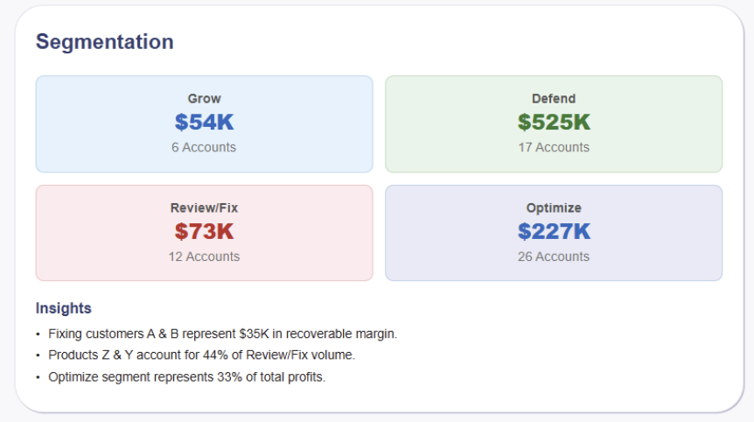
Cluster Model UI
11
Notes:
Afterward we convert the information into a simple UI design that even a non-technical user can interpret where you can see any accounts that you should grow, defend, fix, and optimize. The model even give actionable insights on what you can take advantage currently.

Slide 12
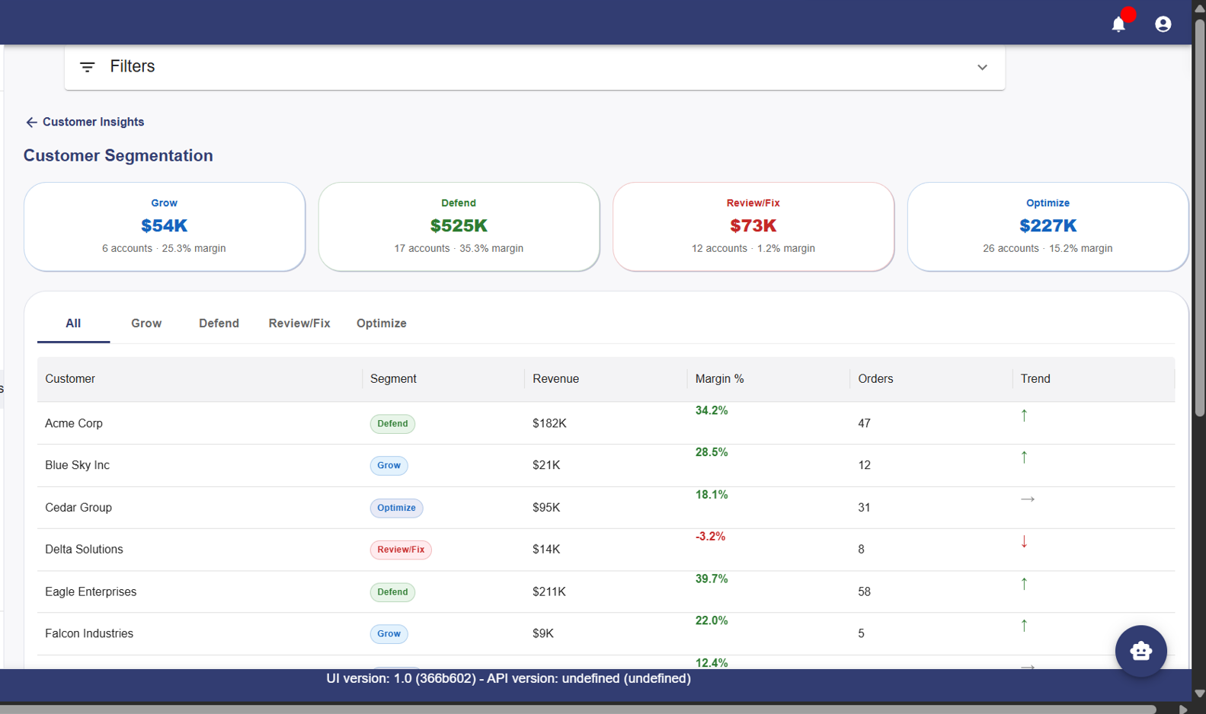
Cluster Model Detailed Page
12
Notes:
If you think that you would need a more indepth guide into what you are looking into, you can simply click on the card, and it will display an even more detailed page of what you were looking at.

Slide 13
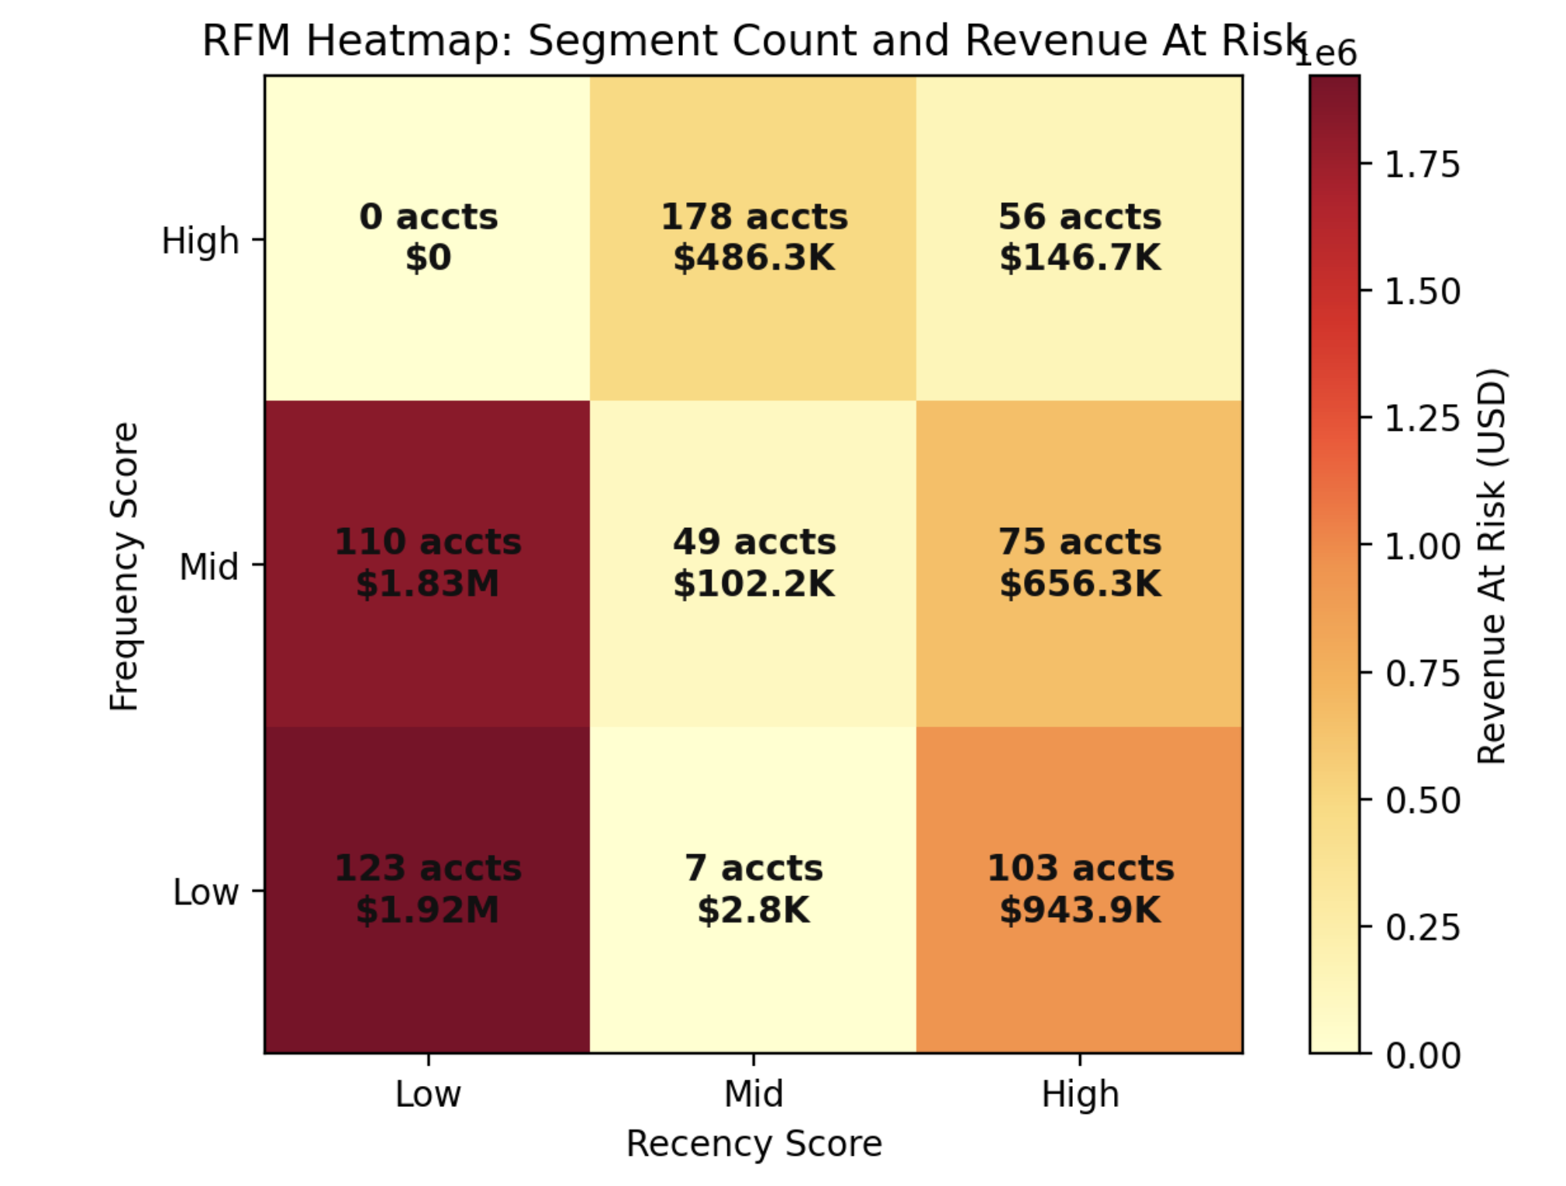
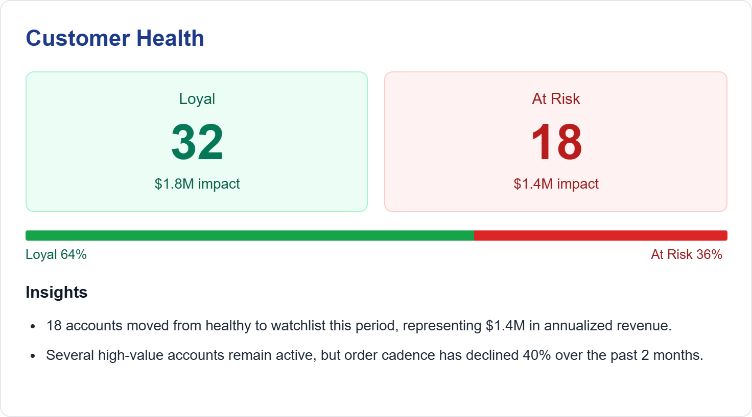
Customer Health
13

Slide 14
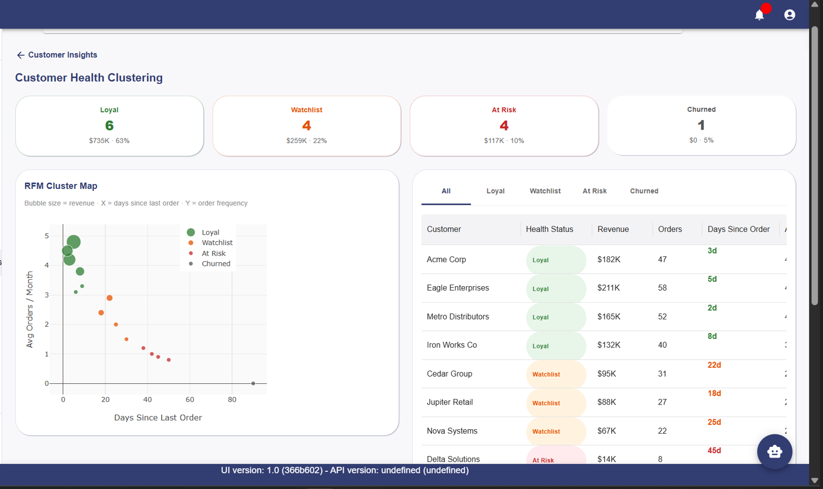
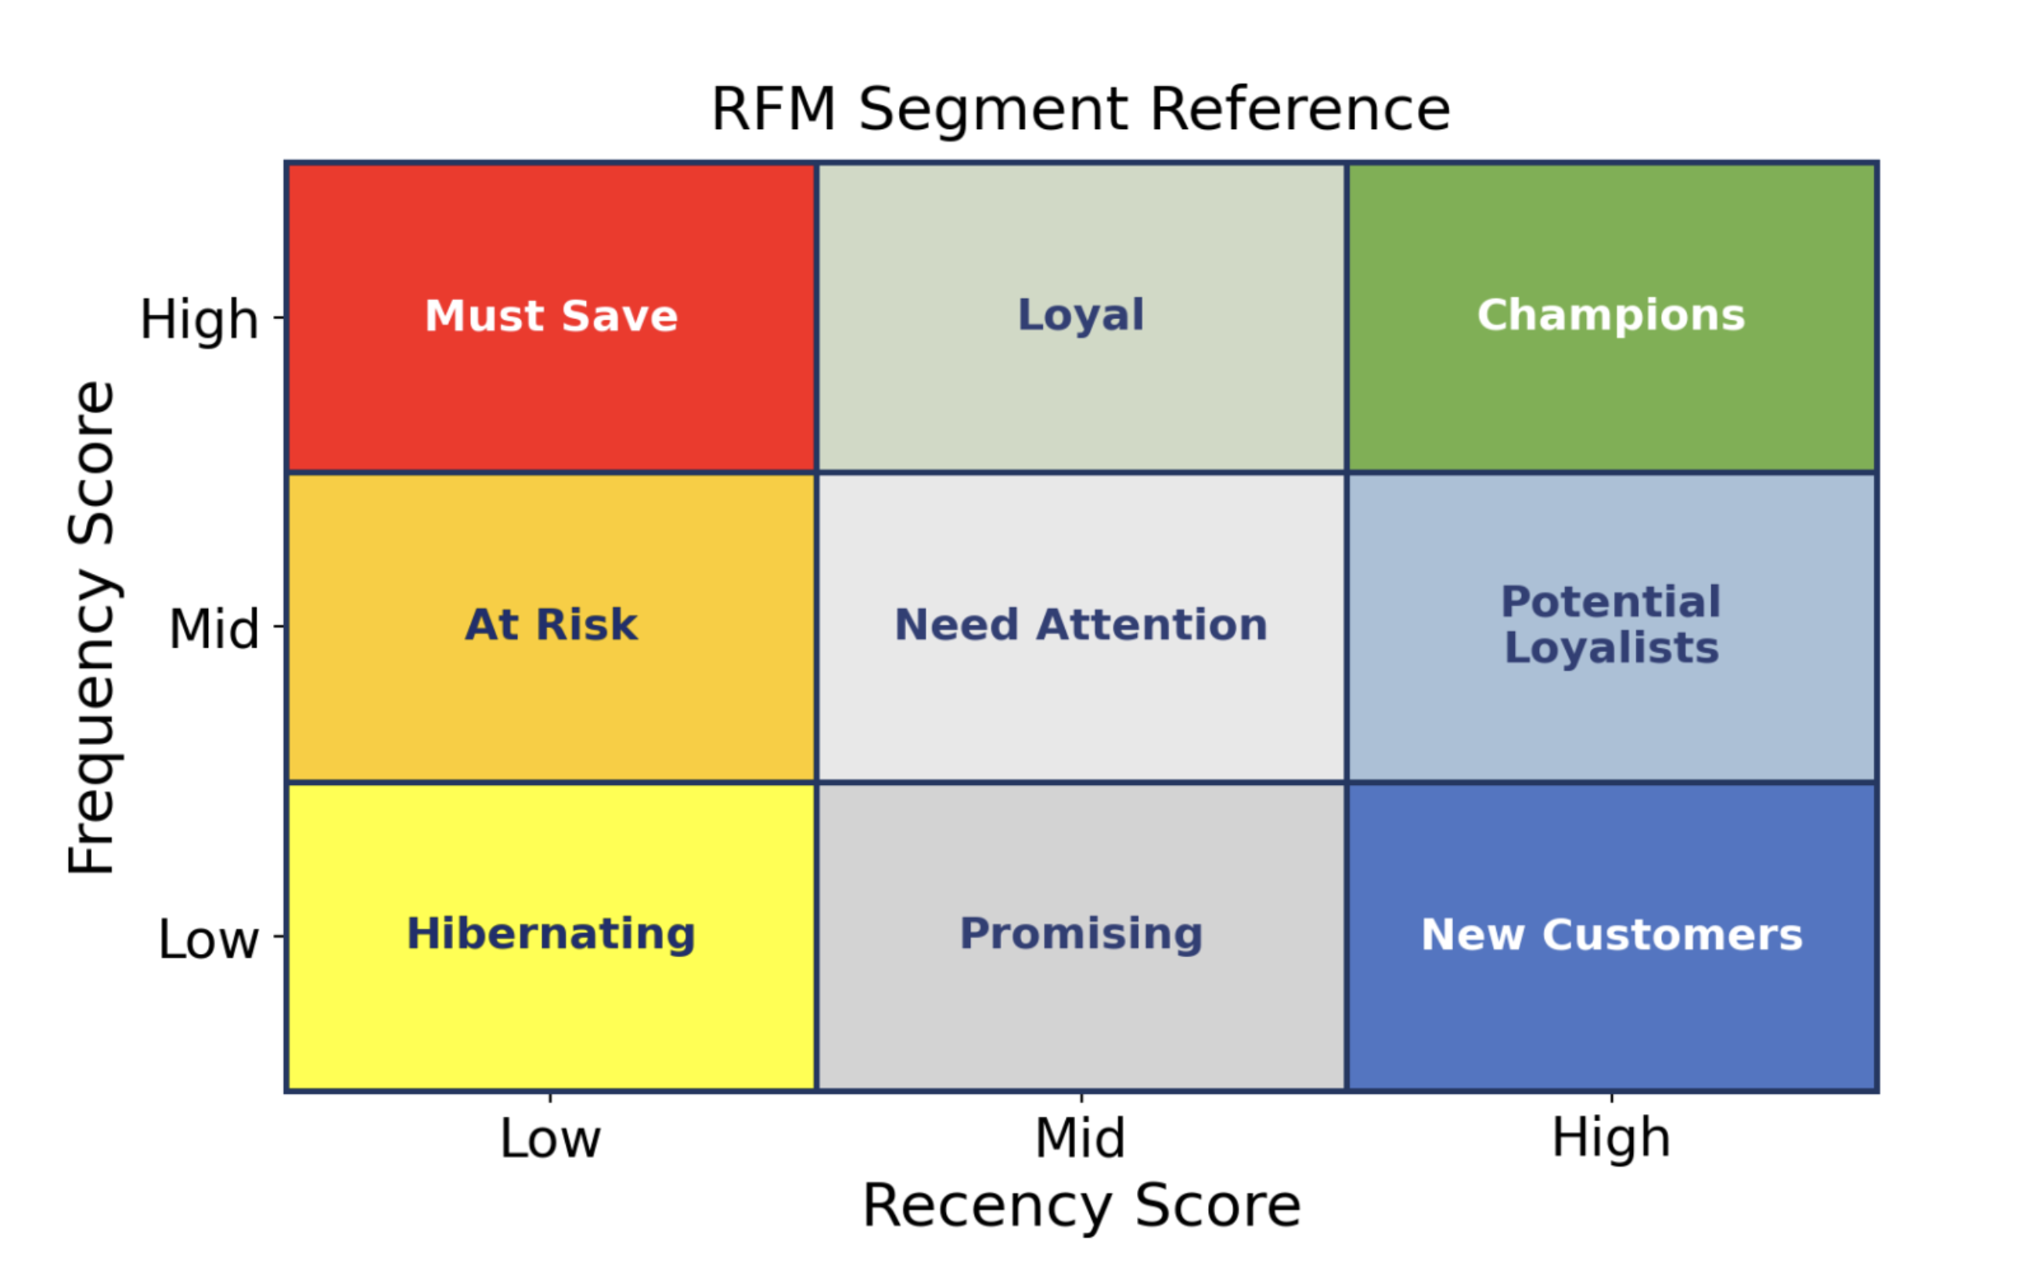
RFM Segmentation
14
Notes:
Here is a more complex version of what you just saw, which is closer to what you are more likely to experience in real life. In many cases, the data would be even more complicated, where it would look just like a pile of dots with no clear pattern.
The job of the clustering model is to interpret this data and group them based on the similarities, so we can understand the information better and actually see patterns that aren’t obvious at first.
And By doing this, it actually gives businesses more insight from the data that they already have instead of just looking at a bunch of scattered points.
For example, it can help identify areas where the business might be losing money without realizing it, dependent on certain types of customers or behaviors.
At the same time, it can also highlight where a large portion of revenue is coming from, helping businesses focus in on their most valuable customers.

Slide 15
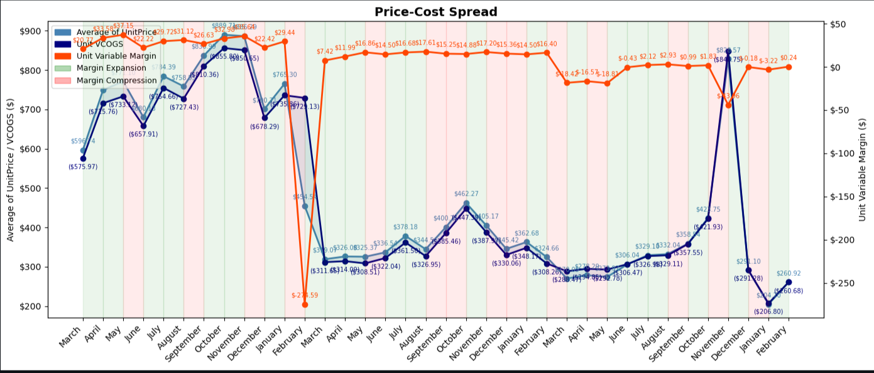
Forecasting Model
15
Feature Inputs
Order Dates
Product Categories
Dynamic Features:
Price-Cost Spread
Lag Features (t-1,t-3)
Sales Volume
Time Index
Month & Quarter

Slide 16
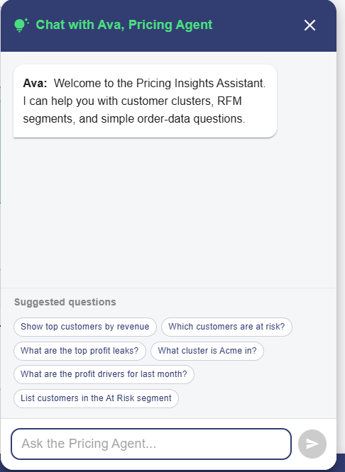
Chatbot Functionality and UI
16
Notes:
Here is a more complex version of what you just saw, which is closer to what you are more likely to experience in real life. In many cases, the data would be even more complicated, where it would look just like a pile of dots with no clear pattern.
The job of the clustering model is to interpret this data and group them based on the similarities, so we can understand the information better and actually see patterns that aren’t obvious at first.
And By doing this, it actually gives businesses more insight from the data that they already have instead of just looking at a bunch of scattered points.
For example, it can help identify areas where the business might be losing money without realizing it, dependent on certain types of customers or behaviors.
At the same time, it can also highlight where a large portion of revenue is coming from, helping businesses focus in on their most valuable customers.

Slide 17
Learning Achievements
17
✅Acquired practical fluency across core AWS services and cloud deployment practices.
✅ Established SageMaker endpoints — listing, describing, invoking, reading
✅ Learned to inspect and finetune a deployed Machine Learning model
✅ Built and connected front-end nested React Router routes Integrated with ML models
✅ Expanded AI Agent creation with Bedrock.js
✅ Constructed data visualizations using CSS and React
✅ Connected clustering, churn, and forecasting predictions concepts to visualized customer segmentation
Notes:
Here is a more complex version of what you just saw, which is closer to what you are more likely to experience in real life. In many cases, the data would be even more complicated, where it would look just like a pile of dots with no clear pattern.
The job of the clustering model is to interpret this data and group them based on the similarities, so we can understand the information better and actually see patterns that aren’t obvious at first.
And By doing this, it actually gives businesses more insight from the data that they already have instead of just looking at a bunch of scattered points.
For example, it can help identify areas where the business might be losing money without realizing it, dependent on certain types of customers or behaviors.
At the same time, it can also highlight where a large portion of revenue is coming from, helping businesses focus in on their most valuable customers.

Slide 18
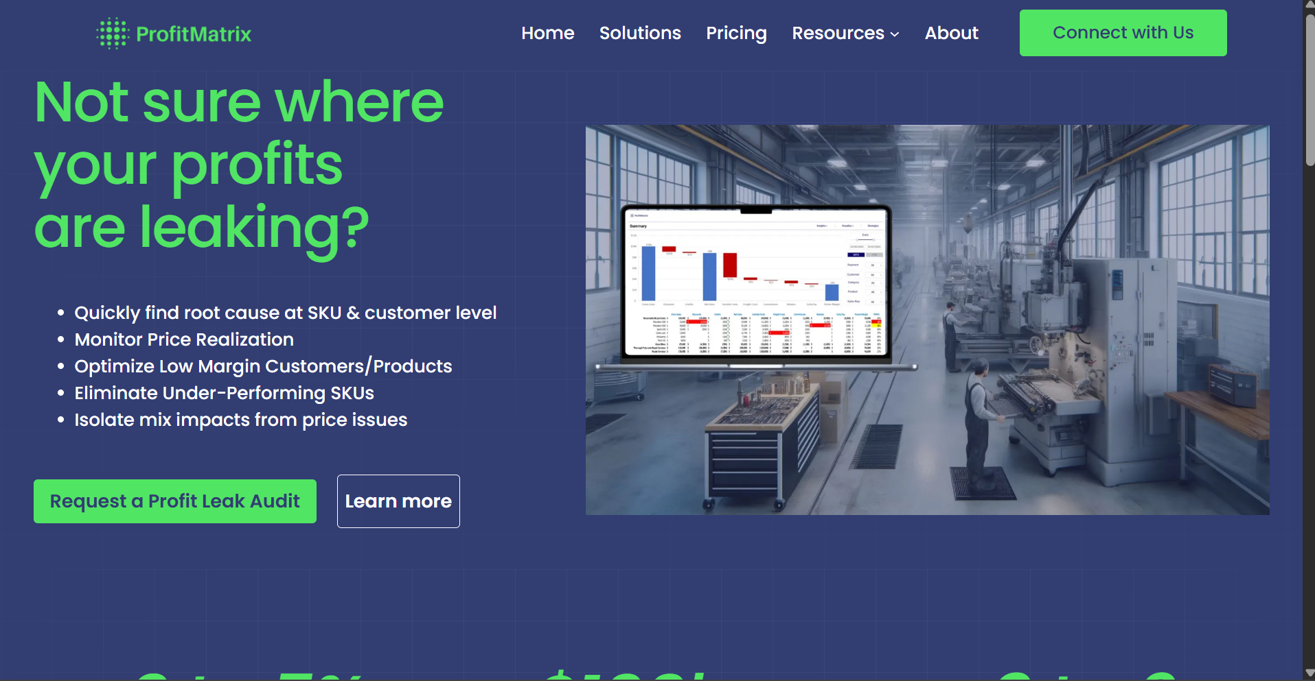
Accomplishments
18
An end-to-end product that displays customer and product segmentation and forecasting.
Key Features:
Ability to pull from a database (S3 Bucket) and to use AI Chatbot for queries.
Ability to use Machine Learning Models to present data that is digestible and simple for a non-expert in Business Analytics.

Slide 19
Thank You!
Questions & Discussion
GitHub: github.com/WCU-ProfitMatrix (3 repos: UI · API · ML)
Platform: AWS Bedrock · SageMaker Studio · RDS PostgreSQL · React
Team: Ali Abdulrazzak · Logan Yates · Dan Gannon · Ky-Khoa Nguyen · Alexander Sepella · Karan Khamadi

