Slide 1
FYND INTERNSHIP CHALLENGE
-Multi-Class Classification Task
-Paveethran S

Slide 2
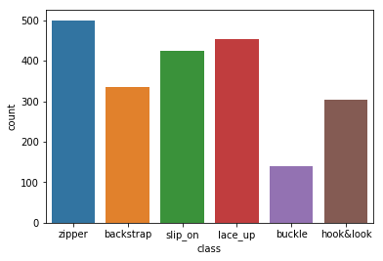
Approach
After web scraping data from the URL’s, I saw the data was Imbalanced.The ‘zipper’ class is major class and ‘buckle’ is minor class.

Slide 3
So I used Under Sampling to get 250 images of each class,totaling 250*6=1535 images for Train dataset
Similarly in Test dataset 100 images of each class, 100*6=600 images.
Then I Augmented the images in the datasets to increase the number of images to 4506 images in Train and 1800 images Test dataset.

Slide 4
Since data was small and large training was not feasible for me, I applied TRANSFER LEARNING to get transform the image features, using the VGG16 network.
After processing the images( hist normalizing), I passed the x_train and x_test through a custom-built MLP.
After training for 30 epochs with an output layer dimension of 6 nodes for 6 classes, I managed to get pretty good results for this multi-class classification problem.

Slide 5
Hyper Parameter Selection
After some calculations, I was convinced with the following parameters:
-Input layer nodes=25088
-Optimizer= SGD
-Learning rate=0.0021
- No. of Epochs=30
-Loss= categorical_crossentropy
-Activation func=Relu(hidden layers), Softmax(Output layer)
-Total Trainable Parameters=56,932,950,000

Slide 6
Optimization
To avoid Overfitting and to slightly improve the validation accuracy, I added the following:
-Regularizer=L1 (0.00001) for 3 layers
-L2(0.00001) for other 2 layers
Added one more Hidden layer, total of 6 layers.

Slide 7
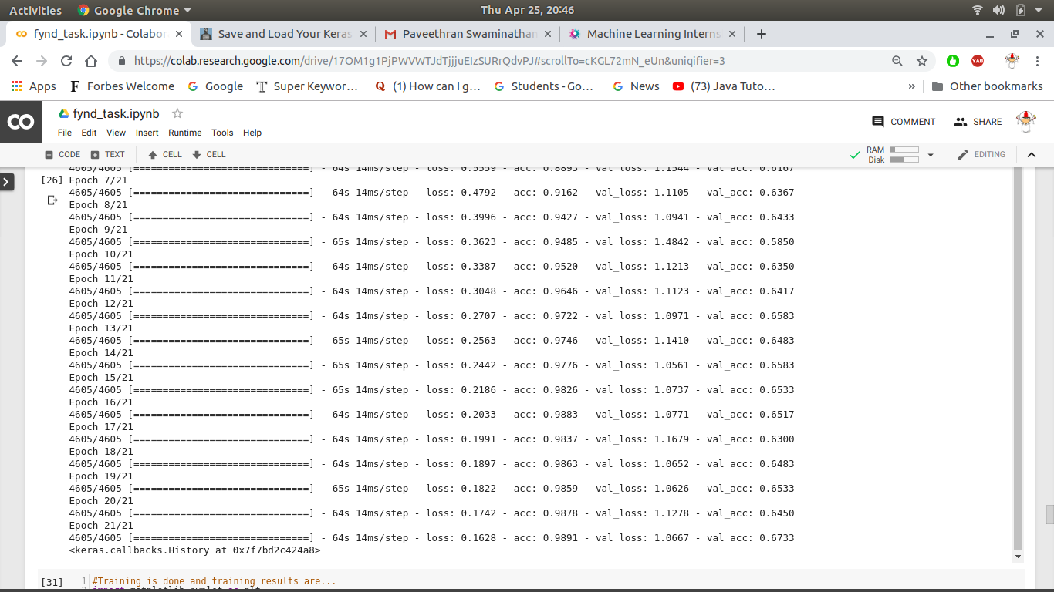
Neural Network Training

Slide 8
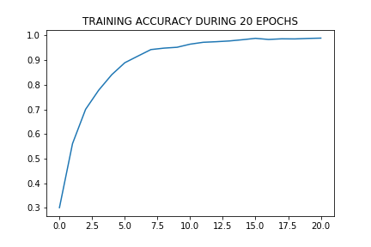
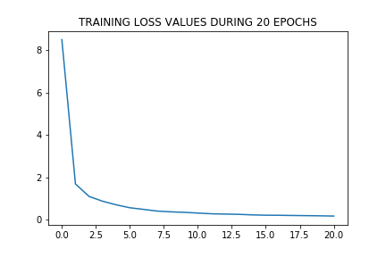
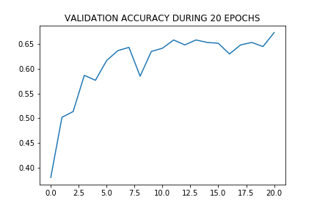
Performance Metrics

Slide 9
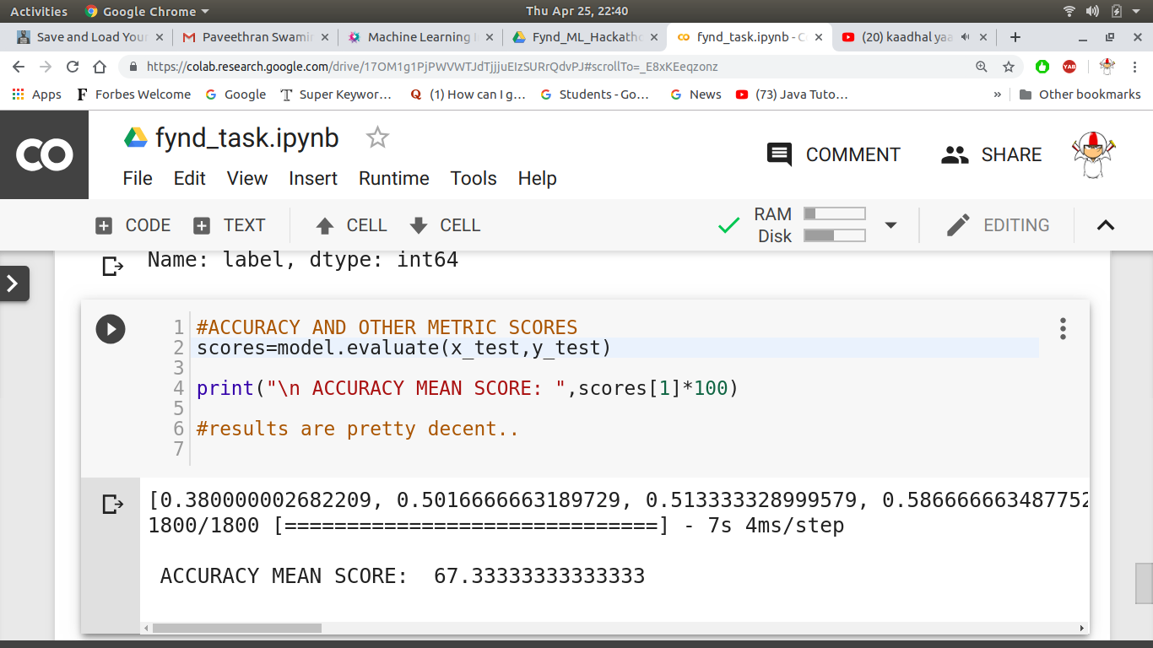
Results
Mean validation accuracy of 68%
Recall score=0.81

Slide 10
What could be done to improve more?
I did not use the given dataset images FULLY.
If I could have been able to download and use the remaining data, the accuracy could have increased to 70-75%.
Also, a Deeper neural network would have increased the accuracy.

Slide 11
Please, refer the folder for fynd_task.ipynb for codes and explanations.
Run the classifier.py file to make predictions on any CSV, and get the resulting predicted CSV in the same folder.

Slide 12
THANK YOU

