Slide 1
Team Name : Roboduino Team Leader Name : Tanish Agarwal Idea Title : Automatic Engine Locking For Drunken Drivers Domain : Auto-Tech
Team and Idea Title

Slide 2


Idea Approach Details
Tech Stack:
Idea:
Predict The Driver Have Drunk or Not: Utilizing mq3 sensor to analyze user is Drunk or not and if its then it will get displayed.
The vehicle get Locked : If alcohol detected then the vehicle get locked and buzzer starts beeping .
Solution Flow
[User Input Drunk ] --> [Mq3 Analysis] --> [Message sent to Arduino uno]
|
v
[Analyze and sent instruction]
|
v
[Vehicle get locked]
|
v
[Reset]

Slide 3




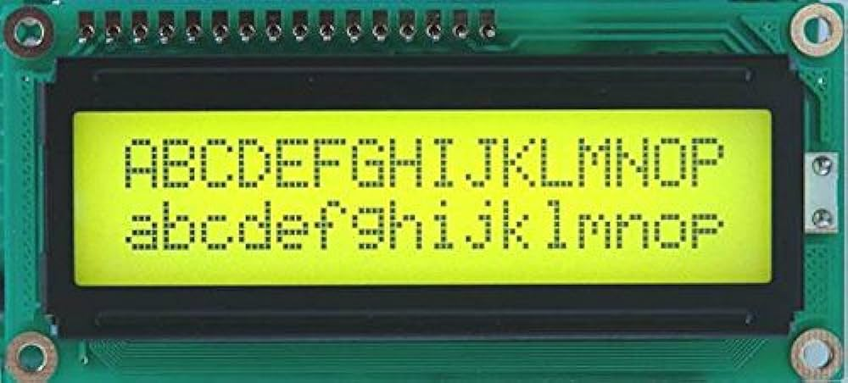
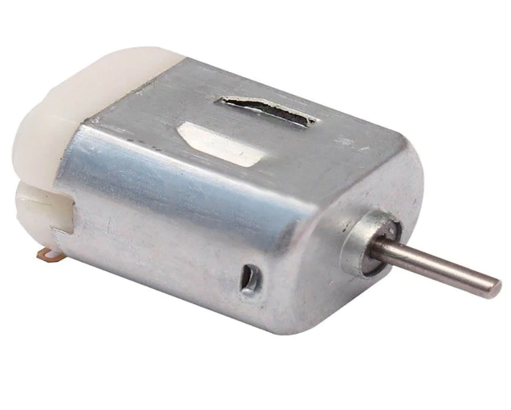
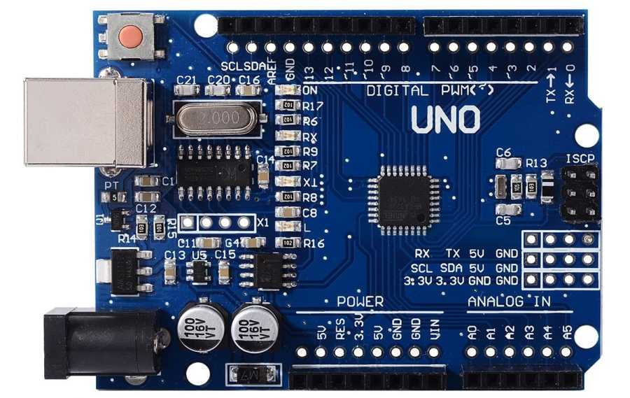
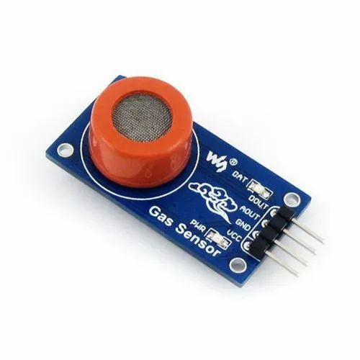
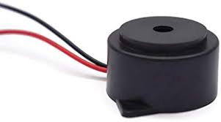
Components Used
Arduino UNO
MQ3 ALCOHOL SENSOR
LCD DISPLAY
BUZZER & DC MOTOR
It is an embedded system which we use for controlling the whole section and dc motor.
It senses the percentage of ethanol molecules. When the value increases then it gives signal to Arduino.
It is used to display and show the percentage level of alcohol
If the alcohol percentage reaches 40% then the motor will stop and engine gets locked

Slide 4
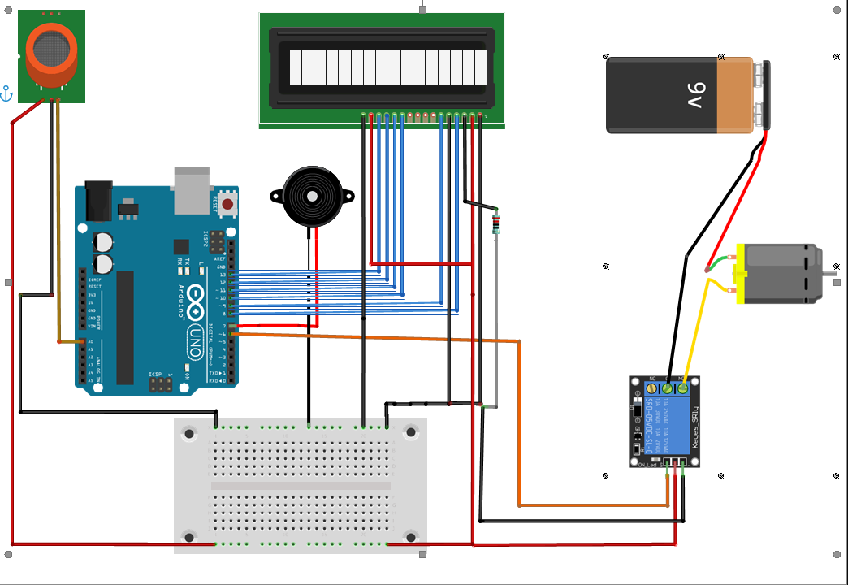
Detection of Alcohol consumption by Driver

Slide 5
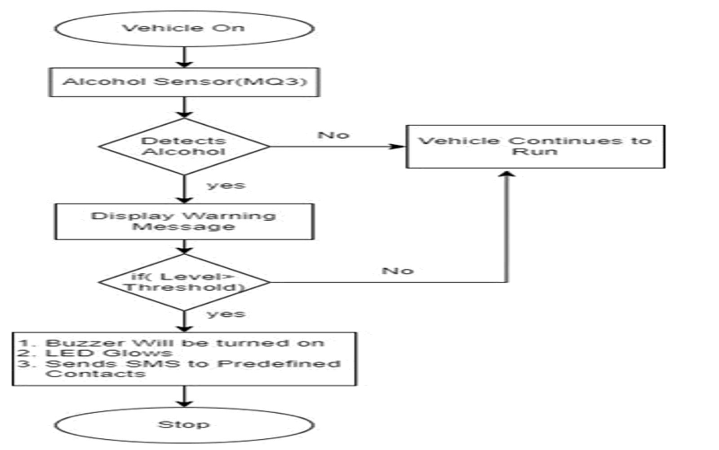

Slide 6
Advantages
It can accurately measure a driver's BAC level and prevent them from operating the vehicle if their level is above the legal limit.
Drink and drive can be avoided.
This reduces the risk of accidents caused by impaired driving
The system can help to deter drunk driving by providing a visual reminder of the consequences of drinking and driving.

Slide 7
THANK YOU
Team members Details:
Tanish Agrewal -3rd year CSE Role – Circuit designing .
Malhar Asegaonkar – 3rd year E&TC Role – Circuit Building.
Mangesh Kattulwad – 3rd year E&TC Role – PPT design , debugging , Software code

