Slide 1
Effective Teaching Session Plan

Slide 2
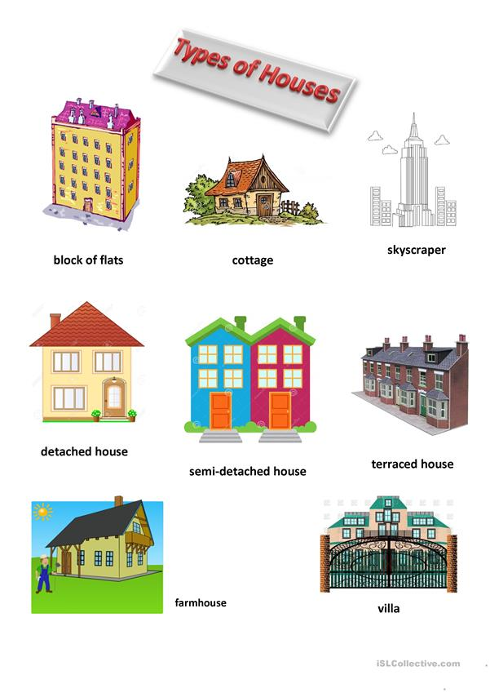
Introduction to Session Planning
Understand the importance of a structured session plan in educational settings.
Identify the key components that constitute a well-rounded session plan.
Learn how detailed session planning enhances the effectiveness of learning outcomes.

Slide 3
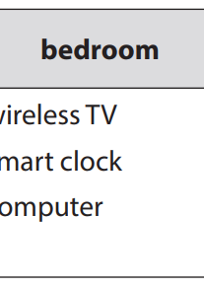
Objectives of the Lesson
Define clear academic goals for students by the end of the lesson.
Align objectives with curriculum standards and student needs.
Example: By the end of the lesson, students will understand the future simple tense.
Example: Students will correctly pronounce vocabulary related to modern technology.

Slide 4
Session Overview
Provide a brief summary of what the session will cover, including main themes and topics.
Incorporate real-world connections to make the content relatable and engaging.
Ensure that all necessary materials and resources are prepared in advance.

Slide 5
Target Vocabulary and Pronunciation
Focus on pronunciation of key vocabulary: UFO, solar TV, smart TV, wireless TV, solar energy.
Integrate engaging activities to familiarize students with the terminology.
Emphasize the importance of correct pronunciation in communication.

Slide 6
Grammar Focus: Future Simple and MIGHT
Introduce and explain the future simple tense and its uses.
Discuss the modal verb 'MIGHT' for indicating possible future actions.
Provide examples and exercises for students to practice these grammatical aspects.

Slide 7
Discussion and Feedback
Encourage student participation through prompted discussion questions.
Gather feedback from students about the lesson content and classroom activities.
Use feedback to adapt future teaching methods for improved learning outcomes.

Slide 8
Implementation of Activities
Begin with an engaging introduction to capture students' interest.
Guide students through vocabulary exercises that reinforce lesson material.
Introduce grammar activities that apply theoretical concepts practically.
Conclude with a recap and Q&A session to consolidate learning.

Slide 9
Home Assignments
Assign tasks that complement the day's lesson, reinforcing learned concepts.
Example: Students read and summarize a conversation on futuristic homes.
Example: Conduct online research on future house designs.
Assess understanding through assignment completion and discussion.

Slide 10
Quiz: Test Your Knowledge
Which word in the vocabulary list is NOT related to 'television'?
A. Smart TV
B. Wireless TV
C. Washing machine
D. Solar TV
Engaging quizzes support active recall and knowledge retention.

Slide 11
Quiz: Answer Explained
Clarifying answers strengthens conceptual understanding.

Slide 12
Competencies Development
Students develop linguistic and communicative competencies through group and individual tasks.
Emphasize the importance of cooperative learning and effective communication.
Foster personal growth by encouraging collaborative projects and pair work.

Slide 13
Qualities and Attitudes
Instill a positive attitude towards learning about modern technology and appliances.
Guide students in appreciating the practical benefits of learning about futuristic homes.
Cultivate respect for diverse perspectives during group activities.

Slide 14
A slide illustrating key ideas/aspects/concepts

Slide 15
Using Technological Resources
Utilize resources like laptops and projectors to enhance lesson presentations.
Incorporate multimedia elements like videos and interactive slides to engage students.
Maintain technical readiness to ensure smooth execution of the session.

Slide 16
Classroom Management Strategies
Design seating arrangements that maximize interaction.
Set clear expectations for behavior and participation.
Implement techniques to maintain focus and address disruptions swiftly.

Slide 17
Assessment and Evaluation
Conduct formative assessments to track progress throughout the session.
Use summative assessments to evaluate overall understanding at session's end.
Provide constructive feedback to support student learning and improvement.

Slide 18
A slide with a double column layout: Future Simple and MIGHT
Understanding Future Simple
Using MIGHT for Possibility
Used for actions certain to happen
Formed with 'will' + base verb
Examples include predictions, promises
Expresses uncertainty or possibility
Formed with 'might' + base verb
Examples illustrate potential outcomes

Slide 19
Real-World Applications
Discuss the impact of modern appliances on daily living efficiency.
Encourage students to envision future homes utilizing advanced technologies.
Engage students in projects that apply lesson concepts to real-world scenarios.

Slide 20
Conclusion and Key Takeaways
Summarize the session with an emphasis on the key learnings and objectives achieved.
Highlight the skills and knowledge students developed during the lesson.
Encourage ongoing exploration of the topics covered and applications in everyday life.

Slide 21
Thank you!

