Slide 1
Session Plan for Teaching: Our Houses in the Future

Slide 2
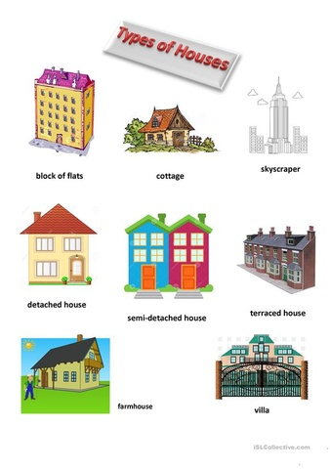
Overview of the Teaching Session
Introduction to the session objectives and goals
Understanding the importance of vocabulary and pronunciation in learning
Highlighting the aspects of grammar to be covered
Discussing the significance of collaborative and independent work

Slide 3
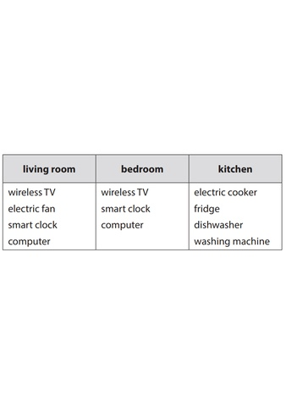
Vocabulary and Pronunciation
Focus on key vocabulary: UFO, solar TV, smart TV, wireless TV, solar energy
Learning the correct pronunciation of these words
Examples: Pronunciation drills and exercises
Introduce additional vocabulary related to home appliances

Slide 4
Key Concepts and Grammar
Understanding the use of Future Simple tense and MIGHT for expressing future possibilities
Usage of prepositions 'in' and 'on' in context with time and place
Examples of sentences using these grammar points in relation to house and appliance descriptions

Slide 5
Session Activities and Implementation
Teacher initiates a recap of the previous lesson
Students engage in vocabulary recall activities
Teacher provides feedback and sets homework assignments

Slide 6
Quiz: Test Your Knowledge
What is one of the key elements of grammar covered in this session?
A. Usage of past perfect tense
B. Future simple and might for possibilities
C. Present continuous only
D. Past simple tense
Testing knowledge enhances engagement

Slide 7
Quiz: Answer Explained
Understanding future tense structures is crucial for expressing future events

Slide 8
Innovative Concepts and Engagement

Slide 9
Conclusion and Next Steps
Key Takeaways: Improved vocabulary and understanding of future tense
The significance of homes and appliances in everyday life
Encouragement for students to explore more about home designs and technology
Call-to-Action: Students should complete the assigned homework and prepare for the next session

Slide 10
Thank you!

