Slide 1
INFINITY LEGAL PLATFORM
New Features & AI Integration Client Presentation
AI-Powered Legal Operations for the South African Market
February 2026 | Confidential

Slide 2
Executive Summary
🤖 AI Audit Intelligence
Automated audit analysis with risk scoring, pattern detection, anomaly alerts, and natural language querying. POPIA & LSSA compliance built-in.
📊 Competitive Intelligence
AI-generated market analysis, competitor profiling (LegalWise, traditional firms, online platforms), and actionable lead generation strategies.
📞 AI Lead Scoring
Automatic lead prioritization with A-F grading, conversion likelihood, personalized talking points, and best follow-up timing.
📚 AI Legal Research
South African law research assistant — case law, legislation references, strategy recommendations with proper disclaimers.
👥 Staff Management
Enhanced team dashboard with composition cards, search/filter, role-based onboarding modal, and department tracking.
🔒 Audit Trail Enhancement
Three view modes (AI Analysis, Timeline, Table), expandable event details, and POPIA compliance notices.

Slide 3
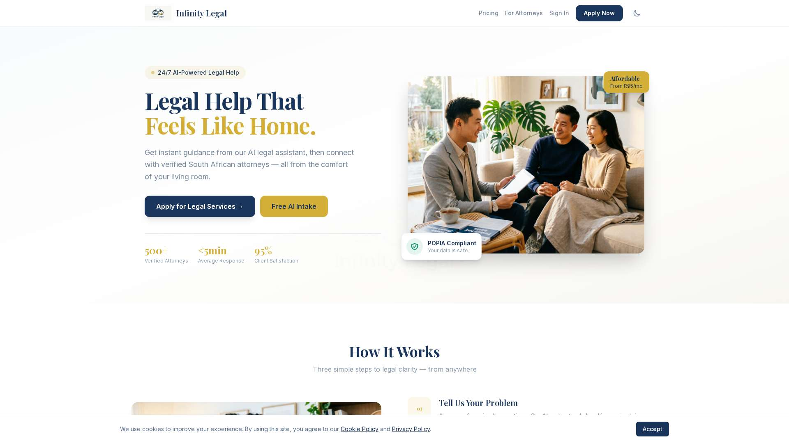
Client-Facing Landing Page
"Legal Help That Feels Like Home" — AI-powered intake, POPIA compliant, subscription pricing from R95/mo

Slide 4
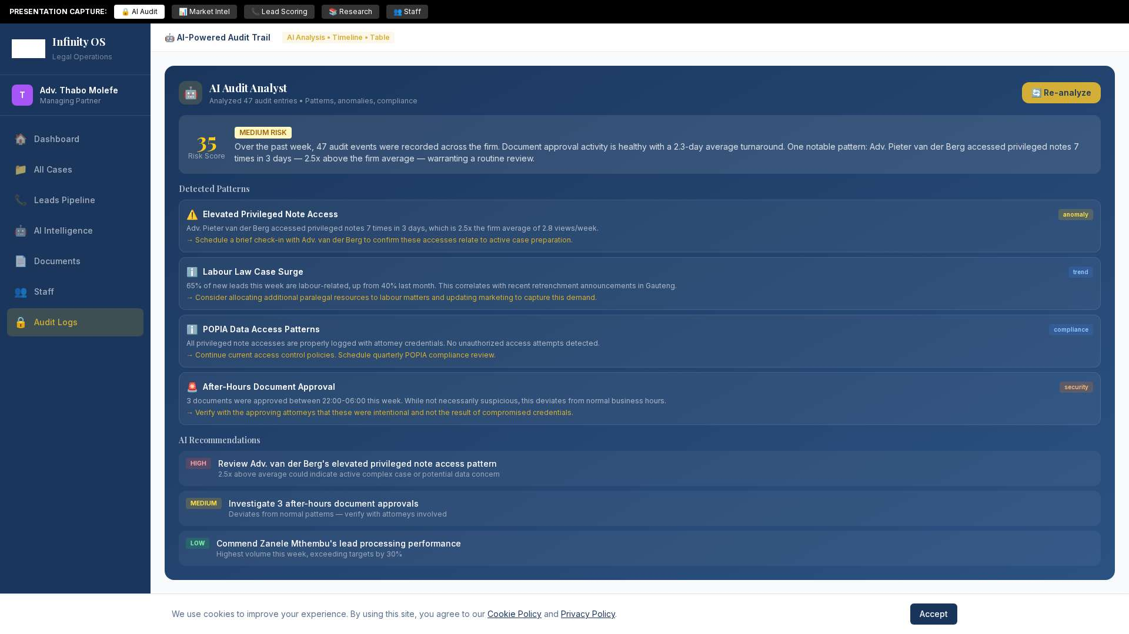
AI-Powered Audit Trail
One-click AI analysis: Risk scoring, pattern detection, anomaly alerts, compliance notes, and "Ask the Audit" natural language queries

Slide 5
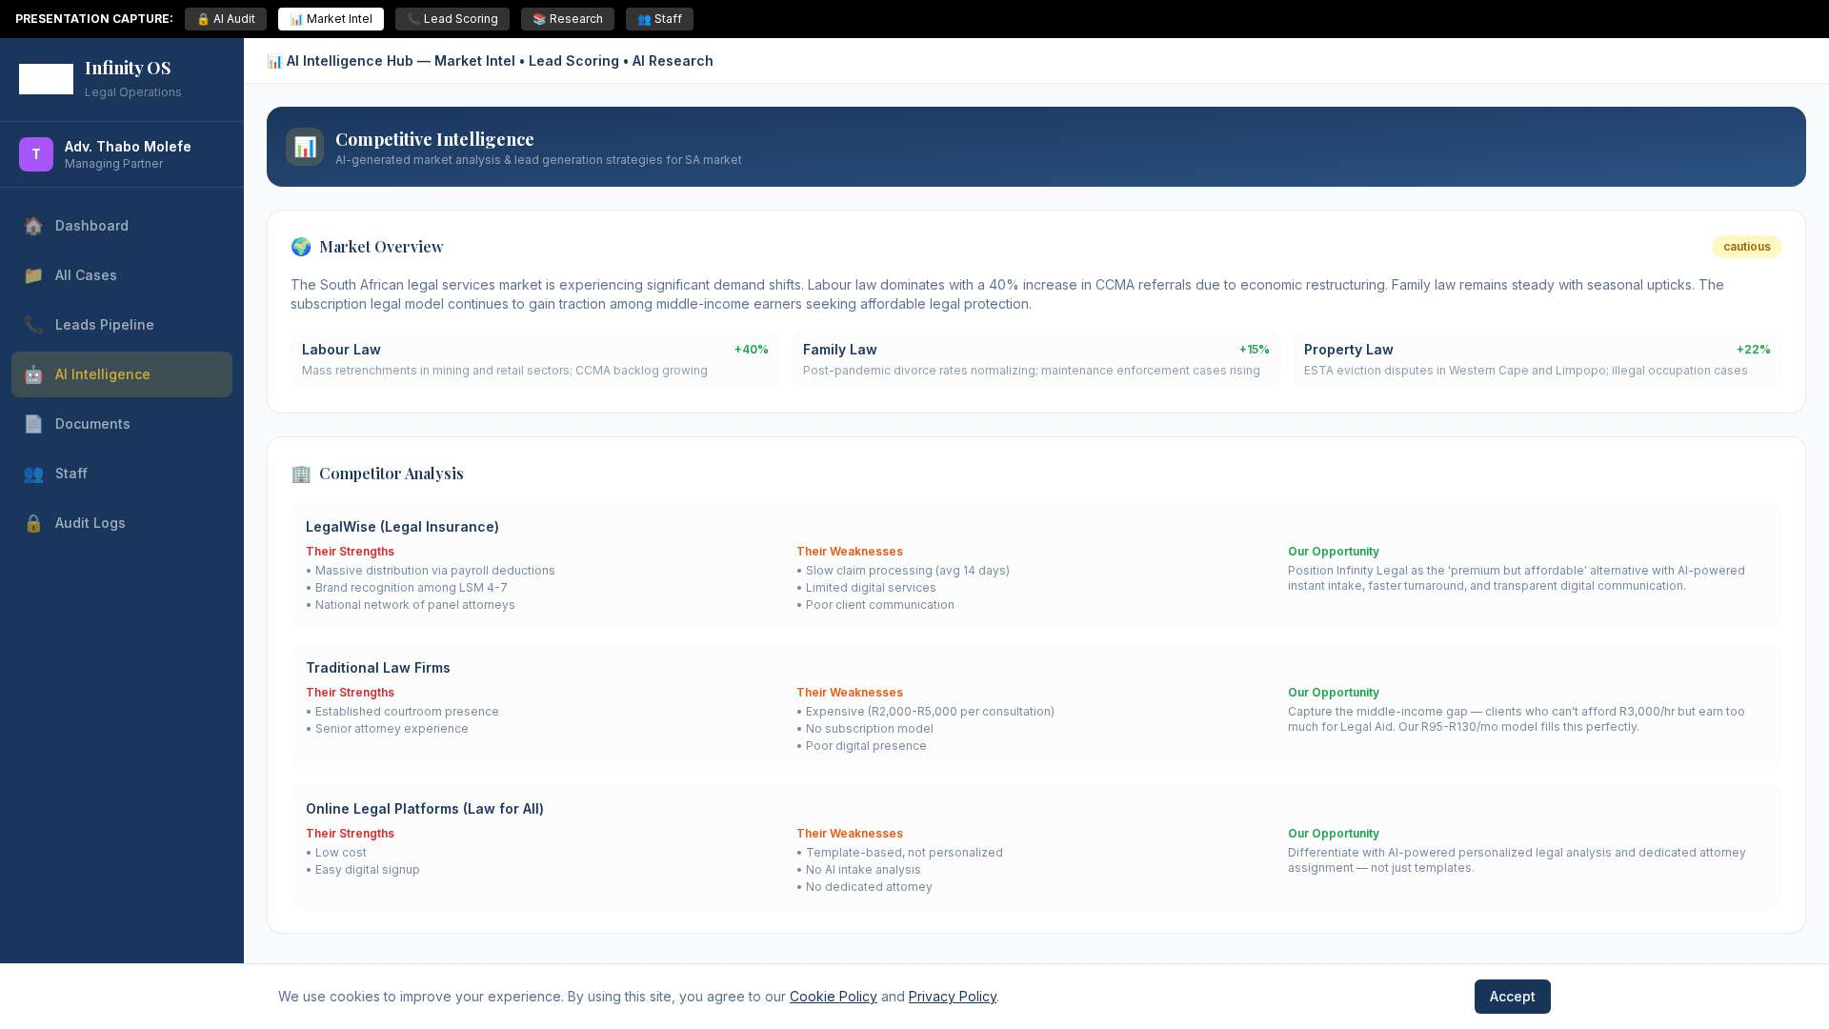
AI Competitive Intelligence
Market overview, trending practice areas, competitor analysis (LegalWise, traditional firms, online platforms), and our strategic opportunities

Slide 6
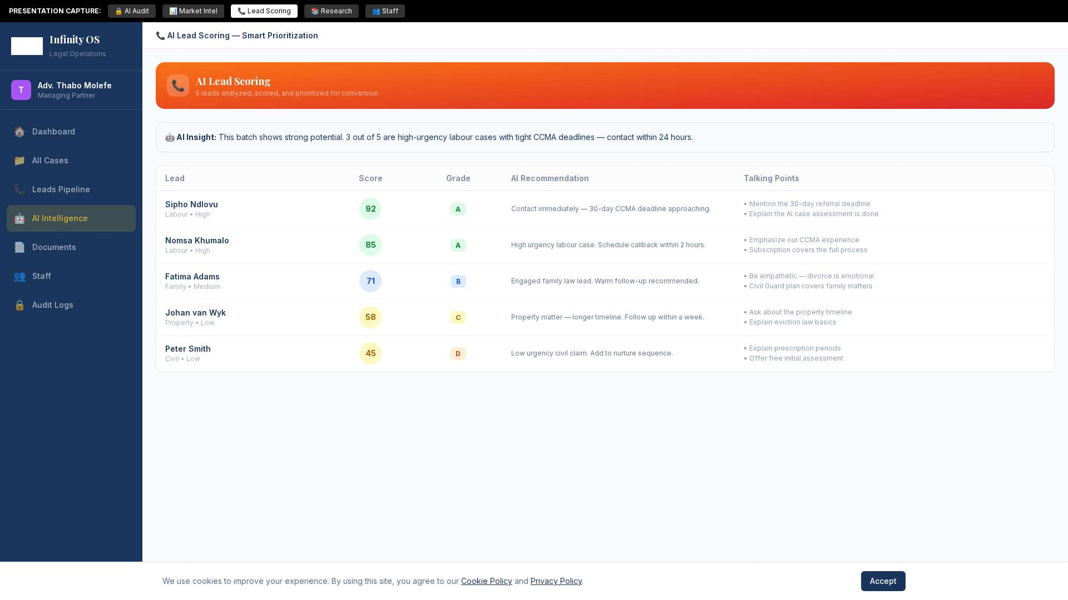
AI Lead Scoring & Prioritization
AI analyzes each lead and provides: conversion score (0-100), letter grade (A-F), actionable recommendation, and culturally appropriate talking points

Slide 7
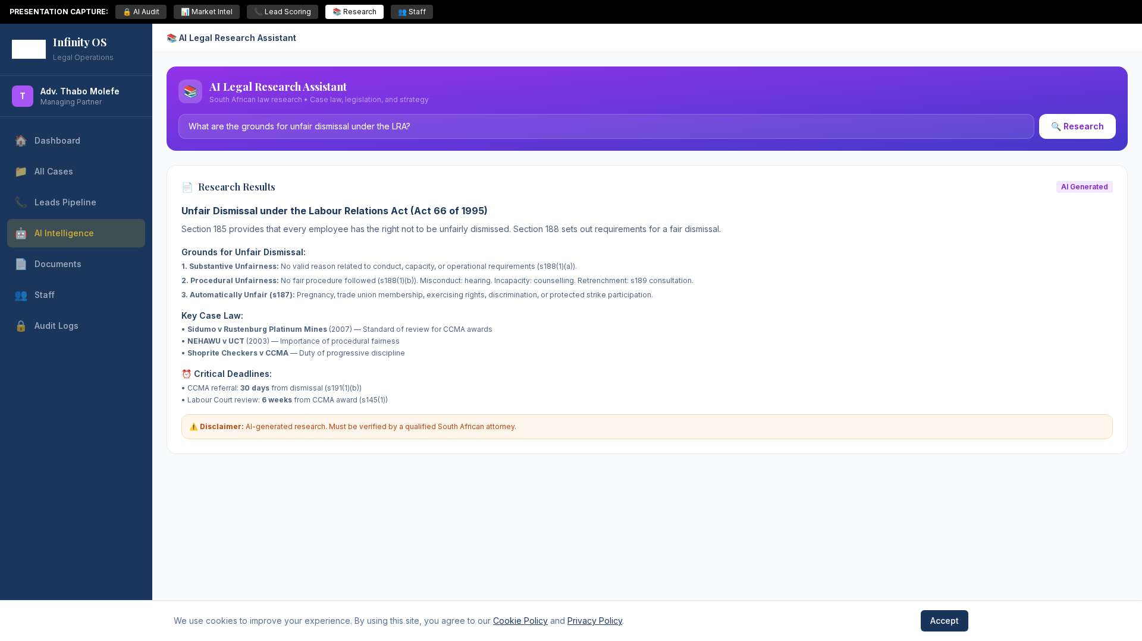
AI Legal Research Assistant
South African law research: LRA, Children's Act, BCEA, PIE Act, and more. Case law citations, critical deadlines, and strategy recommendations.

Slide 8
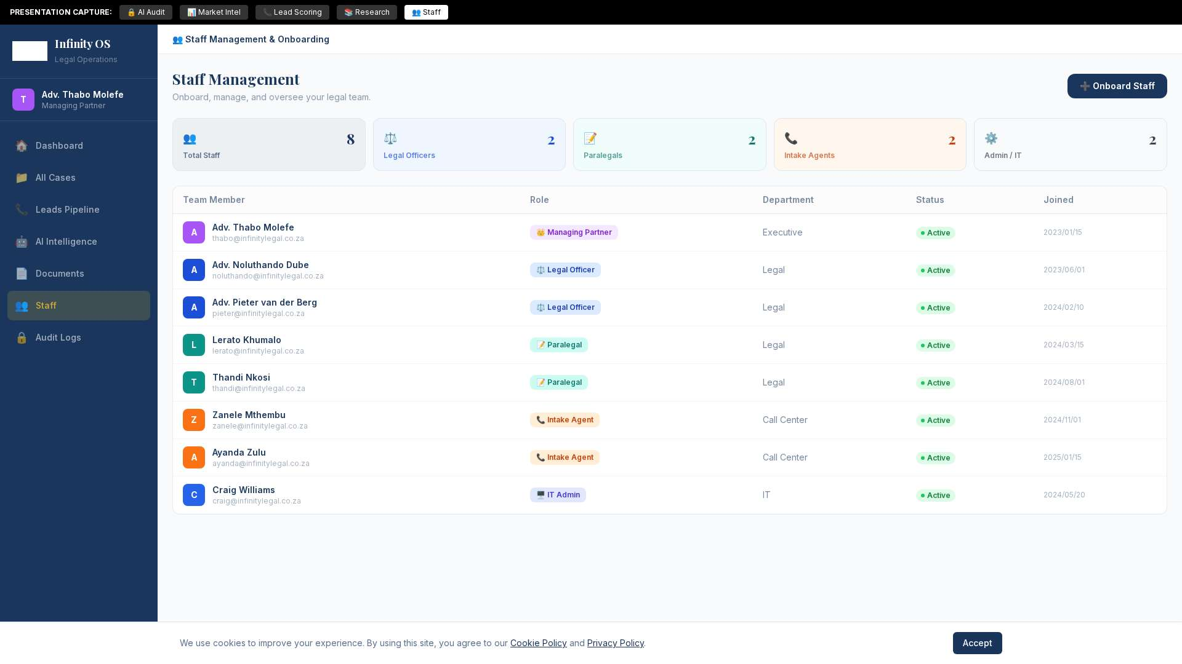
Staff Management & Onboarding
Team composition dashboard, role-based search/filter, visual onboarding form with role selector, department tracking, and status management.

Slide 9
🔒 Role-Based Access Control (RBAC)
👑 Managing Partner
Full access to all features including AI Intelligence, Audit Trail, Staff Management, and all case data. Can approve documents and create privileged strategy notes.
⚖️ Legal Officers / Attorneys
Access to cases, approvals, AI Intelligence Hub, document workflow, and privileged notes. Cannot access Staff Management or Audit Logs.
📝 Paralegals
Access to assigned tasks, cases, AI Research Assistant, documents (draft only), and lead pipeline. Cannot see privileged notes or approve documents.
📞 Intake Agents
Access to lead queue, call management, and follow-ups only. Cannot access case files, documents, or provide legal advice. Qualified leads auto-routed.
🖥️ IT Admin
Access to Staff Management, Audit Logs, and system configuration. No access to case data or legal documents.
All access is enforced server-side via JWT token verification — not just UI-level hiding.

Slide 10
Technology Stack
Frontend
Next.js 14 (App Router) • React • TailwindCSS • shadcn/ui
Database
Supabase (PostgreSQL) for primary data & auth • MongoDB for notifications
AI / LLM
Google Gemini 2.5 Flash via Emergent Proxy • Used for audit analysis, market intelligence, lead scoring, legal research, and client intake
Email
Brevo (Sendinblue) for transactional emails — signup confirmations, booking notifications, case updates
Authentication
Supabase Auth with JWT tokens • Custom RBAC middleware for role enforcement
Security
POPIA compliant • Server-side RBAC • Immutable audit logs (7-year retention) • Rate limiting on AI endpoints
Payments
PayFast integration (On Hold — ready for activation)

Slide 11
Next Steps & Roadmap
✅ Completed
AI Audit Intelligence • Competitive Intelligence • Lead Scoring • AI Research • Staff Management • RBAC Engine • Brevo Email • Dark Mode • Landing Page
🟡 On Hold
PayFast Payment Integration — Subscription checkout flow ready for activation when needed
🔵 Upcoming
Staff invitation email flow • Client portal dashboard • Notification center UI • Mobile responsive portal refinements
🟣 Future
AI-powered document drafting • Automated case status updates • WhatsApp integration • Client self-service portal • Analytics dashboard
Thank you for your trust in Infinity Legal.

