Slide 1
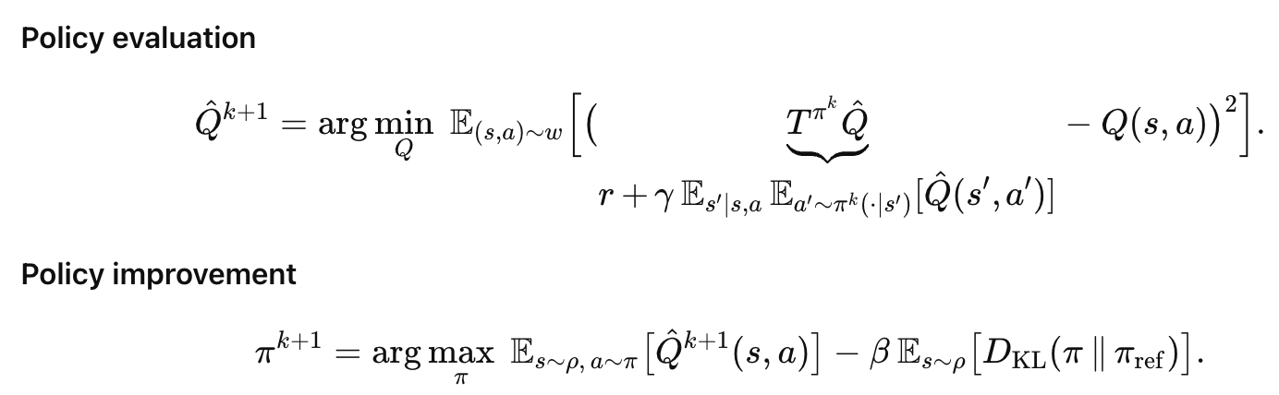

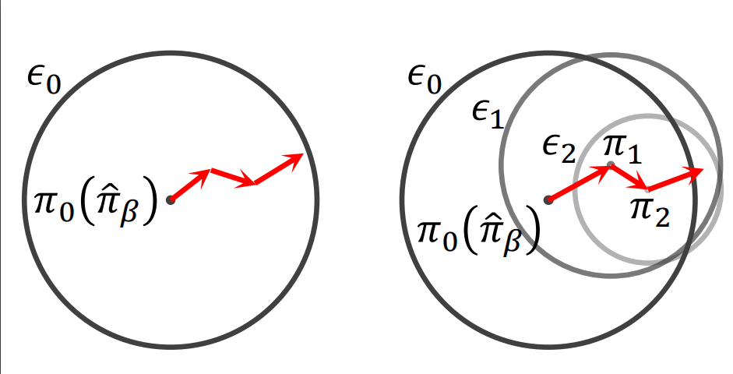
A general version of RL policy update forms
1
2
One-step RL
Multi-step RL
Iterative RL
High return region
2
1
2
2
2
1
1
2
1
1
2
1
One-step RL/IQL/IDQL…
BPPO Uni-O4/RL-100…
PPO/SAC/…
More conservative, but stable
More conservative, but stable

