Slide 1
CS411 Project FINAL Demo
NoMoreWait

Slide 2
Agenda
App introduction
SQL Database
Dataset & load data
SQL queries
Basic Functionalities
Advanced functions
No-SQL Database
Advanced techniques

Slide 3
NoMoreWait
Online restaurant reservation system
Book reservations at more then 60,000 restaurants around the US and Canada
Users manage orders

Slide 4
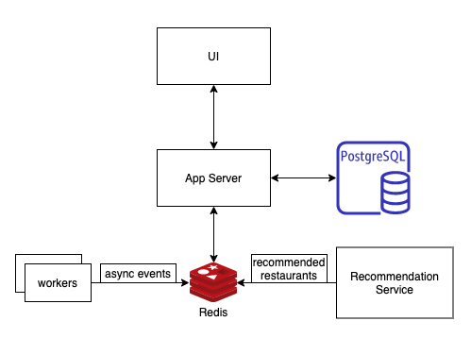
NoMoreWait ARCHITECTURE

Slide 5
SQL database & dataset
Postgres
Yelp academic restaurant dataset (https://www.yelp.com/dataset)
Script to load dataset into Postgres using “SQL INSERT” statement
Data is loaded into restaurant and location tables

Slide 6
NOMOREWAIT SQL QUERIES
List enrolled city names in the US
SELECT city FROM location where country = 'USA'
List first 100 enrolled restaurants
SELECT * FROM restaurant LIMIT 100
Count Steakhouses enrolled in Chicago
SELECT count(*) FROM location, restaurant where restaurant.location_id = location.id AND location.city = 'Chicago' and cuisine like '%Steakhouse%'
Count restaurants in each city
SELECT COUNT(location_id), city, state, country FROM location, restaurant where restaurant.location_id = location.id GROUP BY location_id, city, state, country

Slide 7
NoMoreWait basic functions
Search restaurants
SQL SELECT statement
Select a table
SQL SELECT/INSERT statement
Confirm an order
SQL UPDATE statement
Manage an order history
SQL UPDATE/DELETE statement

Slide 8
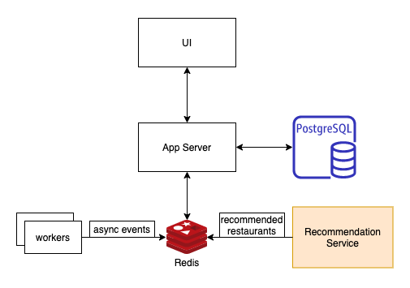
Advanced function
Recommendation Service
Machine learning
Challenges:
- best matched restaurants for each user and each request
- Update/push recommendations as fast as possible

Slide 9
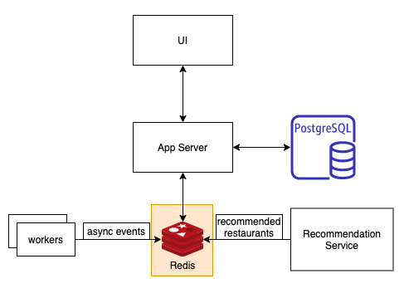
No-SQl database
Redis
In-memory cache
- decrease data access latency
- increase throughput and ease the load off SQL database
Message queue
- Background workers push async events

Slide 10
Advanced techniques
Indexing
Transaction
Stored Procedure
Prepared Statement
View
Constraint
Trigger

Slide 11
ADVANCED TECHNIQUES - INDEXING
Speed up restaurant search by name
CREATE INDEX ix_restaurant_name ON restaurant (name)

Slide 12
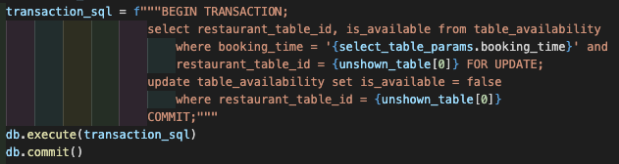
ADVANCED TECHNIQUES - TRANSACTION
Solve a race condition problem that multiple users book the last seat

Slide 13
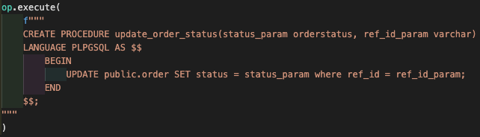
ADVANCED TECHNIQUES – STORED PROCEDURE
A stored procedure helps update order’s status

Slide 14
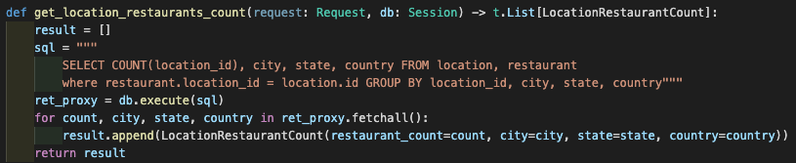
Advanced techniques – Prepared statement
Count restaurants by each city

Slide 15
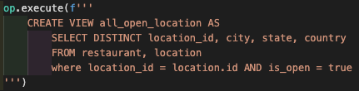
ADVANCED TECHNIQUES – VIEW
A view to get all open cities

Slide 16
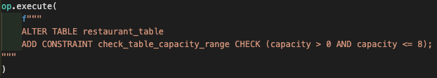
ADVANCED TECHNIQUES - CONSTRAINT
A constraint checks restaurant table capacity is between one to eight

Slide 17
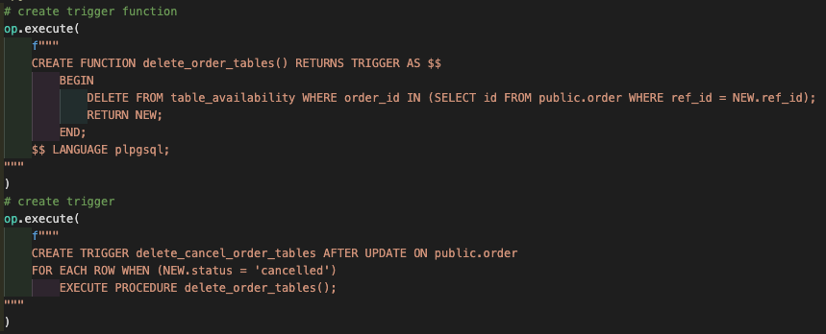
ADVANCED TECHNIQUES - TRIGGER
When an order is cancelled, a trigger will delete its associated table availability so that the window will be available again to all users.

Slide 18

Thank you!

