Slide 1
CS411 Project Initial Demo
NoMoreWait

Slide 2
Agenda
Initial Phase
- App introduction
- SQL Database
- Dataset & load data
- Basic Functionalities
Planning
- Advanced functions
- Advanced techniques
- No-SQL Database

Slide 3
NoMoreWait
Online restaurant reservation system
Book reservations at more then 60,000 restaurants around the US and Canada

Slide 4
SQL database & dataset
Postgres
Yelp academic restaurant dataset (https://www.yelp.com/dataset)
Script to load dataset into Postgres using “SQL INSERT” statement
Data is loaded into restaurant and location tables

Slide 5
NoMoreWait basic functions
Search restaurants
SQL SELECT statement
Select a table
SQL SELECT/INSERT statement
Confirm an order
SQL UPDATE statement
Manage an order history
SQL UPDATE/DELETE statement

Slide 6
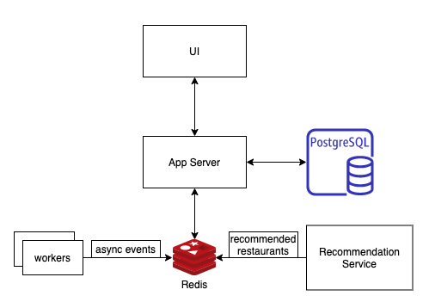
NoMoreWait Planning

Slide 7
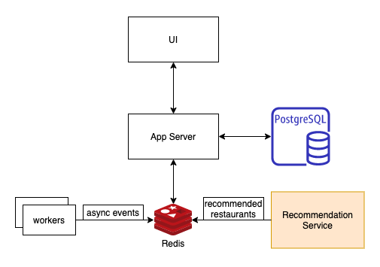
Advanced function
Recommendation Service
Machine learning
Challenges:
- best matched restaurants for each user and each request
- Optimize models to increase accuracy
- Update/push recommendations as fast as possible

Slide 8
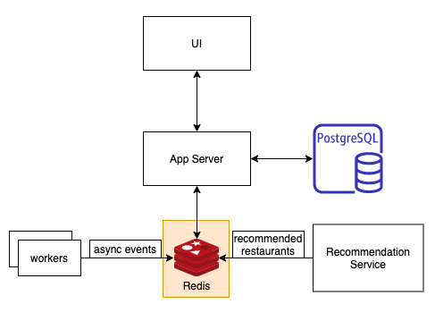
No-SQl database
Redis
In-memory cache
- decrease data access latency
- increase throughput and ease the load off SQL database
Message queue
- Background workers push async events

Slide 9
Advanced techniques
Indexing
Transaction
Stored Procedure
Prepared Statement
View
Constraint
Trigger

Slide 10

Thank you!

