Slide 1


Librator: Gibson cloning fragments designer for Influenza gene segments
Lei Li
Advised by Dr. Patrick Wilson
Oct 31, 2019

Slide 2
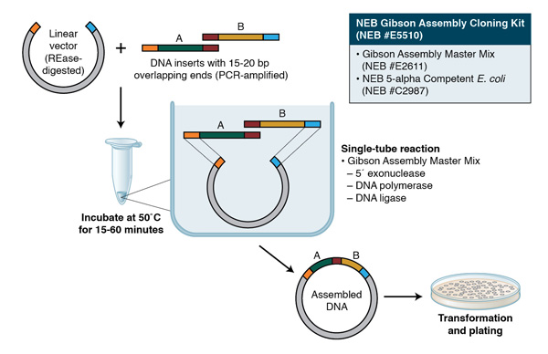
Background – Gibson Clone
Daniel G. Gibson, of the J. Craig Venter Institute, described a robust exonuclease-based method to assemble DNA seamlessly and in the correct order, eponymously known as Gibson Assembly.
Gibson, D.G., et al. (2009) Nat. Methods 6, 343-345. Figure adopted from www.neb.com

Slide 3
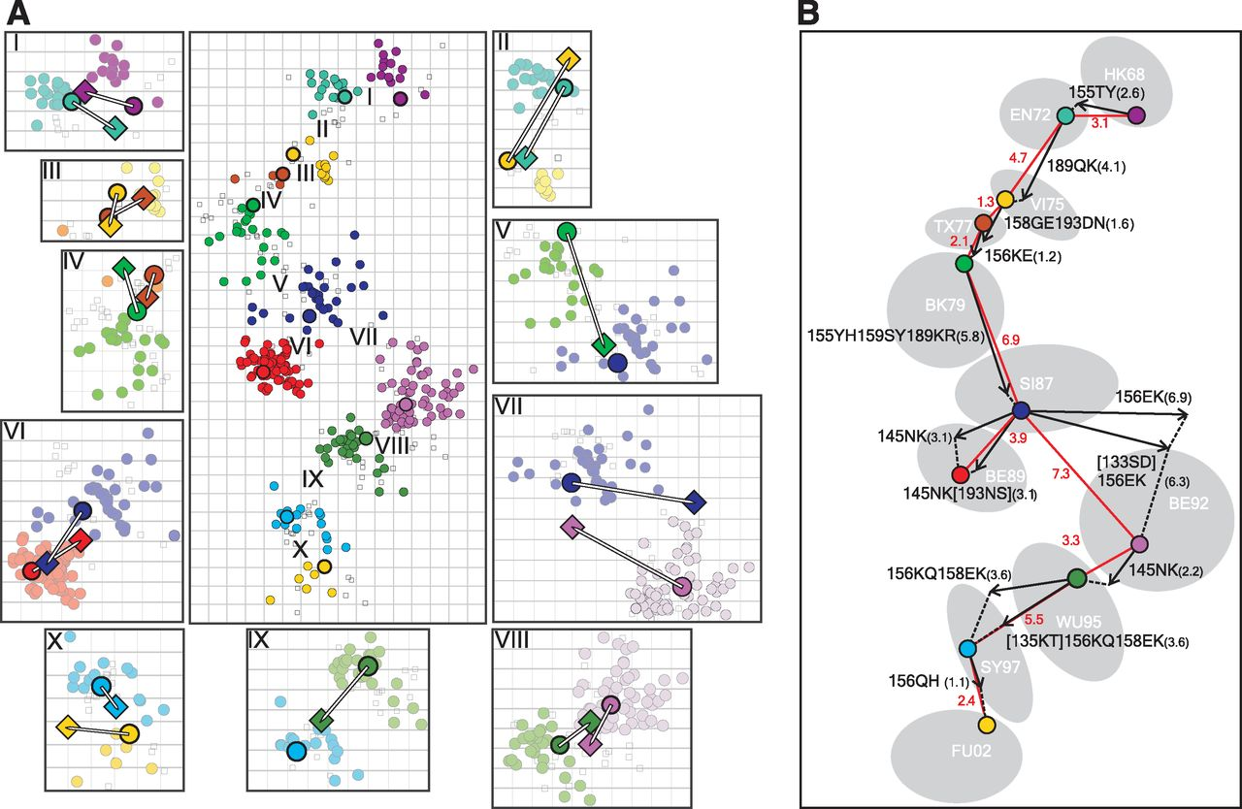
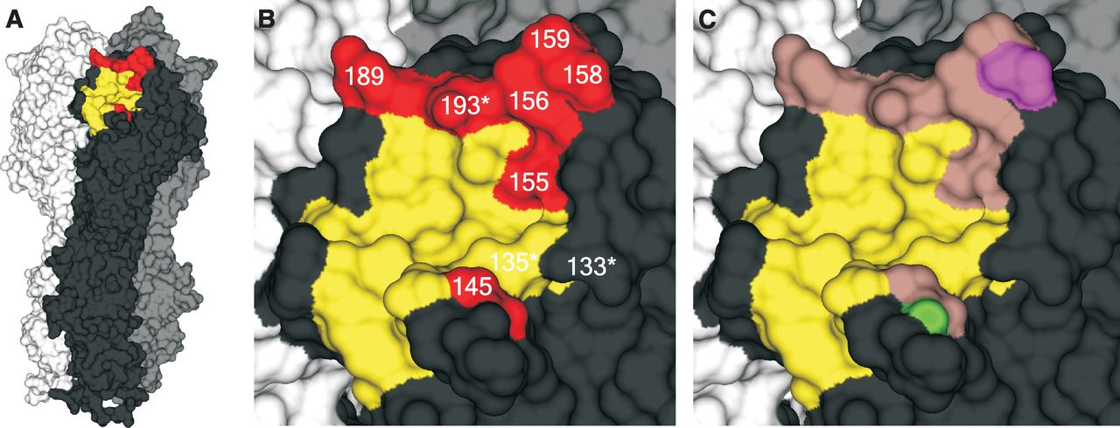
Background – HA protein of Influenza virus
Frequent mutations on HA protein allows Influenza virus to escape from host immunity
Mutations on different residues have different impact to antigenicity
Koel BF, et al. Science 2013 Nov 22;342(6161):976-9

Slide 4
Background – Generate mutations on HA
To investigate and quantify the impact of different mutations on antigenicity
Using Gibson Assembly, we can divide full HA into 4 fragments. Then for most of those mutated sequence, only 1 fragment is needed. This could save a lot of resources (money).
Fragment 1
Fragment 2
Fragment 3
Fragment 4

Slide 5
Method-identifying conserved region
A 25nt joint region between any two neighbor fragments, so the joint region should be located on most conserved region.
The three joint regions should be relatively evenly distributed
Full HA
Fragment

Slide 6
Amino Acid Variation Index
Current Amino Acid Variation Index = 1 – ratio of predominant amino acid
Pros: The intuitionistic visualization of the amino acid variation of each residue
Cons: Can not show the complexity among all minor amino acids
100%
100%
50%
50%
0%
0%
predominant amino acid
predominant amino acid

Slide 7
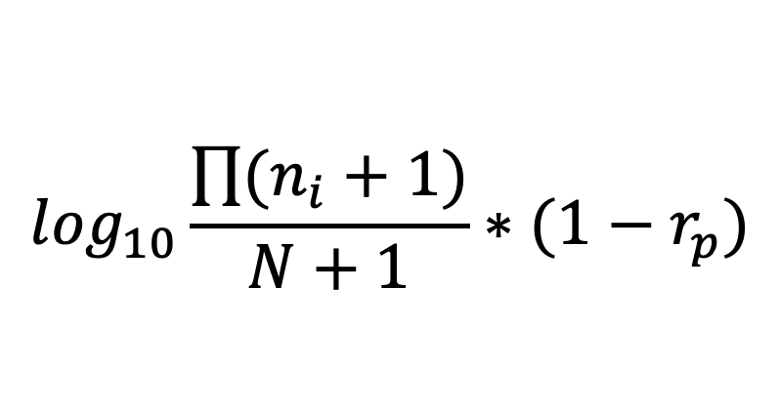
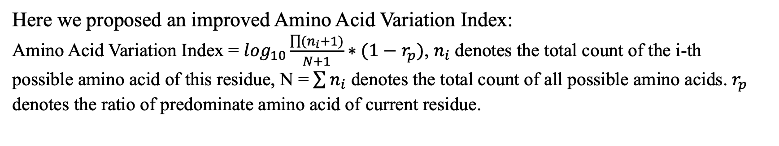
Amino Acid Variation Index
Here we proposed an improved Amino Acid Variation Index:
Amino Acid Variation Index = $\log_{10}\frac{\prod{(n_{i}+1)}}{N+1}∗(1−r_{p})$, $n_{i}$ denotes the total count of the i-th
possible amino acid of this residue, N = $\sum{n_{i}}$ denotes the total count of all possible amino acids. $r_{p}$
denotes the ratio of predominate amino acid of current residue.
Amino acid variation
$$\log_{10}\frac{\prod{(n_{i}+1)}}{N+1}∗(1−r_{p})$$
Linearize the variation
Ratio of minor amino acids

Slide 8
Amino Acid Variation Index
Amino acid in residue 1: 40, 15, 15, 10, 10, 10. (total = 100)
Amino Acid Variation Index of residue 1 =
log₁₀(41*16*16*11*11*11/101)*(1-0.4) = 3.084528
100%
50%
Amino acid in residue 2: 40, 30, 30. (total = 100)
Amino Acid Variation Index of residue 2 =
log₁₀(41*31*31/101) * (1-0.4) = 1.554712
0%
Residue 1
Residue 2
Residue 3
Amino acid in residue 3: 95, 5. (total = 100)
Amino Acid Variation Index of residue 3 =
log₁₀(96*6/101)*(1-0.95) = 0.03780506

Slide 9
Data
We collected 2,243 seasonal human H1N1 and 38,575 pdm09 human H1N1 from GISAID
We collect 61,798 human H3N2 from GISAID

Slide 10
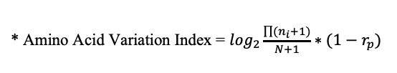
H3N2
Joint 1
Joint 2
Joint 3
1
16/17
17/18
343
346
HA2
520
521
566
Signal peptide
HA1
Transmembrane
Fragment 1
Fragment 2
Joint 1
Joint 2
Fragment 3
Joint 3
Fragment 4
Add to the upstream end for Gibson cloning into the vector
Add to the 3’ end (instead of transmembrane region)
* Amino Acid Variation Index = $\log_{2}\frac{\prod{(n_{i}+1)}}{N+1}∗(1−r_{p})$
Fragments | Start | End | Length(AA) | Length(NT) | Antigenic sites
Fragment 1 | 1 | 131 | 131 | 393 | C, E, Stalk-MN
Fragment 2 | 123 | 272 | 150 | 450 | A, B, D
Fragment 3 | 264 | 411 | 148 | 444 | C, Stalk-MN
Fragment 4 | 403 | 520 | 118 | 354 | Stalk-MN
Joint 1: 123 – 131, not in any antigenic sites or RBS , conserved region
Joint 2: 264 – 272, not in any antigenic sites or RBS , conserved region
Joint 3: 403 – 411, not in any antigenic sites or RBS , conserved region

Slide 11
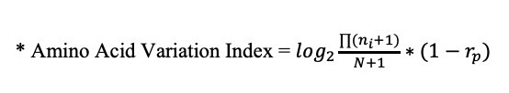
H1N1
Joint 1
Joint 2
Joint 3
1
17
18
344
345
HA2
519
520
566
Signal peptide
HA1
Transmembrane
Fragment 1
Fragment 2
Joint 1
Joint 2
Fragment 3
Joint 3
Fragment 4
Add to the upstream end for Gibson cloning into the vector
Add to the 3’ end (instead of transmembrane region)
Fragments | Start | End | Length(AA) | Length(NT) | Antigenic sites
Fragment 1 | 1 | 131 | 131 | 393 | C, E, Stalk-MN
Fragment 2 | 123 | 272 | 150 | 450 | A, B, D
Fragment 3 | 264 | 411 | 148 | 444 | C, Stalk-MN
Fragment 4 | 403 | 520 | 118 | 354 | Stalk-MN
* Amino Acid Variation Index = $\log_{2}\frac{\prod{(n_{i}+1)}}{N+1}∗(1−r_{p})$
Joint 1: 123 – 131, not in any antigenic sites or RBS , conserved region
Joint 2: 264 – 272, not in any antigenic sites or RBS , conserved region
Joint 3: 403 – 411, not in any antigenic sites or RBS , conserved region

Slide 12
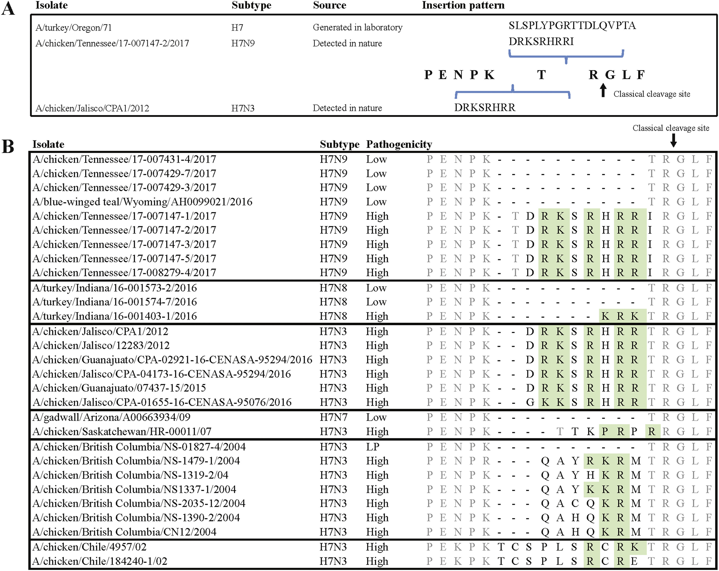
This fragment design works for both H1 and H3, and also can be extended to all other 16 subtypes of HA. All group1 HA use H1 numbering and all group2 HA use H3 numbering.
BTW, High pathogenic H5 and H7 have insertions in cleavage site, will affect Fragment 3
Signal peptide
HA1
Cleavage site
HA2
Transmembrane
Fragment 1
Fragment 2
Fragment 3
Fragment 4
Joint 1
Joint 2
Joint 3
Lei L, et al. Virology 525, 32-39

Slide 13
Fragments name
H3-F1-0001
Gene segment
subtype
Fragment
number
ID
Database design
Name(prime key) | Segment | Fragment | Subtype | ID | template | AAseq | NTseq | In Stock
H3-F1-0001 | HA | F1 | H3 | 0001 | HK/68 | GQPR… | ACTG…. | yes
H3-F2-0001 | HA | F2 | H3 | 0001 | TX/12 | GQPR… | ACTG…. | yes
H3-F2-0002 | HA | F2 | H3 | 0002 | SGP/16 | GQPR… | ACTG…. | Yes
…
H3-F1-0002 | HA | F1 | H3 | 0002 | TX/12 | GQPR… | ACTG…. | no
H3-F3-0001 | HA | F3 | H3 | 0001 | SGP/16 | GQPR… | ACTG…. | no

Slide 14
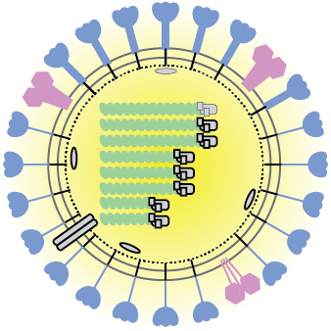
Librator
Now let’s try our new software, Librator

Slide 15
Steps
Create/open database
Interface
Sequence/alignment/popup alignment
Mutations
Sequence editing
Sequence fusion (different subtypes)
Gibson Clones design

Slide 16
Sequence DB
Import sequence
Import sequence
Phylogenetic analysis
Multiple sequence alignment
Sequence edit
Chimeric HA design
Structure visualization
Gibson Clone fragments design
Fragment DB

