Slide 1
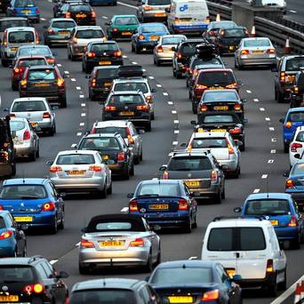
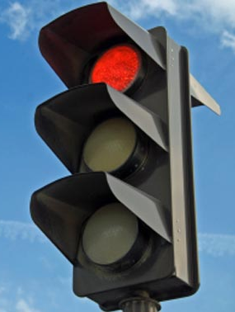
Traffic dynamics
Model traffic flow on single lane freeway with bottleneck
Established model: Intelligent Driver Model
Each vehicle’s acceleration determined by gap to leading vehicle, speed difference, … → ODE
Observation: Formation of stop-and-go waves around bottlenecks
Can instability still be observed at low speeds?
Planned extension: traffic light
Forced stop-and-go waves
Vary green light period
Interaction with natural instability?
Resonance possible?
Optimal switching frequency?
Image: Tim Ireland/PA Archive/Press Association Images
Image: http://www.etatrust.org.uk

