Slide 1
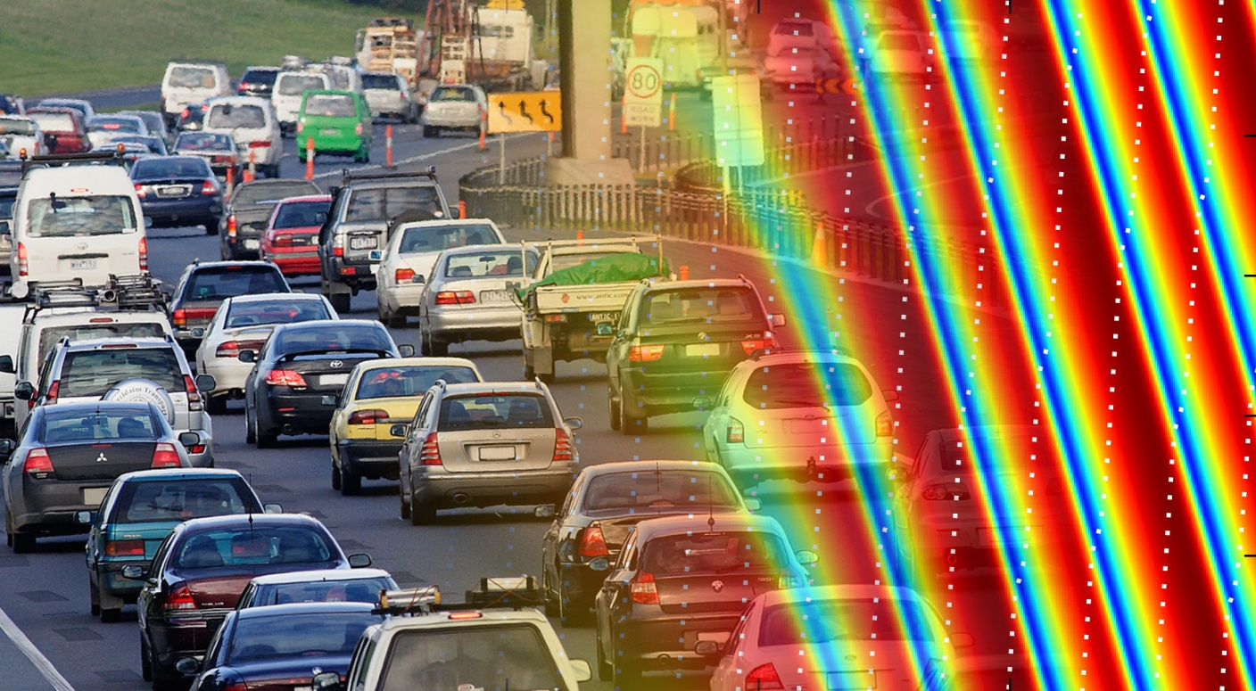
Phase transition in the Intelligent Driver Model induced by interaction exponent

Slide 2
Overview

Slide 3
Introduction

Slide 4
Intelligent Driver Model

Slide 5
Intelligent Driver Model

