Slide 1
Password Protector
Andrew Guilbeau
Christopher Sickler
Lei Liu
Christopher Gang

Slide 2
Android Studio Practice
Tutorial 3 Android Tutorial (Lab)
Tutorials Point
Developer.Android
Video Tutorials

Slide 3
Information Hiding
Information hiding is a key aspect of our program, as limiting access to the information cannot be implemented poorly given the highly-sensitive information we are protecting
Advantages
  Low coupling
  High cohesion
  Hide sensitive info
Disadvantages
  User restrictions
  User cannot change interaction between client and database

Slide 4
Singleton Method
The Singleton Class will be our account system.
Each app will have the capability to only create one user
  Will still be able to create multiple passwords for different uses on the device
Advantages
  Simplifies our code and overall design of app as we won’t have to worry about overlapping memory
Disadvantages
  The user will only be allowed to have one overall Password Protector account on one device

Slide 5
Factory Method
The factory method will be our way of creating and storing different kinds of passwords inside of our app
Advantages
  Will allow us to easily create passwords with different information attached to them
  Low coupling
  Creates only one path for storing the passwords in the application
Disadvantages
  Makes the code more difficult to read
  Class diagrams are more complex
  Increased difficulty in comprehending the general flow of the app

Slide 6
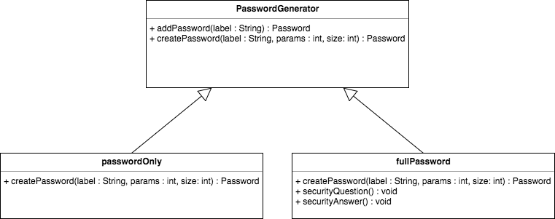

Slide 7

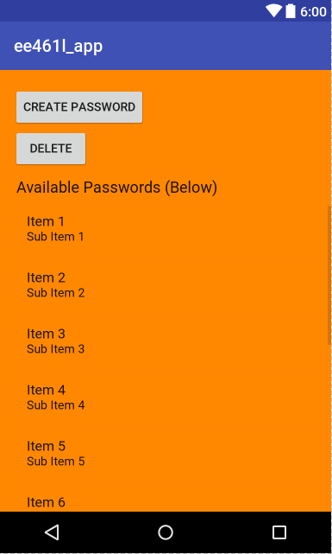
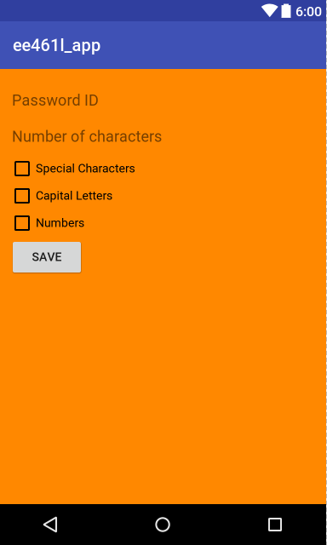
User Interface Design

