Slide 1

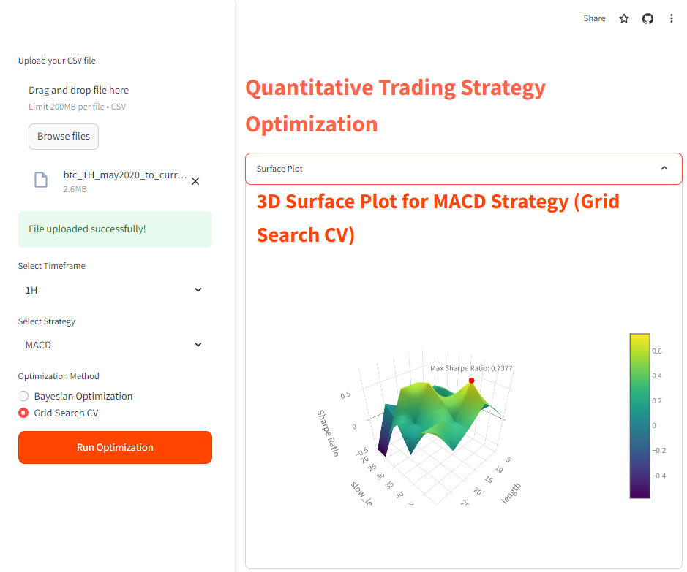
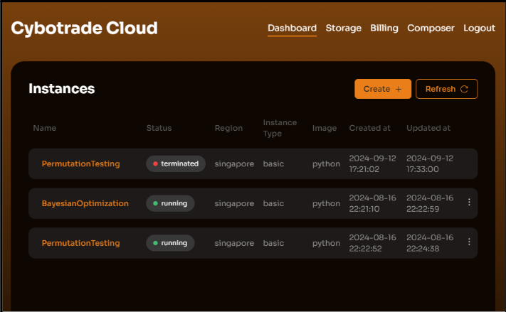
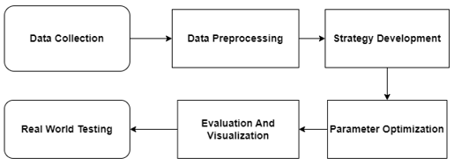
Optimization of Quantitative Trading Strategies Through 3D Visualization Techniques
Chan Li Yang
BCS(Hons) in Data Science
Supervisor: Ms.Fatin Izzati Ramli
This project addresses the challenge of optimizing quantitative trading strategies using advanced data visualization and optimization techniques. The objective is to enhance trading decisions by applying Bayesian Optimization and Grid Search Cross-Validation (CV) to maximize the Sharpe Ratio, thereby identifying the most efficient trading strategies under varying market conditions. The methodology combines statistical analysis, machine learning, and 3D visualization to interpret complex data and improve strategy performance.
Abstract
The optimization of trading strategies in volatile cryptocurrency markets remains a significant challenge due to the complex dynamics and unpredictable nature of financial data. Traditional methods often fail to adequately capture and leverage patterns in large datasets, resulting in suboptimal trading performance and increased risk.
Question Approach: How can we enhance the optimization of trading strategies in volatile cryptocurrency markets using advanced data science techniques and visualization methods to improve decision-making and risk-adjusted returns?
Construction and Testing
Problem Statement
To apply Bayesian Optimization and Grid Search CV for parameter tuning of trading strategies.
To utilize 3D visualization techniques for intuitive understanding and analysis of complex trading data
To improve the risk-adjusted returns of trading strategies, as measured by the Sharpe Ratio.
Objectives
Figure 2: Streamlit User Interface
Figure 2 shows the Streamlit user interface for optimizing quantitative trading strategies. Users can upload market data, select parameters like timeframe and strategy, and choose between Bayesian Optimization or Grid Search CV for optimization. The interface displays results in a 3D surface plot that visualizes the Sharpe Ratio across different settings, with a color gradient to indicate value levels, facilitating easy analysis of optimal parameters.
Design and Methodology
The project’s design is centered around the development of a sophisticated 3D visualization tool that enables an intuitive exploration and optimization of trading parameters. This tool is designed to transform complex, high-dimensional data into a comprehensible and interactable visual format, which allows users to effectively perceive and manipulate the trading parameters in real-time.
Figure 1: System Flow Chart
Figure 3: Cybotrade Cloud Dashboard
The methodology of the project begins with the collection of historical Bitcoin price data from the CryptoCurrency eXchange Trading Library (CCXT), focusing on significant market events over the past four years. This data is then rigorously preprocessed to enhance its reliability for subsequent analysis, involving cleaning, filling missing values, aligning timestamps to UTC, and transforming prices into logarithmic returns. Various trading strategies, both mean-reversion and momentum-based, are developed using financial indicators like Bollinger Bands, RSI, moving averages, and MACD. These strategies undergo optimization through Bayesian Optimization and Grid Search CV to maximize performance metrics such as the Sharpe Ratio. The effectiveness of these strategies is assessed via backtesting, with results visualized through 3D graphs to analyze the impact of parameter changes. Finally, the strategies are tested in a live trading environment using the Cybotrade Cloud to ensure they are robust and effective under real-world market conditions.
Figure 3 displays the Cybotrade Cloud interface, used for real-world testing of trading strategies. This platform connects strategies directly to market exchanges, executing and managing trades based on defined strategies, and continuously monitors and updates their statuses, ensuring seamless integration with users' exchange accounts.
Enhances trading software and services, boosting profitability and market efficiency.
Increases transparency and trust in financial markets through clearer trading strategies.
Leverages advanced data science and 3D visualization to innovate in financial technology.
Contribution
This project successfully achieved its objectives by integrating Bayesian Optimization and Grid Search CV to enhance trading strategy performance. The design combined these optimization techniques with 3D visualization, providing deep insights into trading data and strategy effectiveness. Key outputs include an improved platform for trading strategy optimization, significantly advancing the field of financial technology by optimizing risk-adjusted returns and delivering dynamic visual analytics.
Conclusion

