Slide 1
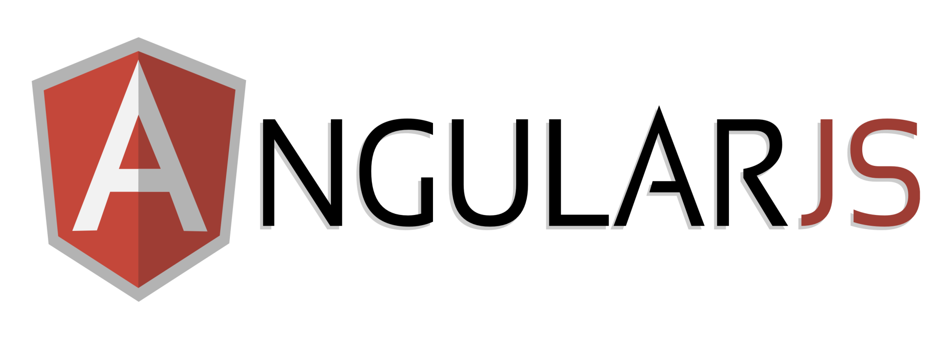
Presented by
Dominic Panthiruvelil / Shailesh Gavathe

Slide 2
Today’s Agenda
Introduction - Round across the room and phone
GitHub set up with Visual Studio
AngularJS Visual studio Configuration/Set up
Two way data binding
Website to fetch data from database
AngularJS Service

Slide 3
NuGet Packages
The packages that we need from NuGet are .
AngularJS
BootStrap (optional )
Notes:
For several years +AngularJS was closer to MVC (or rather one of its client-side variants), but over time and thanks to many refactorings and api improvements, it's now closer to MVVM – the $scope object could be considered the ViewModel that is being decorated by a function that we call a Controller.

Slide 4
Application Discussion
Create new project using Web API
Download AngularJS and BootStrap
Using any database for backend
Uses ASP.NET MVC’s routing in routeConfig.cs

Slide 5
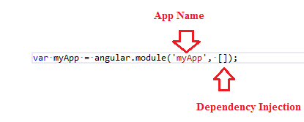
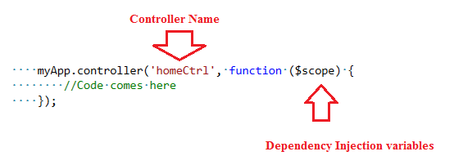
Application Discussion
AngularJS Entry point
App.Js file
Declaration of the angular module
Declaration of controllers ( either HTML OR JS file )

Slide 6
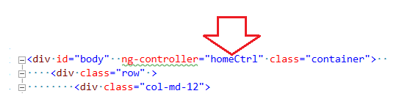
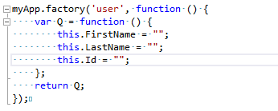
Application Discussion
AngularJS Entry point
Tying the Controller to the HTML View
Declaration of factory

Slide 7
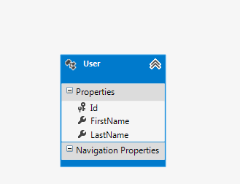
Application Discussion
Database Set up
Uses Entity Framework which is mapped to the localDB
Communicates via WebApi controller
Html Uses $http services like $httpPost,$httpGet,$httpPut
More about $http

Slide 8
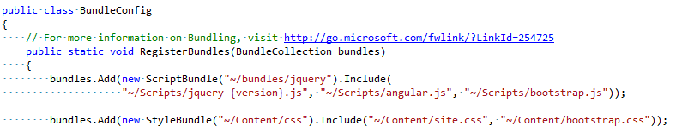
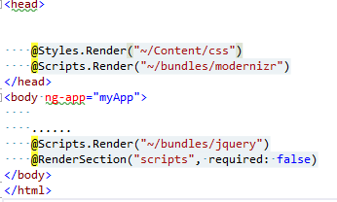
Tying files together
BundleConfig.cs
_Layout.cshtml

Slide 9
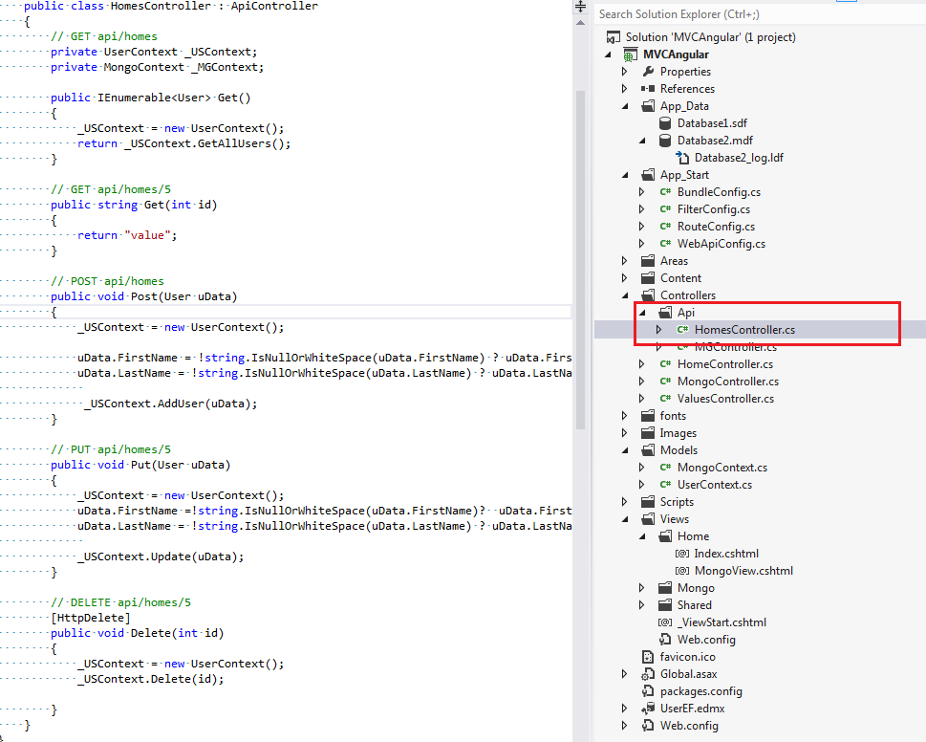
Application Discussion
Database Set up

Slide 10
AngularJS Services
Best used for separation of concerns within controller
Uses Singleton ( one instance)
Service Types
$http
$window
$route
Custom Services
Custom Service can be created either by.
Factory
Service
More Service Info

Slide 11
Questions?

