Slide 1
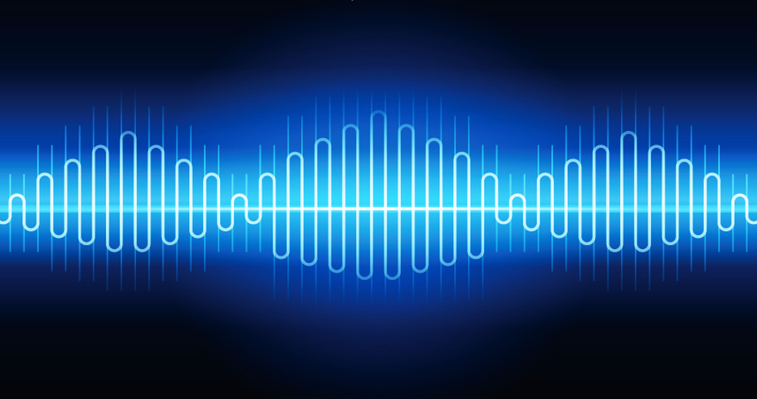
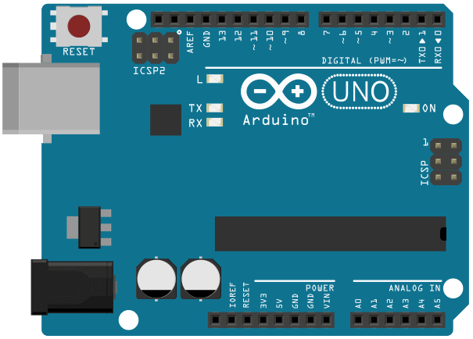
Audible Objects
Leif Bloomquist – Inter/Access June 13-14, 2016

Slide 2
Overview
Day 2 (Practical)
Hook up and test sensors (1 hour)
Hook up and test MIDI (1 hour)
Put it all together (1 hour)
Day 1 (Theory)
Introduction (15 minutes)
Arduino Basics (30 minutes)
Sensor Basics (15 minutes)
Analog vs. Digital (15 minutes)
Detecting Events (15 minutes)
Programming Basics (30 minutes)
MIDI (15 minutes)
Set up and test Arduino IDE (30 minutes)

Slide 3
A bit about me…
“Classically trained” in clarinet and percussion
Have been dabbling with music, composing, and technology since the 1980s
Moved to Waterloo in 1992 to study Systems Design Engineering
Moved to Toronto in 1997 and discovered the Ambient Ping, Riot Art and other experimental music communities
Occasional “live” gigs under the moniker Schema Factor
Playing with the tech is half the fun!
In general I release my tools and techniques open-source
Enable other electronic musicians to build on ideas!
“Day job” in software engineering at MDA, creators of the Canadarm

Slide 4
Demos

Slide 5
Introduction to Arduino

Slide 6
What is Arduino?
An open-source electronics prototyping platform based on flexible, easy-to-use hardware and software. It’s intended for artists, designers, hobbyists, and anyone interested in creating interactive objects or environments.
Named after a bar in Italy, where it was invented!
The bar, in turn, was named after Arduin of Ivrea, king of Italy 1002-1014
www.arduino.cc

Slide 7
Why Arduino?
Comes in a variety of shapes and sizes (and cost).
All programmed very similarly.
Emphasis on ease of programming and connecting to the outside world.
Arduino Uno is the most basic model (we will use for this course).
Open-Source: All designs, code, and tools are freely available.

Slide 8
An Arduino is a computer!
Technically, a “microcontroller.”
Most run at 16 MHz – about the same power as a ‘286 computer from the 1990s (but with much less memory).
No Operating System, just a “bootloader.”

Slide 9
Some Terminology
Bit: The smallest unit a computer can represent (0 or 1)
Byte: A collection of 8 bits (represents a whole number, 0 to 255)
Baud: (Also bps): bits per second
Serial: Method of transmitting data between computers (including Arduinos)
Named because the bits flow one at a time
Speed is represented in baud
Pin: Connection point to an Arduino for connecting inputs or outputs

Slide 10
More Terminology
USB: Universal Serial Bus
Digital: An input or output that can be 0 or 1 (off or on)
Analog: An input or output that can be a range of values – like a volume control
ADC: Analog to Digital Converter – converts an analog input into a numeric whole number that the Arduino can work with

Slide 11
Arduino Uno Parts
Digital Pins (Input or Output)
Reset Button
(Reboots the Arduino)
USB Port
(Power and Serial)
Programming Pins
(For factory setup)
Microcontroller
Power Port
(If not using USB)
Analog Pins (Input Only)
Power Pins

Slide 12
Introduction to Sensors

Slide 13
Sensors
Motion
Acceleration
Sound
Light
Touch
Flex
Switches / Buttons
Moisture level
Temperature
Atmospheric pressure
Etc, etc.

Slide 14
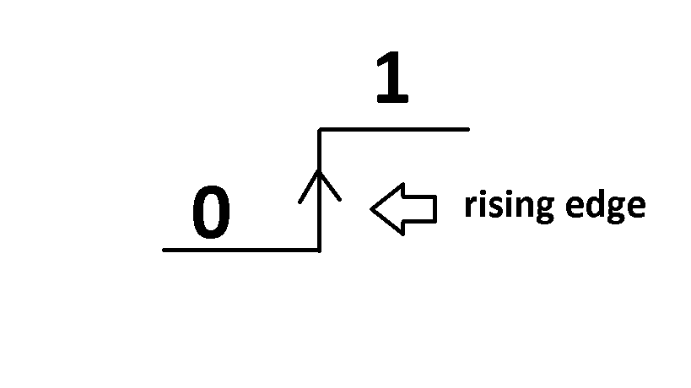
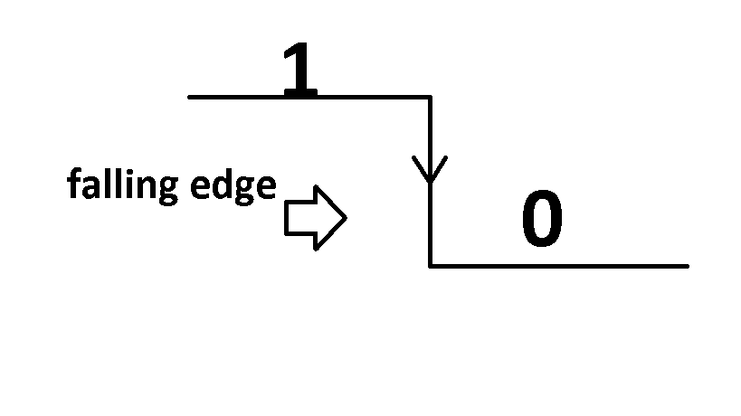
Detecting Digital Events
Rising Edge: 0 → 1
Falling Edge: 1 → 0
You need to remember the “previous” value
Image Credit: Manpreet Singh Minhas

Slide 15
Debouncing
In theory, the input signal from a perfect button looks like this (negative logic):
1
0
Time →

Slide 16

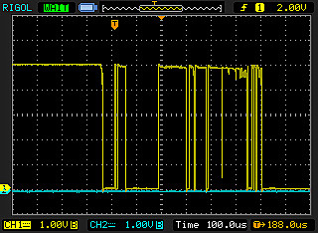
Debouncing
But in reality, it looks like this: (trace from an oscilloscope)

Slide 17
Debouncing Strategies
Wait for the value to stabilize over a few milliseconds
A simple delay timer works reasonably well

Slide 18
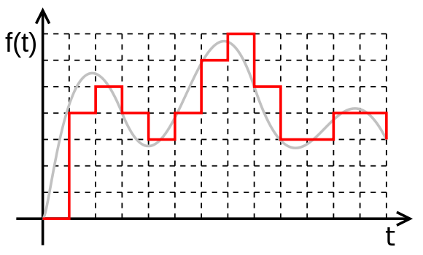
Analog inputs are still “digital”…kind of
A typical analog sensor gives an output 0 volts to 5 volts, with infinite precision
To represent an analog input, the Arduino’s ADC converts these into a (typically) 10-bit value.
This ranges 0 to 1023. (Representing 0 volts to 5 volts)

Slide 19
Detecting Analog Events
Set a “threshold” to trigger the event
1023
Threshold
0
Time →

Slide 20
Analog Inputs and Thresholds - Tips
The threshold value can be determined by trial and error
Print out the ADC value and note that happens when you activate the sensor
You may have to define an “on” threshold and an “off” threshold to keep it from triggering over and over again
Your thermostat at home does this
“Hysteresis”
Each individual sensor is slightly different – always check the values if changing sensors

Slide 21
Arduino Programming

Slide 22
Arduino Programming Basics
Arduino programs are called sketches.
The Arduino programming language is based on the Wiring language, which in turn is a simplified version of C++.
Libraries are collections of functions that do various tasks.
The Arduino Integrated Development Environment (IDE) includes many libraries to help get you started.

Slide 23
A Very Simple Arduino Program
/*
* Hello World!
*
* This is the Hello World! for Arduino.
* It shows how to send data to the computer
*/
void setup() // run once, when the sketch starts
{
Serial.begin(9600); // set up Serial library at 9600 baud
}
void loop() // run over and over again
{
Serial.println("Hello world!"); // prints hello with ending line break
}

Slide 24
Arduino Programming Terminology
Statements are individual instructions to the Arduino.
Functions are a group of statements that do a single task.
Variables are placeholders in memory that can store a value.
Every variable has a data type (byte, integer, “float”, boolean, etc.)
Comments are notes that stay inside the program to explain what’s going on
The Arduino ignores these, they are for future you!
Use // or /* */ to indicate a comment.
Control structures are statements like if, for, while that let you direct the flow of the program based on conditions.

Slide 25
Arduino Programming Continued…
Arduino requires two functions at minimum: setup() and loop()
setup() is where you get everything ready (runs once at powerup or reset)
loop() runs over and over infinitely until the power is turned off.
You can create your own functions if you find you are doing something over and over again

Slide 26
Anatomy of a Function
Output of the Function
aka “return type”
Inputs to the Function aka “parameters”
int AddTwoNumbers(int num1, int num2)
{
int sum = num1+num2;
return sum;
}
Statements
Return this value back to the main function
{ and } surround the function statements

Slide 27
Using Functions
Variable data type (must match!)
Inputs to the Function aka “arguments”
Function “call”
…
…
int answer = AddTwoNumbers(2,3);
…
…
<do something with the answer>
Variable to hold the returned value

Slide 28
Useful Built-In Arduino Functions
pinMode(): set a pin as input or output
digitalWrite() – set a digital pin high/low
digitalRead() – read a digital pin’s state
analogRead() – read an analog pin
delay() – wait an amount of time
millis() – get the current time in milliseconds

Slide 29
Using Comparison Operators
(3 == 2) FALSE
(3 > 2) TRUE
(3 < 2) FALSE
(answer < 5) FALSE
(answer <= 5) TRUE
Potential gotcha: Off-by-one errors are very common

Slide 30
Control Statements – if / else
if (<condition is true>)
{ <do something>
}
else
{
<do something else> }

Slide 31
Control Statements – while
while (<condition is true>)
{ <do something over and over>
}
…
Potential gotcha: Your program will “freeze” inside the while loop while the condition is true

Slide 32
Control Statements – for
for (<initialization>, <condition>, <increment>)
{ <do something>
}
Potential gotcha: Your program will “freeze” until the loop completes

Slide 33
Control Statements – for (Example)
for (int i=1; i<10; i++)
{ <do something 9 times>
}

Slide 34
A more complete Arduino program
// Analog Input Example with Control Structures int sensorPin = A0; // select the input pin for the sensor int ledPin = 13; // select the pin for the LED int sensorValue = 0; // variable to store the value coming from the sensor void setup() { pinMode(ledPin, OUTPUT); // declare the ledPin as an OUTPUT } void loop() {
sensorValue = analogRead(sensorPin); // read the value from the sensor
Serial.println(sensorValue); // send the value to the PC
if (sensorValue > 2000) // Have we crossed the threshold?
{ // turn the ledPin on digitalWrite(ledPin, HIGH);
}
else
{ // turn the ledPin off: digitalWrite(ledPin, LOW);
} }
“Global” variables – shared by entire program
“setup” runs once
“loop” runs infinitely

Slide 35
Getting the Program into the Arduino
The Arduino IDE needs to know the type of Arduino that is connected, and which Serial port it is connected to.
Windows: COMxx
Mac: /dev/usbserialxx
The process of converting your human-readable program into Arduino “machine code” (a series of bytes) is called compiling.
The Arduino IDE checks your code for “correctness” (typos etc.), then compiles it, then transmits the program into the actual Arduino through USB.
The program stays permanently inside the Arduino until you change it.

Slide 36
Musical Instrument Digital Interface (MIDI)

Slide 37
The MIDI Protocol
Musical Instrument Digital Interface
Defined in 1982.
Serial Interface at 31250 baud (though this can be changed).
Messages consist of a Status (command) byte followed by Data bytes (usually two).
16 virtual “Channels”.
Commands such as Note On, Note Off, Control Change, etc.
The defacto standard for exchanging music between computers, synthesizers, software, Arduinos…

Slide 38
Decimal vs. Hexadecimal Notation
Most of the time, we use “decimal” (base 10) notation.
0, 1, 2, 3, 4, 5, 6, 7, 8, 9, 10, 11, 12, 13…
In many cases in programming and data communications (including MIDI), it is helpful to use “hexadecimal” (base 16)
0, 1, 2, 3, 4, 5, 6, 7, 8, 9, A, B, C, D, E, F, 10, 11, 12, 13…

Slide 39
Why Hexadecimal?
Remember that a byte is 8 bits.
A “nybble” is 4 bits, which is 0-15 decimal…or 0-F hexadecimal.
Therefore, a byte can be conveniently represented in 2 hexadecimal digits.
In MIDI the different digits may have different meanings – example next slide
Hexadecimal is usually represented with the prefix 0x (other notations are heresy)
0x00 = 0 decimal
0x10 = 16 decimal
0x64 = 100 decimal
0xFF = 255 decimal (maximum for 1 byte)

Slide 40
Typical MIDI Message
Status
byte
Data
bytes
0x
9 | 0 | 0x3C | 0x64
Command
Channel

Slide 41
Example MIDI Message: Note On
Status
byte
A440
Volume
(“Velocity”)
0x
9 | 1 | 0x45 | 0x7F
Command “Note On”
Channel 2

Slide 42
Every Note On should be paired with a Note Off!
Status
byte
A440
“Velocity”
0x
8 | 1 | 0x45 | 0x7F
Command “Note Off”
Channel 2

Slide 43
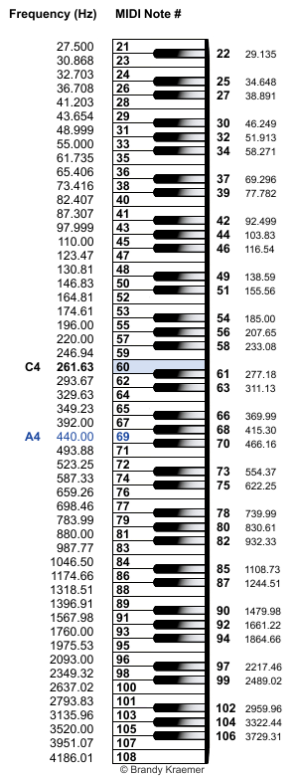
MIDI Note Numbers
Range from 0 (C in Octave 0) to 127 (G in Octave 10)
Middle C is 60
A440 is 69
etc…

Slide 44
MIDI can also represent “continuous” values
Status
byte
Controller
Number
Controller
Value
0x
B | 1 | 20 | 100
Command “Controller”
Channel 2
Useful for volume, pitch, filters, panning, other effects

Slide 45
MIDI Gotchas to Watch Out For
Remember to follow every Note On with a Note Off.
Note numbers and commands are often cited in hexadecimal.
Channel numbers are off by 1. A channel value of 3 refers to channel 4.
The values can only be 0 to 127 (7 bits)

Slide 46
There is an Arduino MIDI Library
However, the protocol is so simple we will do it “by hand.”
The library is most useful for receiving+processing MIDI within the Arduino itself (outside the scope of this course.) http://playground.arduino.cc/Main/MIDILibrary

Slide 47
Arduino Function to Send MIDI
void sendMIDI(byte cmd, byte data1, byte data2)
{
Serial.write(cmd);
Serial.write(data1);
Serial.write(data2);
}

Slide 48
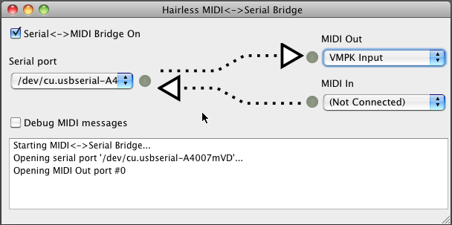
Receiving the Data: Hairless MIDI Bridge
http://projectgus.github.io/hairless-midiserial/

Slide 49
Putting It All Together
We now have almost everything we need:
We can create Arduino Sketches.
We can read from a sensor.
We can detect events.
We can send MIDI data from the Arduino to a computer .
We can receive MIDI data on the computer.

Slide 50
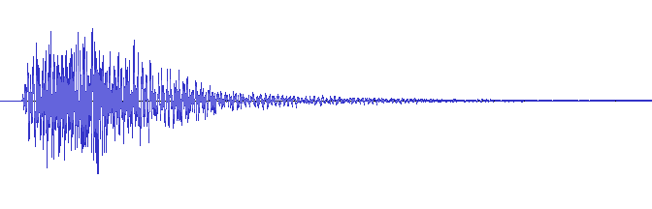
Types of playback: Samples

Slide 51
Types of playback: Synthesized
Additive and subtractive synthesis
Generated algorithmically
Many parameters you can adjust in “real time”

Slide 52
Digital Audio Workstations (DAWs)
Many to choose from!
Ableton, Logic Pro, GarageBand, Sonar, MAX, Reason, Cubase, Pro Tools,
Different strengths and weaknesses, some free, many cost
Concepts are similar
Browser based!! https://www.soundtrap.com/

Slide 53
What Next?
What MIDI data to send?
That depends on you!

Slide 54
Some Ideas…
Trigger a sample based on a sensor event
Change the volume of a sound based on a sensor input
Change the pitch of a sound based on a sensor input
Play a musical ditty when an event happens
…

Slide 55
Alternatives
A modern alternative to MIDI exists, called Open Sound Control: http://opensoundcontrol.org/
(It’s complicated and hasn’t really caught on)

Slide 56
Making it Wireless
Batteries
Wireless
Xbees (Serial to Serial)
ESP8266 (Serial to Wifi)

Slide 57
Prep for tomorrow
Arduino IDE Setup
Hairless MIDI
Soundtrap

Slide 58
Slides will be here tonight!!!
http://www.slideshare.net/leifbloomquist1

