Slide 1

Commodore 64
Telnet BBS Server
Leif Bloomquist – Toronto, Canada
SWRAP Expo – Lombard, IL, USA October 11, 2003

Slide 2

Overview and Goals
Commodore 64 BBS that anyone on the Internet can “Telnet” to
No long distance charges
No need for a second phone line
No special software on C64 side
  Use existing BBS programs

Slide 3
Block Diagram
Telnet BBS Server Program
Windows PC
Telnet
Client
Internet
Telnet
Server
TCP/IP
Port 23
DSL
Router
COM
Port
VIC
1011A
10BaseT Ethernet
Null Modem Cable
Commodore 64

Slide 4
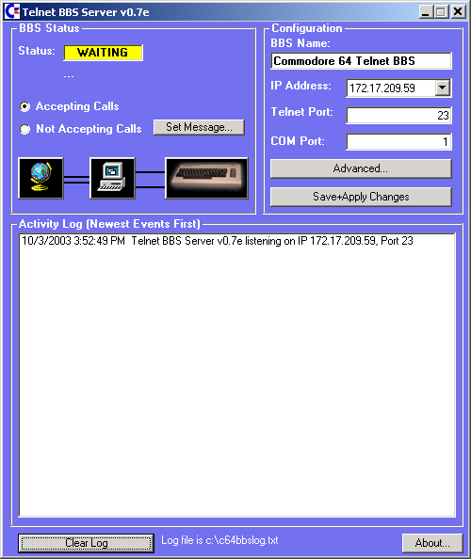

Server Software…
Written in Visual Basic 6.0
  “Winsock” Object for TCP/IP
  MSComm Object for COM Port
Runs as background task
Essentially a “software router”

Slide 5
Server Software
Listens for connections on TCP/IP Port 23 (Telnet)
When connection detected, “Rings” the BBS
  Pretends to be a modem
Transparently forwards data between Telnet server and COM Port
“Hangs Up” if Telnet Client disconnects
Disconnects Telnet Client if BBS Hangs up

Slide 6
Test System
EBBS 3.3 by Ed Parry (1987)
Static IP: 209.151.141.59 Port 23
c64bbs.no-ip.org
Online since April 10, 2003

Slide 7
Surprises
EBBS isn’t Y2K Compliant
  “?ILLEGAL QUANTITY ERROR IN 31527”
XModem protocol upload/download works if “calling” from a real C64
Over 700 callers to date
>250 unique callers from all over the world

Slide 8
Next Steps
Realtime character translation (complete)
  ASCII <-> PETSCII
  Backspace
  etc…
Tests with more BBS programs
Hayes Modem emulation
Adapt for gaming? (Modem Wars)
Dedicated hardware?

Slide 9
Acknowledgements
Jeff Ledger (testing, suggestions)
Bo Zimmers (BBS program archive)
Anthony Beckett (discussion)
Aili Bloomquist (support, patience :-)

Slide 10
For More Information
General information
Download server application+source
home.ica.net/~leifb/bbs/
BBS Lists, hardware plans, etc.
www.petscii.com
Thank you!!

