Slide 1



Interactive Multi-User Electronic Music and Visualization
Leif Bloomquist | Schema Factor
Maker Festival 2016
June 1, 2016

Slide 2
Description
This would be a larger, louder, multi-user version of my popular demo from the 2014 Toronto Mini Maker Faire where participants could manipulate music and visuals through movement. Instead of wearable sensors, I propose to upgrade to LEAP Motion gesture controllers to make it easier for participants to walk up to and interact with the installation. I envision three "stations": One for the beat, one for the melody, and one for the visuals. This will allow the participants to control the music and visual effects with their hands, interacting with the music as well as each other in real-time. The music and effects will all be synchronized, with interplay between the elements. This installation would be set up all weekend.

Slide 3
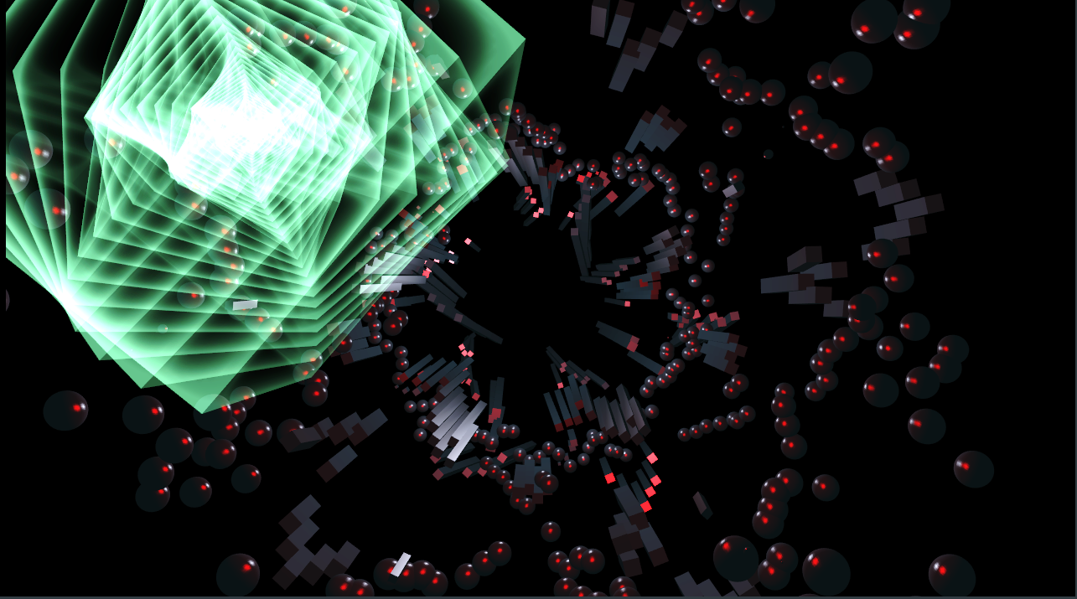
Example Visualizations (#1)

Slide 4
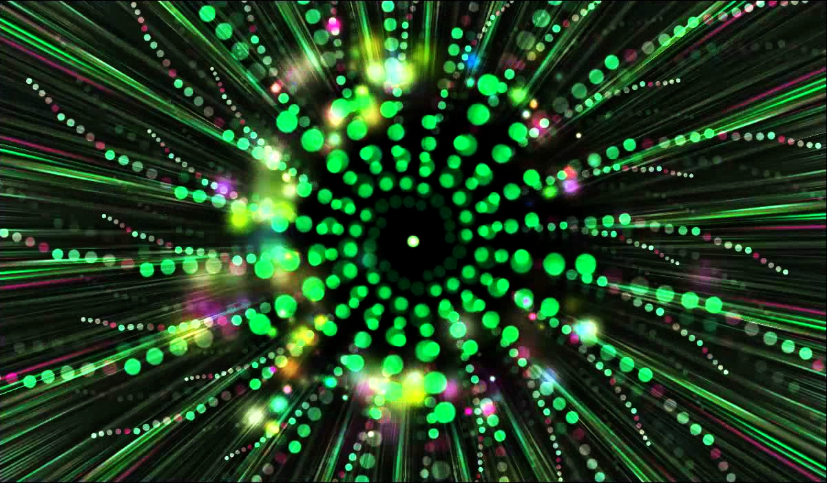
Example Visualizations (#2)

Slide 5
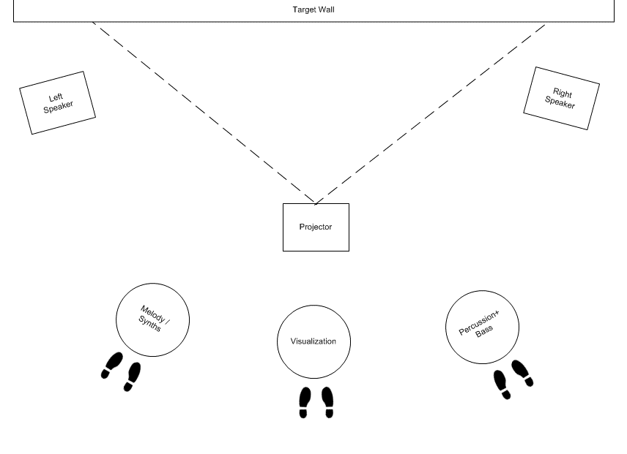
Proposed Layout

Slide 6
Gear List
Item | Quantity | Description
LEAP Motion | 3 | Used to sense participants' hand motions, as inputs into the music and visuals generation software.
12" SONO Tubes | 2 | To serve as as "podiums" to hold the LEAP Motions. (cut into sections)
Spraypaint | 2 | To paint the SONO Tubes shiny futuristic black.
Sound System | 1 | Mixer, 2 speakers, cables. Power depends on the space. Long and McQuade "System One" rental is baseline.
Projector | 1 | To project generated visuals on the wall. 4000 Lumens+, HDMI, 1920x1080
PC #1 | 1 | To run the visualization software.
PC #2 | 1 | To run the music sequencing/generation software.
PC #3 | 1 | Extra PC to interface to the third LEAP Motion (linked to PC #2)
Gigabit Ethernet Hub | 1 | To link PCs together
Ethernet Cables | 3 | To link PCs together
Floor Mats | 3 | With "footprint" pattern to show participants where to stand.
Signs | 3 | Graphics for drum/waveform/melody to indicate the function of each podium.
Plexiglass/etc to support LEAPs | 1 | Top cover for SONO tubes
Miscellanous | 1 | Cable guides/covers, other supports/stands, duct tape

Slide 7
Budget
Item | Qty. | Estimated Price | Total | Source
LEAP Motion | 3 | 80 | 240 | Best Buy
12" SONO Tubes | 2 | 25 | 50 | Rona
Spraypaint | 2 | 10 | 20 | Rona
Sound System | 1 | 36 | 36 | Long and McQuade
Projector | 1 |  | 0 | TBD (assume loaner)
PC #1 | 1 |  | 0 | TBD (assume loaner)
PC #2 | 1 |  | 0 | TBD (assume loaner)
PC #3 | 1 |  | 0 | TBD (assume loaner)
Gigabit Ethernet Hub | 1 | 25 | 25 | Canada Computers
Ethernet Cables | 3 | 5 | 15 | Canada Computers
Floor Mats | 3 | 10 | 30 | TBD
Signs | 3 | 10 | 30 | TBD
Plexiglass/etc to support LEAPs | 1 | 50 | 50 | TBD
Miscellanous wiring, etc. | 1 | 50 | 50 | Creatron
Contingency | 1 | 50 | 50
TOTAL |  |  | 596

Slide 8
Enhancements?
Pressure sensors so the pedestals “light up” when participants stand in front of them
3 x Arduinos+LED strips+wiring ~$200

Slide 9
PC Requirements
PC Requirements
Windows® 7+
Intel® Core™ i5/i7 processor
8 GB RAM
USB 2.0 port
NVIDIA GTX 970 / AMD R9 290 equivalent or greater (For Visualization PC)
HDMI Output

Slide 10
Timeline
29-May-16 |  | Project Start
30-May-16 |  | Detailed concept definition
31-May-16
01-Jun-16
02-Jun-16 |  | Configure tracking software
03-Jun-16
04-Jun-16 |  | Develop musical generation rules and algorithms (these build on existing concepts from Maker Festival 2014)
05-Jun-16
06-Jun-16
07-Jun-16 |  | Develop visualization generation rules and algorithms (these build on existing concepts from Maker Festival 2014)
08-Jun-16
09-Jun-16
10-Jun-16 |  | Hardware Available - install drivers and software
11-Jun-16
12-Jun-16
13-Jun-16
14-Jun-16
15-Jun-16 |  | First "full up" integration test (tabletop) - at Hacklab?
16-Jun-16
17-Jun-16
18-Jun-16 |  | Construction of podiums
19-Jun-16
20-Jun-16 |  | Test with volunteers
21-Jun-16 |  | Incorporate feedback
22-Jun-16
23-Jun-16
24-Jun-16 |  | Testing and tweaking
25-Jun-16
26-Jun-16
27-Jun-16
28-Jun-16
29-Jun-16
30-Jun-16
01-Jul-16
02-Jul-16
03-Jul-16
04-Jul-16
05-Jul-16 |  | Final Integration and test - at Hacklab or Electric Perfume
06-Jul-16
07-Jul-16
08-Jul-16 |  | Load-In and Setup
09-Jul-16 |  | Maker Festival Main Event
10-Jul-16 |  | Maker Festival Main Event

Slide 11
Links
LEAP Motion used for Interactive Music+Visuals (one person) https://www.youtube.com/watch?v=PWN5hufwWRQ

Slide 12
Guidelines
The music should sound good no matter what the participants do.
The visuals should look good no matter what the participants do.
It should be fun and easy to use. Intuitive.
It needs to be awesome!

