Slide 1

NetRacer
A networked multiplayer game for the Commodore 64
Leif Bloomquist
Cincinnati Commodore Computer Club Expo 2008

Slide 2
The Goal
Create a real-time multiplayer action game for the Commodore 64 with network cart
Build on network code written for Artillery Duel Network to add multiplayer capability

Slide 3
Gameplay
Simple race-around-the-track game against other players
Points for distance traveled and laps completed
Car takes damage and you slow down if you collide with the track edge or other players
Complete laps to fix damage

Slide 4
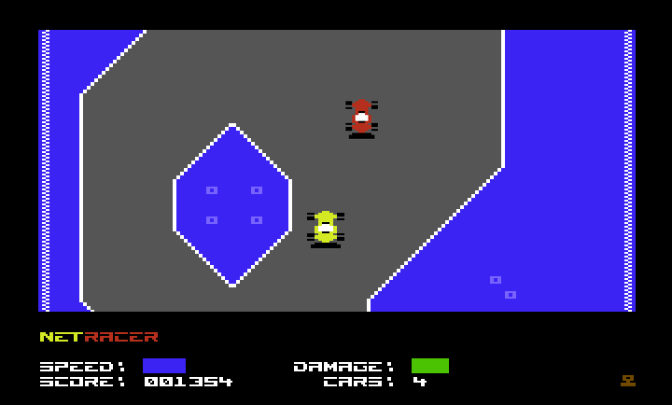
Screenshot

Slide 5
Client/Server Architecture
Commodore 64
(ML)
Commodore 64
(ML)
UDP
UDP
Commodore 64
(ML)
Server
(Java)
Commodore 64
(ML)
UDP
UDP
UDP
UDP
Commodore 64
(ML)
Commodore 64
(ML)

Slide 6
Internet Protocols
Transport Control Protocol (TCP)
    Guaranteed delivery of data + packet ordering
    Not implemented in ML yet, high overhead
    A lot of work for a poor 1Mhz computer
User Datagram Protocol (UDP)
    Much simpler protocol than TCP
    No guarantees – you do all the confirmation
    Working implementations in 6502 ML
    Used extensively in PC Internet gaming

Slide 7
Simplifying Assumptions
Minimal and static game “world”
Lost packets are ignored – subsequent packets supercede old data anyway
  No ACKing required
Maximum 8 players per server instance to keep to max. 8 sprites on screen
  No theoretical limit on # players otherwise

Slide 8
Technical Challenges
Keeping everything synchronized
  Mitigated by providing the illusion of a consistent game world (“good enough”)
Raster time
  Solved by skipping network update for one frame when screen is scrolled
Internet Lag
  Could be mitigated by transmitting player speed and direction to each client, which can interpolate other players’ positions in between updates

Slide 9
Server
Written in Java 5
  Platform independent
  Trivial UDP networking
Receives and maintains all player’s positions on the track
Updates all clients with information on other players that are currently visible

Slide 10
Server Threads
Receiver Thread
  Receives data from all clients
  Updates internal representation of game world
Updater Thread
  Maintains list of players (watches for drop-outs)
  Sends packet to all active players 20 times per second with details of what sprites to display

Slide 11
Client
Written in 6502 machine language using the DASM cross-assembler
Controls local player’s position and displays sprites representing other players based on updates from server
Tracks damage and score
Transmits player stats (location, speed, etc.) to server 60 times per second

Slide 12
Future Plans and Ideas
Enhance the game to add ‘combat’ elements (weapons, other hazards)?
Build on this experience to make a full-blown MMORPG on the C64 similar to Ultima?
<Your idea here!>

Slide 13
Where to get the Game
Grab a copy on disk from me today
Download latest version from www.petscii.com forums
(Network Game Development section)
Look for opponents on the #c64friends IRC channel (www.c64friends.com)

Slide 14
Credits
Leif Bloomquist – Game concept and framework
Robin Harbron and Lasse Öörni – Graphics/display code
Oliver VieBrooks – Network library code
Raymond Lejuez – Graphics
Alexander Rotzsch - Music
Ian Colquhoun – Server hosting
Robin Harbron, Dave McMurtrie, Dave Hartman – Playtesting

Slide 15
Demo Time!

