Slide 1
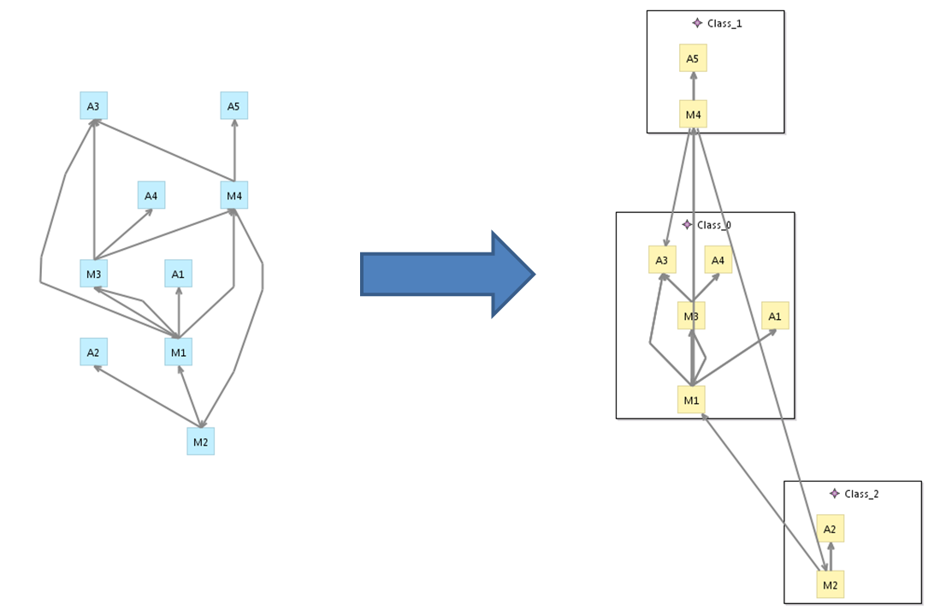

Solving the CRA problem with simulated annealing implemented in Java and ATL
Leif Arne Johnsen, Fernando Macías and Adrian Rutle

Slide 2


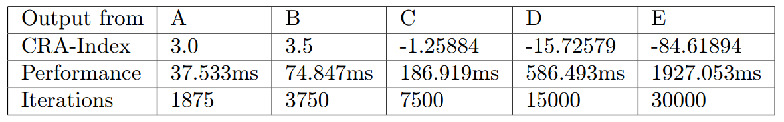
We used a probabilistic technique to evolve a solution towards the global optimum
Simulated annealing
Implementation
Evaluation

Slide 3
Simulated annealing is a metaheuristic to approximate global optima, avoiding local optima
Notes:
Heat treatment that alters the physical and sometimes chemical properties of a material to increase its ductility and reduce its hardness, making it more workable.
Simulated annealing interprets slow cooling as a slow decrease in the probability of accepting worse solutions as it explores the solution space. Accepting worse solutions is a fundamental property of metaheuristics because it allows for a more extensive search for the optimal solution.

Slide 4
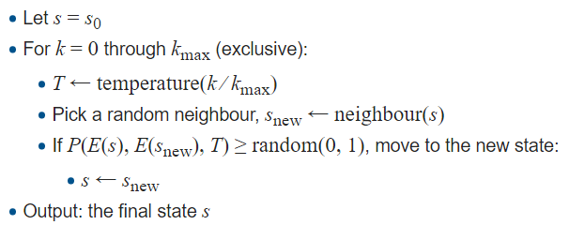
Simulated annealing is a metaheuristic to approximate global optima, avoiding local optima

Slide 5


This solution combines ATL for the generation of states and Java to implement the SA algorithm
CRA-index
Notes:
The first rule creates an empty class for each feature in the class model. It also sets the name of the classes created, each class is named from 1 to the number of features in the class model. The second rule randomly assigns each feature to a class, but the empty classes are still kept. The third rule randomly reassigns features. It goes through each feature. The fourth rule deletes all empty classes.

Slide 6
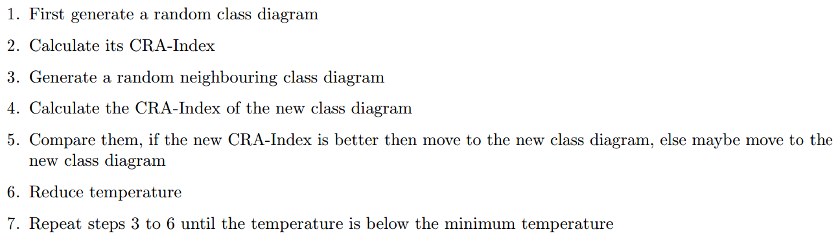
This solution combines ATL for the generation of states and Java to implement the SA algorithm
CRA-index
Notes:
In order to apply the SA method to a specific problem, one must specify the following parameters: the state space, the energy (goal) function E(), the candidate generator procedure neighbour(), the acceptance probability function P(), and the annealing schedule temperature() AND initial temperature <init temp>. These choices can have a significant impact on the method's effectiveness. Unfortunately, there are no choices of these parameters that will be good for all problems, and there is no general way to find the best choices for a given problem.

Slide 7
For bigger problems, a higher number of iterations is required, which affects execution time
Thank you for your attention!
Notes:
Correctness and completeness criteria were met

