Slide 1
MP4: REDUCING OPERATIONAL RISKS using loan approval predictions
PRESENTER
Lee Santos

Slide 2
Common Risks
Credit Risk
Accounts for a large portion of risk for banks
Occurs when clients fail to meet contractual obligations
Operational Risks
Include errors, fraud, or service interruptions
Caused by people or processes

Slide 3
Risk Mitigation
Credit Risk Mitigation
Optimize for loan approvals to increase client retention
Minimize loan default risk
Operational Risk Mitigation
Improve efficiency and accuracy of loan processing by eliminating subjective profiling and worker error during loan approval processes
Solution
Automated, unbiased heuristic for predicting risk values based on client profiles using machine learning

Slide 4
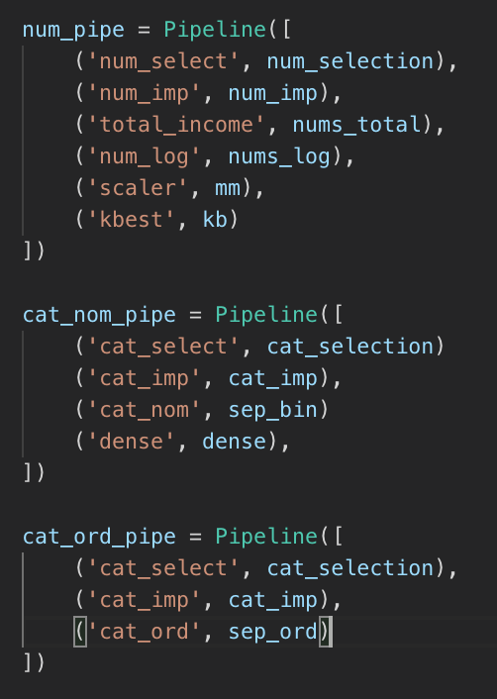
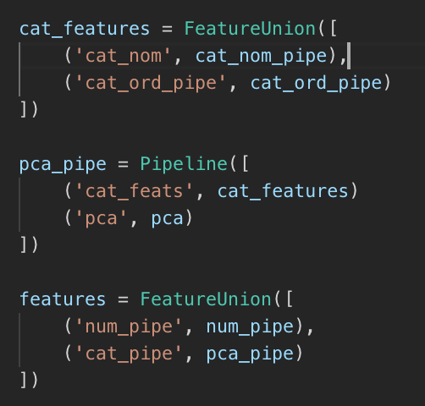
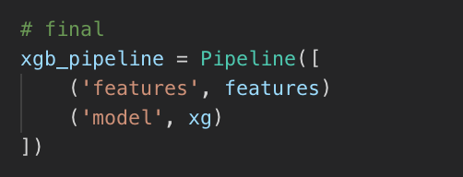
Workflow

Slide 5
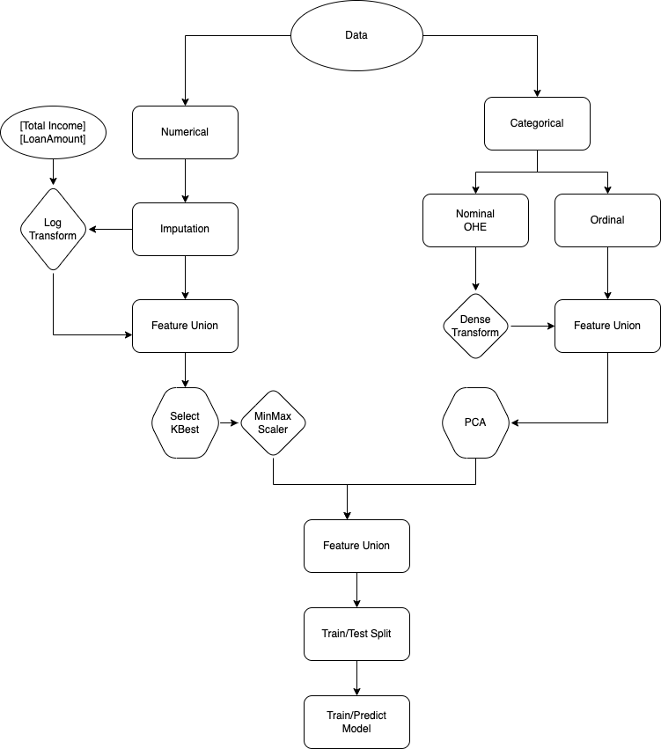
Workflow

Slide 6
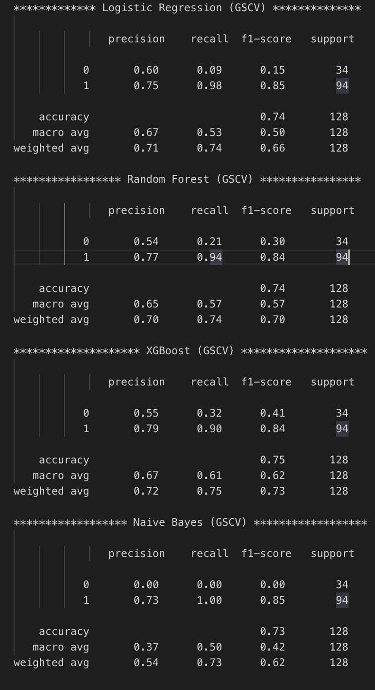
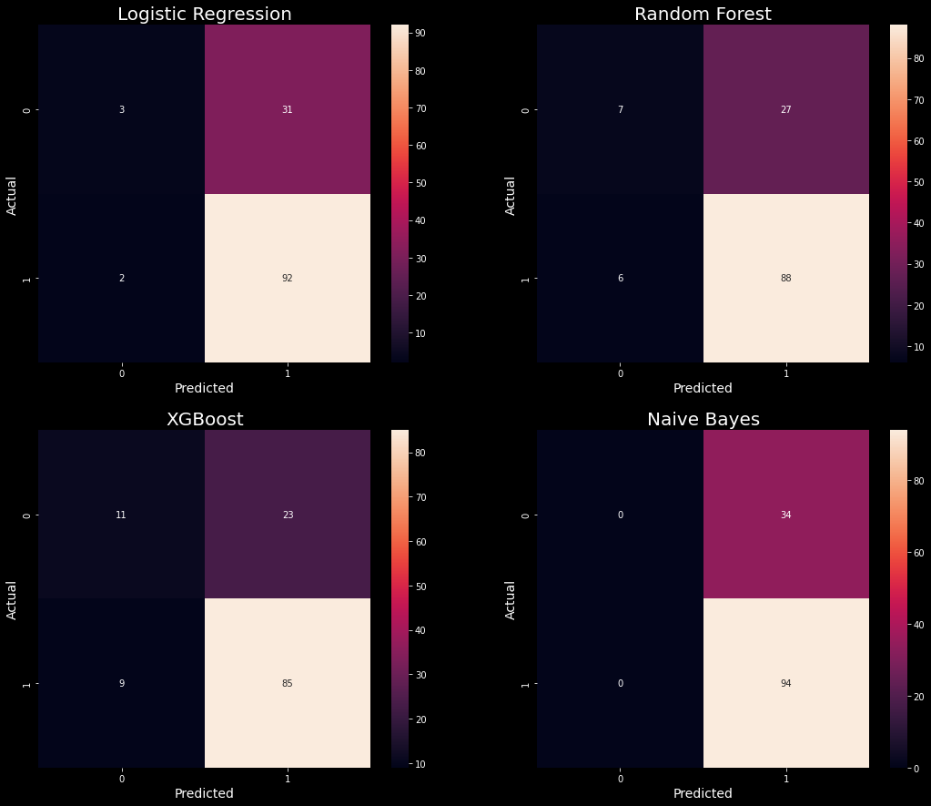
Results
XGBoost Classifier
Provided best results
Precision score: 79, Accuracy score: 75

Slide 7
Parting thoughts…
Proof-of-concept
Requires tweaking
Most of the legwork is frontloaded
Repeatable
Reliable
A deployed model can be accessed from

