Slide 1
W05D3 – Trees and Forests
Instructor: Jeremy Eng
Credit: Zain Hasan

Slide 2

Introduction
Instructor: Dr. Jeremy Eng (engj@saskpolytech.ca)
Lead Cloud Applications and Data Instructor at Sask Polytech
Born and raised in Saskatoon, Saskatchewan
PhD in Statistics
Research Areas:
Big data simulations involving Monte Carlo techniques
Developing and applying machine learning techniques to model COVID-19 spread in Saskatchewan and Canada (PMCMC)
Microsoft Certified Trainer
LinkedIn: https://www.linkedin.com/in/jeremy-eng-sk/

Slide 3
Outline
Decision Trees
Classification Trees
Regression Trees
Random Forests
Ensemble Methods
Bagging
Boosting
Stacking
Demo

Slide 4
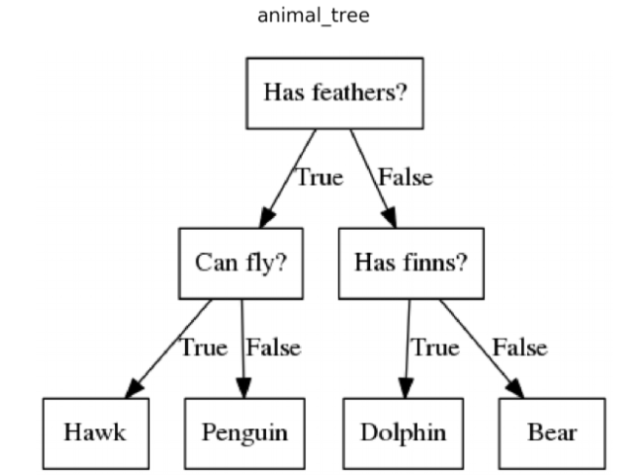
Decision Trees
Flow chart based on features
Can program using nested if-else statements.
Tree models will create these automatically in an optimal fashion.
Ex: Classification Tree
Notes:
Trees with 3 options could always just be modelled as a binary tree
Can also have regression trees

Slide 5
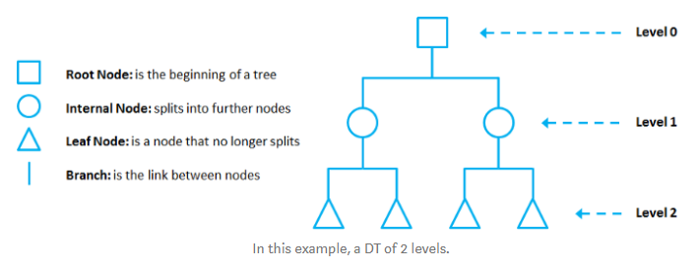
Decision Trees
Flow chart based on features
Can program using nested if-else statements.
Tree models will create these automatically in an optimal fashion.
Ex: Classification Tree
Terminology:
Nodes and Branches
Root, internal, and leaf nodes.
Levels (depth)
Let’s focus on classification trees first.
Notes:
Trees with 3 options could always just be modelled as a binary tree
Can also have regression trees

Slide 6
Classification Trees
Classification trees create regions in the feature space.
Each boundary line represents a root/internal node
Each region represents a leaf node
Notes:
Also for regression trees

Slide 7
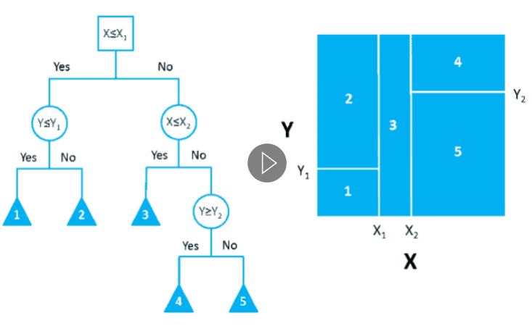
Classification Trees
Classification trees create regions in the feature space.
Each boundary line represents a root/internal node
Each region represents a leaf node
Notes:
Also for regression trees

Slide 8
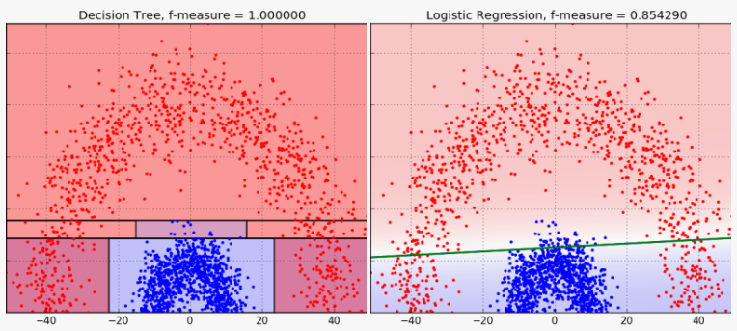
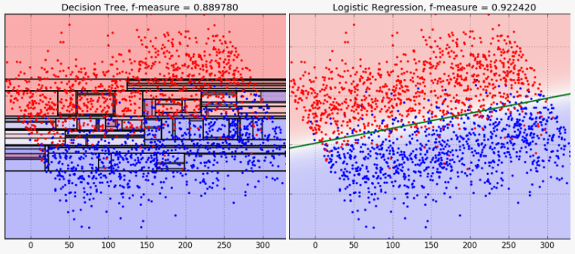
Classification Trees vs Logistic Regression
Classification trees create regions in the feature space.
Logistic regression creates a single decision boundary line.
Example of over-fitting (2 features).
Main drawback with Trees
Notes:
Dot color = true category
Shaded region = predicted category
Could theoretically have a region for every single datapoint

Slide 9
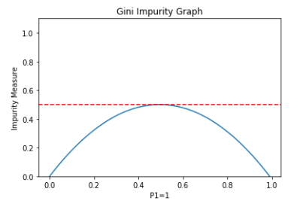
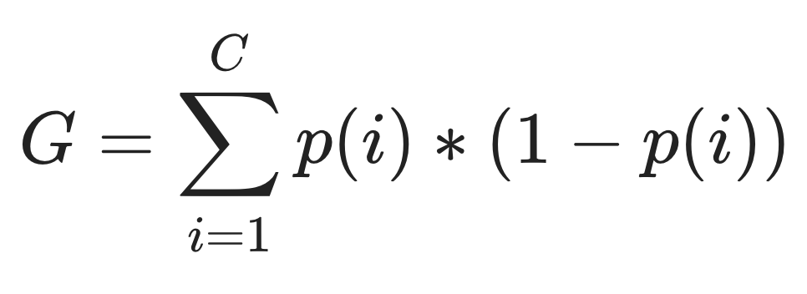
Classification Trees
How do we decide the split in an optimal way?
Pick a criterion and minimize it across possible splits
Based on the proportions after split
Popular: Gini, entropy, misclassification (details)
Ex: Gini impurity
C=number of classes
p(i)=proportion of class i
Notes:
Splits like when a region contains only a single color (low gini score)

Slide 10
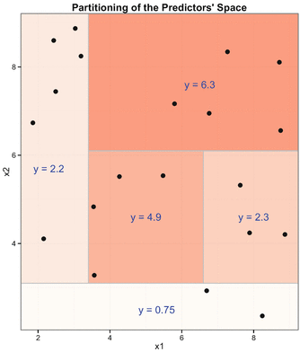
Regression Trees
Leaf nodes will now give us a number, not a class.
Regression tree criterion are calculated on the values in each region.
Popular: MSE, MAE, Half-Poisson deviance (details)
Minimized across all possible splits
Notes:
Notice stepwise behavior

Slide 11
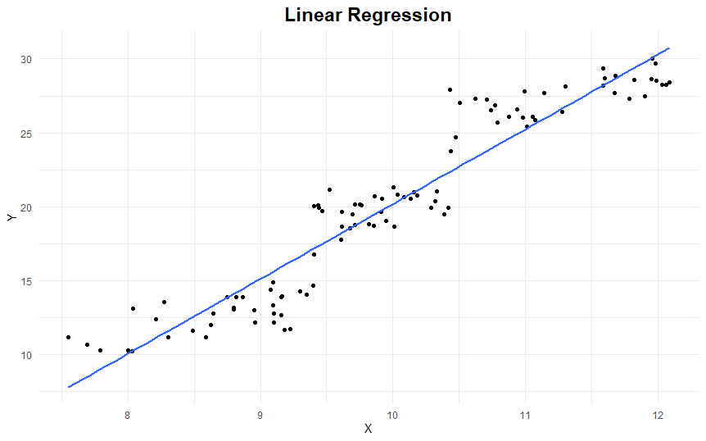
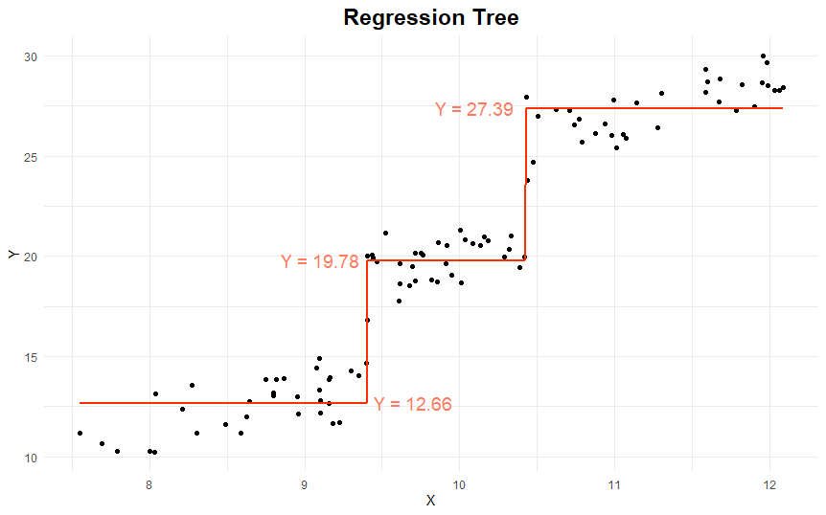
Regression Trees vs Linear Regression
Notes:
Note this is using only one feature to predict the target variable (previous examples were using two features)
Notice stepwise behavior

Slide 12
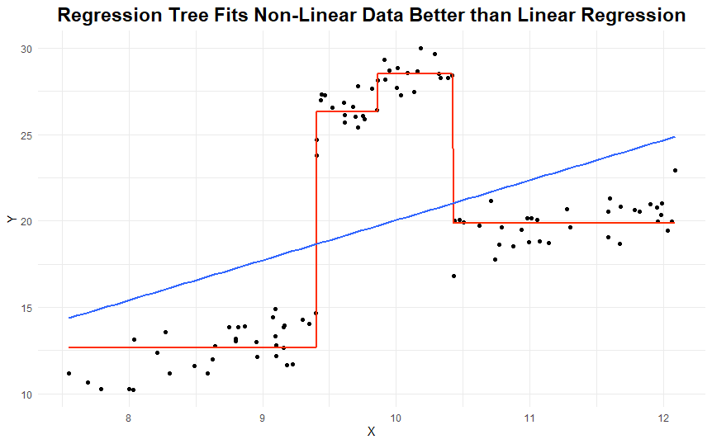
Regression Trees vs Linear Regression
Notes:
Line vs step-wise function
Beware of over-fitting again

Slide 13
Decision Trees: Pros and Cons
Pros:
Simple to understand and interpret.
Can be visualized
Requires little data preparation (doesn’t require normalization, can work with NaNs)
Can handle multi-class classification well.
Cons:
Tendency to overfit (pruning techniques are needed)
Can be unstable (small change to data may result in a completely different tree)
Each node is locally optimized (not globally)
Notes:
Pruning=reducing size of decision tree
Interpretability vs overfitting

Slide 14
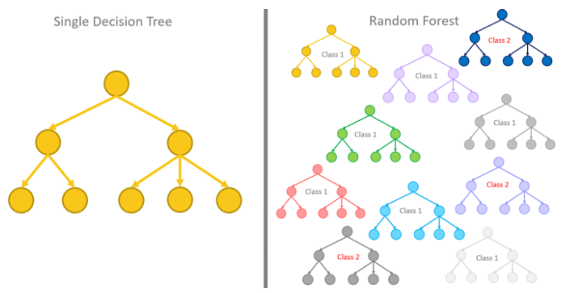
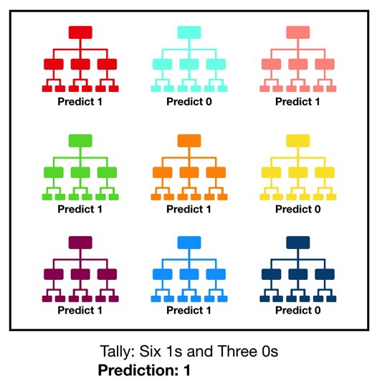
Random Forests
Addresses the problem that decision trees are susceptible to over-fitting.
General idea: fit a diverse set of trees by injecting “randomness”.
Then use the most common (or average) of all the predictions as our single prediction.

Slide 15
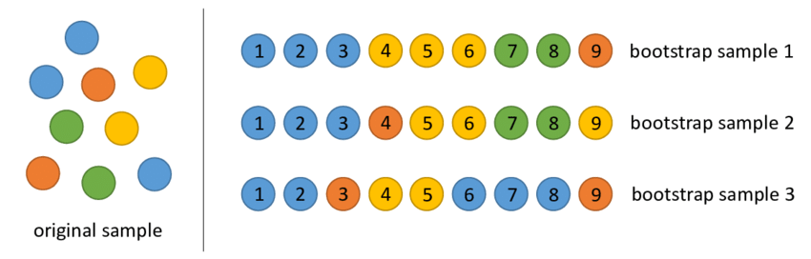
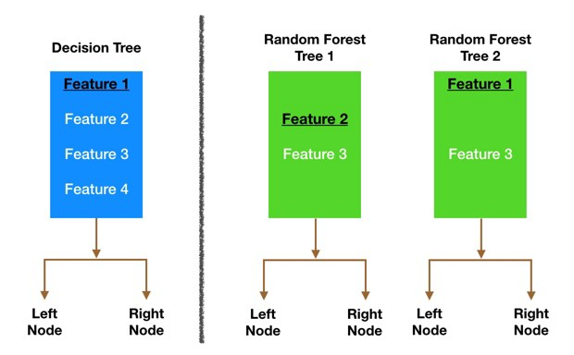
Random Forests
Ways to inject randomness:
Create “bootstrap samples”, and then build a tree for each bootstrap sample
At each split, consider only a random subset of features.
Notes:
Bootstrap sample: re-sample your data, but with replacement.
When determining how large the subset of features should be, general rule that gives good results is use sqrt(number of features) features

Slide 16
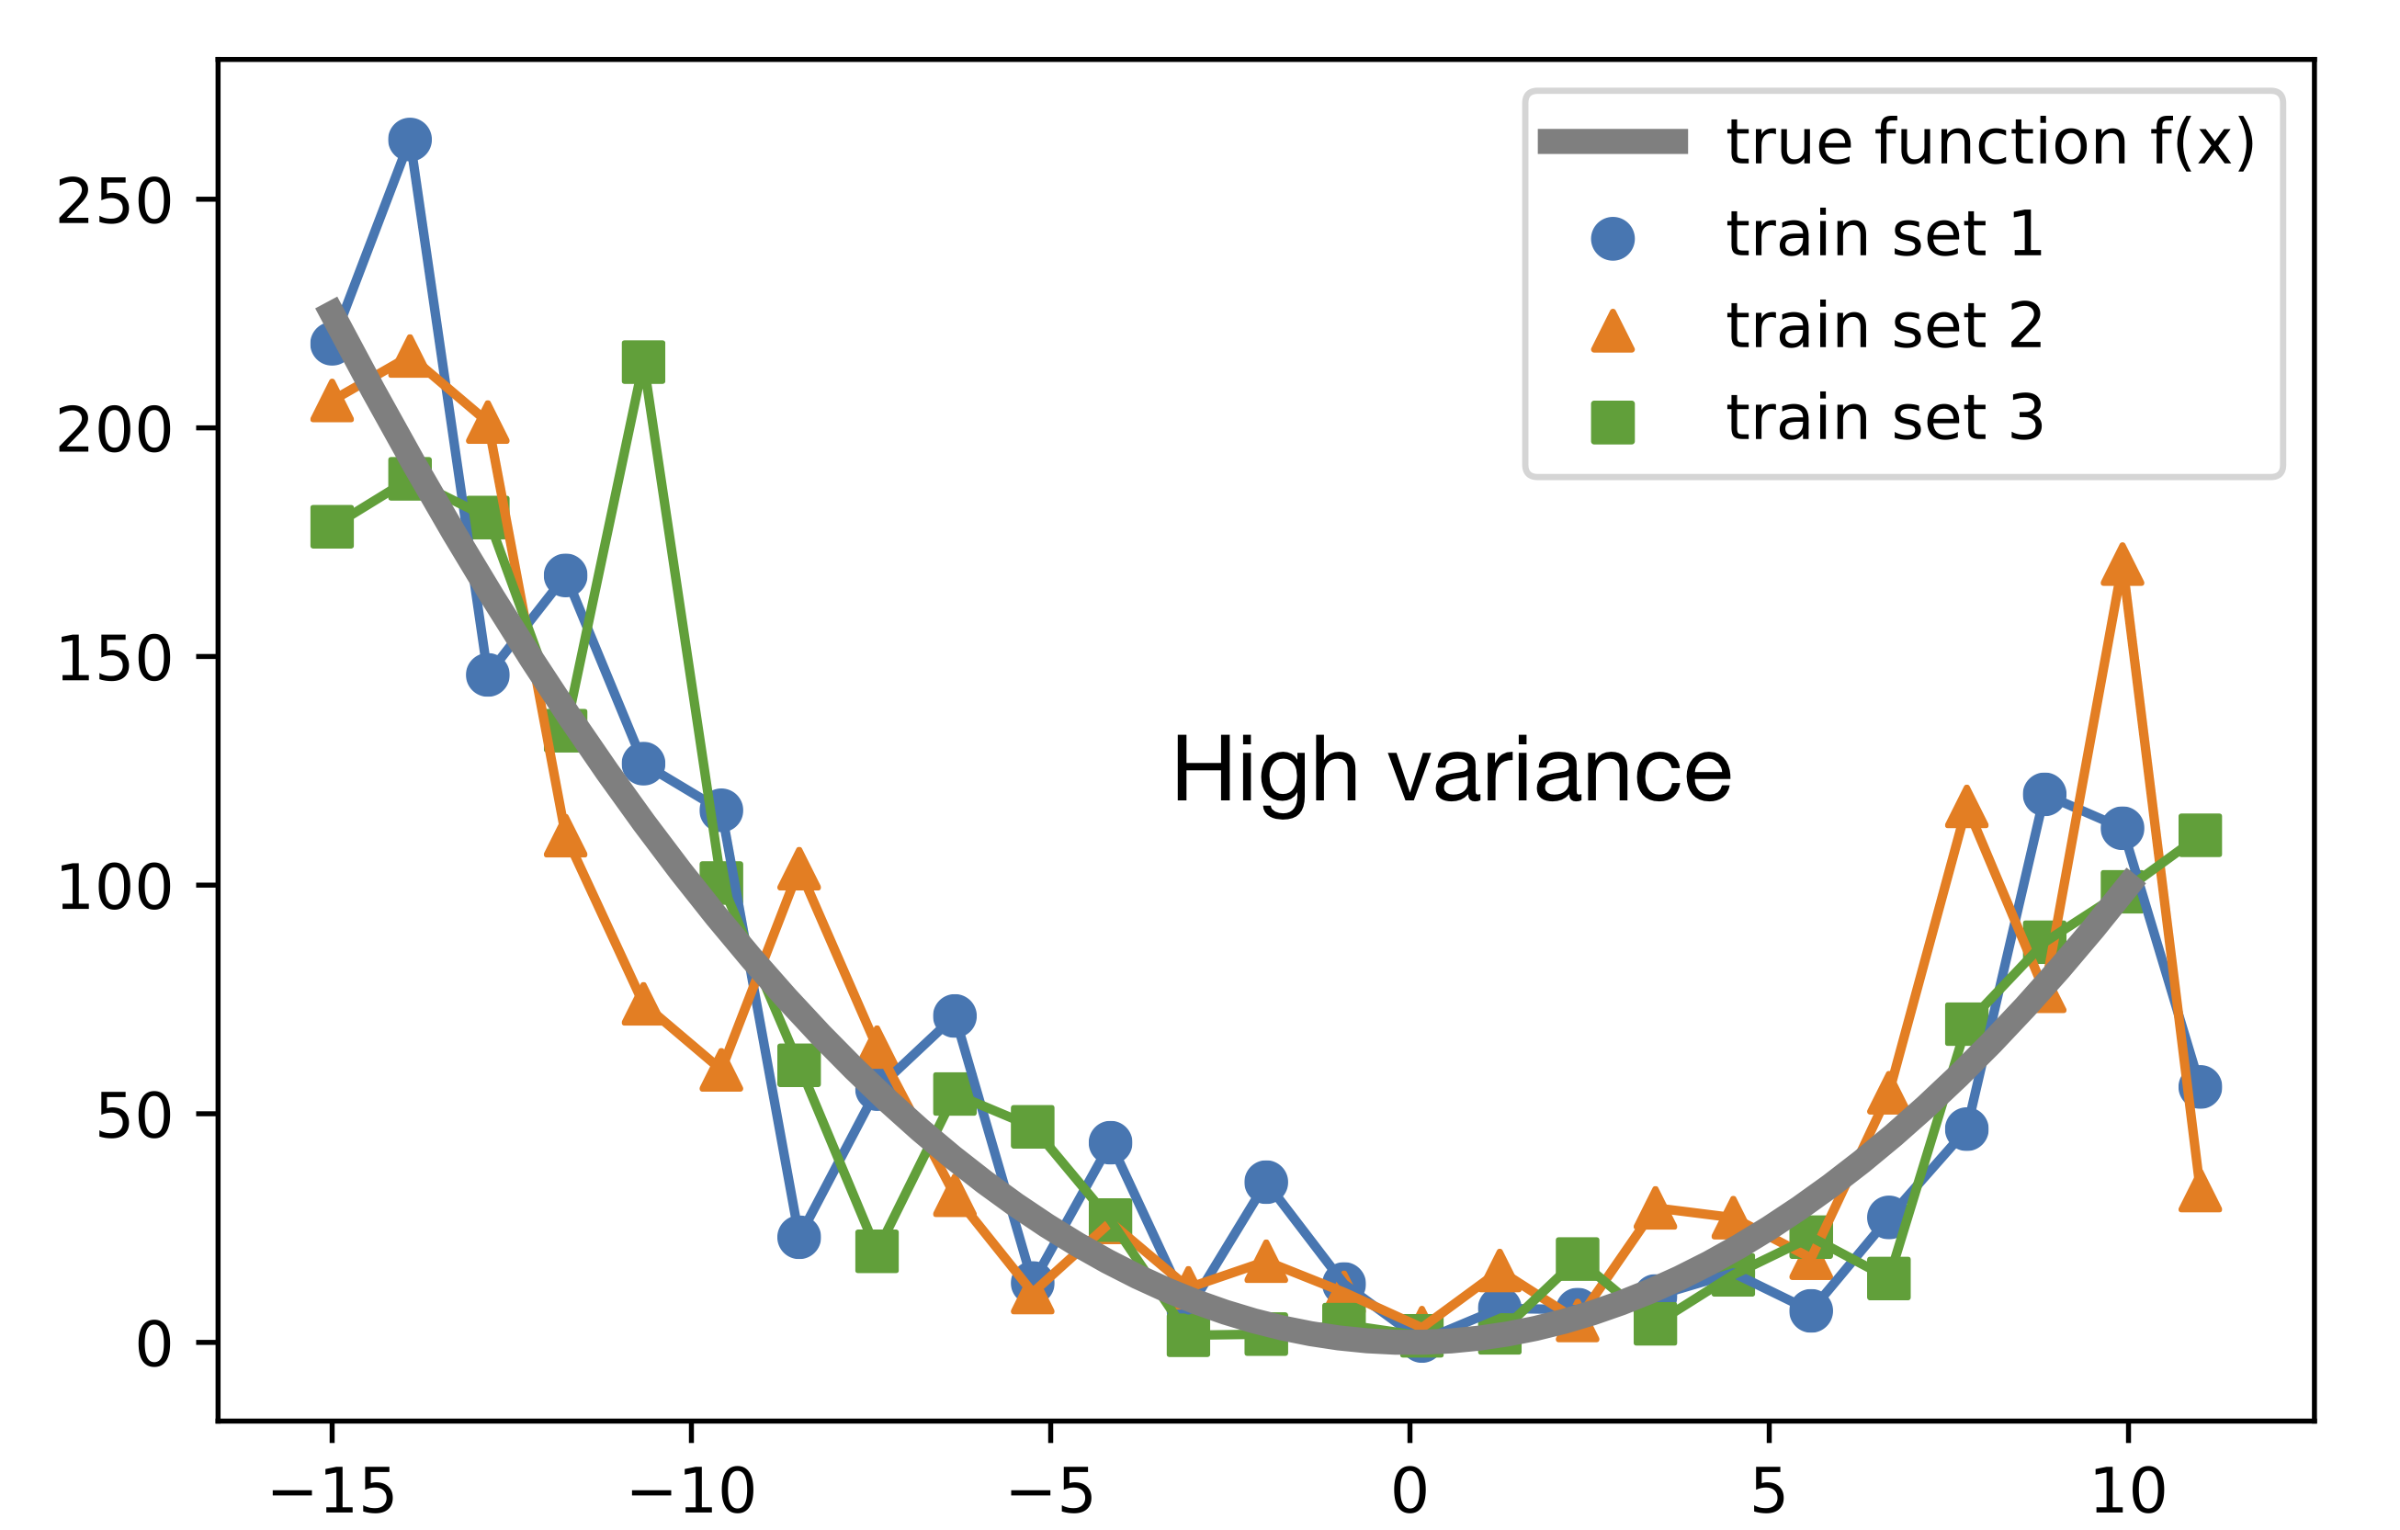
Random Forests
Averaging many over-fitted models reduces variance.

Slide 17
Random Forests
Accuracy
Usually more accurate when compared to decision trees.
Usually one of the best performing off-the-shelf classifiers.
Speed
Slower than decision trees because we are training multiple trees.
But can easily parallelize training because trees are independent.
Overfitting
Addresses the over-fitting tendency of decision trees.
Interpretability
Decision trees are more interpretable than random forests.

Slide 18
Ensemble Methods
Random Forests are an example of an ensemble method.
Ensemble methods are techniques that create multiple models (weak models) and then combine them to produce improved results.
Bagging (bootstrap and aggregate, e.g. random forest)
Same type of weak model used, models learn in parallel, combined in a deterministic process.
Addresses over-fitting.
Boosting
Add one model at a time that addresses the “shortcomings” of the current ensemble (iterative process).
Aggregation (averaging) is done during training, not after.
Addresses under-fitting.
Stacking
Use a variety of weak models as input to a “meta-model”.
Similar to bagging, but can use different types of models.
Source
Notes:
Examples of boosting next

Slide 19
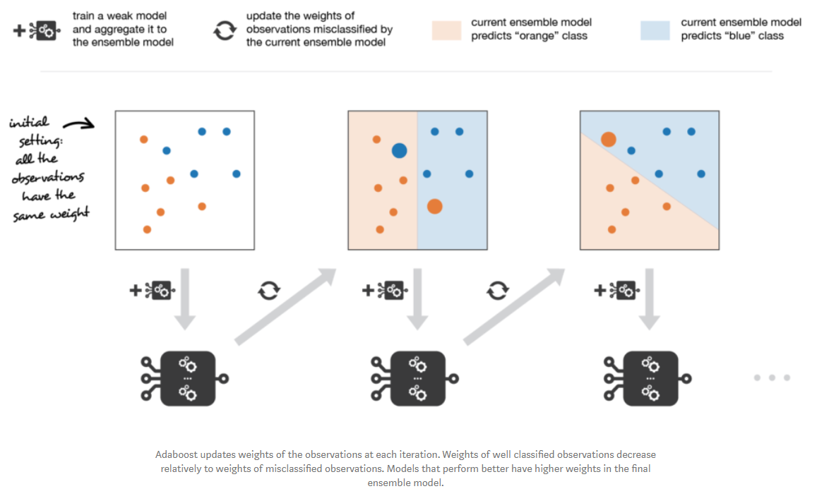
Ensemble Methods: Boosting Example
AdaBoost (Adaptive Boosting)
Notes:
Weighting of data points, and also weighting of models

Slide 20
Jupyter Notebook Demo
Notes:
Weighting of data points, and also weighting of models

