Slide 1

recognizing Duplications between queries
Presented by Lee santos
Using quora dataset

Slide 2
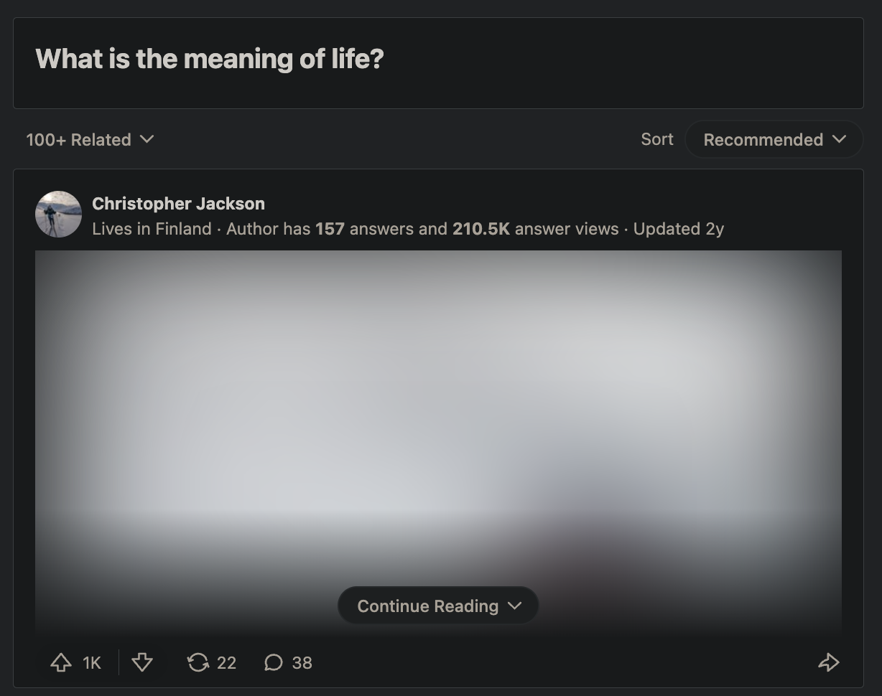

The issue with user-driven q&a solutions
Dilution of quality answers
Answers split between query pages
Answer ratings become less effective
Less answers per query page
Less effective search results
Increased sensitivity to search terms used
Noisier results = less relevant searches
Introduces

Slide 3
Finding duplications using nlp classification
Quora dataset
Dataset compares two questions with labels to classify duplicates
Cleaning
Tokenize using “nltk.word_tokenize”
Filter for alphanumeric values (accounting for error codes and other important numeric features)
Remove stop words
Lemmatize
Remove single characters
Did not filter for unique values; assumption that repeat words imply significance

Slide 4
combined queries: Idea & process
Combine tokenized, cleaned question columns to generate new feature
Resulting column should exhibit patterns of duplication or otherwise
Vectorize
Used TF-IDF
Limited output with “min_df = 10” to decrease number of parameters
Q1
Q1
Q1 + Q2
Q1 + Q3
Q2
Q3

Slide 5
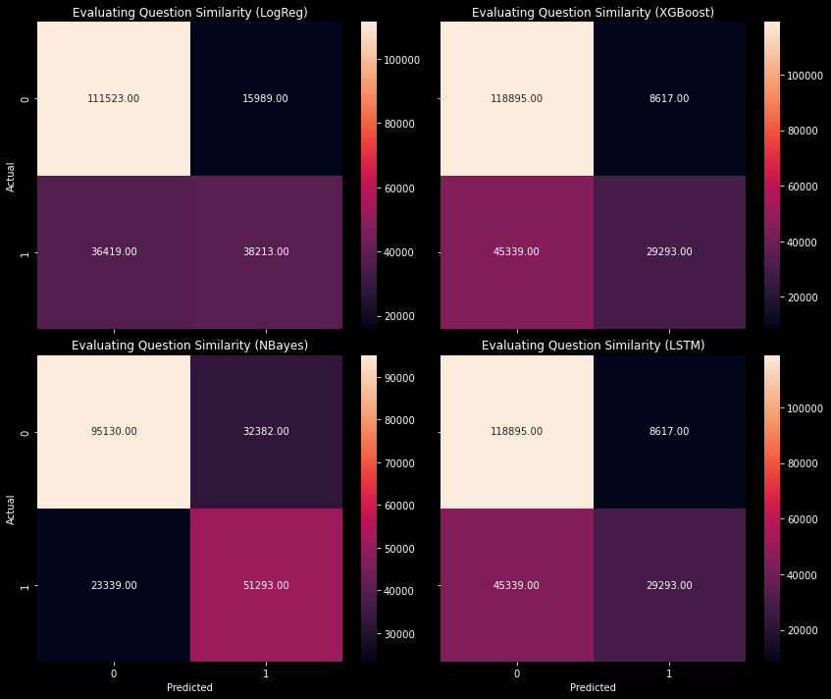
Combined queries: results
Split data 50/50 for train/test
According to the results, Naïve Bayes performs best for the problem
Preference towards False Positives to prevent wrongly classifying non-duplicates as duplicates (thereby reducing results)

Slide 6
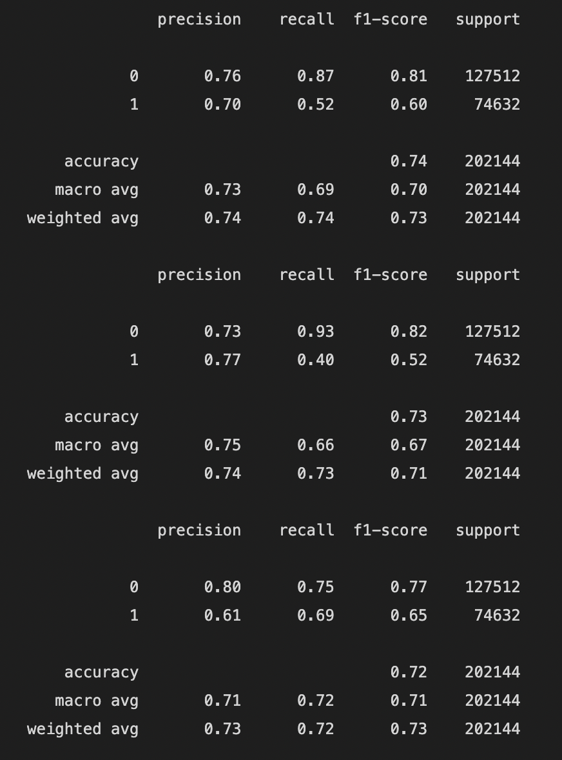
Next steps
Develop a method to account for spelling mistakes
Optimize hyperparameters for current models
Compare queries columns directly rather
Euclidean distances
Cosine Similarity
KNN?
Train network using LSTM algorithm
Compare performance between TF-IDF
and W2V vectorization methods

