Slide 1
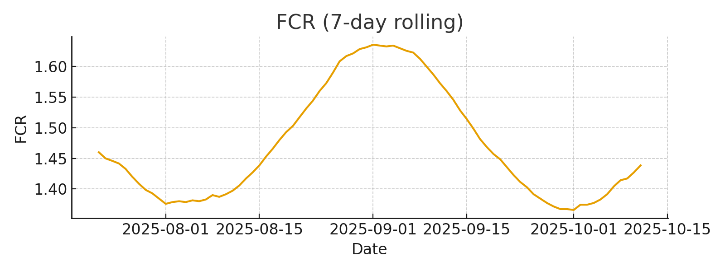
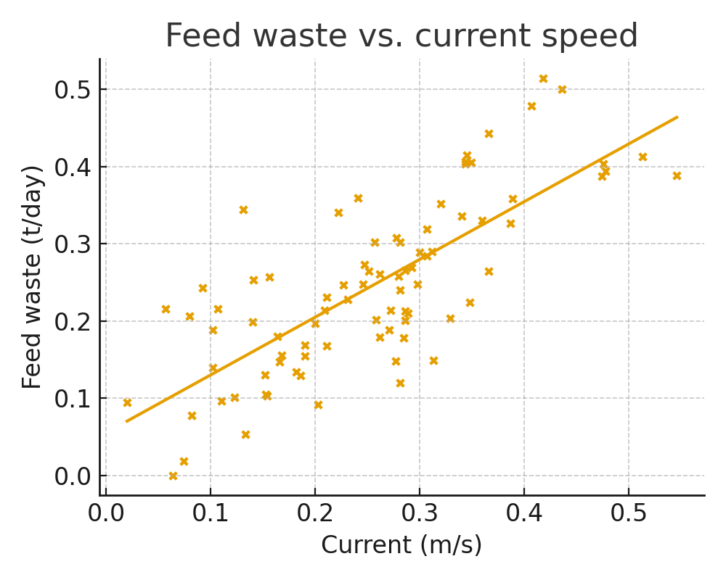
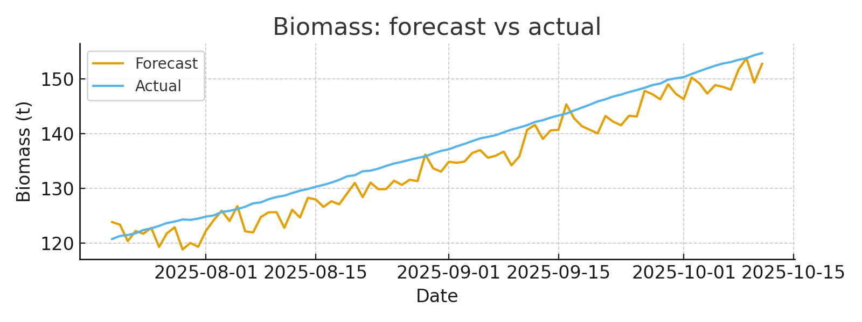
Feed Optimization Dashboard – Aquaculture (Portfolio Mock)
Synthetic sample (84 days) • KPIs for last 7 days • Built with Python/PowerPoint
FCR (avg, 7d)
1.44
Feed waste (t, 7d)
2.42
Biomass growth (t, 7d)
2.30
Portfolio mock • Replace with farm data • KPIs: FCR↓, waste↓, growth↑ • Built by Leila Barmoudeh

