Slide 1
An Analysis on Team Dynamics : Golden State Warriors vs. Cleveland Cavaliers 2016 - 2017
Presented by Leila Erbay

Slide 2
Overview
Main Question
Description of Qualifying Score (QS)
Data Wrangling
QS by Player
Correlation Coefficient: Win Proportion vs Team Ave QS
Test Stats : Comparisons Between GS and Cavs
Conclusion
Future Investigation

Slide 3
Main Question of Research
ARE TEAMS WITH THREE STRONG PLAYERS MORE LIKELY TO WIN THE NBA FINALS?
i.e.
SUPER TEAMS vs SUPER STAR PLAYER

Slide 4
Idea of a STRONG Player
Initial problem: Need a way of standardizing the set of player stats
Reaches a certain benchmark - no defined benchmark in NBA
According to article: “A superstar is someone who can have a team built around him. He should be able to take them deep into the playoffs and be that guy you can depend on in the closing minutes” ¹

Slide 5
Recruits and coaches should seek to
build a “Super Team” ¹ rather
than a superstar

Slide 6
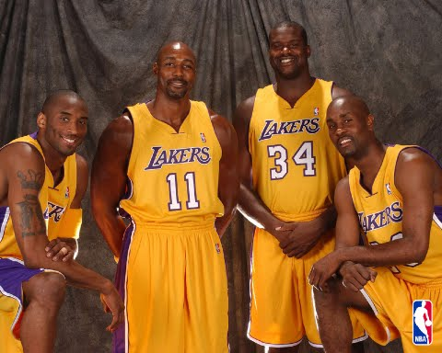
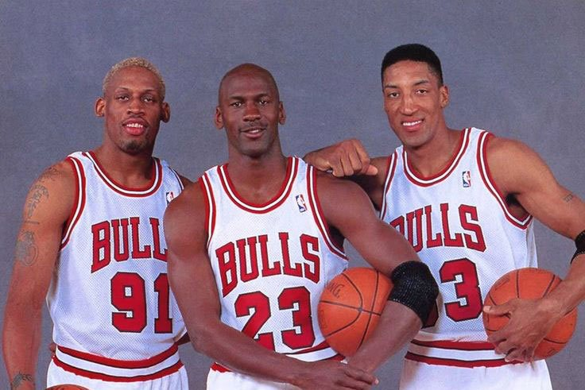
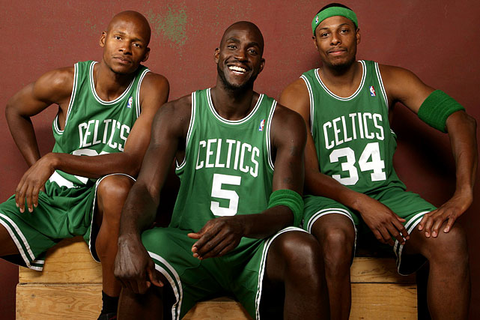

Notable Examples:
LA Lakers:
Malone,
Payton,
Kobe,
Shaq
(2004)
Chicago Bulls:
Jordan,
Pippen,
Rodman
(1996)
Boston Celtics: Garnett,
Pierce,
Allen
(2008)
Miami Heat:
L. James,
D. Wade,
Bosh
(2012, 2013)

Slide 7
Perspective
Objective as intention of predicting outcome of 2016 - 2017 Finals
Only used 2016 – 2017 Regular Season logs to see if any sort of trend in player stats of regular season could be used to foresee outcome of NBA playoffs and finals

Slide 8
Overview
Main Question
Description of Qualifying Score (QS)
Data Wrangling
QS by Player
Correlation Coefficient: Win Proportion vs Team Ave QS
Test Stats : Comparisons Between GS and Cavs
Conclusion
Future Investigation

Slide 9
Qualifying Score
Motivated by Player Efficiency Rating (PER) developed by John Hollinger
PER is determined by a very complex equation
Combines player stats with team stats to create each player’s PER
QS is simpler for the purpose of this project
Only looks at player stats to determine QS

Slide 10
Weights for QS
STAT | WEIGHT
FGM | 1.591
STL | 0.998
3PTM | 0.958
FTM | 0.868
BLK | 0.726
OFF. REB | 0.726
AST | 0.642
DEF. REB | 0.272
FOUL | -0.318
FT MISS | -0.372
FG MISS | -0.726
TO | -0.998
Description of Stats:
FGM – Field Goals Made
STL – Steals
3PTM – 3 pointers made
FTM – Free Throws Made
BLK – Blocks
OFF.REB – Offensive Rebounds
AST – Assists
DEF.REB – Defensive Rebounds
FOUL – Fouls (personal and technical)
FG Miss – Field Goal Miss
TO - Turnovers

Slide 11
Notes on QS and PER
Weights used for QS were based off calculations of Zachary Fein, a columnist for Bleacher Report.
QS weights recreate each player’s PER before setting the league average PER to 15.00.
Caution:
PER, and thus QS, largely measure offensive performance.
The defensive stats they incorporate—blocks and steals – can produce a distorted picture of a player's value
PER is not always considered a reliable measure of a player's defensive acumen.

Slide 12
Strong Player based on QS
My definition of a strong player
With my QS as standardization
Players who rank in top 2.5% of overall league QS is considered a super star player
Players who rank in top 5% of overall league QS is considered a strong player
Players who rank in top 10% of overall league QS is considered a necessary player
Players who rank in top 25% of overall league QS is considered above average
player

Slide 13
Overview
Main Question
Description of Qualifying Score (QS)
Data Wrangling
QS by Player
Correlation Coefficient: Win Proportion vs Team Ave QS
Test Stats : Comparisons Between GS and Cavs
Conclusion
Future Investigation

Slide 14
Data Wrangling
Process:
Game Logs 2016—2017 Regular Season
Removed illegible ids
Only NAs that existed: Team Name, Team Nickname
Fixed NAs
Removed Players when they played zero minutes in a game
Note: Data decreased from 36578 to 26162 (-10416)
Created qualifying score for each player in each game
Normalized data - square root of the qualifying scores
Note: Data decreased from 26162 to 24978 (-1184)
Notes:
Bank
Id name chkc_id sav_id
1 R.gao chk_1 sav_1
Checking
Id
1 r.gao….
Saving
id
1 r.gao….

Slide 15
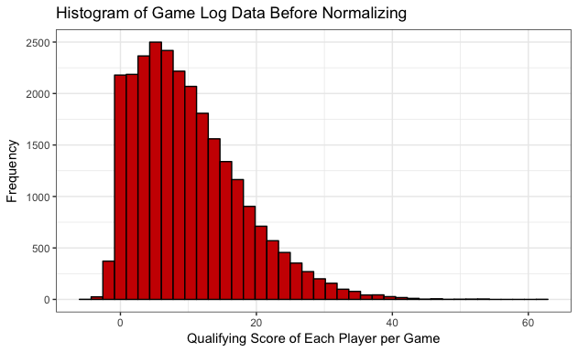
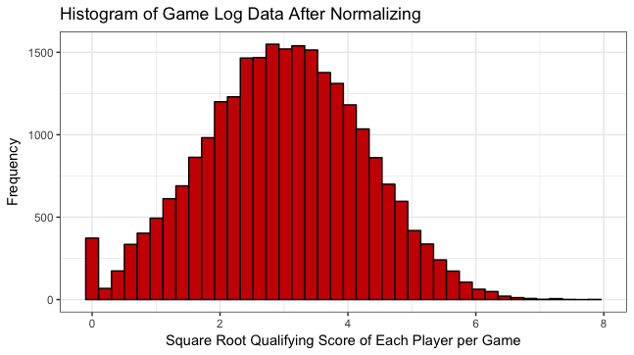
Data Wrangling Cont’d
Before Normalizing Data
After Normalizing Data
Notes:
BOXCOX

Slide 16
NOTE
From this point :
“Qualifying Score” (QS) refers to the
square root of the initial qualifying score
&
“GS” refers to Golden State Warriors (BLUE)
“Cavs” refers to Cleveland Cavaliers (RED)

Slide 17
Overview
Main Question
Description of Qualifying Score (QS)
Data Wrangling
QS over Various Groupings
Correlation Coefficient: Win Proportion vs Team Ave QS
Test Stats : Comparisons Between GS and Cavs
Conclusion
Future Investigation

Slide 18
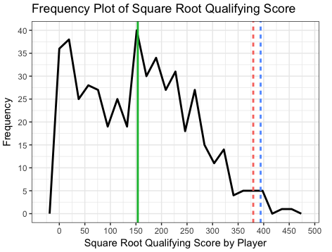
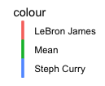
Total QS Per Player
Analysis:
In the 2016-2017 Season,
Stephen Curry was seen to have a higher total QS than LeBron James.
Both players had total QS much greater than the average player in the league.
Note:
It would be beneficial to see how total QS per player over time changes between the players
S.C = 394.0499
L.J. = 379.5965
Notes:
Why is this important?
LeBron James is considered the best in the league
Stephen Curry is a upcoming star
Although Curry seemed to out perform James in this season,
It is possible that the team dynamics, play by play, among the GS
allowed for Curry to outperform James.
Also data of James may be skewed since there were instances were he did not play at all

Slide 19
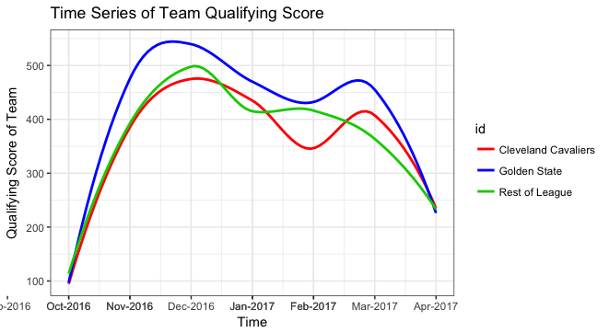
League QS vs Finalists’ QS Over the Season
Analysis:
It is seen that GS have a team QS that is noticeably greater than that of the Cavs ( and the rest of the League)
Notes:
But how significant is this difference between GS and the Cavs ?
Is this enough to ensure that the team would go on to win the NBA finals for this year?

Slide 20
Z – Test: Golden State vs Cleveland Cavaliers
H₀ : μ_{GS} ≤ μ_{Cavs}
H_{a} : μ_{GS} > μ_{Cavs}
H₀ : mean QS of GS ≤ mean of QS of Cavs
H_{a} : mean QS of GS > mean of QS of Cavs
Significance level: ⍺ = 0.05
P-Value : 0.5
Notes:
P value = .5 !< 0.05 do not reject null hypothesis <--- not necessarily Greater
= ? yes: p val =2

Slide 21
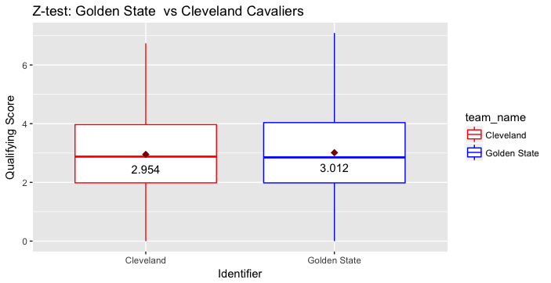
Z – Test: Golden State vs Cleveland Cavaliers
Statistical Decision:
Do Not Reject Null Hypothesis
Formal Decision:
GS mean QS is not significantly greater than Cavs’ mean QS
Notes:
Ran another test:
Alt: Cavs mean QS > GS mean QS
p.value = 0.5 ← not significantly greater
Ran another test:
Alt: Cavs mean QS != GS mean QS
p.value = 2 <-- not sign different

Slide 22
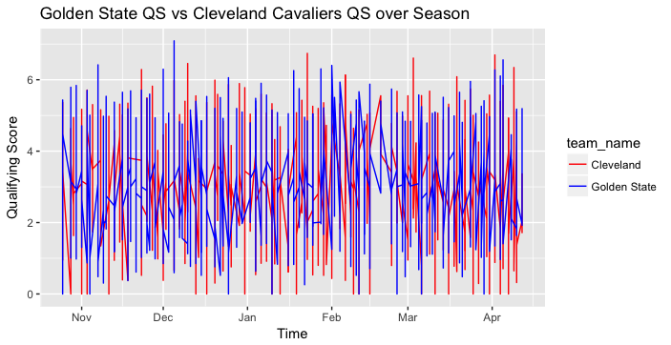
Golden State vs Cleveland Cavaliers Over the Season

Slide 23
Overview
Main Question
Description of Qualifying Score (QS)
Data Wrangling
QS by Player
Correlation Coefficient: Win Proportion vs Team Ave QS
Test Stats : Comparisons Between GS and Cavs
Conclusion
Future Investigation

Slide 24
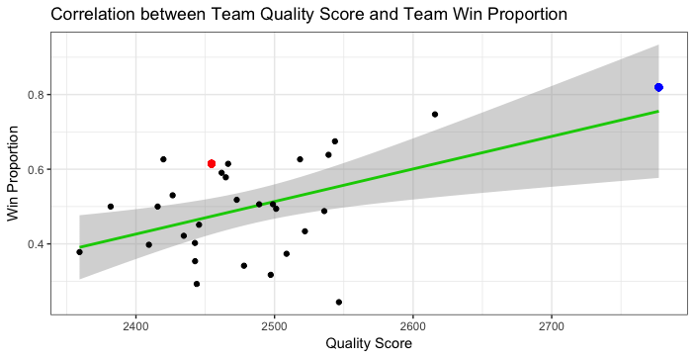
QS vs Win Proportion
R-squared =
0.2475054
Correlation Coefficient = 0.4974992
Notes:
R-squared is not very high thus the linear model does not fit the data very well
The correlation coefficient shows somewhat positive relation between the 2 variables
Although this model does not show a strong relationship between the 2 variables,
Please note the difference between the point of the GS team and the that of the Cavs
If time permitted, I would have liked to explore the relationship between these 2 variables in further detail.
There may be some strong relationship that exists between these 2 variables that could potential act as a predicting factor in a team winning the finals
Reg Season … playoffs

Slide 25
Overview
Main Question
Description of Qualifying Score (QS)
Data Wrangling
QS by Player
Correlation Coefficient: Win Proportion vs Team Ave QS
Test Stats : Comparisons Between GS and Cavs
Conclusion
Future Investigation

Slide 26
Test Stats : Comparisons Between GS and Cavs
Tests:
Stephen Curry vs League
LeBron James vs League
Stephen Curry vs LeBron James
LeBron James vs Top 3 of GS (1 vs 3)
LeBron James vs Top 2 of GS (1 vs 2)
Top 2 Cavs vs Top 3 GS (2 vs 3)

Slide 27
T-Test : Stephen Curry (GS) vs League
H₀ : μ_{SC} ≤ μ
H_{a} : μ_{SC} > μ
H₀ : mean QS of Stephen Curry ≤ to the population mean
H_{a} : mean QS of Stephen Curry > to the population mean
Significance level: ⍺ = 0.05
P-Value : 2.592455 e-40

Slide 28
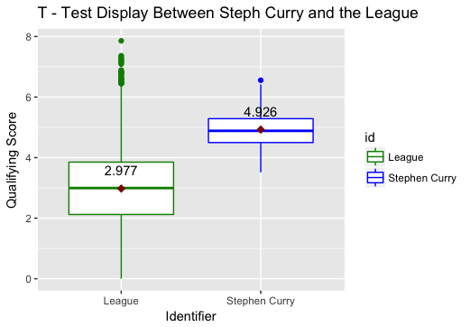
T-Test : Stephen Curry (GS) vs League
Statistical Decision:
Reject the null hypothesis
Formal Decision:
Confident to say that Stephen Curry’s mean QS is significantly greater than the mean QS of the population

Slide 29
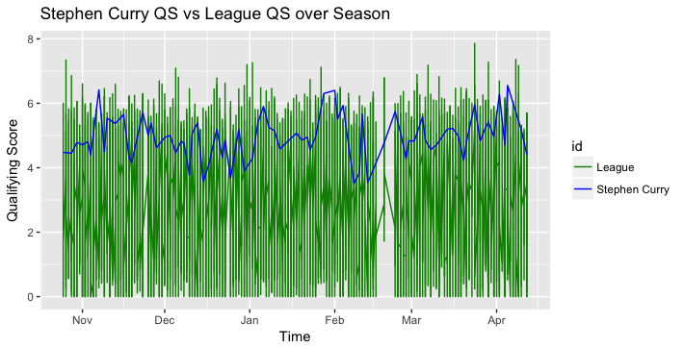
Stephen Curry (GS) vs League Over the Season
Notes:
Overall Stephen is a top player among the NBA players

Slide 30
T – Test : LeBron James (Cavs) vs League
H₀ : μ_{LJ} ≤ μ
H_{a} : μ_{LJ} > μ
H₀ : mean QS of LeBron James ≤ to the population mean
H_{a} : mean QS of LeBron James > to the population mean
Significance level: ⍺ = 0.05
P-Value : 5.418868 e-42

Slide 31
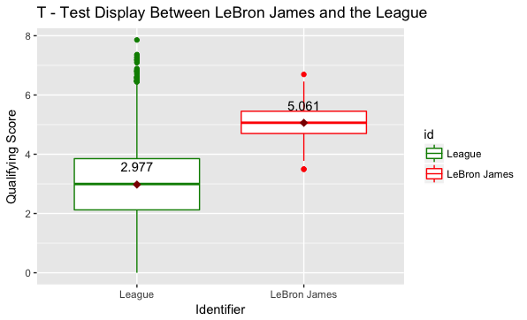
T – Test : LeBron James (Cavs) vs League
Statistical Decision:
Reject the null hypothesis
Formal Decision:
Confident to say that LeBron James’ mean QS is significantly greater than the mean QS of the population

Slide 32
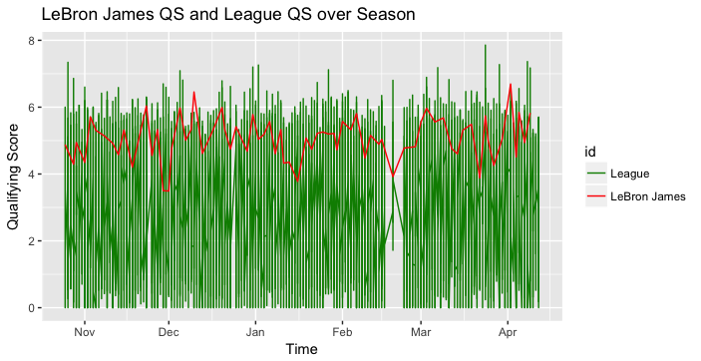
LeBron James(Cavs) vs League Over the Season

Slide 33
Stephen Curry vs League LeBron James vs League
As expected from the presentation of one of the initial graphs:
Both Stephen Curry and LeBron James have total QS much greater than the mean QS of the whole league

Slide 34
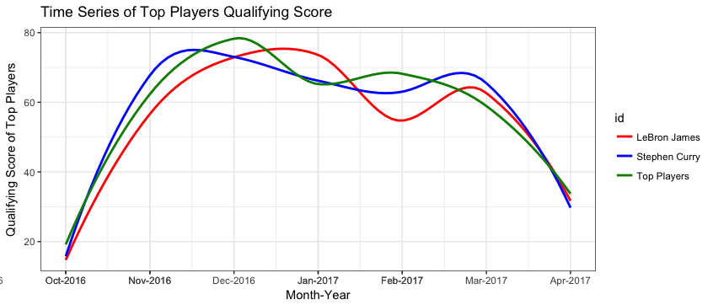
Top Tier Player QS over the Season
Notes:
What is a top Tier Player?
Comparison of Steph Curry and Lebron QS over time among the top tier
Note that LeBron and Curry are fairly close in their QS over the season
Thus the hypothesis test from the previous slides is consistent with this graph in that
the QS of LeBron and Stephen is not fairly different overtime

Slide 35
Expectation vs Reality: Stephen Curry vs LeBron James
Expectation:
mean QS of Stephen Curry would be greater than mean QS of Lebron James
Reality:
Mean QS of Stephen Curry = 4.925623
Mean QS of LeBron James = 5.061287

Slide 36
T-Test: Stephen Curry vs LeBron James
H₀ : μ_{SC} = μ_{LJ}
H_{a} : μ_{SC} ≠ μ_{LJ}
H₀ : mean QS of Stephen Curry = mean of QS of LeBron James
H_{a} : mean QS of Stephen Curry ≠ mean of QS of LeBron James
Significance level: ⍺ = 0.05
P-Value : 2
Notes:
Even though SC mean is seen to be greater than LJ is it significantly greater??

Slide 37
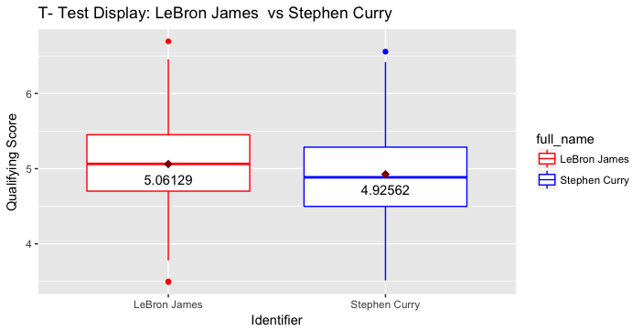
T – Test: Stephen Curry vs LeBron James
Statistical Decision:
Do Not Reject Null Hypothesis
Formal Decision:
Stephen Curry’s mean QS is not significantly different than LeBron James’ mean QS

Slide 38
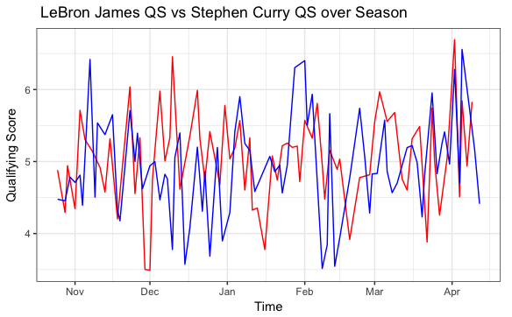
Stephen Curry vs LeBron James Over the Season
Notes:
Hard to tell a significant difference between the two players

Slide 39
Z-Test: LeBron James vs Top 3 of GS
H₀ : μ_{GS} ≤ μ_{LJ}
H_{a} : μ_{GS} > μ_{LJ}
Significance level: ⍺ = 0.05
P-Value : 1
Decision:
Do Not reject Null Hypothesis
mean QS of Top 3 of GS is not significantly greater than mean QS of LeBron James
Notes:
H₀ : mean QS of Stephen Curry ≤ mean of QS of LeBron James
H_{a} : mean QS of Stephen Curry > mean of QS of LeBron James

Slide 40
Z-Test: LeBron James vs Top 3 of GS
H₀ : μ_{GS} ≥ μ_{LJ}
H_{a} : μ_{GS} < μ_{LJ}
Significance level: ⍺ = 0.05
P-Value : 3.40658 e-12
Decision:
Reject Null Hypothesis
mean QS of Top 3 of GS is significantly less than mean QS of LeBron James
Notes:
H₀ : mean QS of Stephen Curry ≥ mean of QS of LeBron James
H_{a} : mean QS of Stephen Curry < mean of QS of LeBron James

Slide 41
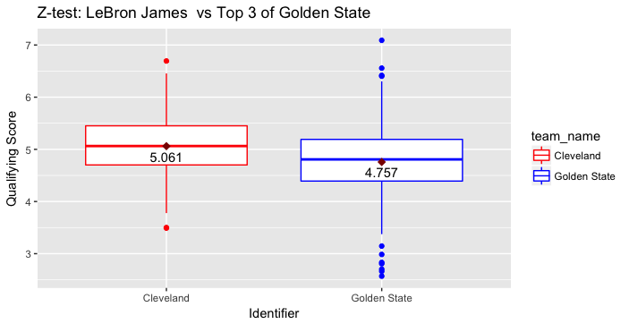
Z-Test: LeBron James vs Top 3 of GS
Note:
Top 3 of GS
Stephen Curry
Kevin Durant
Klay Thompson

Slide 42
Z-Test: LeBron James vs Top 2 of GS
H₀ : μ_{GS} ≤ μ_{LJ}
H_{a} : μ_{GS} > μ_{LJ}
Significance level: ⍺ = 0.05
P-Value : 0.9999722
Decision:
Do Not reject Null Hypothesis
mean QS of Top 2 of GS is not significantly greater than mean QS of LeBron James
Notes:
H₀ : mean QS of Stephen Curry ≤ mean of QS of LeBron James
H_{a} : mean QS of Stephen Curry > mean of QS of LeBron James

Slide 43
Z-Test: LeBron James vs Top 2 of GS
H₀ : μ_{GS} ≥ μ_{LJ}
H_{a} : μ_{GS} < μ_{LJ}
Significance level: ⍺ = 0.05
P-Value : 2.780161 e-05
Decision:
Reject Null Hypothesis
mean QS of Top 2 of GS is significantly less than mean QS of LeBron James
Notes:
H₀ : mean QS of Stephen Curry ≤ mean of QS of LeBron James
H_{a} : mean QS of Stephen Curry > mean of QS of LeBron James

Slide 44
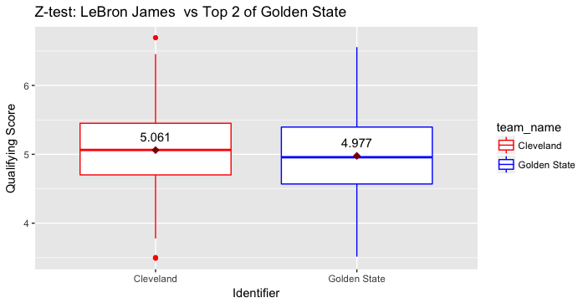
Z – Test: LeBron James vs Top 2 of GS
Note:
Top 2 of GS
Stephen Curry
Kevin Durant

Slide 45
Z – Test: Top 2 Cavs vs Top 3 GS
H₀ : μ_{GS} ≤ μ_{Cavs}
H_{a} : μ_{GS} > μ_{Cavs}
Significance level: ⍺ = 0.05
P-Value : 0.9999947
Decision:
Do Not reject Null Hypothesis
mean QS of Top 3 of GS is not significantly greater than mean QS of Top 2 Cavs

Slide 46
Z – Test: Top 2 Cavs vs Top 3 GS
H₀ : μ_{GS} ≥ μ_{Cavs}
H_{a} : μ_{GS} < μ_{Cavs}
Significance level: ⍺ = 0.05
P-Value : 5.257373 e-06
Decision:
Reject Null Hypothesis
mean QS of Top 3 of GS is significantly less than mean QS of Top 2 Cavs
Notes:
5.257373e-06

Slide 47
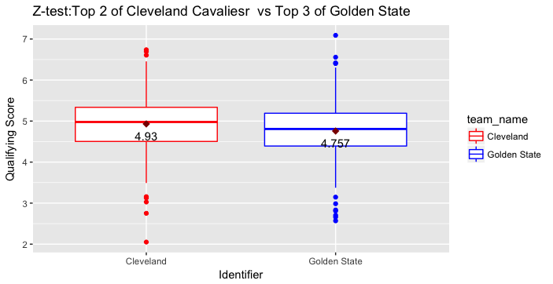
Z – Test: Top 2 Cavs vs Top 3 GS
Note:
Top 3 of GS
Stephen Curry
Kevin Durant
Klay Thompson
Note:
Top 2 of Cavs
LeBron James
Kyrie Irving
Notes:
I would have like to compare GS to Cavs w/o Lebron

Slide 48
Overview
Main Question
Description of Qualifying Score (QS)
Data Wrangling
QS by Player
Correlation Coefficient: Win Proportion vs Team Ave QS
Test Stats : Comparisons Between GS and Cavs
Conclusion
Future Investigation

Slide 49
Conclusion
Expectation :
Surmised that the tests between GS and Cavs would show significant difference
Surmised that tests would show GS have a significantly greater mean QS than the Cavs
Results:
Mean QS of Stephen Curry is not significantly different than mean QS of LeBron James
Mean QS of Top 3 Players of GS is significantly less than mean QS of LeBron James
Mean QS of Top 2 Players of GS is significantly less than mean QS of LeBron James
Mean QS of Top 3 Players of GS is significantly less than mean QS of Top 2 Players of Cavs
Notes:
Knowing that GS won the 2016 – 2017 finals

Slide 50
Conclusion Cont’d
Main Q:
Does a team have a greater chance of winning the NBA finals if it consists of 3 strong players versus a team with 1 super star?
Response:
With the limited data that was used,
A team with only 3 strong players is not guaranteed to win the NBA finals
However a team with 3 strong players and a team of above average starters and bench players seem to bolster the chances of winning the NBA finals (more to research in the future)
Notes:
Lebron
Steph
Durant
THompson
Irving
Player2

Slide 51
Overview
Main Question
Description of Qualifying Score (QS)
Data Wrangling
QS by Player
Correlation Coefficient: Win Proportion vs Team Ave QS
Test Stats : Comparisons Between GS and Cavs
Conclusion
Future Investigation

Slide 52
Future Investigation
Create a better QS that more accurately summarizes a player’s overall statistics
Incorporate Win Proportion more so in analysis
Look at stats not only from 2016 – 2017 but over a wider range of time to see more obvious trends in data
Looking at a wider range of team dynamics among the 2 teams:
Starters, Bench Players, How each team plays without their respective stars

Slide 53
Questions

