Slide 1
Sets
Lab 07

Slide 2
Java Interfaces
The following are important
interfaces included in the
Java language ::
Collection
Set
Map

Slide 3
Iterable
Java Collections
Map
Sub-interface
extends Collection
Collection
Implementing
Classes
SortedMap
Sub-
interfaces
extend Collection
HashMap
HashTable
Implementing
Classes
List Set
sub-interface
Implementing
Classes
TreeMap
SortedSet
Implementing
Classes
ArrayList
LinkedList
Vector
TreeSet
HashSet

Slide 4
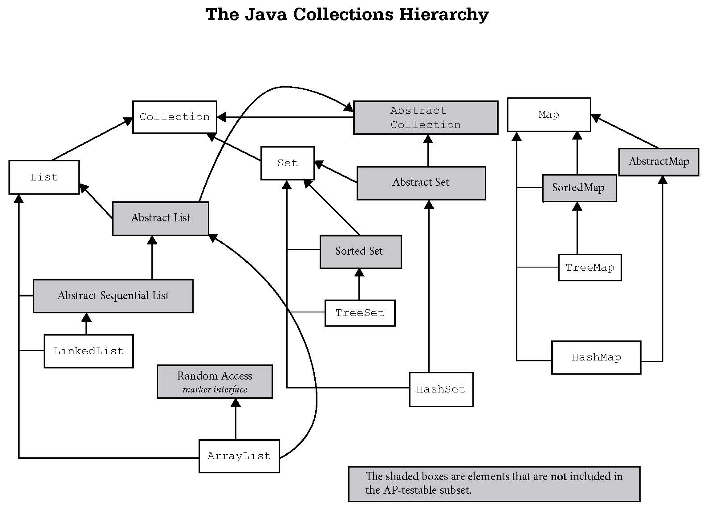
Iterable

Slide 5
The Collection Interface
The Collection interface is the parent of List and Set. It lists methods such as add(), clear(), remove(), and size() that every Collection must have.
Collection
List
Set
others not shown

Slide 6
The Set Interface
The Set interface extends the Collection interface.
Set
interface
AbstractSet
SortedSet
interface
HashSet
TreeSet

Slide 7
Set
A set is a group of items all of the same type of which none are duplicates.

Slide 8
Set
Because Set is an interface, you cannot instantiate it.
Set bad = new Set(); //illegal
Set set = new HashSet(); //legal
set = new TreeSet(); //legal
hash and tree store Object references.
Notes:
Interfaces cannot be instantiated.
Set bad = new Set(); //illegal
Set can be used as a reference to one of its children.
Set hash = new HashSet();
Set tree = new TreeSet();

Slide 9
Set
You should always specify which
type of reference you want to store in the TreeSet or HashSet.
Set<Double> bytes = new TreeSet<Double>();
Set<String> its = new HashSet<>();
Notes:
Interfaces cannot be instantiated.
Set<String> bad = new Set<String>(); //illegal
Set can be used as a reference to one of its children.
Set<Byte> hash = new HashSet<Byte>();
Set<String> tree = new TreeSet<String>();

Slide 10
Set
HashSet – a set ordered by each
item’s hashCode that is extremely time efficient.
TreeSet – a naturally ordered set that is very efficient, but not as efficient as HashSet.

Slide 11
HashTable
HashSet and HashMap were both
created around hash tables.
A hash table is essentially a giant array. Each item is inserted into the array
according to a hash formula.
0 1 2 3 4
Notes:
Hash tables will be explained in great detail later, but the following overview will be enough for now.
Hash tables typically exist in one of two forms.
The first form is a giant array. The drawback with a giant array is that you may have wasted positions in the array where no values are being stored. The other drawback involves determining how big to make the array and when and how to increase the size of the array if needed.
The second and probably more common form involves an array of a predetermined size where items with the same hash value are chained together. The drawback with this form is that many values could have the same hash value causing one position in the array to store most of the values.

Slide 12
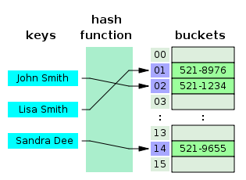
HashTable
The hash function calculates an index from the data item's key and use this index to place the data into the array.
Notes:
In another strategy, called open addressing, all entry records are stored in the bucket array itself. When a new entry has to be inserted, the buckets are examined, starting with the hashed-to slot and proceeding in some probe sequence, until an unoccupied slot is found. When searching for an entry, the buckets are scanned in the same sequence, until either the target record is found, or an unused array slot is found, which indicates that there is no such key in the table.[

Slide 13
HashTable
The advantage of hash tables is their speed.
The disadvantage is that you don’t know what order you’ll iterate over the contents.
Notes:
In another strategy, called open addressing, all entry records are stored in the bucket array itself. When a new entry has to be inserted, the buckets are examined, starting with the hashed-to slot and proceeding in some probe sequence, until an unoccupied slot is found. When searching for an entry, the buckets are scanned in the same sequence, until either the target record is found, or an unused array slot is found, which indicates that there is no such key in the table.[

Slide 14
Binary Tree
TreeSet and TreeMap were built
around binary trees.
A Binary Tree is a group of nodes that
contain left and right references.
Each item is inserted into the tree
according to its relationship to the
other nodes.
2
1
3
Notes:
Binary trees will be explained in great detail later, but the following overview will be enough for now.
Binary Trees are organized data structures that compare new values to existing values to determine placement of the new value.
By rule, smaller items go on the left of the tree and larger items go on the right.

Slide 15
Set
Methods

Slide 16
Set frequently used methods
 | Name | Use
boolean | add(obj) | adds item obj to the set
boolean | remove(obj) | removes item obj from the set
void | clear() | removes all items from the set
int | size() | returns the # of items in the set

Slide 17
Why does the Set interface not include corollaries to these List methods?
get(int index)
remove(int index)
add(int index, E element)
set(int index, E element)

Slide 18
HashSet add
Set<Integer> intSet;
intSet = new HashSet<Integer>();
intSet.add(45);
System.out.println(intSet.add(12));
System.out.println(intSet.add(12));
intSet.add(23);
System.out.println(intSet);
OUTPUT true
false [45, 23, 12]
Notes:
The add() method for HashSet and TreeSet is a return method. The reason add() is a boolean return method is due to the fact that an add() call may not add anything.
Sets do not store duplicate values so an attempt to add an item that is already present returns false. Attempting to add an item that is not present will return true.

Slide 19
HashSet add
Set<String> stringSet; stringSet = new HashSet<String>();
stringSet.add("AB");
stringSet.add("23");
stringSet.add("ab");
System.out.println(stringSet);
OUTPUT [ab, 23, AB]
Notes:
The ordering of items in a HashSet is not as predicable as the ordering of items in a TreeSet. HashSet orders items using a formula based on each item’s hashCode() whereas a TreeSet orders items using the natural ordering of the type using the item’s compareTo().

Slide 20
Open
hashsetint.java
hashsetstring.java

Slide 21
Quick Creation of a Set
String[] words = “I am Crazy I am".split(" ");
List<String> wordList = Arrays.asList(words); Set<String> set = new TreeSet<String>(wordList); System.out.println(set);
OUTPUT [Crazy, I, am]

Slide 22
Open
SetSplit.java

Slide 23
HashSet remove()
Set<Double> doubleSet;
doubleSet = new HashSet<Double>();
doubleSet.add(2.5);
doubleSet.add(5.8);
doubleSet.add(7.3);
System.out.println(doubleSet);
doubleSet.remove(5.8);
System.out.println(doubleSet.remove(0));
System.out.println(doubleSet);
OUTPUT [7.3, 2.5, 5.8]
false
[7.3, 2.5]
Notes:
The remove() method will remove a specified item if that item is present. If the specified item is not present, remove() simply does nothing.

Slide 24
Open
hashsetremove.java

Slide 25
TreeSet add
Set<Integer> intSet;
intSet = new TreeSet<Integer>();
System.out.println(intSet.add(45));
intSet.add(12);
System.out.println(intSet.add(12));
intSet.add(23);
System.out.println(intSet);
OUTPUT
true false [12, 23, 45]
TreeSets behave exactly like HashSets, except they are in order:
Notes:
The add() method for HashSet and TreeSet is a return method. The reason add() is a boolean return method is due to the fact that an add() call may not add anything.
Sets do not store duplicate values so an attempt to add an item that is already present returns false. Attempting to add an item that is not present will return true.

Slide 26
TreeSet add
Set<String> stringSet;
stringSet = new TreeSet<String>();
stringSet.add("AB");
stringSet.add("23");
stringSet.add("ab");
System.out.println(stringSet);
OUTPUT [23, AB, ab]
In order!
Notes:
The ordering of items in a HashSet is not as predicable as the ordering of items in a TreeSet. HashSet orders items using a formula based on each item’s hashCode() whereas a TreeSet orders items using the natural ordering of the type using the item’s compareTo().

Slide 27
Open
treesetint.java
treesetstring.java

Slide 28
TreeSet remove()
Set<Double> doubleSet;
doubleSet = new TreeSet<Double>();
doubleSet.add(2.5);
doubleSet.add(5.8);
doubleSet.add(7.3);
System.out.println(doubleSet);
doubleSet.remove(5.8);
doubleSet.remove(0.0);
System.out.println(doubleSet);
OUTPUT [2.5, 5.8, 7.3]
[2.5, 7.3]
In order!
Notes:
The remove() method will remove a specified item if that item is present. If the specified item is not present, remove() simply does nothing.

Slide 29
Open
treesetremove.java

Slide 30
Sets aren’t Lists!
List methods Sets don’t have:
get(i)
indexOf(E)
listIterator()
remove(i)
set(i, E)

Slide 31
Open
setoutput.java

Slide 32
Iterating
over
Sets

Slide 33
Sets aren’t Lists!
This means you can’t iterate over a Set via the indices (since there are none!):
for (int i=0; i<set.size(); i++)
out.print(set.get(i) + "");

Slide 34
Looping thru a Set
Using a for-each loop
Set<Double> set = new TreeSet<Double>();
set.add(5.8);
set.add(7.3);
set.add(2.5);
for(double num : set)
{
System.out.println(num);
}
OUTPUT 2.5
5.8
7.3
Notes:
The new for loop iterates over all of the references in the set.
The new for loop is a little easier to code and a little easier to read than the standard iterator code needed to do the same job.
for( double dec : doubleSet ) //will iterate as long as the set contains values
//will copy the next value from doubleSet to dec each time the loop iterates
{
//do something
}

Slide 35
Looping thru a Set
Using an iterator
Set<Double> set = new TreeSet<>();
set.add(5.8);
set.add(7.3);
set.add(2.5);
Iterator<Double> it = set.iterator();
while(it.hasNext())
{
double num = it.next();
out.println(num);
}
OUTPUT 2.5
5.8
7.3

Slide 36
Using the Collection forEach Method
and Lambda Expressions
Set<Double> set = new TreeSet<>();
set.add(5.8);
set.add(7.3);
set.add(2.5);
set.forEach(
num -> out.println(num)
);
Uses the Set’s iterator, so same order as the normal for-each loop.
OUTPUT 2.5
5.8
7.3

Slide 37
Open
setoutputnew.java
setsplit.java

Slide 38
BigO

Slide 39
Big-O frequently used notations
Name | Notation
constant | O(1)
logarithmic | O(log₂N)
linear | O(N)
linearithmic | O(N log₂N)
quadratic | O(N²)
exponential | O(2^{n})

Slide 40
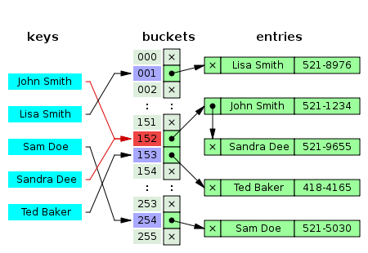
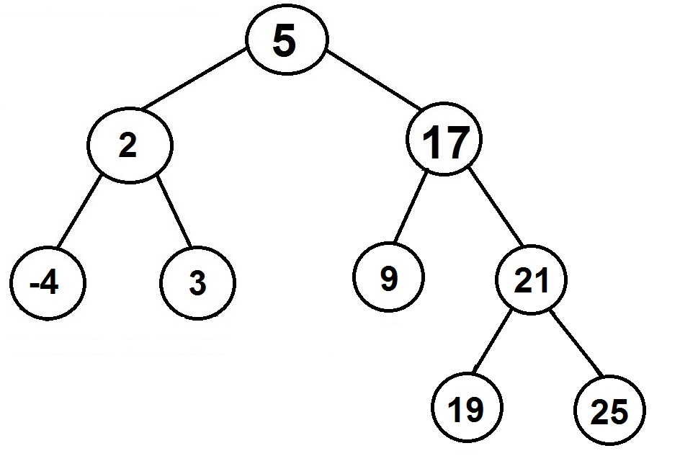
Hash Table
Binary Search Tree

Slide 41
Set Big O
Tree Set Hash Set
add O(Log₂N) O(1)
remove O(Log₂N) O(1)
contains O(Log₂N) O(1)
size O(1) O(1)
iterate over set O(n) O(n)
TreeSets are implemented with balanced binary trees ( red/black trees ).
HashSets are implemented with hash tables.

Slide 42
Now it is time for
another round of ....
What is the Big-O?

Slide 43
What is the Big-O?
int n = list.size();
Set s = new HashSet();
for(int i=0; i<n; i++)
s.add(list.get(i));
Big O Notation – O(N)
The work needed to add each element
of ray to s would be N*1. Ray has N items
and add() for HashSet has an O(1) bigO.

Slide 44
What is the Big-O?
int n = list.size();
Set s = new TreeSet();
for(int i=0; i<n; i++)
s.add(list.get(i));
Big O Notation – N*Log₂(N)
The work needed to add each element
of ray to s would be N * log₂N. Ray has N items and add() for TreeSet has a log₂ bigO.

Slide 45
Set Theory

Slide 46
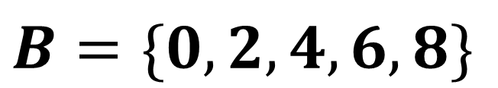
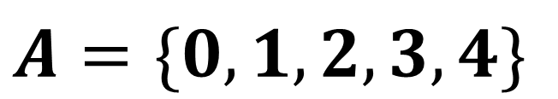
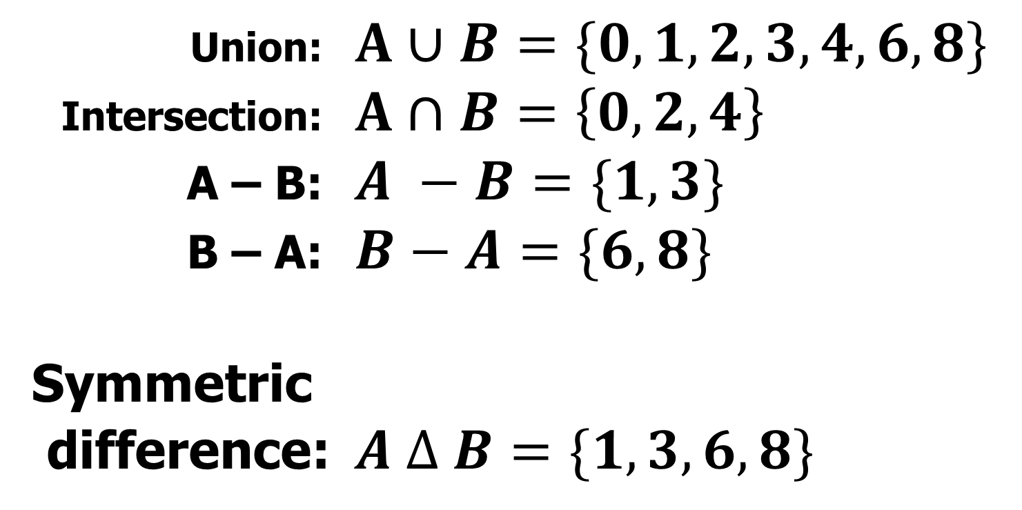
$$A=\{0,1,2,3,4\}$$
$$B=\{0,2,4,6,8\}$$
Union: $A∪B=\{0,1,2,3,4,6,8\}$
Intersection: $A∩B=\left\{0,2,4\right\}$
A – B: $A −B=\{1,3\}$
B – A: $B−A=\{6,8\}$
Symmetric difference: $A ∆ B=\{1,3,6,8\}$

Slide 47
Set methods
addAll
removeAll
retainAll

Slide 48
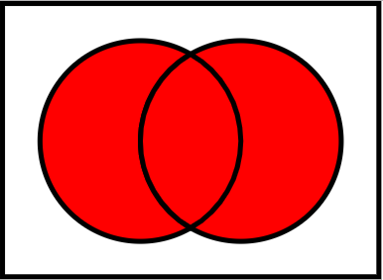
Union
A
B
union.addAll(A)
union.addAll(B)

Slide 49
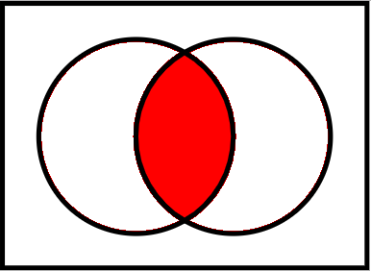
Intersection
A
B
intersection.addAll(A)
intersection.retainAll(B)

Slide 50
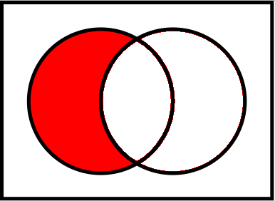
A minus B
A
B
diff.addAll(A)
diff.removeAll(B)

Slide 51
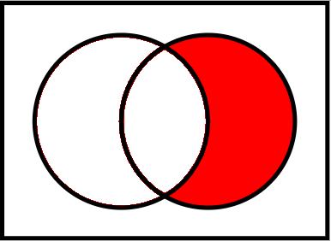
B minus A
A
B
diff.addAll(B)
diff.removeAll(A)

Slide 52
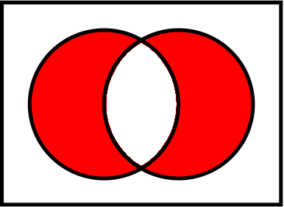
Symmetric Difference
A
B
Two ways!

Slide 53
Symmetric Difference
A
B
diff = new set
diff.addAll(aMinusB(A, B))
diff.addAll(bMinusA(A, B))

Slide 54
Symmetric Difference
A
B
diff = union(aMinusB(A, B), bMinusA(A, B))

Slide 55
Symmetric Difference
A
B
diff = union(A, B)
diff.remove(intersection(A, B))

Slide 56
Symmetric Difference
A
B
diff = aMinusB(union(A, B), intersection(A, B))

Slide 57
Using the Stream forEach Method
Parallel streams allow us to execute the stream in multiple threads, and in such situations, the execution order is undefined. Java only requires all threads to finish before any terminal operation, such as Collectors.toList(), is called.

Slide 58
Using the Stream forEach Method
Calling add or remove while iterating using the Stream forEach will lead to a ComodificationException being thrown:
Consumer<String> removeElement = s -> {
System.out.println(s + " " + list.size());
if (s != null && s.equals("A")) {
list.remove(“A");
}
};
list.stream().forEach(removeElement);
Just like it would if you used the Collection forEach method:
list.forEach(removeElement);

Slide 59
Using the Stream forEach Method
If you’re using the Collection forEach method, it’s okay to modify elements while iterating, for instance by calling the list set method.
However, Java requires an operation on a stream to be non-interfering. This means that elements shouldn’t be modified during the execution of the stream pipeline.

Slide 60
Using the Stream forEach Method
Set<Double> set = new TreeSet<>();
set.add(5.8);
set.add(7.3);
set.add(2.5);
set.stream().forEach(
num -> out.println(num)
);
Creates a Stream. Calls its forEach method. Doesn’t follow encounter order. Better for parallelism.
OUTPUT 2.5
5.8
7.3

Slide 61
Using the Stream forEachOrdered Method
Set<Double> set = new TreeSet<>();
set.add(5.8);
set.add(7.3);
set.add(2.5);
set.stream().forEachOrdered(
num -> out.println(num)
);
Follows the encounter order of the Stream, which is natural order in this case.
OUTPUT 2.5
5.8
7.3

