Slide 1
Stacks

Slide 2
Stacks & Queues
Stacks and Queues allow insertion and removal at the ends only, not in the middle.

Slide 3
What is a Stack?
A stack is a group of items all of the same type where items are added to the top of the stack and removed from the top.
Stacks work in a LIFO manner.

Slide 4
What is a Stack?
Stack<Integer> stack = new Stack<>();
stack will only store Integer values.

Slide 5
What is a Stack?
stack.push(15);
push adds an item to the stack.
15

Slide 6
What is a Stack?
stack.push(47);
47
15
push adds an item to the stack.

Slide 7
What is a Stack?
11
47
15
stack.push(11);
push adds an item to the stack.

Slide 8
What is a Stack?
stack.pop();
47
15
pop removes an item from the stack.

Slide 9
What is a Stack?
stack.pop();
pop removes an item from the stack.
15

Slide 10
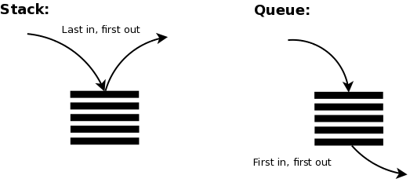
Stack (LIFO) Queue (FIFO)
Notes:
There are also double-ended queues.

Slide 11
Applications of Stacks
Programming languages:
method calls are placed onto a stack (call=push, return=pop)
Matching up related pairs of things:
find out whether a string is a palindrome
examine a file to see if its braces { } and other operators match
Sophisticated algorithms:
searching through a maze with "backtracking"
many programs use an "undo stack" of previous operations
method3 | return var local vars parameters
method2 | return var local vars parameters
method1 | return var local vars parameters

Slide 12
Stack
Methods

Slide 13
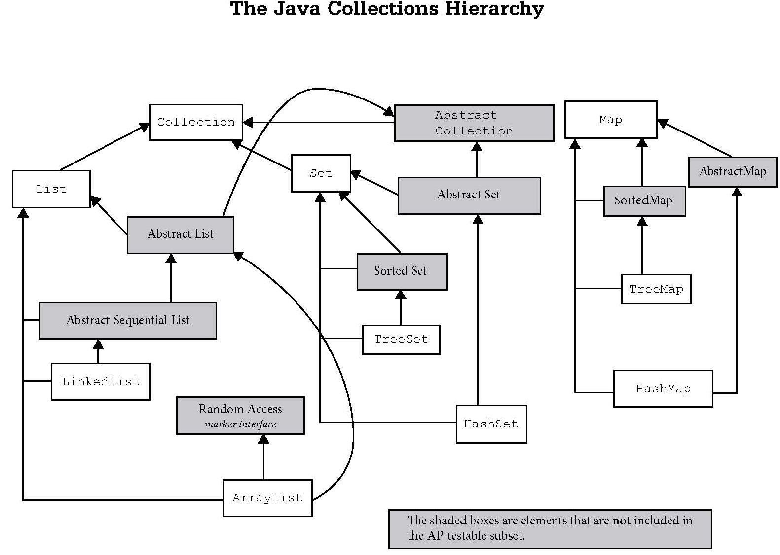
Iterable
Vector
Stack

Slide 14
Stack frequently used methods
Name | Use
push(x) | adds item x to the stack
add(x) | add() is inherited from the Vector class. Use push() instead.
pop() | removes and returns an item
peek() | returns the top item with no remove
size() | returns the # of items in the stack
isEmpty() | checks to see if the stack is empty
import java.util.Stack;

Slide 15
push
Stack<Integer> s;
s = new Stack<Integer>();
s.push(88);
s.push(23);
s.push(11);
out.println(s);
OUTPUT
[88, 23, 11]

Slide 16
Open
stackpush.java

Slide 17
pop
Stack<Integer> s;
s = new Stack<Integer>();
s.push(88);
s.push(23);
s.push(11);
out.println(s.pop());
out.println(s);
out.println(s.pop());
out.println(s);
OUTPUT
11
[88, 23]
23
[88]
How many more times can we call pop()?

Slide 18
pop
Stack<Integer> s;
s = new Stack<Integer>();
s.push(88);
s.push(23);
s.push(11);
out.println(s.pop());
out.println(s);
out.println(s.pop());
out.println(s);
out.println(s.pop());
out.println(s);
out.println(s.pop());
OUTPUT
11
[88, 23]
23
[88]
88
[]
EmptyStackException

Slide 19
Open
stackpop.java

Slide 20
peek
Stack<Integer> s;
s = new Stack<Integer>();
s.push(88);
s.push(23);
s.push(11);
out.println(s.peek());
out.println(s);
OUTPUT
11 [88, 23, 11]

Slide 21
Open
stackpeek.java

Slide 22
Looping thru a
Processing a Stack

Slide 23
Processing a Stack
A stack is a type of queue.
The primary purpose of a queue in is to process data or tasks in a specific, ordered sequence, typically following the First-In, First-Out (FIFO) principle.
Notes:
First-In, First-Out (FIFO) means that the first item added to the queue is the first one to be processed or removed.

Slide 24
Processing a Stack
Stack<Integer> s;
s = new Stack<Integer>();
s.push(88);
s.push(23);
s.push(11);
out.println(s);
while(!s.isEmpty()) {
out.println(s.pop());
}
out.println(s);
OUTPUT
[88, 23, 11]
11 23 88
[]

Slide 25
Stack limitations/idioms
Remember: You can’t loop over a stack like you do a list.
Stack<Integer> s = new Stack<Integer>();
...
for (int i = 0; i < s.size(); i++) {
do something with s.get(i);
}
Instead, you pull contents out of the stack to view them.
Idiom: Remove each element until the stack is empty.
while (!s.isEmpty()) {
do something with s.pop();
}

Slide 26
Open
stackisempty.java

Slide 27
The Java Collections Hierarchy
Iterable
Queue
Deque
Abstract Queue
Priority Queue
Vector
Stack

Slide 28
Array-based Stacks
Stack<Integer> s;
s = new Stack<Integer>();
s.push(88);
s.push(23);
s.push(11);
out.println(s);
out.println(s.pop());
out.println(s);
OUTPUT
[88, 23, 11]
11
[88, 23]

Slide 29
LinkedList-based Stacks
LinkedList<Integer> s;
s = new LinkedList<Integer>();
s.push(88);
s.push(23);
s.push(11);
out.println(s);
out.println(s.pop());
OUTPUT
[11, 23, 88]
11
[23, 88]

