Slide 1

Queues and
PQueues
Lab 14

Slide 2
What is a Queue?
A queue is a group of items all of the same type where items are added to the back of the queue and removed from the front.
The first item added would be the first item removed. Queues work in a FIFO manner.

Slide 3

What is a Queue?
In England, when you are to stand in a line, they tell you to go get in the queue.

Slide 4
Queues in computer science
Operating systems:
queue of print jobs to send to the printer
queue of programs / processes to be run
queue of network data packets to send
Programming:
modeling a line of customers or clients
storing a queue of computations to be performed in order
Real world examples:
people on an escalator or waiting in a line
cars at a gas station (or on an assembly line)

Slide 5
What is a Queue?
An empty integer queue.
Queue<Integer> queue;
queue = new LinkedList<Integer>();
queue will only store integer values.

Slide 6
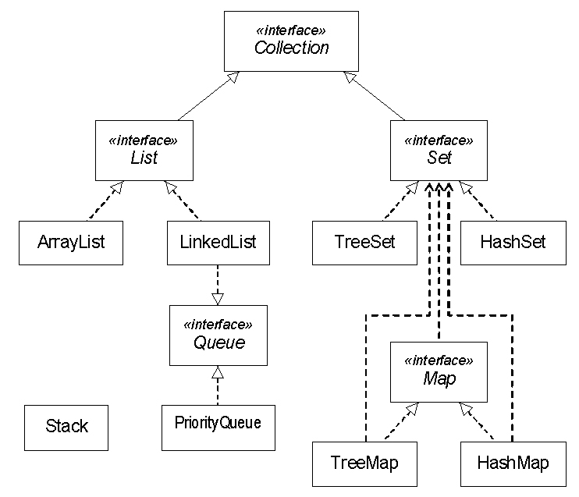

Vector

Slide 7
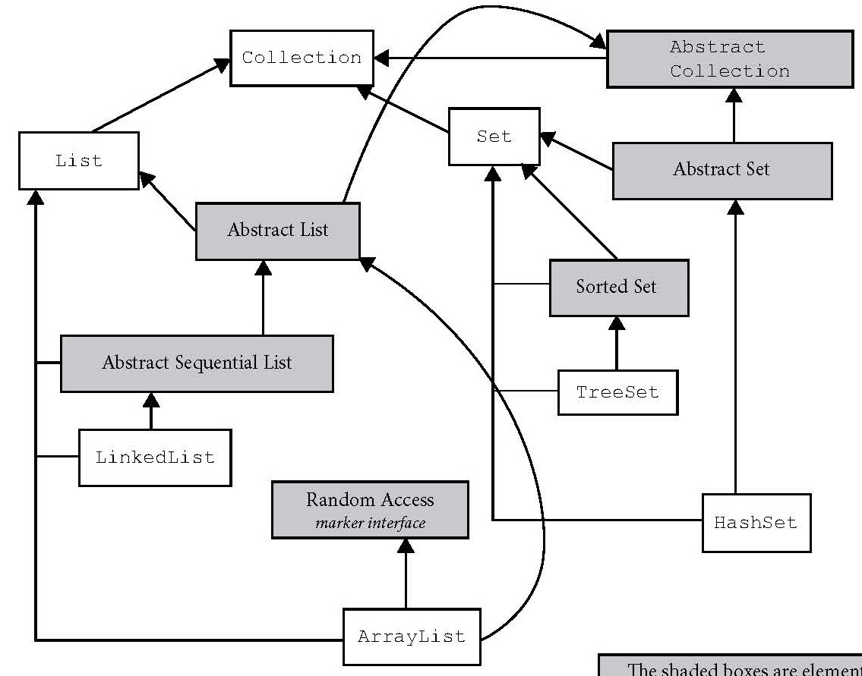
The Java Collections Hierarchy
Iterable
Queue
Deque
Abstract Queue
Priority Queue
Vector
Stack

Slide 8
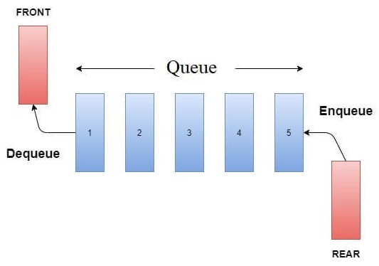
A queue is a data structure in which you add to one end and remove from the other.
Notes:
A queue (specific sense) is a data structure in which you add to one end and remove from the other.

Slide 9
What is a Queue?
add adds an item to the queue.
enqueue is a very common name given to the operation of adding items to a queue.
queue.add(25);
25

Slide 10
What is a Queue?
add adds an item to the queue.
queue.add(14);
25 | 14

Slide 11
What is a Queue?
add adds an item to the queue.
queue.add(67);
25 | 14 | 67

Slide 12
What is a Queue?
remove removes an item from the queue.
dequeue is a very common name given to the operation of removing items from a queue.
queue.remove();
14 | 67

Slide 13
What is a Queue?
remove removes an item from the queue.
queue.remove();
67

Slide 14
What is a Queue?
add adds an item to the queue.
queue.add(99);
67 | 99

Slide 15
Java Queue Interface
The Queue interface was designed to allow
the use of a queue in java.
The LinkedList class implements the Queue
interface.
If you need a queue, just make a Queue
reference to a LinkedList.

Slide 16
Vector

Slide 17
Queue
Methods

Slide 18
Linked List as a Queue frequently used methods
Name | Use
offer(x) / add(x) | adds item x to the queue
poll() / remove() | removes and returns front item
peek() / element() | returns the front item with no remove
size() | returns the # of items in the queue
isEmpty() | checks to see if the queue is empty
import java.util.Queue;

Slide 19
Offer
Queue<Integer> queue;
queue = new LinkedList<Integer>();
queue.offer(11);
queue.offer(10);
queue.offer(7);
out.println(queue);
OUTPUT
[11, 10, 7]

Slide 20
Poll
Queue<Integer> queue;
queue = new LinkedList<Integer>();
queue.offer(11);
queue.offer(10);
queue.offer(7);
out.println(queue.poll());
out.println(queue);
OUTPUT
11 [10, 7]

Slide 21
Offer, Poll, Peek
Queue<Integer> queue;
queue = new LinkedList<Integer>();
queue.offer(11);
queue.offer(7);
out.println(queue);
out.println(queue.peek());
queue.poll();
out.println(queue.peek());
queue.poll();
out.println(queue);
OUTPUT
[11, 7]
11
7
[]

Slide 22
Processing a Queue
Queue<Integer> queue;
queue = new LinkedList<Integer>();
queue.offer(11);
queue.offer(10);
queue.offer(7);
while(!queue.isEmpty())
{
out.println(queue.poll());
}
OUTPUT
11 10 7

Slide 23
Queue idioms
As with stacks, must pull contents out of queue to view them.
while (!q.isEmpty()) {
do something with q.remove();
}
another idiom: Examining each element exactly once.
int size = q.size();
for (int i = 0; i < size; i++) {
do something with q.remove();
(including possibly re-adding it to the queue)
}
Why do we need the size variable

Slide 24
Summary of Queue methods
Operation | Returns special value | Throws exception
Insert | offer(e) | add(e)
Remove | poll() | remove()
Examine | peek() | element()
You should use offer() when failure to insert an element would be normal, and add() when failure would be an exceptional occurrence (that needs to be handled).

Slide 25
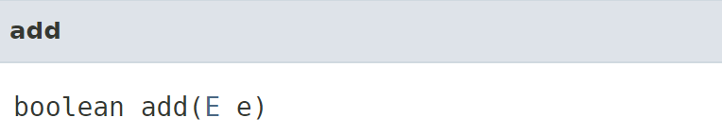
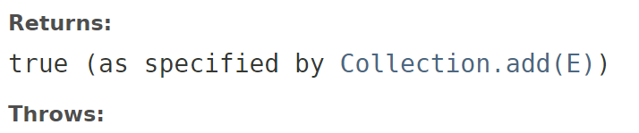

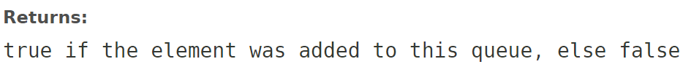
Add vs. Offer
IllegalStateException - if the element cannot be added at this time due to capacity restrictions

Slide 26
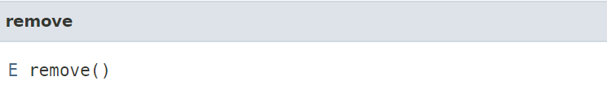
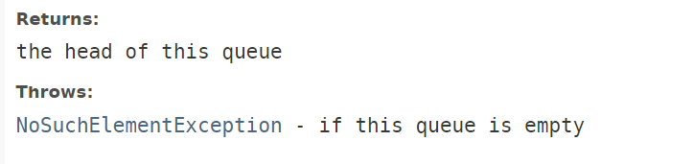
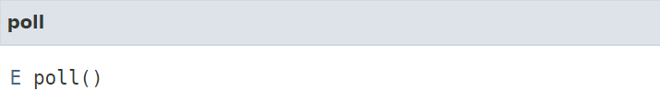

Remove vs. Poll
Note that there is no EmpytQueueException!

Slide 27
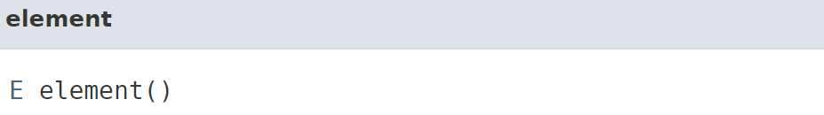
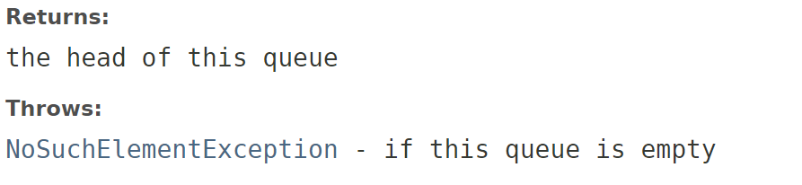
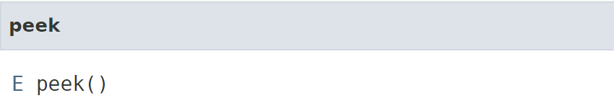
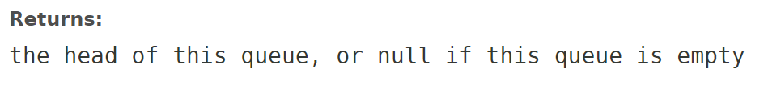
Element vs. Peek

Slide 28
Why are there two versions of the Queue methods?
In some situations, it's expected that a queue will be empty, and in those cases, it isn’t appropriate to throw an exception, so a special value is returned.
In other situations, it's an exceptional circumstance that the queue is empty, and an exception is appropriate.
Notes:
Throwing exceptions incurs a performance penalty, and if it's the case that you expect the queue to be empty from time to time you don't want to have to handle the queue-empty-logic as catching an exception -- it's both costly and difficult to read.
In the opposite case where you don't expect the queue to ever be empty it is a sign of a programming error, or some other exceptional circumstance that it is, and you don't want to write ugly error condition checking code (e.g. checking for null), because in this case that would be less readable than catching an exception (which you can do in another scope).

Slide 29
Offer, Poll, Peek
Queue<Integer> queue;
queue = new LinkedList<Integer>();
queue.offer(11);
queue.offer(7);
out.println(queue);
out.println(queue.peek());
queue.poll();
out.println(queue.peek());
queue.poll();
out.println(queue);
OUTPUT
[11, 7]
11
7
[]

Slide 30
Add
Queue<Integer> queue;
queue = new LinkedList<Integer>();
queue.offer(11);
queue.offer(10);
queue.offer(7);
out.println(queue);
OUTPUT
[11, 10, 7]

Slide 31
Remove
Queue<Integer> queue;
queue = new LinkedList<Integer>();
queue.add(11);
queue.add(10);
queue.add(7);
out.println(queue.remove());
out.println(queue);
OUTPUT
11 [10, 7]

Slide 32
Add, Remove, Element
Queue<Integer> queue;
queue = new LinkedList<Integer>();
queue.add(11);
queue.add(7);
out.println(queue);
out.println(queue.element());
queue.remove();
out.println(queue.element());
queue.remove();
out.println(queue);
OUTPUT
[11, 7]
11
7
[]

Slide 33
Processing a Queue
Queue<Integer> queue;
queue = new LinkedList<Integer>();
queue.add(11);
queue.add(10);
queue.add(7);
while(!queue.isEmpty())
{
out.println(queue.remove());
}
OUTPUT
11 10 7

