Slide 1

Priority Queues

Slide 2
Priority Queue
A PriorityQueue is a queue structure that, when polled, removes the highest priority item, not the first one added as with a normal queue.

Slide 3

An Emergency Department operates as a priority queue. A triage nurse determines the severity of patients’ ailments, and those with the most severe issues are treated first.

Slide 4
Priority Queue
The Java PriorityQueue is a min heap
as it removes the smallest items first.
The Java PriorityQueue stores Comparables.

Slide 5
min heap
9
18
23
20
27
25
A min heap is a complete binary tree that has a root smaller than all of its children.

Slide 6
Priority Queue
A priority queue is an abstract datatype.
It is a shorthand way of describing a particular interface and behavior, and says nothing about the underlying implementation.
A heap is a data structure.
It is a name for a particular way of storing data that makes certain operations very efficient.
Notes:
It just so happens that a heap is a very good data structure to implement a priority queue, because the operations which are made efficient by the heap data strucure are the operations that the priority queue interface needs.

Slide 7
Priority Queue
A priority queue is an abstract datatype.
A heap is a data structure.
It just so happens that a heap is a very good data structure to implement a priority queue, because the operations which are made efficient by the heap data strucure are the operations that the priority queue interface needs.

Slide 8
Priority Queue
Could a sorted array be used to implement a PQ?
Yes, but we don’t use that.
Why not?

Slide 9
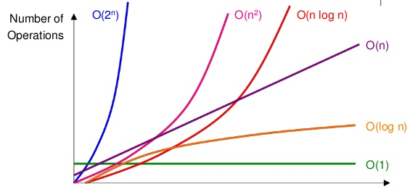
Why use a heap?
Operation | Big O
Adding to a heap | O(log n)
Adding to a sorted array | O(n)
Sorting an array | O(n log n)

Slide 10
PQ
Methods

Slide 11
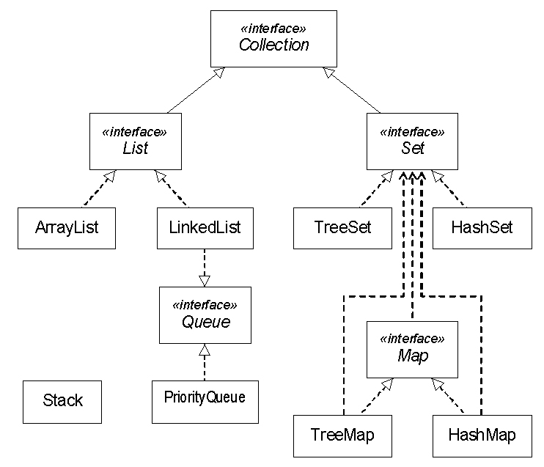

Java Collection Hierarchy
Vector

Slide 12
PriorityQueue
frequently used methods
Name | Use
add(x) | adds item x to the pQueue
remove() | removes and returns min priority item
element() | returns the min item with no remove
size() | returns the # of items in the pQueue
isEmpty() | checks to see if the pQueue is empty

Slide 13
Summary of Queue methods
Operation | Throws exception | Returns special value
Insert | add(e) | offer(e)
Remove | remove() | poll()
Examine | element() | peek()

Slide 14
add
PriorityQueue<Integer> pQueue;
pQueue = new PriorityQueue<>();
pQueue.add(11);
pQueue.add(10);
pQueue.add(7);
out.println(pQueue);
OUTPUT
[7, 11, 10]
11
11
/
10
10
/
11
10
/ \
11 7
7
/ \
11 10
Notes:
The built-in iterator does not traverse the data structure in any particular order because the underlying data structure doesn't support it. A binary heap is only partially ordered, with the smallest element at the root. When you remove that, the heap is reordered so that the next smallest element is at the root. There is no efficient ordered traversal algorithm so none is provided in Java.

Slide 15
remove
PriorityQueue<Integer> pQueue;
pQueue = new PriorityQueue<>();
pQueue.add(11);
pQueue.add(10);
pQueue.add(7);
out.println(pQueue); out.println(pQueue.remove());
out.println(pQueue.element());
out.println(pQueue);
OUTPUT
[7, 11, 10] 7 10 [10, 11]

Slide 16
isEmpty
PriorityQueue<Integer> pQueue;
pQueue = new PriorityQueue<>();
pQueue.add(11);
pQueue.add(10);
pQueue.add(7);
while(!pQueue.isEmpty())
{
out.println(pQueue.remove());
}
OUTPUT
7 10 11

Slide 17
Two Types of Queue methods
 | Throws exception | Returns special value
Insert | add(e) | offer(e)
Remove | remove() | poll()
Examine | element() | peek()

Slide 18
add
PriorityQueue<Integer> pQueue;
pQueue = new PriorityQueue<>();
pQueue.offer(11);
pQueue.offer(10);
pQueue.offer(7);
out.println(pQueue);
OUTPUT
[7, 11, 10]
11
11
/
10
10
/
11
10
/ \
11 7
7
/ \
11 10
Notes:
The built-in iterator does not traverse the data structure in any particular order because the underlying data structure doesn't support it. A binary heap is only partially ordered, with the smallest element at the root. When you remove that, the heap is reordered so that the next smallest element is at the root. There is no efficient ordered traversal algorithm so none is provided in Java.

Slide 19
remove
PriorityQueue<Integer> pQueue;
pQueue = new PriorityQueue<>();
pQueue.offer(11);
pQueue.offer(10);
pQueue.offer(7);
out.println(pQueue); out.println(pQueue.poll());
out.println(pQueue.peek());
out.println(pQueue);
OUTPUT
[7, 11, 10] 7 10 [10, 11]

Slide 20
isEmpty
PriorityQueue<Integer> pQueue;
pQueue = new PriorityQueue<>();
pQueue.offer(11);
pQueue.offer(10);
pQueue.offer(7);
while(!pQueue.isEmpty())
{
out.println(pQueue.poll());
}
OUTPUT
7 10 11

