Slide 1
Heapsort
CSE 373
Data Structures

Slide 2
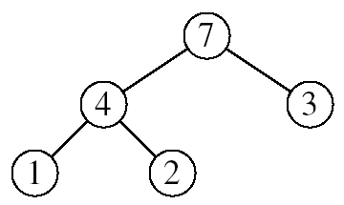
Heapsort
Goal:
Sort an array using heap representations
Idea:
Build a max-heap from the array
Swap the root (the maximum element) with the last element in the array
“Discard” this last node by decreasing the heap size
Call MAX-HEAPIFY on the new root
Repeat this process until only one node remains

Slide 3
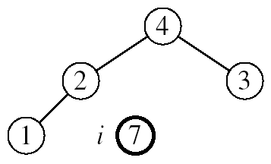
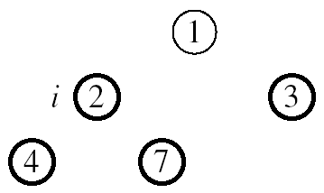
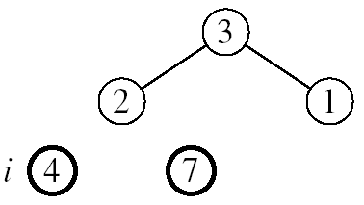
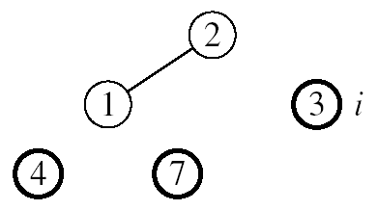

Example: A=[7, 4, 3, 1, 2]
MAX-HEAPIFY(A, 1, 4)
MAX-HEAPIFY(A, 1, 3)
MAX-HEAPIFY(A, 1, 2)
MAX-HEAPIFY(A, 1, 1)

Slide 4
Alg: HEAPSORT(A)
BUILD-MAX-HEAP(A)
for i = length[A]-1 downto 1
do exchange A[0] ↔ A[i]
MAX-HEAPIFY(A, 0, i - 1)
Running time: O(n log n)
O(n)
n-1 times
O(lgn)

Slide 5
Heap Sort
We use a Max-Heap
Root node = A[0]
Children of A[i] = A[2i+1], A[2i+2]
Keep track of current size N (number of nodes)
7
value
7
5
6
2
4
5
6
index
0
1
2
3
4
5
6
7
2
4
N = 5

Slide 6
Using Binary Heaps for Sorting
Build a max-heap
Do N DeleteMax operations and store each Max element as it comes out of the heap
Data comes out in largest to smallest order
Where can we put the elements as they are removed from the heap?
7
Build
Max-heap
5
6
2
4
DeleteMax
6
5
4
2
7

Slide 7
1 Removal = 1 Addition
Every time we do a DeleteMax, the heap gets smaller by one node, and we have one more node to store
Store the data at the end of the heap array
Not "in the heap" but it is in the heap array
6
value
6
5
4
2
7
5
4
index
0
1
2
3
4
5
6
7
2
7
N = 4

Slide 8
Repeated DeleteMax
5
5
2
4
6
7
2
4
0
1
2
3
4
5
6
7
6
7
N = 3
4
4
2
5
6
7
2
5
0
1
2
3
4
5
6
7
6
7
N = 2

Slide 9
Heap Sort is In-place
After all the DeleteMaxs, the heap is gone but the array is full and is in sorted order
2
value
2
4
5
6
7
4
5
index
0
1
2
3
4
5
6
7
6
7
N = 0

Slide 10
Sorting Definitions
In-place sorting
Sorting of a data structure does not require any external data structure for storing the intermediate steps
Stable sorting
If the same element is present multiple times, then they retain the original relative order of positions

Slide 11
Heapsort: Analysis
Running time
time to build max-heap is O(N)
time for N DeleteMax operations is N O(log N)
total time is O(N log N)
Heapsort is in-place but not stable (why?)

Slide 12
Heapsort: Analysis
Consider max-heap: 5 4a 4b 3 2 1
5 is removed first and placed in the last index,
but nothing then 4a is removed and placed in the last but one index and 4b in the last but two index so after heap sort the array looks like:
1 2 3 4b 4a 5
It does not preserve the order of elements and hence can't be stable
Notes:
here 20a = 20b just to differentiate the order we represent them as 20a and 20b
From: https://stackoverflow.com/questions/19336881/why-isnt-heapsort-stable

Slide 13
HeapSort vs MergeSort
Both are O(n log n)
MergeSort
Is stable
but temporarily requires extra storage
HeapSort
works in place (no additional storage)
but is not stable

